Slide 1
RESEARCH RESULTS · RoboSketch-RL
What does a drawing robot lose
by learning from its camera?
A simulation study of perception-based rewards and visual recovery for reinforcement-learning drawing agents
[TODO: presenter name]
[TODO: institution / guide]
[TODO: date / venue]
Measurement study: D01 position supported
Notes:
Working title from docs/paper/main.tex. D01 position supported per PAPER_PLAN section 3.

Slide 2
THE PROBLEM
Drawing agents learn from a canvas no robot has
In simulation (prior work)
On a real robot
The agent is rewarded by comparing a PERFECT rendering of its strokes with the target.
Learning to Paint, SPIRAL, Zhou et al., CalliRewrite, Lee et al. (D02, D05, D07, D09, D01).
There is no perfect canvas. The only record of the drawing is what a camera sees:
blur, uneven light, imperfect registration, noise.
The question
How much drawing accuracy is lost when the agent learns from what a camera perceives instead of from the true canvas - and does seeing the paper help when things go wrong?
RoboSketch-RL · research results
2
Notes:
Paper Sec. I. We do not claim RL drawing, image rewards or visual feedback as new (PAPER_PLAN s5). The contribution is a measurement.

Slide 3
CLOSEST PRIOR WORK
The position we have to answer: draw without a camera
Lee et al., ICRA 2022 (D01)
A robotic sketching agent that synchronises with the canvas through FORWARD KINEMATICS - it assumes every commanded stroke landed as planned - and argues camera-free is an advantage.
D01, Lee et al. ICRA 2022
D03, Kotani & Tellex ICRA 2019
D09, Luo et al. ICRA 2024
“using a camera as an observation of canvas in the future work could be of great help in the synchronization step”
“closing the learning loop by enabling the robot to inspect what it has drawn”
“a lack of real-world training scenarios to bridge the sim2real gap” - left as future work
The gap is named by the three closest papers themselves.
RoboSketch-RL · research results
3
Notes:
Quotes from research_papers/STUDY_NOTES.md - re-check each against its PDF before presenting externally.

Slide 4
METHOD
Setup: one environment, three things we can swap
Target
PPO agent
Pen action
Canvas
Perception
Reward
line / circle / square / triangle
CNN policy
dx, dy, pen-down
PyBullet, KUKA arm
true / fk / camera
truth or vision IoU
Reward source
What the agent observes
Always scored the same way
truth: IoU of the real canvas (privileged)
vision: IoU of a simulated camera image
true: the real ink (ceiling)
fk: what kinematics predicts it drew (D01)
camera: a photograph of the paper (ours)
TRUE IoU of the real canvas - whatever the agent saw or was rewarded with.
No agent is credited for what its camera believes.
RoboSketch-RL · research results
4
Notes:
PPO, 8 envs, 512-step rollouts, batch 256, 6 epochs, gamma 0.99, entropy 0.02, lr 3e-4, 200k steps (rl/experiment.py, rl/h4_experiment.py). Episode 240 steps.

Slide 5
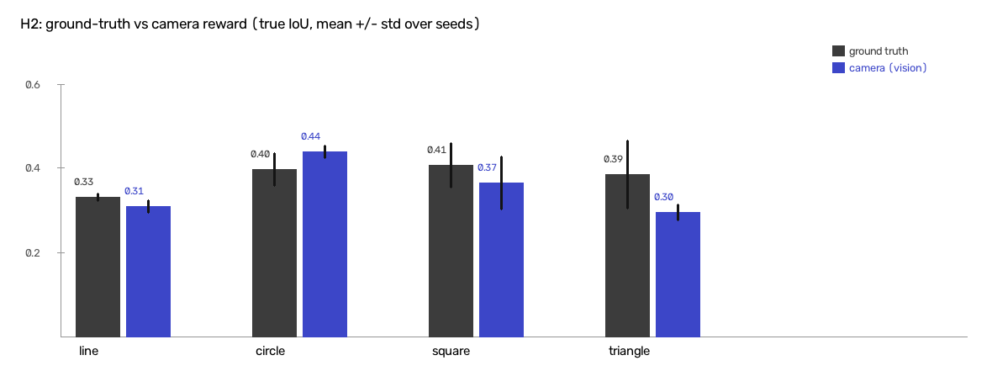
RESULT 1 - H2
Camera reward vs privileged reward: no detectable difference
Shape | Truth reward | Camera reward
line | 0.333 ± 0.008 | 0.312 ± 0.013
circle | 0.399 ± 0.032 | 0.441 ± 0.013
square | 0.408 ± 0.044 | 0.366 ± 0.052
triangle | 0.387 ± 0.067 | 0.297 ± 0.015
mean | 0.382 ± 0.052 | 0.354 ± 0.063
True IoU, 3 seeds per cell, 200k steps.
A second run of the same configurations: paired gap +0.013 (t = 0.57, 8/12) - opposite sign to the first.
Shape-dependent: camera better on circle, worse on triangle.
RoboSketch-RL · research results
5
Notes:
src: RESEARCH_LOG 'H2 multi-seed sweep (2026-08-12)' and 'H2 PEAK-vs-FINAL RESULT'. Say 'no detectable difference', never 'equivalent'. Limits: both runs used seeds 0,1,2 (overlapping env streams, F6) so they are not independent and the seed spread is likely understated; no equivalence test yet.

Slide 6
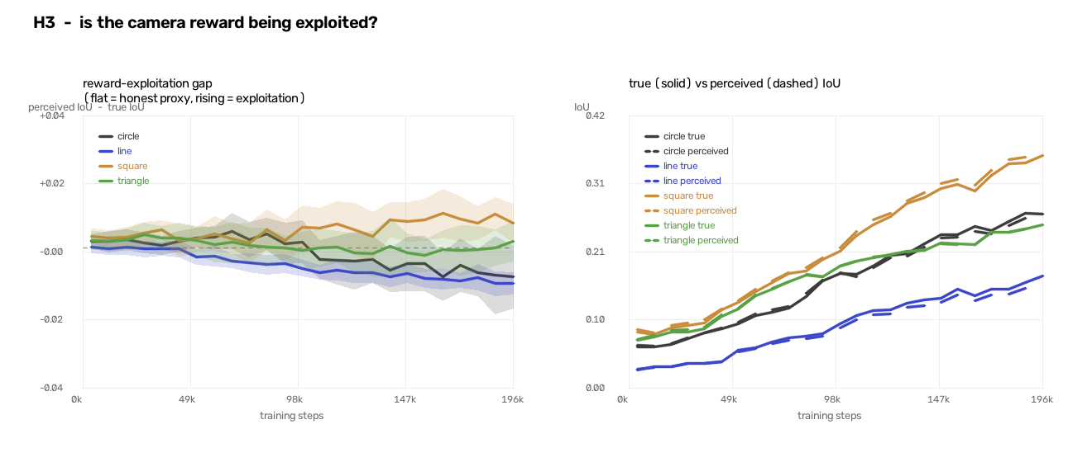
RESULT 2 - H3
The agent does not learn to fool the camera
-0.0001
3328
0.997-0.999
mean perceived - true IoU
training episodes logged
correlation, true vs perceived
RoboSketch-RL · research results
6
Notes:
src: RESEARCH_LOG 'H3 RESULT'. No consistent sign across shapes; truth control gap exactly zero. Limits: one seed per shape, fixed camera only.

Slide 7
RESULT 3 - CAMERA RANDOMISATION
It survives a much worse camera
Trained on | eval: fixed | eval: train | eval: held-out
truth (no camera) | 0.389 | 0.389 | 0.389
fixed camera | 0.393 | 0.386 | 0.379
randomised cameras | 0.371 | 0.365 | 0.368
0.394
of a perfect drawing's ink the held-out camera recovers (fixed: 0.834)
-0.014
Randomising the camera during training adds nothing: randomised - fixed on the held-out camera = -0.011 (t = -0.67, n = 8).
The policy needs a coarse record of where it has drawn - even a poor camera keeps it.
3 of 8 camera parameters carry the effect (resolution, blur, warp); exposure, paper tone and ink contrast cancel by construction.
true IoU the fixed-camera agent loses on it
RoboSketch-RL · research results
7
Notes:
src: RESEARCH_LOG 'STAGE 2 RESULT', 'Calibration, measured rather than asserted', 'Correction (2026-10-19)'. n = 2 seeds; camera is in the observation here so do not compare absolute IoU with H2.

Slide 8
H4 - DESIGN
The linchpin: does seeing the paper help recovery?
Pen slip
Paper shift
Ink failure
pen displaced, command unchanged
sheet moves under the pen
pen deposits nothing - invisible to kinematics by construction
open-loop
true
fk
camera
contour tracer, no feedback - the floor
sees the real ink - the ceiling
sees its kinematic belief (D01)
sees a photograph (ours)
All learning arms train on a MIX of disturbances, then are scored on each one.
Pre-registered test: does camera LOSE LESS than fk from its own clean score (paired difference-in-differences, n = 8, critical t = 2.365)?
RoboSketch-RL · research results
8
Notes:
src: RESEARCH_LOG '2026-10-19 - Stage 3 begins: H4'. Disturbances fire at 4-16% of the episode, inside the drawing phase. Reward asymmetry: fk and true are rewarded from the true canvas, camera from vision - biased AGAINST the camera arm.

Slide 9
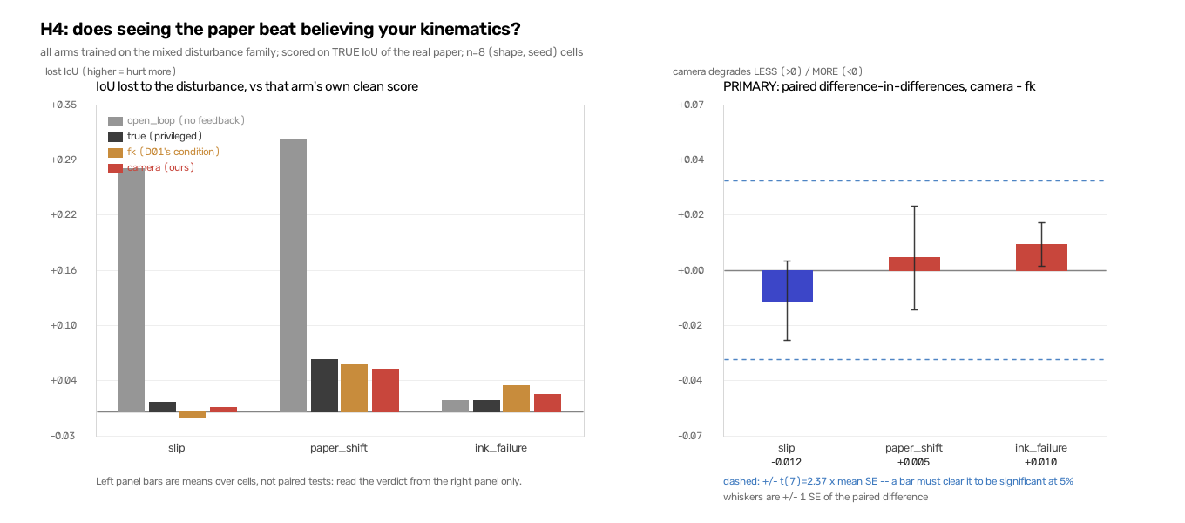
RESULT 3 - DISTURBANCE RECOVERY (H4)
No detectable recovery difference: seeing the paper does not beat kinematics
Null on primary endpoint
Pre-registered diff-in-diff: camera vs fk recovery is null on all three disturbances (|t| = 0.24 to 1.19, crit 2.365).
Control: even privileged 'true' (sees real ink perfectly) recovers no better than fk (-0.018 / -0.005 / +0.017).
Channel carries no recoverable signal in this setup; null is not perception quality.
Open-loop collapses (loses 0.28 slip / 0.31 shift), but trained arms absorb hits via overdrawing (~74% idle tail).
RoboSketch-RL · research results
9
Notes:
src: RESEARCH_LOG 'H4 RESULT', 'The verdict, stated as pre-registered', 'A control added after the fact'. Primary diff-in-diff (n=8): slip -0.012 (t=-0.78), paper_shift +0.005 (t=+0.24), ink_failure +0.010 (t=+1.19). Ceiling control true-vs-fk: -0.018 / -0.005 / +0.017. Open-loop drop: slip +0.276, paper_shift +0.309.

Slide 10
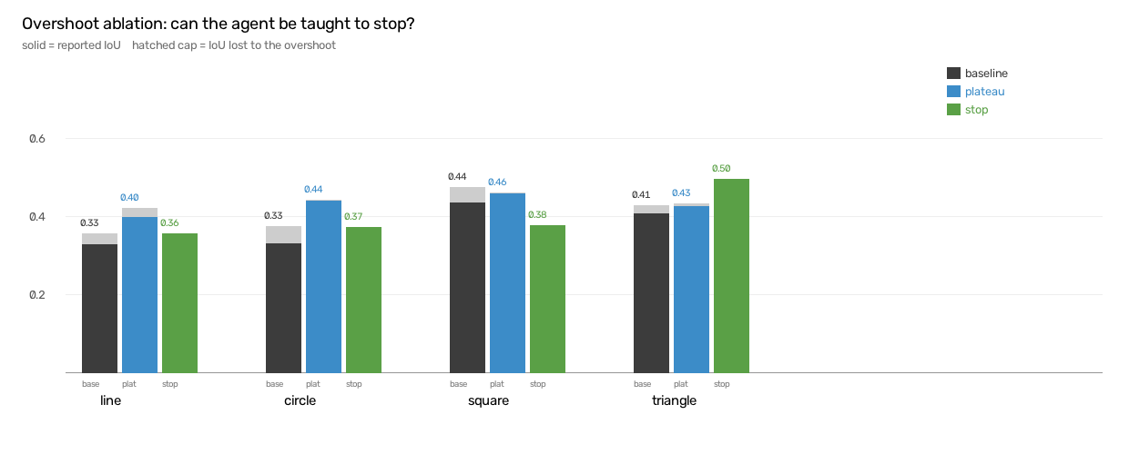
RESULT 4 - METHODOLOGY
A pitfall worth checking: agents finish early and overshoot
What it means
Agents complete the shape early, then idle on a frozen canvas or draw past their best.
Scoring only the final frame can understate a drawing.
Reporting peak alongside final IoU did NOT change the H2 comparison.
Plateau stopping is NOT yet a fix: its gain is confounded with a shorter exploration horizon.
RoboSketch-RL · research results
10
Notes:
src: RESEARCH_LOG 'UNEXPECTED FINDING - agents finish early', 'OVERSHOOT ABLATION RESULT', 'H2 PEAK-vs-FINAL RESULT'. Present as a pitfall, not a contribution claim.

Slide 11
HONEST LIMITS
Limitations
• Simulation only; four simple shapes; pen always down.
• 2-3 seeds per cell and 200k steps: nulls mean 'not detected', not 'absent'. No equivalence test yet.
• Both H2 runs used seeds 0, 1, 2 - adjacent seeds share most environment streams, so they are not independent and the seed spread is likely understated.
• Seeded results depend on thread count; two settings are mixed in the H4 sweep.
• The camera is a model with eight parameters, not a real sensor.
• H4: fk is rewarded from the true canvas, the camera arm from vision.
RoboSketch-RL · research results
11
Notes:
Paper Sec. V. src: RESEARCH_LOG 'Found while drafting the paper', 'H4 bookkeeping', 'A reproducibility limit'.

Slide 12
NEXT
What remains before submission
1 Short-window H4
2 Equivalence test for H2
3 Re-run H2 with spaced seeds
cut max_steps ~60 to test recovery without overdrawing.
bound the gap, not just fail to detect it.
seeds 0 / 100 / 200, new results file.
4 Held-out shapes
5 Baselines
6 Hardware
show the agent did not memorise four shapes.
open-loop tracer already inside H4; PPO vs SAC optional.
real camera / arm - the thesis needs at least a plan.
RoboSketch-RL · research results
12
Notes:
From docs/PAPER_PLAN.md section 4, in the order a reviewer would care.

Slide 13
SUMMARY
Takeaways
Learning from a camera costs no detectable accuracy
H2: camera vs privileged reward, no detectable difference in true IoU.
The camera reward is not exploited
H3: perceived and true IoU agree to within 0.0001 on average.
It survives a much worse camera
Stage 2: a held-out camera that keeps under 40% of the ink costs 0.014 IoU.
Seeing the paper buys no recovery over kinematic sync in simulation (H4)
Camera and privileged true arms recover identically to blind kinematics; D01 supported.
RoboSketch-RL · research results
13
Notes:
Wording from PAPER_PLAN section 2 & 3. H4 completed with null recovery on primary endpoint.

