Slide 1
Evaluation of Controllability, Accuracy, and Response Time: Pure Inverse Kinematics Vs. Resolved Rates Algorithm
ME635: Modeling and Simulation
Fall 2022
Presented By Group#3:
Aldrin Padua
Viral Panchal
Alexander Snyder
Rishabh Gupta

Slide 2
Objectives
To evaluate the intrinsic characteristics of Pure Inverse Kinematics (PIK) and Resolved Rates Algorithm (RRA) in propagating motion of a serial manipulator in 3D space in terms of controllability, accuracy, and response time
To compare and highlight the strengths and weaknesses of both methods
To find and recommend the optimal values of tuning parameters that will result in the best performance of both methods

Slide 3










Scope and Delimitations
$$l_{3}$$
$q$
$$l_{4}$$
5DOF 5R Serial Manipulator
$$l_{2}$$
$q_{3}$
The goal points are given in cartesian coordinates.
The input to the system are the joint variables.
Only the position component of the robot pose is evaluated.
The initial configuration (initial values of the joint variables) is known.
The workspace is obstacle free.
j4
$q_{2}$
j3
$$l_{5}$$
j5
$q_{5}$
j2
$$l_{1}$$
Link
Link lengths
Joints
Joint variables (angles)
End-effector
j1
$q_{1}$

Slide 4










Mathematical Model (Forward Kinematics)
$$l_{3}$$
$q_{4}$
$q_{3}$
$$l_{4}$$
Denavit-Hartenberg (DH) Convention
$$l_{2}$$
$q_{5}$
Provides a systematic way of solving the forward kinematics of a serial manipulator
$q_{2}$
$$l_{5}$$
$$l_{1}$$
$q_{1}$

Slide 5


































Mathematical Model (Forward Kinematics)
$$y_{3}$$
$$y_{2}$$
$$l_{3}$$
$q_{4}$
$q_{3}$
$$o_{3}$$
$$l_{4}$$
Denavit-Hartenberg (DH) Convention
$$x_{3}$$
$$y_{4}$$
$$y_{1}$$
$$o_{2}$$
$$x_{2}$$
$$z_{3}$$
$q_{5}$
Reference frames are defined on all joints and the end-effector.
The z-axis is always the axis of rotation if revolute, or the direction of translation if prismatic.
If the current z-axis is parallel to the previous z-axis, the previous x-axis must be perpendicular to the current z-axis.
If the current z-axis is perpendicular to the previous z-axis, the previous x-axis can point anywhere.
The direction y-axis follow the right-hand rule.
The world/first frame orientation is arbitrary subject to above constraints.
The reference frame on the end-effector is recommended to be a the same that that of the joint it immediately follows.
$q_{2}$
$$l_{2}$$
$$z_{2}$$
$$o_{4}$$
$$o_{1}$$
$$x_{1}$$
$$z_{4}$$
$$l_{5}$$
$$y_{5}$$
$$z_{1}$$
$$x_{4}$$
$$o_{5}$$
$$x_{5}$$
$$z_{5}$$
$$l_{1}$$
$$x_{0}$$
$$y_{0}$$
$$o_{0}$$
$$z_{0}$$
$q_{1}$

Slide 6
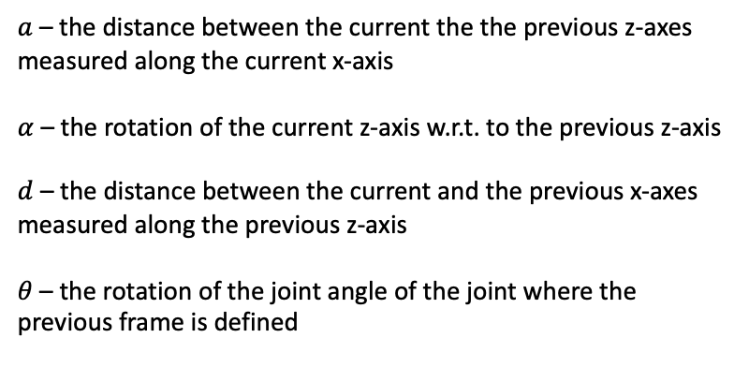
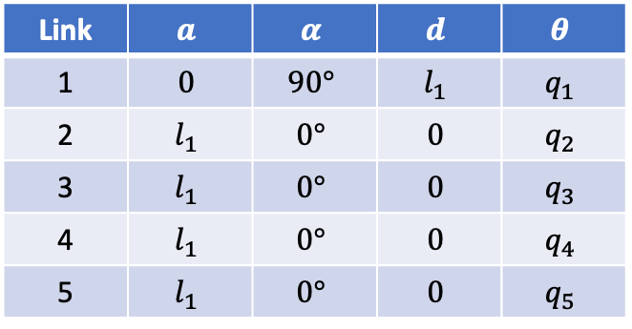
Mathematical Model (Forward Kinematics)
$$y_{3}$$
$$y_{2}$$
$$l_{3}$$
$q_{4}$
$q_{3}$
$$o_{3}$$
$$l_{4}$$
$$x_{3}$$
$$y_{4}$$
$$y_{1}$$
$$o_{2}$$
$$x_{2}$$
$$z_{3}$$
$q_{5}$
$q_{2}$
$$l_{2}$$
$$z_{2}$$
$$o_{4}$$
$$o_{1}$$
$$x_{1}$$
$$z_{4}$$
$$l_{5}$$
$$y_{5}$$
$$z_{1}$$
$$x_{4}$$
$$o_{5}$$
$$x_{5}$$
$$z_{5}$$
DH Table
$$l_{1}$$
Link | $$a$$ | $$α$$ | $$d$$ | $$θ$$
1 | $$0$$ | $$90°$$ | $$l_{1}$$ | $$q_{1}$$
2 | $$l_{1}$$ | $$0°$$ | $$0$$ | $$q_{2}$$
3 | $$l_{1}$$ | $$0°$$ | $$0$$ | $$q_{3}$$
4 | $$l_{1}$$ | $$0°$$ | $$0$$ | $$q_{4}$$
5 | $$l_{1}$$ | $$0°$$ | $$0$$ | $$q_{5}$$
$a$ – the distance between the current the the previous z-axes measured along the current x-axis
$α$ – the rotation of the current z-axis w.r.t. to the previous z-axis
$d$ – the distance between the current and the previous x-axes measured along the previous z-axis
$θ$ – the rotation of the joint angle of the joint where the previous frame is defined
$$x_{0}$$
$$y_{0}$$
$$o_{0}$$
$$z_{0}$$
$q_{1}$

Slide 7
Mathematical Model (Forward Kinematics)
$$y_{3}$$
$$y_{2}$$
$$l_{3}$$
$q_{4}$
$q_{3}$
$$o_{3}$$
$$l_{4}$$
$$x_{3}$$
$$y_{4}$$
$$y_{1}$$
$$o_{2}$$
$$x_{2}$$
$$z_{3}$$
$q_{5}$
$q_{2}$
$$l_{2}$$
$$z_{2}$$
$$o_{4}$$
$$o_{1}$$
$$x_{1}$$
$$z_{4}$$
$$l_{5}$$
$$y_{5}$$
$$z_{1}$$
$$x_{4}$$
$$o_{5}$$
$$x_{5}$$
$$z_{5}$$
DH Table
$$l_{1}$$
Link | $$a$$ | $$α$$ | $$d$$ | $$θ$$
1 | $$0$$ | $$90°$$ | $$l_{1}$$ | $$q_{1}$$
2 | $$l_{1}$$ | $$0°$$ | $$0$$ | $$q_{2}$$
3 | $$l_{1}$$ | $$0°$$ | $$0$$ | $$q_{3}$$
4 | $$l_{1}$$ | $$0°$$ | $$0$$ | $$q_{4}$$
5 | $$l_{1}$$ | $$0°$$ | $$0$$ | $$q_{5}$$
$$T_{1}^{0}={Rot}_{z,{ θ}_{1}}∙{Trans}_{z,{ d}_{1}}∙{Trans}_{x,{ a}_{1}}∙{Rot}_{x,{ α}_{1}}$$
$$T_{2}^{1}={Rot}_{z,{ θ}_{2}}∙{Trans}_{z,{ d}_{2}}∙{Trans}_{x,{ a}_{2}}∙{Rot}_{x,{ α}_{2}}$$
$$x_{0}$$
$$T_{3}^{2}={Rot}_{z,{ θ}_{3}}∙{Trans}_{z,{ d}_{3}}∙{Trans}_{x,{ a}_{3}}∙{Rot}_{x,{ α}_{3}}$$
$$y_{0}$$
$$o_{0}$$
$$T_{4}^{3}={Rot}_{z,{ θ}_{4}}∙{Trans}_{z,{ d}_{4}}∙{Trans}_{x,{ a}_{4}}∙{Rot}_{x,{ α}_{4}}$$
$$z_{0}$$
$q_{1}$
$$T_{5}^{4}={Rot}_{z,{ θ}_{5}}∙{Trans}_{z,{ d}_{5}}∙{Trans}_{x,{ a}_{5}}∙{Rot}_{x,{ α}_{5}}$$

Slide 8
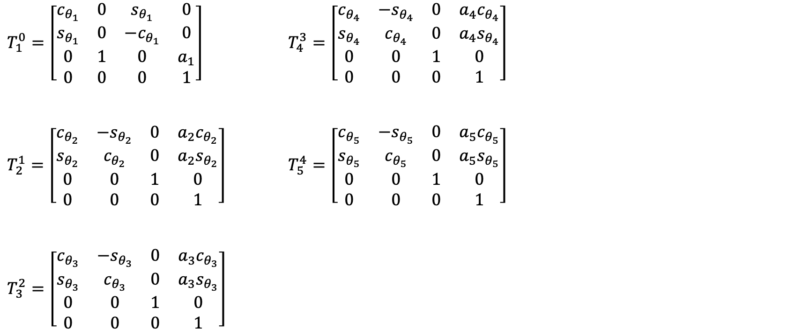
Mathematical Model (Forward Kinematics)
$T_{1}^{0}=\left[\begin{matrix}c_{θ_{1}} & 0 & s_{θ_{1}} & 0 \\ s_{θ_{1}} & 0 & {−c}_{θ_{1}} & 0 \\ 0 & 1 & 0 & a_{1} \\ 0 & 0 & 0 & 1\end{matrix}\right]$ $T_{4}^{3}=\left[\begin{matrix}c_{θ_{4}} & {−s}_{θ_{4}} & 0 & a_{4}c_{θ_{4}} \\ s_{θ_{4}} & c_{θ_{4}} & 0 & a_{4}s_{θ_{4}} \\ 0 & 0 & 1 & 0 \\ 0 & 0 & 0 & 1\end{matrix}\right]$
$T_{2}^{1}=\left[\begin{matrix}c_{θ_{2}} & {−s}_{θ_{2}} & 0 & a_{2}c_{θ_{2}} \\ s_{θ_{2}} & c_{θ_{2}} & 0 & a_{2}s_{θ_{2}} \\ 0 & 0 & 1 & 0 \\ 0 & 0 & 0 & 1\end{matrix}\right]$ $T_{5}^{4}=\left[\begin{matrix}c_{θ_{5}} & {−s}_{θ_{5}} & 0 & a_{5}c_{θ_{5}} \\ s_{θ_{5}} & c_{θ_{5}} & 0 & a_{5}s_{θ_{5}} \\ 0 & 0 & 1 & 0 \\ 0 & 0 & 0 & 1\end{matrix}\right]$
$T_{3}^{2}=\left[\begin{matrix}c_{θ_{3}} & {−s}_{θ_{3}} & 0 & a_{3}c_{θ_{3}} \\ s_{θ_{3}} & c_{θ_{3}} & 0 & a_{3}s_{θ_{3}} \\ 0 & 0 & 1 & 0 \\ 0 & 0 & 0 & 1\end{matrix}\right]$

Slide 9
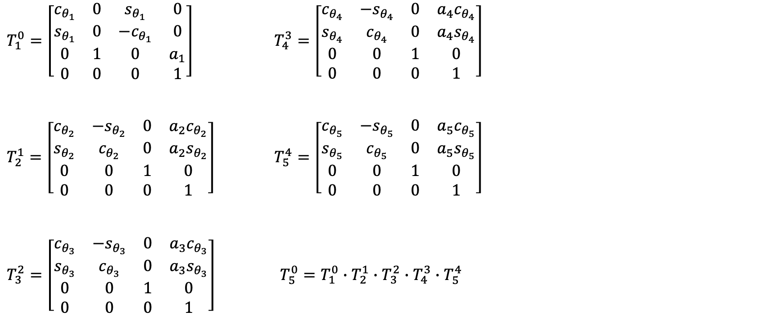
Mathematical Model (Forward Kinematics)
$T_{1}^{0}=\left[\begin{matrix}c_{θ_{1}} & 0 & s_{θ_{1}} & 0 \\ s_{θ_{1}} & 0 & {−c}_{θ_{1}} & 0 \\ 0 & 1 & 0 & a_{1} \\ 0 & 0 & 0 & 1\end{matrix}\right]$ $T_{4}^{3}=\left[\begin{matrix}c_{θ_{4}} & {−s}_{θ_{4}} & 0 & a_{4}c_{θ_{4}} \\ s_{θ_{4}} & c_{θ_{4}} & 0 & a_{4}s_{θ_{4}} \\ 0 & 0 & 1 & 0 \\ 0 & 0 & 0 & 1\end{matrix}\right]$
$T_{2}^{1}=\left[\begin{matrix}c_{θ_{2}} & {−s}_{θ_{2}} & 0 & a_{2}c_{θ_{2}} \\ s_{θ_{2}} & c_{θ_{2}} & 0 & a_{2}s_{θ_{2}} \\ 0 & 0 & 1 & 0 \\ 0 & 0 & 0 & 1\end{matrix}\right]$ $T_{5}^{4}=\left[\begin{matrix}c_{θ_{5}} & {−s}_{θ_{5}} & 0 & a_{5}c_{θ_{5}} \\ s_{θ_{5}} & c_{θ_{5}} & 0 & a_{5}s_{θ_{5}} \\ 0 & 0 & 1 & 0 \\ 0 & 0 & 0 & 1\end{matrix}\right]$
$T_{3}^{2}=\left[\begin{matrix}c_{θ_{3}} & {−s}_{θ_{3}} & 0 & a_{3}c_{θ_{3}} \\ s_{θ_{3}} & c_{θ_{3}} & 0 & a_{3}s_{θ_{3}} \\ 0 & 0 & 1 & 0 \\ 0 & 0 & 0 & 1\end{matrix}\right]$ $T_{5}^{0}=T_{1}^{0}∙T_{2}^{1}∙T_{3}^{2}$ $∙T_{4}^{3}$ $∙T_{5}^{4}$

Slide 10

Mathematical Model (Forward Kinematics)
$T_{5}^{0}=\left[\begin{matrix}{c_{θ_{1}}c}_{θ_{2345}} & {{−c}_{θ_{1}}s}_{θ_{2345}} & s_{θ_{1}} & c_{θ_{1}}({a_{2}c}_{θ_{2}}+{a_{3}c}_{θ_{23}}+{a_{4}c}_{θ_{234}}+{a_{5}c}_{θ_{2345}}) \\ {s_{θ_{1}}c}_{θ_{2345}} & {{−s}_{θ_{1}}s}_{θ_{2345}} & {−c}_{θ_{1}} & s_{θ_{1}}({a_{2}c}_{θ_{2}}+{a_{3}c}_{θ_{23}}+{a_{4}c}_{θ_{234}}+{a_{5}c}_{θ_{2345}}) \\ s_{θ_{2345}} & c_{θ_{2345}} & 0 & {a_{1}+a_{2}s}_{θ_{2}}+{a_{3}s}_{θ_{23}}+{a_{4}s}_{θ_{234}}+{a_{5}s}_{θ_{2345}} \\ 0 & 0 & 0 & 1\end{matrix}\right]$

Slide 11


Mathematical Model (Forward Kinematics)
$$R$$
$$p$$
$T_{5}^{0}=\left[\begin{matrix}{c_{θ_{1}}c}_{θ_{2345}} & {{−c}_{θ_{1}}s}_{θ_{2345}} & s_{θ_{1}} & c_{θ_{1}}({a_{2}c}_{θ_{2}}+{a_{3}c}_{θ_{23}}+{a_{4}c}_{θ_{234}}+{a_{5}c}_{θ_{2345}}) \\ {s_{θ_{1}}c}_{θ_{2345}} & {{−s}_{θ_{1}}s}_{θ_{2345}} & {−c}_{θ_{1}} & s_{θ_{1}}({a_{2}c}_{θ_{2}}+{a_{3}c}_{θ_{23}}+{a_{4}c}_{θ_{234}}+{a_{5}c}_{θ_{2345}}) \\ s_{θ_{2345}} & c_{θ_{2345}} & 0 & {a_{1}+a_{2}s}_{θ_{2}}+{a_{3}s}_{θ_{23}}+{a_{4}s}_{θ_{234}}+{a_{5}s}_{θ_{2345}} \\ 0 & 0 & 0 & 1\end{matrix}\right]$

Slide 12

Mathematical Model (Forward Kinematics)
$$p=\left[\begin{matrix}c_{θ_{1}}\left({a_{2}c}_{θ_{2}}+{a_{3}c}_{θ_{23}}+{a_{4}c}_{θ_{234}}+{a_{5}c}_{θ_{2345}}\right) \\ s_{θ_{1}}\left({a_{2}c}_{θ_{2}}+{a_{3}c}_{θ_{23}}+{a_{4}c}_{θ_{234}}+{a_{5}c}_{θ_{2345}}\right) \\ {a_{1}+a_{2}s}_{θ_{2}}+{a_{3}s}_{θ_{23}}+{a_{4}s}_{θ_{234}}+{a_{5}s}_{θ_{2345}}\end{matrix}\right]$$

Slide 13

Mathematical Model (Forward Kinematics)
$$p=\left[\begin{matrix}c_{θ_{1}}\left({a_{2}c}_{θ_{2}}+{a_{3}c}_{θ_{23}}+{a_{4}c}_{θ_{234}}+{a_{5}c}_{θ_{2345}}\right) \\ s_{θ_{1}}\left({a_{2}c}_{θ_{2}}+{a_{3}c}_{θ_{23}}+{a_{4}c}_{θ_{234}}+{a_{5}c}_{θ_{2345}}\right) \\ {a_{1}+a_{2}s}_{θ_{2}}+{a_{3}s}_{θ_{23}}+{a_{4}s}_{θ_{234}}+{a_{5}s}_{θ_{2345}}\end{matrix}\right]=\left[\begin{matrix}x \\ y \\ z\end{matrix}\right]=f(q)$$

Slide 14

Mathematical Model
$$p=\left[\begin{matrix}c_{θ_{1}}\left({a_{2}c}_{θ_{2}}+{a_{3}c}_{θ_{23}}+{a_{4}c}_{θ_{234}}+{a_{5}c}_{θ_{2345}}\right) \\ s_{θ_{1}}\left({a_{2}c}_{θ_{2}}+{a_{3}c}_{θ_{23}}+{a_{4}c}_{θ_{234}}+{a_{5}c}_{θ_{2345}}\right) \\ {a_{1}+a_{2}s}_{θ_{2}}+{a_{3}s}_{θ_{23}}+{a_{4}s}_{θ_{234}}+{a_{5}s}_{θ_{2345}}\end{matrix}\right]$$
$$\dot{p}=\left[\begin{matrix}\dot{x} \\ \dot{y} \\ \dot{z}\end{matrix}\right]=∇_{q}p∙\left[\begin{matrix}\dot{θ_{1}} \\ \dot{θ_{2}} \\ \dot{θ_{3}} \\ \dot{θ_{4}} \\ \dot{θ_{5}}\end{matrix}\right]$$

Slide 15



Mathematical Model
$$p=\left[\begin{matrix}c_{θ_{1}}\left({a_{2}c}_{θ_{2}}+{a_{3}c}_{θ_{23}}+{a_{4}c}_{θ_{234}}+{a_{5}c}_{θ_{2345}}\right) \\ s_{θ_{1}}\left({a_{2}c}_{θ_{2}}+{a_{3}c}_{θ_{23}}+{a_{4}c}_{θ_{234}}+{a_{5}c}_{θ_{2345}}\right) \\ {a_{1}+a_{2}s}_{θ_{2}}+{a_{3}s}_{θ_{23}}+{a_{4}s}_{θ_{234}}+{a_{5}s}_{θ_{2345}}\end{matrix}\right]$$
$$\dot{p}=\left[\begin{matrix}\dot{x} \\ \dot{y} \\ \dot{z}\end{matrix}\right]=∇_{q}p∙\left[\begin{matrix}\dot{θ_{1}} \\ \dot{θ_{2}} \\ \dot{θ_{3}} \\ \dot{θ_{4}} \\ \dot{θ_{5}}\end{matrix}\right]$$
$$5×1$$
$$3×1$$
$$3×5$$

Slide 16

Mathematical Model
$$p=\left[\begin{matrix}c_{θ_{1}}\left({a_{2}c}_{θ_{2}}+{a_{3}c}_{θ_{23}}+{a_{4}c}_{θ_{234}}+{a_{5}c}_{θ_{2345}}\right) \\ s_{θ_{1}}\left({a_{2}c}_{θ_{2}}+{a_{3}c}_{θ_{23}}+{a_{4}c}_{θ_{234}}+{a_{5}c}_{θ_{2345}}\right) \\ {a_{1}+a_{2}s}_{θ_{2}}+{a_{3}s}_{θ_{23}}+{a_{4}s}_{θ_{234}}+{a_{5}s}_{θ_{2345}}\end{matrix}\right]$$
$$\dot{p}=\left[\begin{matrix}\dot{x} \\ \dot{y} \\ \dot{z}\end{matrix}\right]=∇_{q}p∙\left[\begin{matrix}\dot{θ_{1}} \\ \dot{θ_{2}} \\ \dot{θ_{3}} \\ \dot{θ_{4}} \\ \dot{θ_{5}}\end{matrix}\right]$$
$$5×1$$
$$3×1$$
$$3×5$$
$$\dot{p}= J∙\dot{q}$$

Slide 17
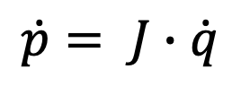
Mathematical Model
$$\dot{p}= J∙\dot{q}$$

Slide 18
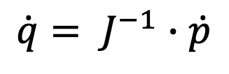
Mathematical Model (Inverse Kinematics)
$$\dot{p}= J∙\dot{q}$$
$$\dot{q}= J^{−1}∙\dot{p}$$

Slide 19

Mathematical Model (Inverse Kinematics)
$$\dot{p}= J∙\dot{q}$$
$$\dot{q}= J^{−1}∙\dot{p}$$
$$3×5$$

Slide 20
Mathematical Model (Inverse Kinematics)
$$\dot{p}= J∙\dot{q}$$
$$\dot{q}= J^{−1}∙\dot{p}$$
$$3×5$$

Slide 21

Mathematical Model (Inverse Kinematics)
$$\dot{p}= J∙\dot{q}$$
$$b=A∙x$$

Slide 22


Mathematical Model (Inverse Kinematics)
$$A∙x=b$$
Underdetermined system of equations
$(infinitely many solutions$)
Optimization problem: find the least norm solution

Slide 23
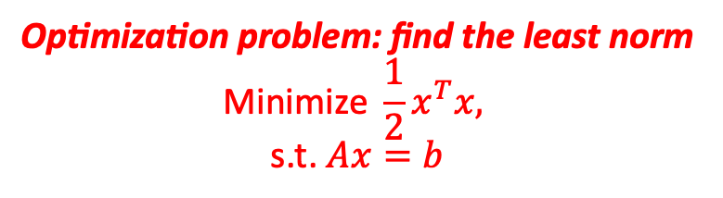
Mathematical Model (Inverse Kinematics)
$$\text{Optimization} \text{problem}\text{: }\text{find} \text{the} \text{least} \text{norm}$$
$$\text{Minimize} \frac{1}{2}x^{T}x,$$
$$\text{s}\text{.}\text{t}\text{. }Ax=b$$

Slide 24
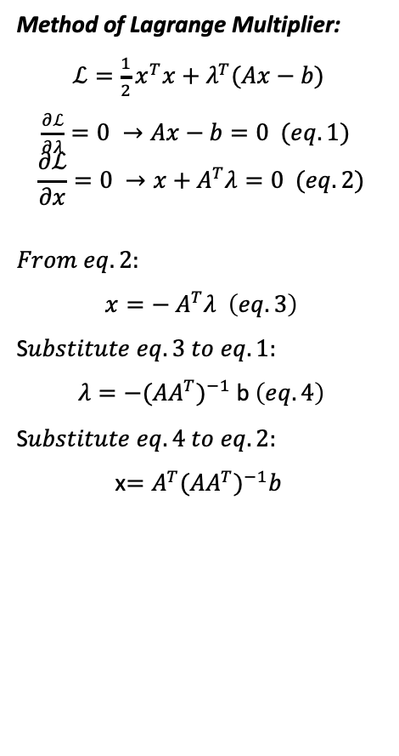
Mathematical Model (Inverse Kinematics)
$$\text{Optimization} \text{problem}\text{: }\text{find} \text{the} \text{least} \text{norm}$$
$$\text{Minimize} \frac{1}{2}x^{T}x,$$
$$\text{s}\text{.}\text{t}\text{. }Ax=b$$
Method of Lagrange Multiplier:
$ℒ=\frac{1}{2}x^{T}x+λ^{T}(Ax−b)$
$\frac{∂ℒ}{∂λ}=0 →Ax−b=0 (eq. 1)$
$$\frac{∂ℒ}{∂x}=0 →x+A^{T}λ=0 (eq. 2)$$
$$From eq. 2:$$
$x=−$ $A^{T}λ \left(eq. 3\right)$
S$ubstitute eq.3 to eq. 1:$
$λ={−({AA}^{T})}^{−1}$ b $\left(eq. 4\right)$
S$ubstitute eq.4 to eq. 2:$
x$={A^{T}({AA}^{T})}^{−1}b$

Slide 25
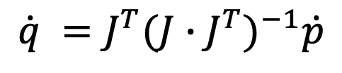
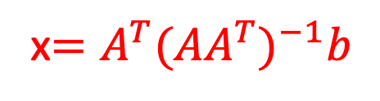
Mathematical Model (Inverse Kinematics)
$$\dot{p}= J∙\dot{q}$$
$$b=A∙x$$
x$={A^{T}({AA}^{T})}^{−1}b$
$$\dot{q} ={J^{T}({J∙J}^{T})}^{−1}\dot{p}$$

Slide 26
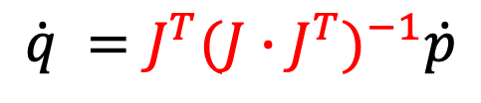
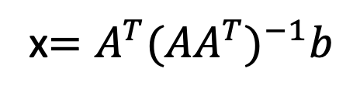
Mathematical Model (Inverse Kinematics)
$$\dot{p}= J∙\dot{q}$$
$$b=A∙x$$
x$={A^{T}({AA}^{T})}^{−1}b$
$$\dot{q} ={J^{T}({J∙J}^{T})}^{−1}\dot{p}$$

Slide 27
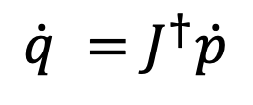
Mathematical Model (Inverse Kinematics)
$$\dot{p}= J∙\dot{q}$$
$$b=A∙x$$
x$={A^{T}({AA}^{T})}^{−1}b$
$$\dot{q} =J^{†}\dot{p}$$

Slide 28
Mathematical Model (Inverse Kinematics)
$$\dot{p}= J∙\dot{q}$$
$$b=A∙x$$
x$={A^{T}({AA}^{T})}^{−1}b$
$$\dot{q} =J^{†}\dot{p}$$

Slide 29
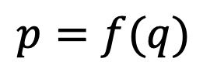
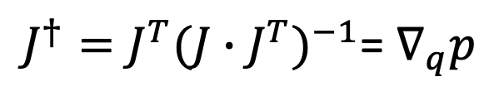
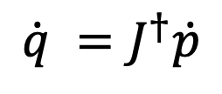
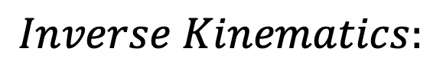
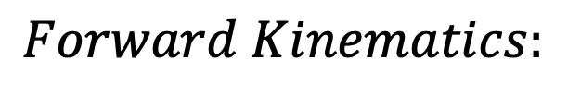
Pure Inverse Kinematics Model
$$Forward Kinematics:$$
$p=f(q)$
$$Inverse Kinematics:$$
$$\dot{q} =J^{†}\dot{p}$$
$J^{†}={J^{T}({J∙J}^{T})}^{−1}$= $∇_{q}p$

Slide 30
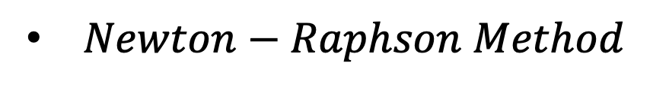
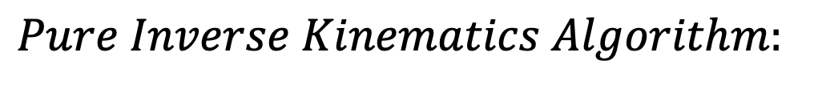
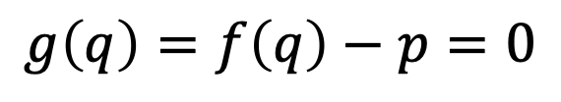
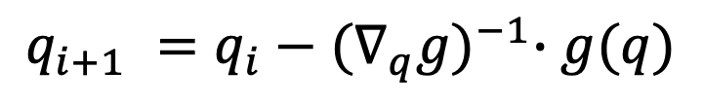
Pure Inverse Kinematics Model
$$Forward Kinematics:$$
$p=f(q)$
$$Inverse Kinematics:$$
$$\dot{q} =J^{†}\dot{p}$$
$J^{†}={J^{T}({J∙J}^{T})}^{−1}$= $∇_{q}p$
$$Pure Inverse Kinematics Algorithm:$$
$Newton−Raphson Method$
$$g\left(q\right)=f\left(q\right)−p=0$$
$$q_{i+1} =q_{i}−{(∇_{q}g)}^{−1}∙g(q)$$

Slide 31
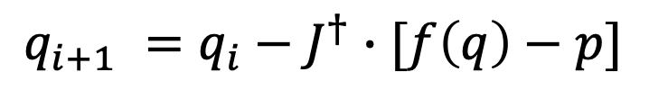
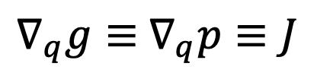
Pure Inverse Kinematics Model
$$Forward Kinematics:$$
$p=f(q)$
$$Inverse Kinematics:$$
$$\dot{q} =J^{†}\dot{p}$$
$J^{†}={J^{T}({J∙J}^{T})}^{−1}$= $∇_{q}p$
$$Pure Inverse Kinematics Algorithm:$$
$Newton−Raphson Method$
$$g\left(q\right)=f\left(q\right)−p=0$$
$$q_{i+1} =q_{i}−{(∇_{q}g)}^{−1}∙g(q)$$
$∇_{q}g≡$ $∇_{q}p≡J$
$$q_{i+1} =q_{i}−J^{†}∙[f\left(q\right)−p]$$

Slide 32
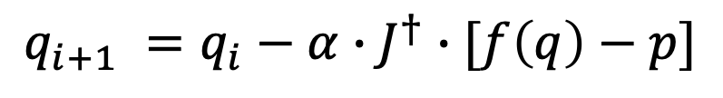
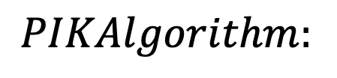
Pure Inverse Kinematics Model
$$Forward Kinematics:$$
$p=f(q)$
$$Inverse Kinematics:$$
$$\dot{q} =J^{†}\dot{p}$$
$J^{†}={J^{T}({J∙J}^{T})}^{−1}$= $∇_{q}p$
$$PIKAlgorithm:$$
$Newton−Raphson Method$
$$g\left(q\right)=f\left(q\right)−p=0$$
$$q_{i+1} =q_{i}−{(∇_{q}g)}^{−1}∙g(q)$$
$∇_{q}g≡$ $∇_{q}p≡J$
$$q_{i+1} =q_{i}−J^{†}∙[f\left(q\right)−p]$$
$$q_{i+1} =q_{i}−α∙J^{†}∙[f\left(q\right)−p]$$

Slide 33
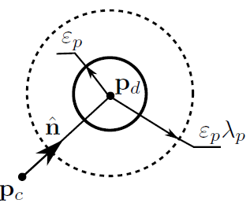
Resolved Rates Algorithm Model
Key idea:
Time derivative of the inverse kinematic problem is linear in joint speeds and end effector orientation.

Slide 34
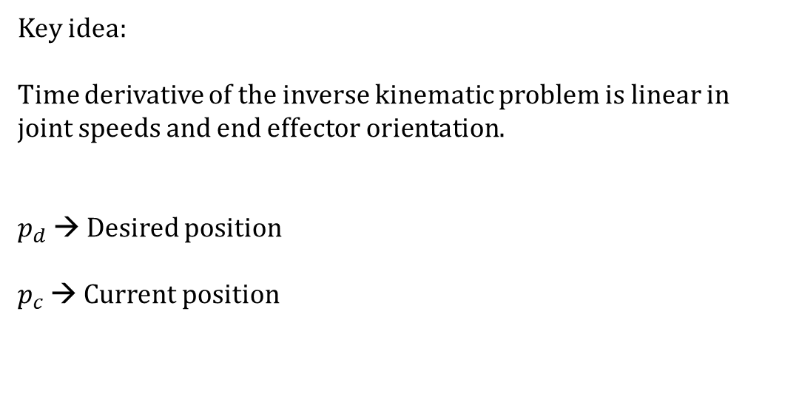

Resolved Rates Algorithm Model
Key idea:
Time derivative of the inverse kinematic problem is linear in joint speeds and end effector orientation.
$p_{d}$ → Desired position
$p_{c}$ → Current position
$$q_{i+1}≔q_{i}+q_{d}Δt$$

Slide 35
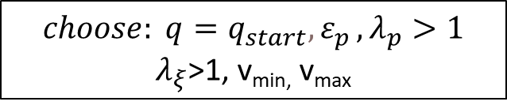

Resolved Rates Algorithm Model
$$q_{i+1}≔q_{i}+q_{d}Δt$$
$$choose: q=q_{start}{,ε}_{p}, λ_{p}>1$$
$λ_{ξ}$>1, v_{min,} v_{max}
Joint coordinates for starting position

Slide 36


Resolved Rates Algorithm Model
$$q_{i+1}≔q_{i}+q_{d}Δt$$
$$choose: q=q_{start}{,ε}_{p}, λ_{p}>1$$
$λ_{ξ}$>1, v_{min,} v_{max}
Joint coordinates for starting position
Forward kinematics – (X,Y,Z)
Position Error
$$\text{X}\text{c}\text{=}\text{Fwd}\text{_}\text{kin}\text{(}\text{q}\text{)}$$
$δ_{p}=\sqrt{{\left(p_{d}−p_{c}\right)}^{T}\left(p_{d}−p_{c}\right)}$

Slide 37

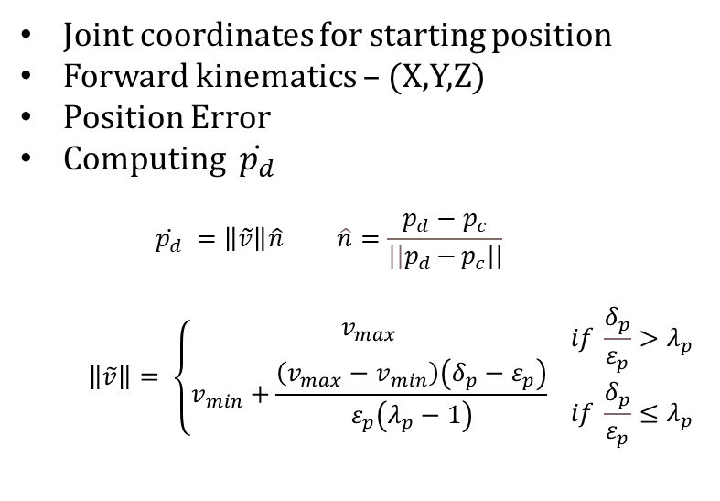
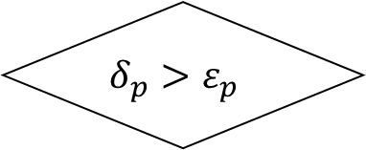
Resolved Rates Algorithm Model
$$q_{i+1}≔q_{i}+q_{d}Δt$$
$$choose: q=q_{start}{,ε}_{p}, λ_{p}>1$$
$λ_{ξ}$>1, v_{min,} v_{max}
Joint coordinates for starting position
Forward kinematics – (X,Y,Z)
Position Error
Computing $\dot{p_{d}}$
$$\dot{p_{d}} =\left\|\tilde{v}\right\|\hat{n} \hat{n}=\frac{p_{d}−p_{c}}{{||p}_{d}{−}p_{c}||}$$
$$\left\|\tilde{v}\right\|= \left\{\begin{aligned}&v_{max} \\ \begin{aligned}& \\ v_{min}+\frac{\left(v_{max}−v_{min}\right)\left(δ_{p}−ε_{p}\right)}{ε_{p}\left(λ_{p}−1\right)}\end{aligned}\end{aligned}\right. \begin{aligned}&if \frac{δ_{p}}{ε_{p}}>λ_{p} \\ &if \frac{δ_{p}}{ε_{p}}≤λ_{p}\end{aligned}$$
$$\text{X}\text{c}\text{=}\text{Fwd}\text{_}\text{kin}\text{(}\text{q}\text{)}$$
$δ_{p}=\sqrt{{\left(p_{d}−p_{c}\right)}^{T}\left(p_{d}−p_{c}\right)}$
$$δ_{p}>ε_{p}$$
Stop
$$\dot{p_{d}} =\left\|\tilde{v}\right\|\hat{n}$$

Slide 38
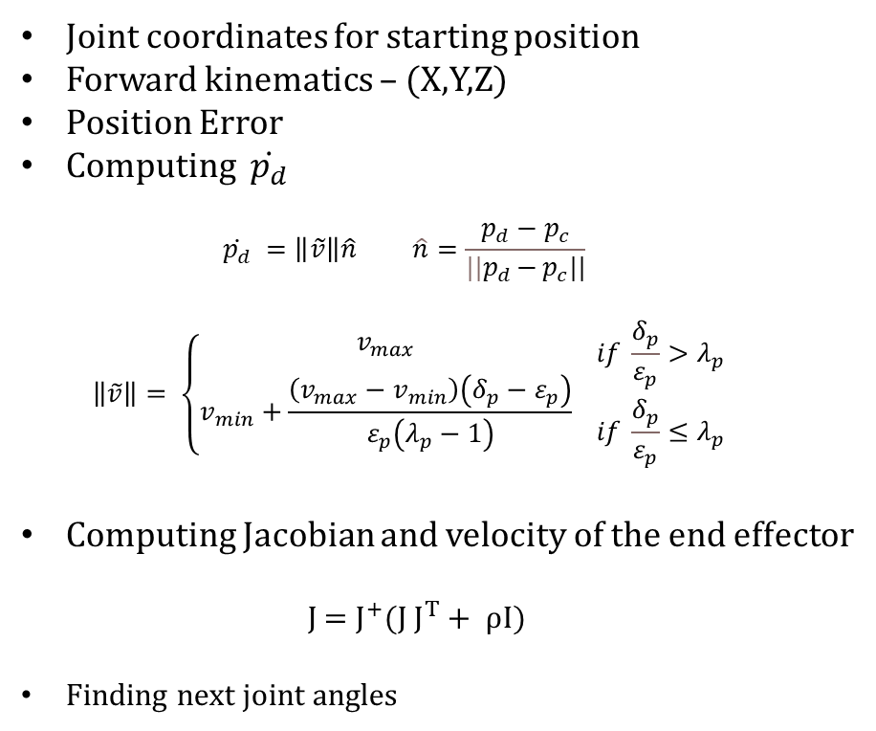


Resolved Rates Algorithm Model
$$q_{i+1}≔q_{i}+q_{d}Δt$$
$$choose: q=q_{start}{,ε}_{p}, λ_{p}>1$$
$λ_{ξ}$>1, v_{min,} v_{max}
Joint coordinates for starting position
Forward kinematics – (X,Y,Z)
Position Error
Computing $\dot{p_{d}}$
$$\dot{p_{d}} =\left\|\tilde{v}\right\|\hat{n} \hat{n}=\frac{p_{d}−p_{c}}{{||p}_{d}{−}p_{c}||}$$
$$\left\|\tilde{v}\right\|= \left\{\begin{aligned}&v_{max} \\ \begin{aligned}& \\ v_{min}+\frac{\left(v_{max}−v_{min}\right)\left(δ_{p}−ε_{p}\right)}{ε_{p}\left(λ_{p}−1\right)}\end{aligned}\end{aligned}\right. \begin{aligned}&if \frac{δ_{p}}{ε_{p}}>λ_{p} \\ &if \frac{δ_{p}}{ε_{p}}≤λ_{p}\end{aligned}$$
Computing Jacobian and velocity of the end effector
J = $J^{+}$(J $J^{T}+ ρI$)
Finding next joint angles
$$\text{X}\text{c}\text{=}\text{Fwd}\text{_}\text{kin}\text{(}\text{q}\text{)}$$
$δ_{p}=\sqrt{{\left(p_{d}−p_{c}\right)}^{T}\left(p_{d}−p_{c}\right)}$
$$δ_{p}>ε_{p}$$
Stop
$$\dot{p_{d}} =\left\|\tilde{v}\right\|\hat{n}$$
$${\dot{x}}_{d}={\left[{\dot{p}}_{d}^{T}\right]}^{T}=\dot{p_{d}}→ {\dot{q}}_{d}=J^{+}\dot{x_{d}}$$
$$q_{i+1}=q_{i}+{\dot{q}}_{d}Δt$$

Slide 39
Results of Resolved Rates Algorithm Model

