Slide 1


IMPLEMENTING NEURAL NETWORK IN ZYBO Z10 BOARD USING VHDL
Viranshu Paruparla (204484351)

Slide 2

INTRODUCTION
Most people now use GPU to run their neural networks. But unfortunately, this has been sourced with a lot of power, and power consumption is a real concern for deployment of ML. With this project, I implemented a neural network for Fashion MNIST classification on an FPGA. This was done with significantly lower power consumption by GPU or CPU. This approach has shown how domain-specific hardware accelerators can also lead to energy-efficient energy consumption at the same level of classification accuracy, making it feasible to run ML in power-constrained environments, where computer systems would not have been possible otherwise. The hardware-accelerated design proves that FPGA is indeed one of the most fitted platforms in embedded AI applications.

Slide 3
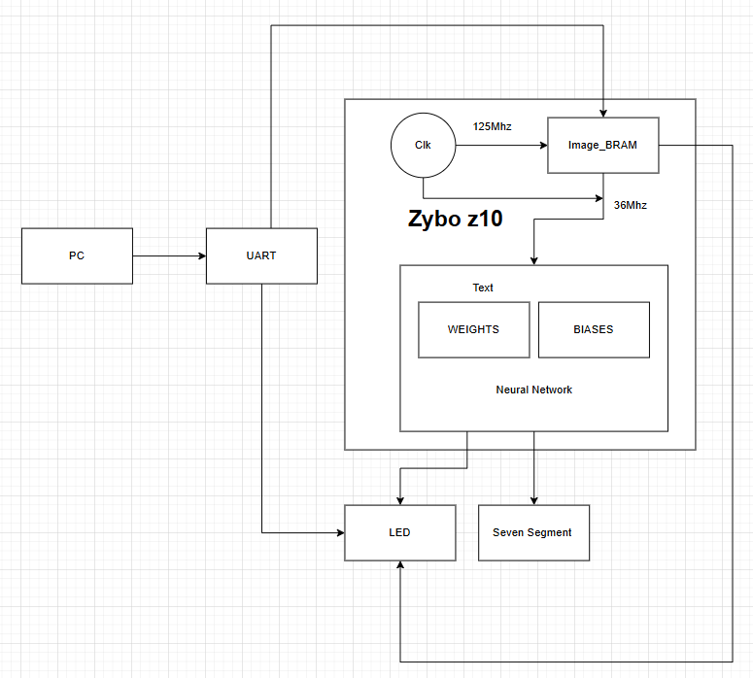
SYSTEM OVERVIEW
Images are transmitted from a PC through a UART interface operating at 9600 baud. The received pixel data is temporarily stored in a dual-port Image BRAM, which bridges between two clock domains: the system clock running at 125MHz and the neural network clock at 36MHz. The core of the system is a three-layer neural network with pre-loaded weights and biases stored in dedicated BRAMs, which performs the classification computation. The system provides visual feedback through status LEDs that indicate the current operation state (idle, receiving, processing, or result ready) and outputs the final classification result (0-9) on a seven-segment display.
IMAGE 1 : SYSTEM FLOW

Slide 4
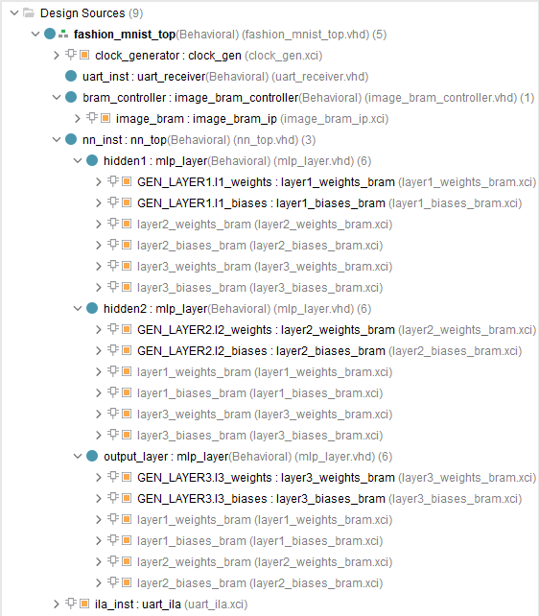
SYSTEM OVERVIEW
FILE HIERARCHY
FASHION_MNIST_TOP - THE TOP-LEVEL MODULE THAT INTEGRATES ALL COMPONENTS. IT HANDLES SYSTEM CLOCK (125MHZ), UART COMMUNICATION, NEURAL NETWORK PROCESSING, AND OUTPUT DISPLAY VIA LEDS AND SEVEN-SEGMENT DISPLAY.
UART_RECIVER - IMPLEMENTS THE UART PROTOCOL FOR RECEIVING IMAGE DATA FROM A PC AT 9600 BAUD.
IMAGE_BRAM_CONTROLLER - MANAGES THE DUAL-PORT BRAM FOR STORING THE INPUT IMAGE, HANDLING CLOCK DOMAIN CROSSING BETWEEN UART (125MHZ) AND NEURAL NETWORK (36MHZ).
NN_TOP - NEURAL NETWORK CONTROLLER THAT ORCHESTRATES THE THREE LAYERS, MANAGES DATA FLOW, AND DETERMINES THE FINAL CLASSIFICATION RESULT.
MLP_LAYER - IMPLEMENTS THE GENERIC MLP LAYER WITH CONFIGURABLE INPUT/OUTPUT SIZES. EACH INSTANCE PERFORMS MATRIX MULTIPLICATION, BIAS ADDITION, AND ACTIVATION FUNCTION APPLICATION.
IMAGE 2 FILE HIERARCHY

Slide 5
SYSTEM OVERVIEW
IP MODULES
CLOCKING WIZARD
CLOCK_GEN - CONVERTS 125MHZ SYSTEM CLOCK TO 36MHZ FOR NEURAL NETWORK OPERATIONS WHILE ENSURING STABLE TIMING.
IILA
UART_ILA - ENABLES REAL-TIME DEBUGGING OF INTERNAL SIGNALS FOR UART AND STATE MACHINE VERIFICATION.
BRAMS
LAYER1_WEIGHTS_BRAM - STORES 784×128 FIRST-LAYER WEIGHT MATRIX FOR INITIAL FEATURE EXTRACTION.
LAYER1_BIASES_BRAM - HOUSES 128 BIAS VALUES FOR FIRST HIDDEN LAYER NEURONS.
LAYER2_WEIGHTS_BRAM - CONTAINS 128×64 WEIGHT MATRIX FOR SECOND-LAYER INTERMEDIATE FEATURE PROCESSING.
LAYER2_BIASES_BRAM - MAINTAINS 64 BIAS VALUES FOR SECOND HIDDEN LAYER COMPUTATIONS.
LAYER3_WEIGHTS_BRAM - HOLDS 64×10 WEIGHT MATRIX TRANSFORMING FEATURES TO CLASSIFICATION SCORES.
LAYER3_BIASES_BRAM - STORES 10 BIAS VALUES FOR FINAL OUTPUT LAYER CLASSIFICATION.
IMAGE_BRAM_IP - DUAL-PORT MEMORY BUFFER BRIDGING 125MHZ UART RECEPTION WITH 36MHZ NEURAL NETWORK PROCESSING.

Slide 6
SYSTEM OVERVIEW
PMODS
UART PMOD
FACILITATES SERIAL COMMUNICATION WITH A PC FOR RECEIVING 28×28 PIXEL IMAGES AT 9600 BAUD RATE.
SEVEN SEGMENT DISPLAY (SSD)
DISPLAYS THE FINAL CLASSIFICATION RESULT (0-9) CORRESPONDING TO FASHION MNIST CLASSES: 0=T-SHIRT/TOP, 1 = TROUSER, 2 = PULLOVER, 3 = DRESS, 4 = COAT, 5 = SANDAL, 6 = SHIRT, 7 = SNEAKER, 8 = BAG, 9 = ANKLE BOOT.
LED PMOD
PROVIDES VISUAL STATUS INDICATION OF THE SYSTEM STATE (WAITING, RECEIVING, PROCESSING, RESULT READY).

Slide 7
SYSTEM WORKFLOW
MODEL TRAINING AND IMPLEMENTATION
The neural network model is accomplished in Python TensorFlow, using the Multi-Layer Perceptron architecture with an input layer, two hidden layers, and an output layer (784→128→64→10). The model was trained on the Fashion MNIST dataset for 20 epochs, producing about 89% classification accuracy. The model was saved in HDF5 format (.h5 file) for weight and bias extraction.
The parameter values were then quantized to 8-bit fixed-point representation and stored in six separate coefficient (.coe) files, one for weights and biases per layer. These coefficient files will, in turn, initialize the Block RAM-BRAM components in the FPGA design, enabling the hardware implementation to infer the pre-trained network parameters.

Slide 8
SYSTEM WORKFLOW
INPUT COLLECTION AND PROCESSING
The pixels of the image are sent in sequential fashion from a PC by means of UART PMOD at 9600 baud. These pixels are stored in a dual-port IMAGE_BRAM, which efficiently couples two completely different clock domains: the 125MHz system clock handling UART communication and the 36MHz clock driving neural network operation. The system thus optimally allows Clock Domain Crossing since the neural network processes data at its optimal frequency while the system interfaces with external devices at standard speeds, maximizing communication reliability and processing efficiency.

Slide 9
SYSTEM WORKFLOW
NEURAL NETWORK FUNCTIONING
This implementation of the neural network leverages a three-layer architecture inspired by Multi-Layer Perceptron (MLP) to successfully classify Fashion MNIST images. Upon arrival from IMAGE_BRAM, pixels get processed at once through the sequential processing pipeline. First, all normalized pixel values enter the input layer (784 neurons) via the to_fixed_point conversion function. Then, the mlp_layer module multiplies the input with its weights in addition to bias for that layer. The calculations here are done element by element in 8-bit fixed point format. Each layer also has its own dedicated BRAM which keeps pre-quantized weights and biases. ReLU activation functions are included between layers implemented as simple zero-threshold comparators. The last layer will give 10 output values representing the class scores. This will be evaluated by using a max_index function by the nn_top module to decide the predicted class (0-9) which will be shown in Seven Segment Display. The entire pipeline will be controlled by a state machine for proper choreography from the reception of images to the showing of results.

Slide 10
VERIFICATION
TESTBENCH
The testbench acts like a real-world simulator, sending a pre-chosen image to the system through a UART connection, which is a bit like texting data at a slow 9600 bits per second. A 125 MHz clock keeps everything ticking along smoothly. The brain of the system is a neural network, originally built in Python but now shrunk down to use 8-bit numbers for efficiency, with its knowledge (weights and biases) stored in BRAM using .coe files. The testbench feeds the image bit by bit through a pin, just like how the real system would get data. Once the system processes the image, it spits out a guess about what it sees. The testbench checks if the guess is correct earns a “pass” message, but missing it means a “fail.” This whole setup makes sure the hardware neural network is doing its job right and accurately identifying images.

Slide 11
VERIFICATION
ILA
The Integrated Logic Analyzer (ILA) performs real-time debug operations on internal UART signals to identify data transfer issues. Three important signals are monitored: bram_write_addr, which indicates the particular BRAM being written to; rx_valid, which indicates valid reception of data; and rx_data, which is the received byte. During hardware verification, monitoring these signals allows for precise debugging and assurance of reliable UART-to-memory data transfers.

Slide 12
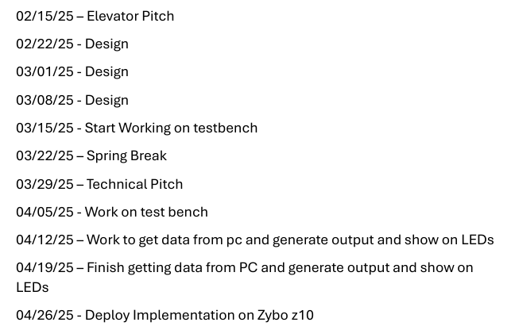
PROJECT TIMELINE
THIS WAS MY ORIGINAL SCHEDULE
IMAGE 3 ORIGINAL SCHEDULE

Slide 13
PROJECT TIMELINE
Indeed, the project did not progress according to the original schedule. I was far ahead in time and had most of the designs completed before the spring break. Challenges arose mainly during bitstream generation-my PC was crashing repeatedly because of processing load, and synthesis errors were appearing, which had no clear reason from the code. To tackle this, I changed my approach and integrated BRAMs to handle memory more effectively, which solved the problem and enabled me to complete the generation of bitstream and finish the project on time.

Slide 14
CHALLENGES AND SOLUTION
Generation of the bitstream was interrupted suddenly with no specific cause and without the output of any error code. Through diagnosis, the package file of the package containing the weights and the biases turned out to exceed the processing ability. I rectified this by making the weights and biases split between six block RAMs so as to promote modularity of the system as well as limit its resources.
At 36MHz, the timing of the neural network conflicts with its functionality, overall costing 125MHz of the system clock. Clock domain crossing is achieved through dual-port RAM buffers with synchronized registers within the image_bram_controller block, which allows UART communication on the 125MHz clock while the neural network is working with simultaneous processing at 36MHz, thus achieving performance requirements amicably without any compromise on functionality.
At first, I intended to incorporate the VGA PMOD in order to output the class on a monitor. Based on the difficulties of implementation and the fact that it is pretty close to deadline, I couldn't progress with this. This would mean the redesigning of a lot of things in the design flow, especially the number of BRAMs, as well as changes in the overall architecture. Given the above conditions, I believe I will finish and verify the core functionality of the system for the available time.

Slide 15
LESSONS LEARNED
I learned that the implementation of neural networks in hardware is quite different compared to that in software, where memory, timing, and architecture have to be considered very carefully, as it is not with GPU-based implementations.
The importance of discussing with the instructor concerning the ideas and difficulties the student faces and germinate the feedback righteously essential for dealing with unexpected problems.
Having backup plans was not something I ventured into doing until I got into a really tight corner and couldn't find a way out. Fortunately, the feedback from my professor gave me really good insights into the solution. It has taught me quite a lot about being flexible in preparing for and solving problems.
I discovered that successful resource management is key to the implementation of complicate systems such as neural networks on FPGAs. Poor planning, however, will cause unnecessary implementation issues and hardware constraints.

Slide 16
FUTURE WORK
In future considerations, I would like to look at the implementation of extended and deeper neural network architectures, such as CNNs and DNNs, on an FPGA platform. These models handle even the most scattered and diverse datasets, achieving an edge in performance in real-world applications. Keeping that in mind, I would like to try floating-point precision to improve inference accuracy and model flexibility; indeed, because of the greater demand on resources and greater design complexity, this would be an arduous but rewarding extension of my present project. This is something I am willing to pursue, given that it might go a long way in developing high-performance AI solutions with energy efficiency for edge devices and embedded systems. This is a path that will, on one hand, consolidate my learning about hardware-based machine-learning efficiency while, on the other hand, solving real-time processing and power constraint problems.

Slide 17
CONCLUSION
The project proved to be capable of accelerating an FPGA neural network for Fashion MNIST classification. The achievement achieved accuracy and energy efficiency by means of 8-bit fixed-point design with optimal clock domain control. Synthesis constraints and timing conflicts being problems, it achieved good image classification at very low power in comparison to typical processors. The general modular structure involves parameterizable modules that set the basis for further extension with the presentation of embedded systems with particular hardware application where energy efficiency is so inherent to AI-based applications.

Slide 18
Live Demo

Slide 19
Questions.....
Thank you!!

