Slide 1

Project - 19
QML for Image Processing
Mentor: Viratkumar Kothari | Co-founder and CTO, Xporium, India | virat.Kothari@gmail.com Devang Gajjar | Chief Solution Architect, HealthTech India, India | devang.gajjar@gmail.com
Interns: Anurag Kulkarni, Azza Fadhel, Pushkal Shukla, Rajatav Dutta, Rifatul Islam Himel, Riya Malani, Vishal Kumar
Summer Internship Program QIntern2021

Slide 2
Research Problem
Image Classification in computer vision in machine learning is a very famous use case in classical computers. This may be binary or multi-class classification. In binary classification, images are classified in two categories, whereas in multi-class classification, images are classified in more than two categories. In a classical computer, we generally use the Central Processing Unit (CPU) or Graphical Processing Unit (GPU) to solve this problem. The GPU processes data faster compared to the CPU because GPU is better at image processing. Still, processing the data more quickly is always a problem in classical computing.
We want to solve the same image classification problem using quantum computing, assuming it may process the data faster than the GPU. Quantum Machine Learning, also known as QML, integrates quantum algorithms in Machine Learning programs. The QML refers to analysing classical data executed on a quantum computer, i.e. quantum-enhanced machine learning. It is assumed that the specialized algorithm may give better and quicker results on Quantum computers. A famous approach to this is to solve the problem using the Hybrid method, which involves both classical and quantum processing, where computationally difficult things are sent to a quantum device.
Summer Internship Program QIntern2021

Slide 3


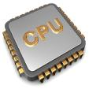



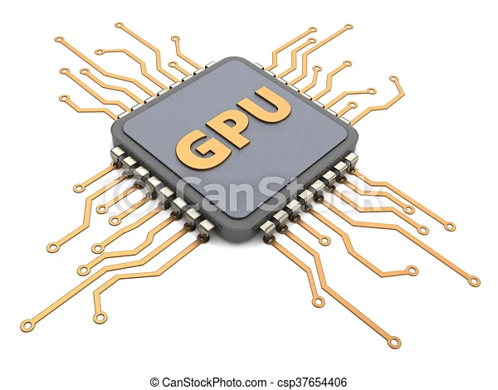


Workflow: Image classification using Classical Machine Learning
Dataset Library Processor Classification
Summer Internship Program QIntern2021

Slide 4


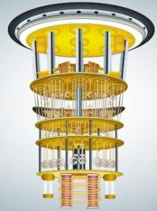

Workflow: Image classification using Quantum Machine Learning
Dataset Library Processor Classification
Summer Internship Program QIntern2021

Slide 5



Dataset, Approach and Team
We have digital images, which are part of the renowned digital archive. It is envisaged to classify these images using Machine Learning or Quantum Machine Learning. Unfortunately, the archival images may be subject to copyright, so we cannot directly use them in the public domain. But the project can begin using open data available image classification problems at Kaggle, e.g., CIFAR, MNIST, Animal images or Chest X-ray images etc. Then the model obtained using open data may be implemented for the digital archival images. Of course, this may reduce the accuracy, but the model can be once again tuned for the archival images to get better accuracy. The problem may be solved using various frameworks, including Qiskit, TensorFlow, and Pennylane etc.
Summer Internship Program QIntern2021

Slide 6
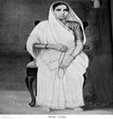
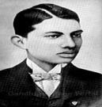
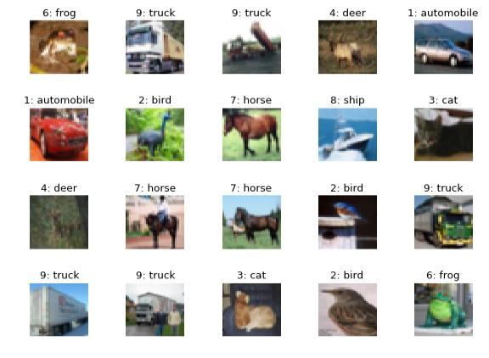
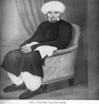
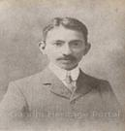
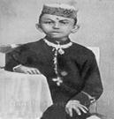
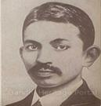
Dataset, Approach and Team
Sample images
Team 1: Qiskit
1) Pushkal Shukla
2) Rifatul Islam Himel
3) Vishal Kumar
Team 2: TensorFlow/Cirq
1) Anurag Kulkarni
2) Rajatav Dutta
Team 3: PennyLane
1) Azza Fadhel
2) Riya Malani
Actual Images CIFAR-10 images
Summer Internship Program QIntern2021

Slide 7
Qiskit
TensorFlow / Cirq
PennyLane
Transfer Learning

Slide 8
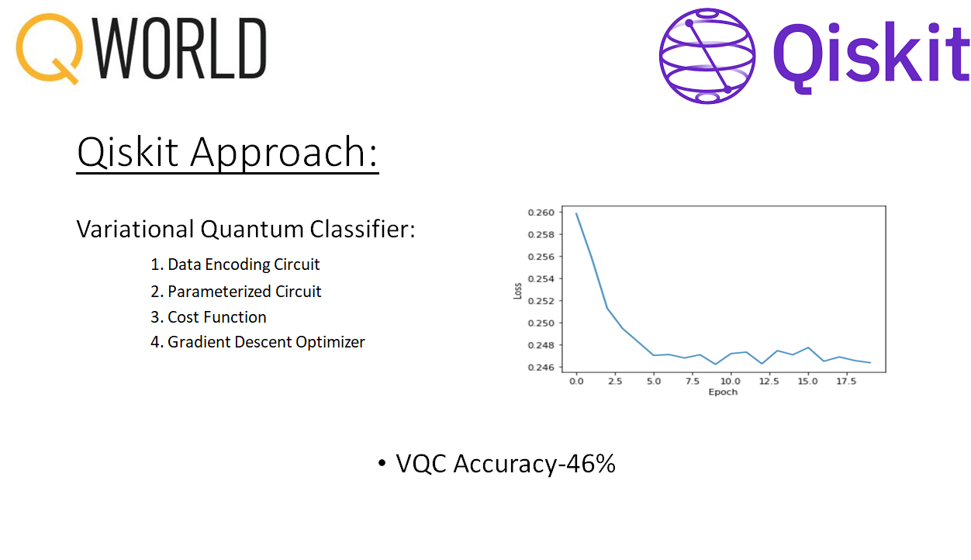
Approach 1 - Qiskit
Summer Internship Program QIntern2021

Slide 9
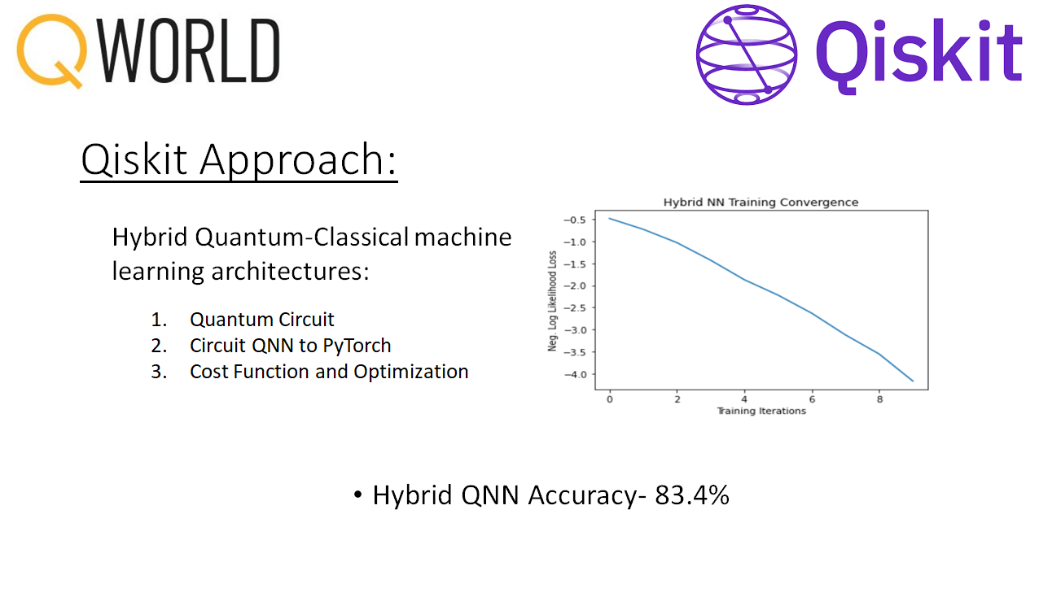
Approach 1 - Qiskit
Summer Internship Program QIntern2021

Slide 10
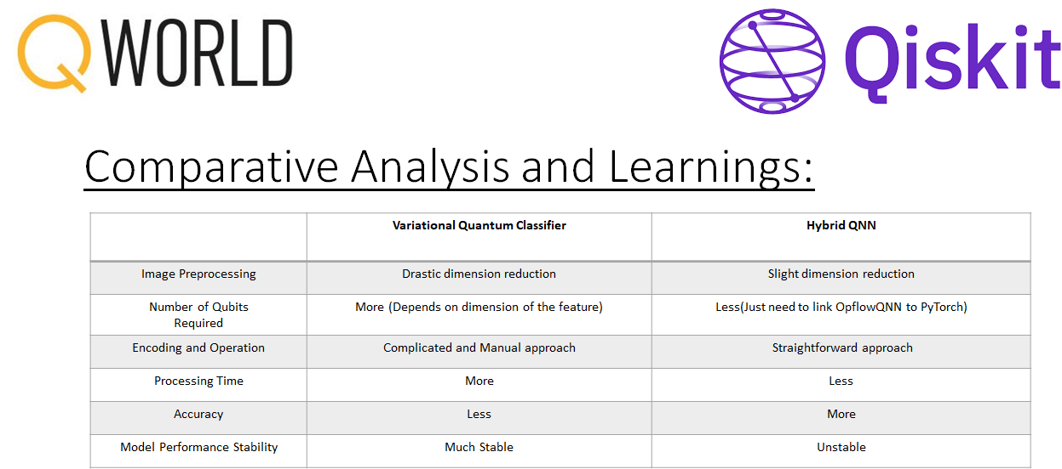
Approach 1 - Qiskit
Summer Internship Program QIntern2021

Slide 11
Qiskit
TensorFlow / Cirq
PennyLane
Transfer Learning

Slide 12
Approach 2 – TensorFlow/Cirq
TensorFlow Quantum is a quantum machine learning library for rapid prototyping of hybrid quantum-classical machine learning model It integrates quantum computing algorithms and logic designed in Cirq
Cirq is an open source Python Library framework for programming quantum computers
During pre processing stage 2 Classes of image (Dog and Aeroplane) were filtered from entire CIFAR10 data set
Then the features were converted into gray scale and downscaled to 4X4 grid
VQC algorithms was implemented
Summer Internship Program QIntern2021

Slide 13
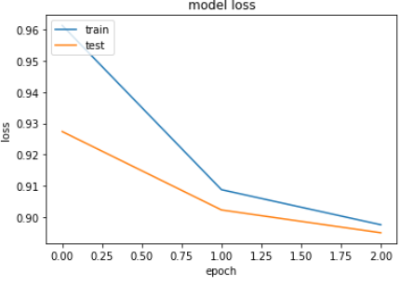
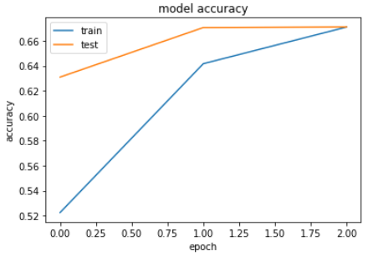

Approach 2 – TensorFlow/Cirq
Variational Quantum Classifier:
Data Encoding was done by 1 layer
Quantum model was created by 16 qubit and 1 layers
Result:
Summer Internship Program QIntern2021

Slide 14
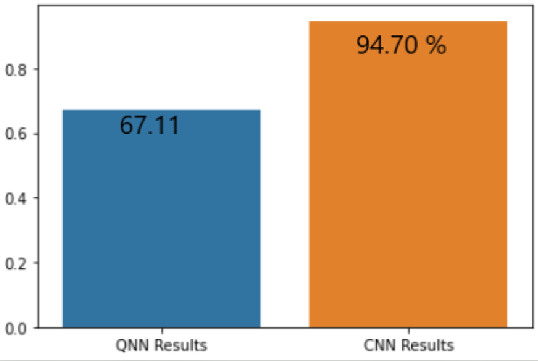
Approach 2 – TensorFlow/Cirq
Comparison of results: QNN Vs. CNN
Summer Internship Program QIntern2021

Slide 15
Qiskit
TensorFlow / Cirq
PennyLane
Transfer Learning

Slide 16
Approach 3 - PennyLane
It’s a cross-platform python library for differentiable programming of quantum computers.
It trains a quantum computer the same way as a neural network.
In comparison with Qiskit and TensorFlow approach, PennyLane can perform:
Multi-class classification (not only binary classification)
Better visualization of the images after encoding and processing.
Three algorithms are implemented :
Quanvolutional neural network algorithm
Ensemble classification algorithm
Transfer learning algorithm
Summer Internship Program QIntern2021

Slide 17
Approach 3 - PennyLane
Quanvolutional Neural Networks Approach
Reference notebook: https://pennylane.ai/qml/demos/tutorial_quanvolution.html
It’s the quantum equivalent of the CNN model in classical computer.
The model is based on the idea of a quanvolutional layer where, instead of processing the full input data with a global function, a local quanvolution is applied. What did we try to boost the result :
Changed the number of layers. Changed the size of train and test data
Changed the number of qubits used from 4 to 9 : It didn’t boost result but increased the run time.
Changed the device: use of default device, Cirq, Forest and Qiskit device.
Tried a lot of Optimizers. The best one was the “adagrad” optimizer
Tried a lot of Loss Function. The best one was ”sparse_categorical_crossentropy”.
Summer Internship Program QIntern2021

Slide 18
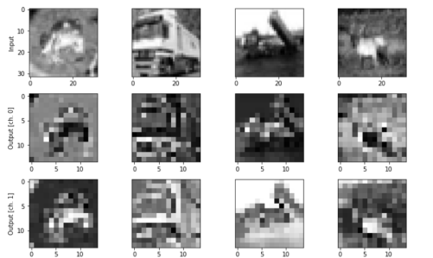
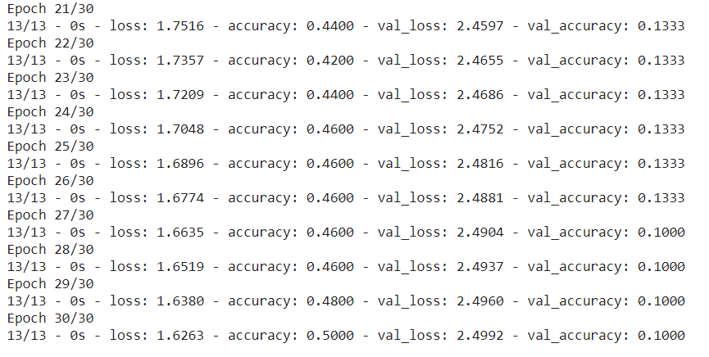
Approach 3 - PennyLane
Results: Overfitting
Summer Internship Program QIntern2021

Slide 19
Approach 3 - PennyLane
Ensemble classification approach
Reference notebook: https://pennylane.ai/qml/demos/tutorial_ensemble_multi_qpu.html
This method combines two QPU in parallel to help solve ML classification problem.
What did we try to boost the result :
Run the algorithm with only two classes.
Changed the size of train and test data
Run the algorithm with different devices: Build in device, Qiskit devices, Cirq devices and Forest devices.
Changed the number of layers.
Result: accuracy is always <0.2.
Summer Internship Program QIntern2021

Slide 20
Approach 3 - PennyLane
Device 0 : forest.numpy_wavefunction
Device 1 : qiskit.basicaer
Train result :
Test result:
Summer Internship Program QIntern2021

Slide 21
Qiskit
TensorFlow / Cirq
PennyLane
Transfer Learning

Slide 22
Approach 4 Additional: Quantum Transfer Learning
Reference notebook : https://pennylane.ai/qml/demos/tutorial_quantum_transfer_learning.html
It’s the quantum equivalent of the transfer learning model in classical computer.
It’s a hybrid quantum-classical machine learning model.
It’s a binary classification model based on Transfer learning.
Number of qubits = 4 qubits.
Device used : default.qubit device.
Train data size : 150 for each class
Test data size : 100 for each class
Summer Internship Program QIntern2021

Slide 23
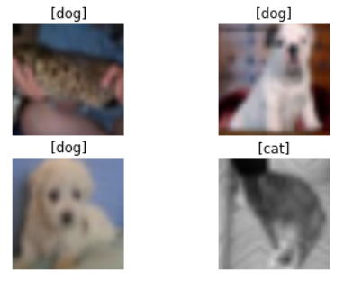

Approach 4 Additional: Quantum Transfer Learning
Results: Overfitting
Summer Internship Program QIntern2021

Slide 24
Conclusion
Summer Internship Program QIntern2021

Slide 25
Way Forward
Applying transfer learning for 10 class classification using PennyLane approach
Redesigning the QNNs (Qiskit+PyTorch) approach
Implementation of Higher Order Embedding encoding technique using Qiskit
Better Data Pre-processing before classification
Try with other complex image dataset like the Chest X-Ray images etc.
Finally using the best model with actual archival images
Summer Internship Program QIntern2021

Slide 26
Thank you!

