Slide 1
EMAIL SPAM DETECTION USING NLP
Team Members
Ch. PRIYANKA 16VV1A0510
K. VAMSI PRASAD 16VV1A0529
M. YOGALEENA 16VV1A0534
T. HARSHA VARDHAN 16VV1A0554
SUPERVISED BY
MR. T. SIVA RAMA KRISHNA

Slide 2
ABSTRACT
With the digital age where we are always connected and constantly generating and consuming multitude of digital content. Email has become the most widely used and economic form of communication in this digital era.
Email users generally get bombarded with unsolicited messages regarding direct marketing often sent to multiple users using bots. Users have to spend a considerable amount of time on clearing such messages.
A study shows that there is sharp increase in spam emails , it is estimated that they are almost 89% of the total email traffic. Spam emails can create a havoc by causing financial loss or identity theft of users.

Slide 3
PROPOSED SYSTEM:
This System classifies mails as spam or ham using Machine Learning Classifiers KNN & NAÏVE BAYES.
Two types of datasets are considered for this project:
Numerical Dataset : This data set is collection of 4601 mails. Each mail consists of 57 word probabilities in numeric format collectively corresponding to mail being spam or ham.
Textual Dataset : This data set is collection of 5739 mails. Each mail has different number of words unlike the above dataset. Used NLP methods to classify this dataset which resulted in better accuracy even though handling huge dimensionality.
Tested on Integrating with Gmail by classifying mail from a gmail user.

Slide 4
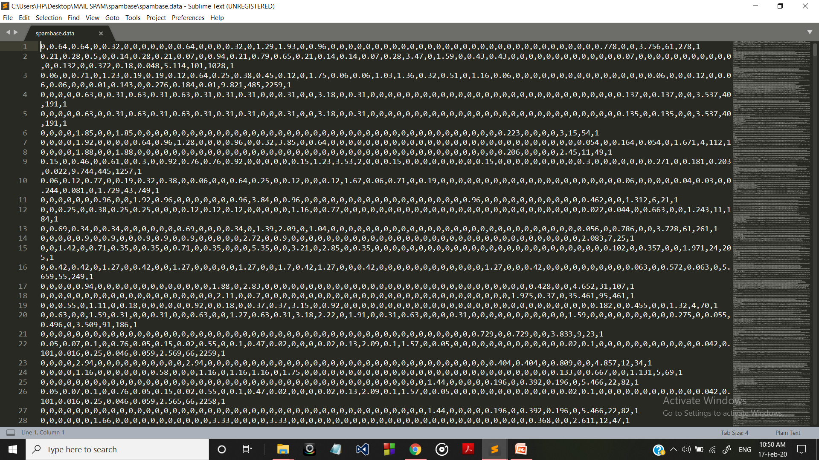

Slide 5
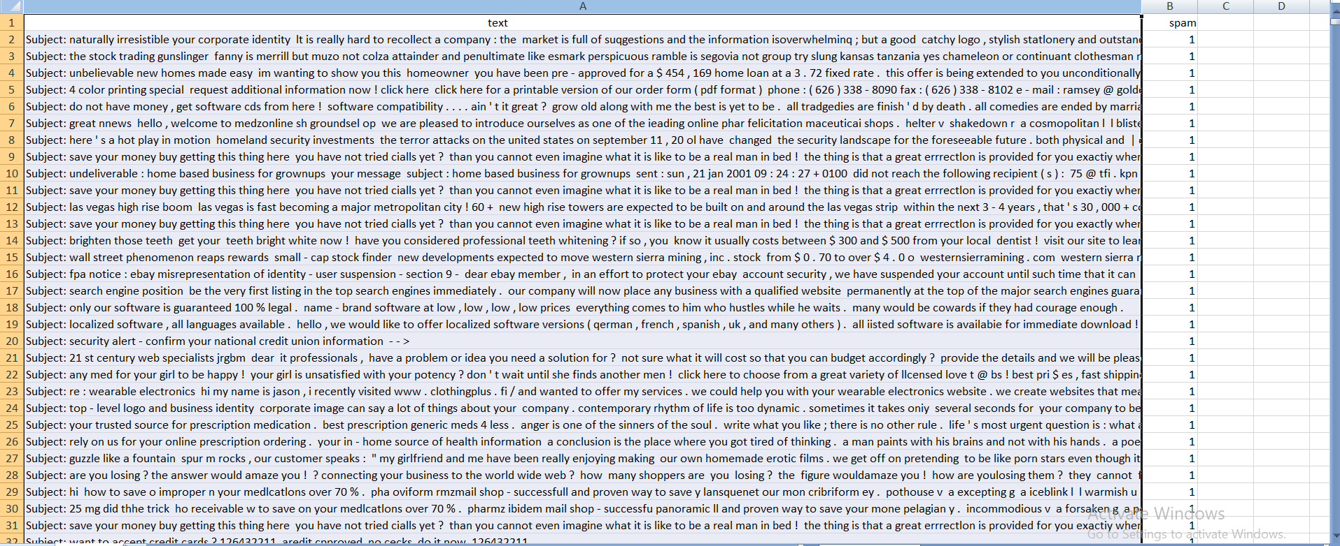

Slide 6
Description of Classifiers :
The project is implemented using two classifiers:
1)KNN
2)Naïve Bayes

Slide 7

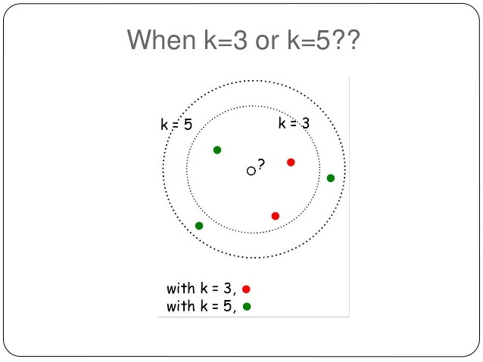
K-NEAREST NEIGHBORS CLASSIFIER
KNN is a machine learning algorithm used in classification
KNN is Easy To Implement
Its accuracy is 78-80%
It takes more time(100-120 seconds approx) when compared to other classifieres

Slide 8

Methodology of KNN classifier
Reading the Dataset and casting its data to numerical format
Splitting the dataset as Trainset and Testset
Training the model
Choosing K value
Calculating Euclidean distance for each mail in testset.
Selecting K nearest neighbours for each mail and classifying that mail in test set as spam or ham

Slide 9
1) Reading the Dataset
with open('spambase.data','r') as spamfile:
lines=list(csv.reader(spamfile))
Casting string format to numerical format
lines[i][j]=float(lines[i][j])
2) Splitting as Trainset and Testset
Each mail in dataset is randomly assigned to Trainset and testset using
Random.random()<split_ratio condition
After that this data is shuffled within Testset and Trainset

Slide 10

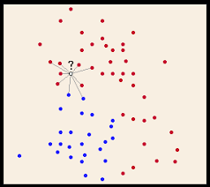
Calculating Euclidean distance for TestSet mails
For each mail in test set we calculate euclidean distance for all mails in trainset.
Based on K value,we select K Nearest Neighbours
We assign the label to test mail based on whose frequency is greater

Slide 11
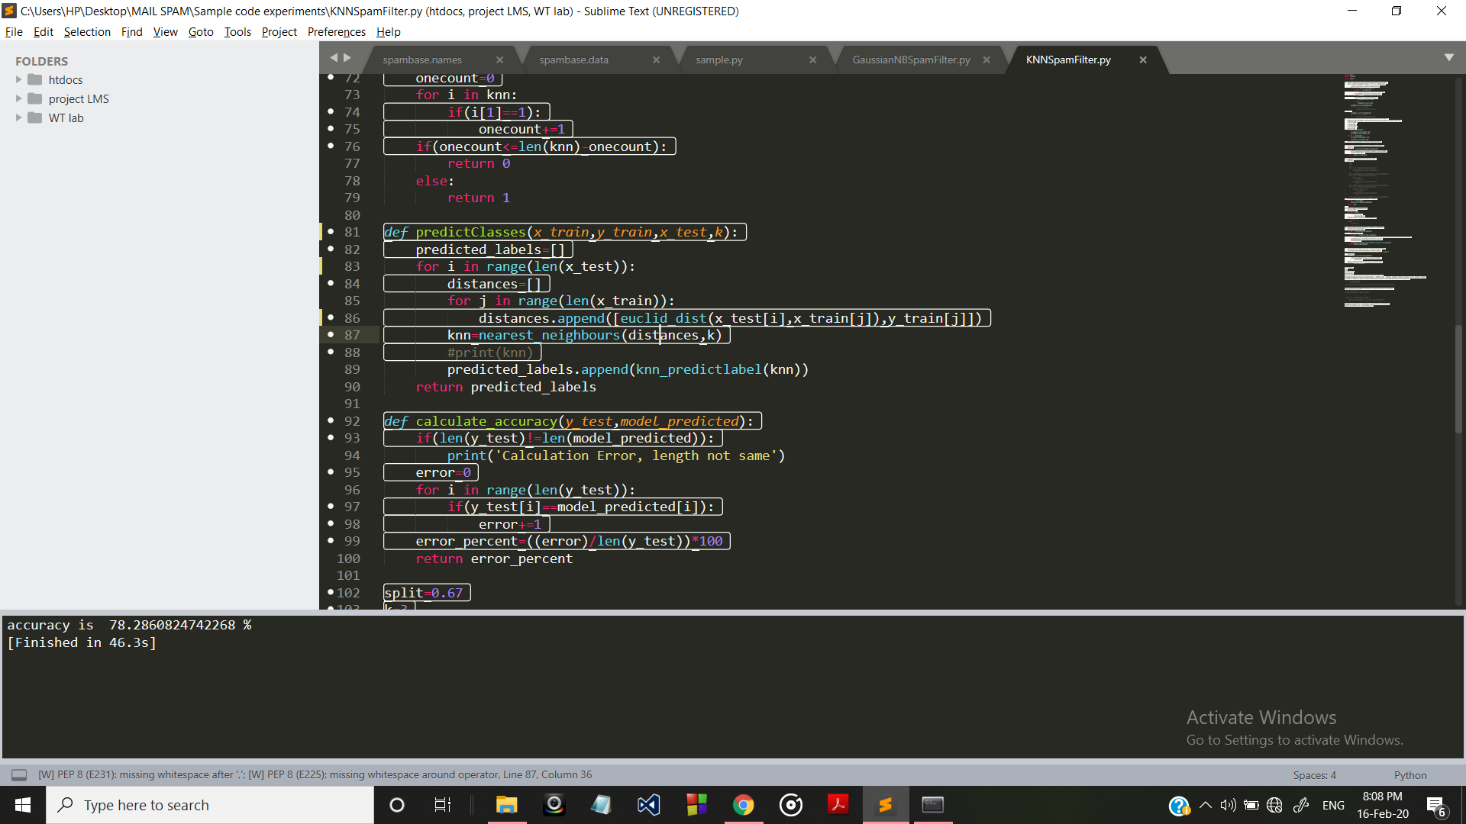
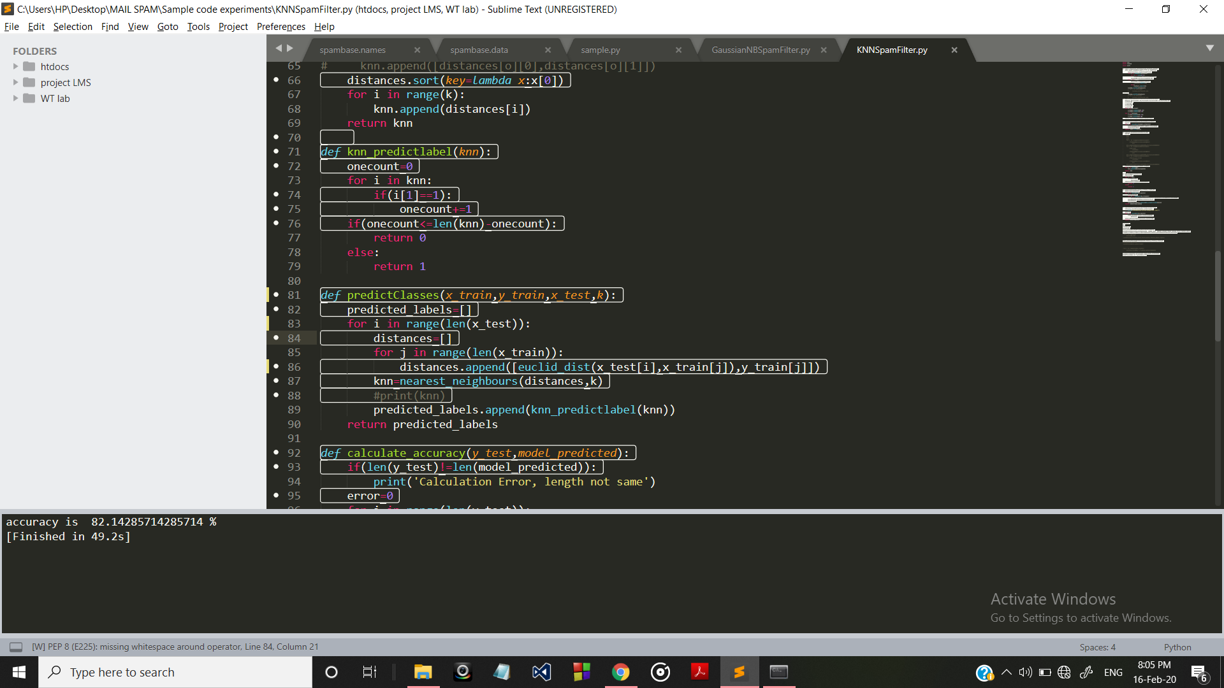
OUTPUTS

Slide 12
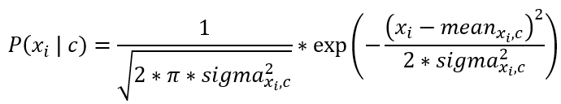
NAÏVE BAYESIAN Classifier
We can use the Bayes theorem to model our problem statement and can be defined as:
P(Spam|Text) = P(Text|Spam).P(Spam)
(P (Text|Spam).P(Spam)+P(Text|Ham).P(Ham))
Since it is Numerical Data, we use Gaussian Naïve Bayes.
Gaussain Naïve Bayes assume that the Data Follow Normal Distribution
Formula to calculate probability is:

Slide 13
Methodology of Naïve Bayes classifier
Reading the Dataset and casting its data to numerical format
Splitting the dataset as Trainset and Testset
Training the model
Calculating Probabilities for each mail in testset.
Predicting Its Label

Slide 14
TRAINING THE MODEL
In Training phase we summarize the training dataset.
The Summarizing is as (Mean,Stand_Deviation) for 57 attributes present in the dataset.
Also the above Summary is categorized as Spam_summary and Ham_summary in summary dictionary variable.

Slide 15
Calculating Probabilities for each mail in TestSet
We calculate MEAN and STANDARD DEVIATION for all 57 attributes in the dataset.
Using the probability formula we calculate probabilty of each mail using formula
P(yi | x1, x2, …, xn) = P(x1|yi) * P(x2|yi) * …...... P(xn|yi) * P(yi)

Slide 16
Predicting Labels
For every mail in Testset,we calculate Its probabilty related to Spam and Ham.
Now we classify that mail as Spam or Ham based on which probability is more(either Spam or Ham).

Slide 17
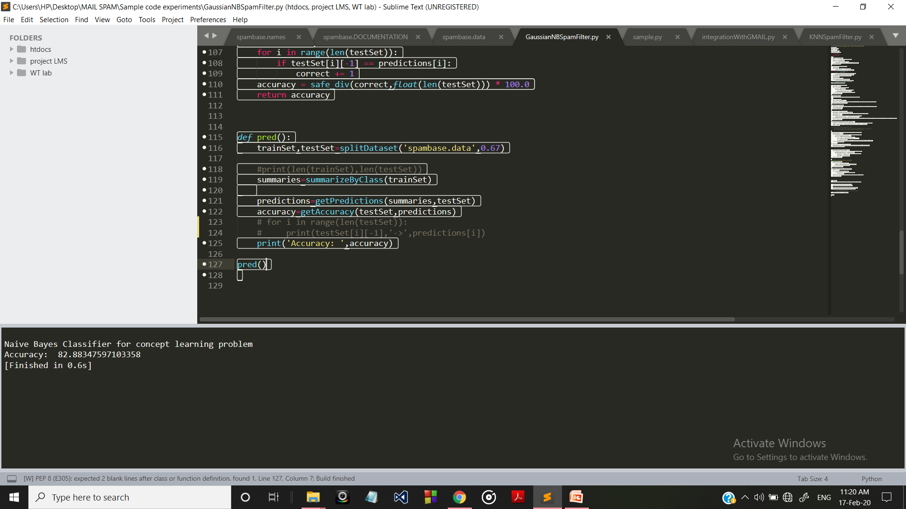
OUTPUT

Slide 18

Natural language processing (NLP)
NLP is a subfield of linguistics, computer science, information engineering, and artificial intelligence concerned with the interactions between computers and human (natural) languages.
NLP is useful in eliminating useless words for text analysis and thus reducing time and increasing performance.

Slide 19
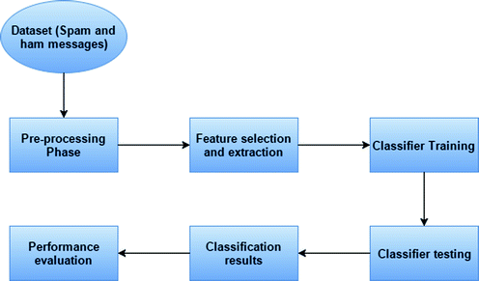
METHODOLOGY

Slide 20
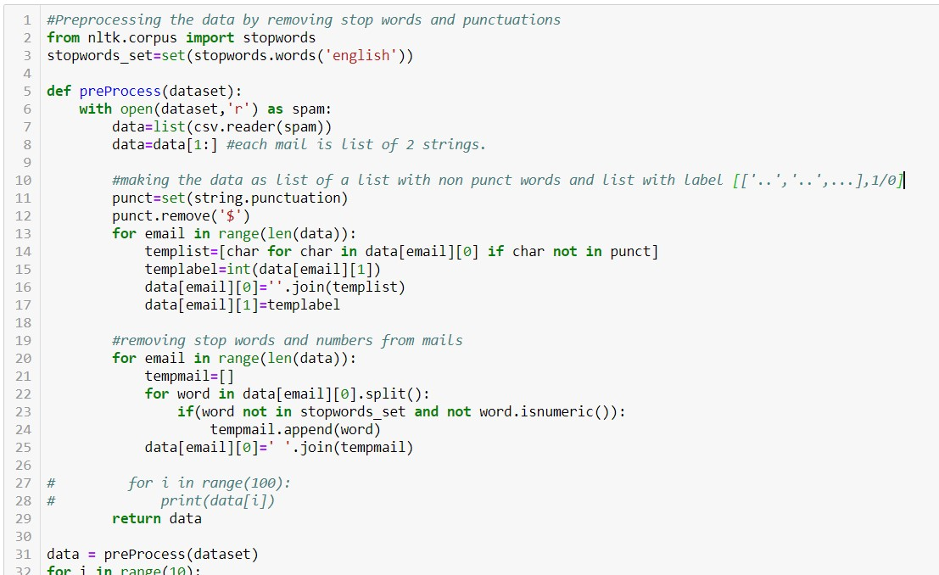
Pre-processing
Removing Stop words
And punctuations

Slide 21
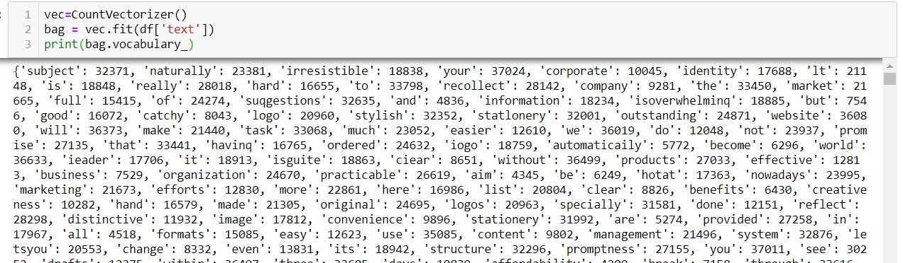
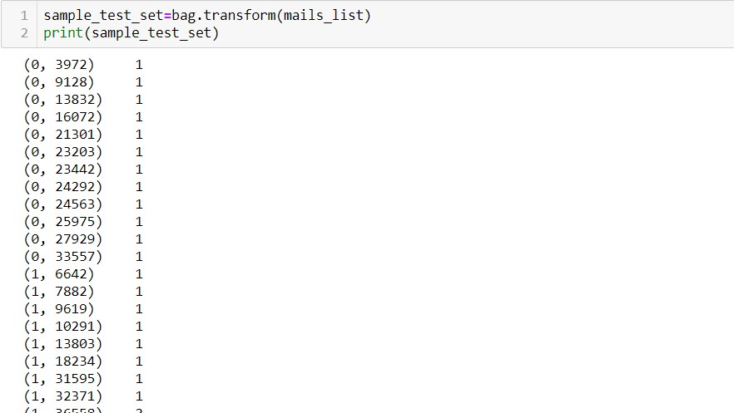
Feature Extraction

Slide 22
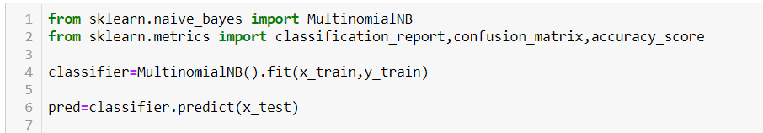
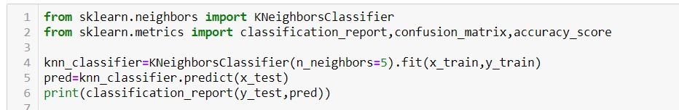
Building Model

Slide 23
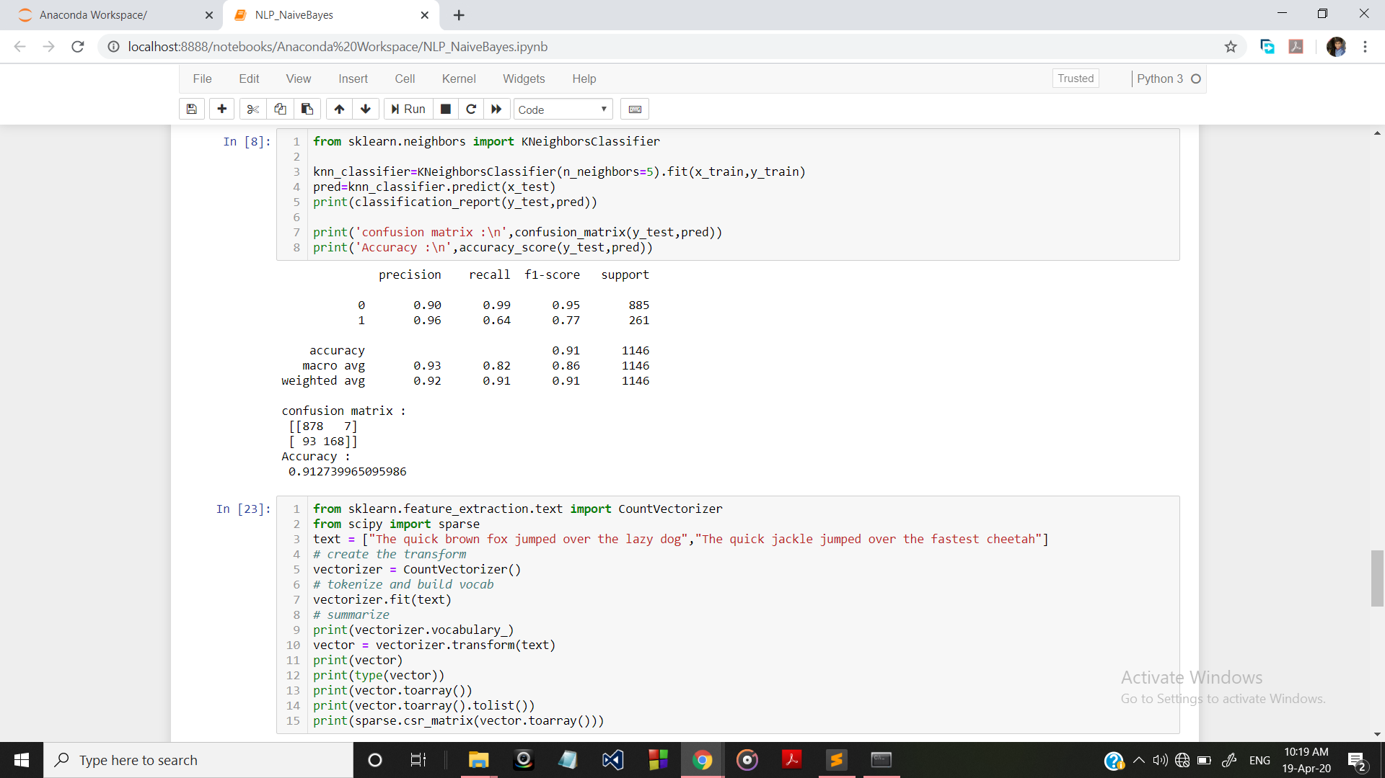
Output of KNN :
91% accuracy

Slide 24
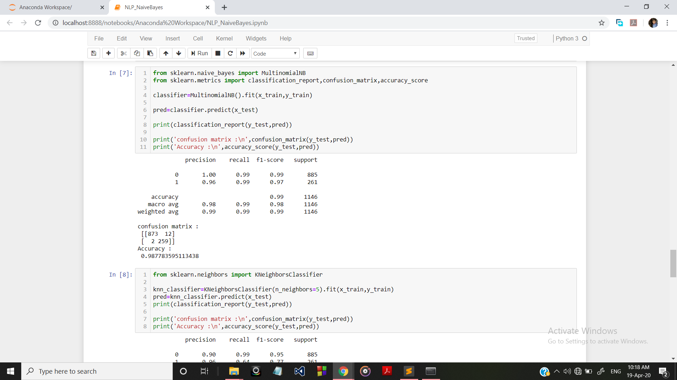
NAIVE bAYES
Output of Naïve Bayes:
98% Accuracy

Slide 25
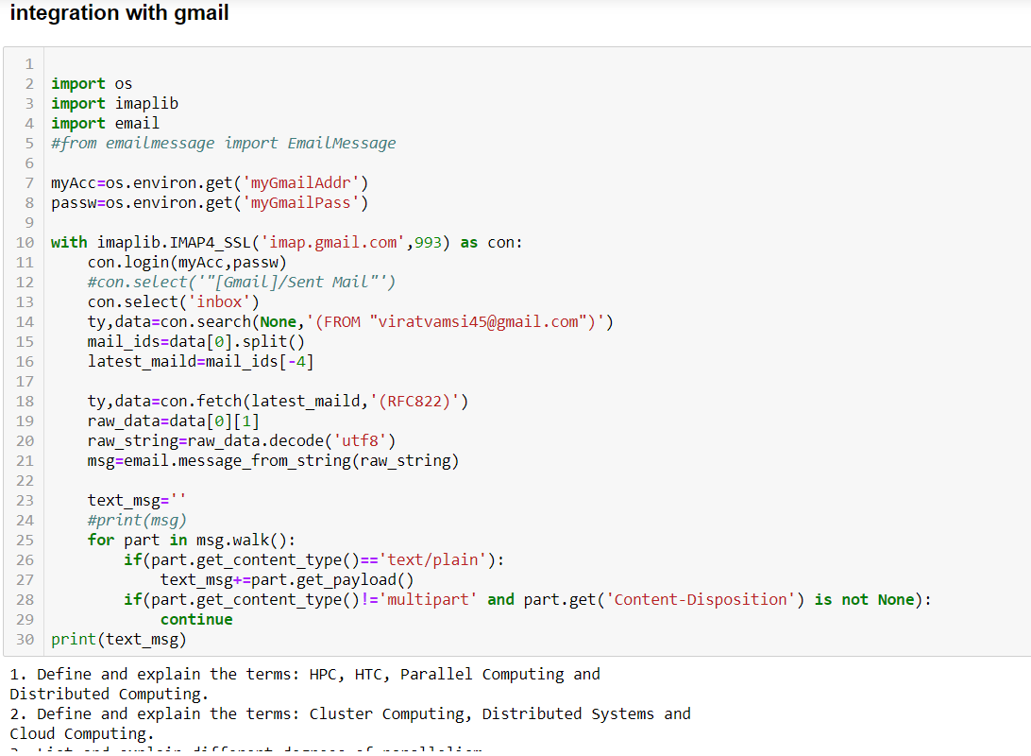

Slide 26
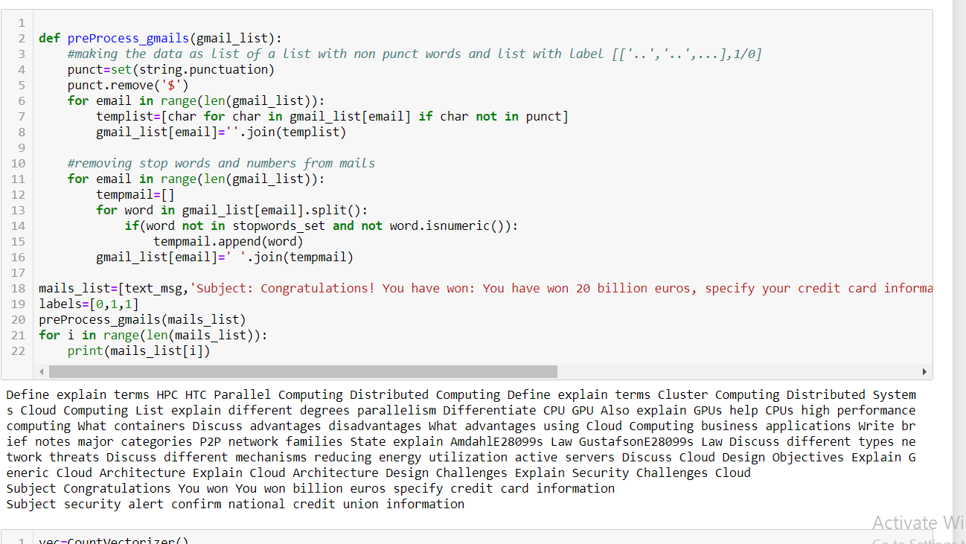

Slide 27
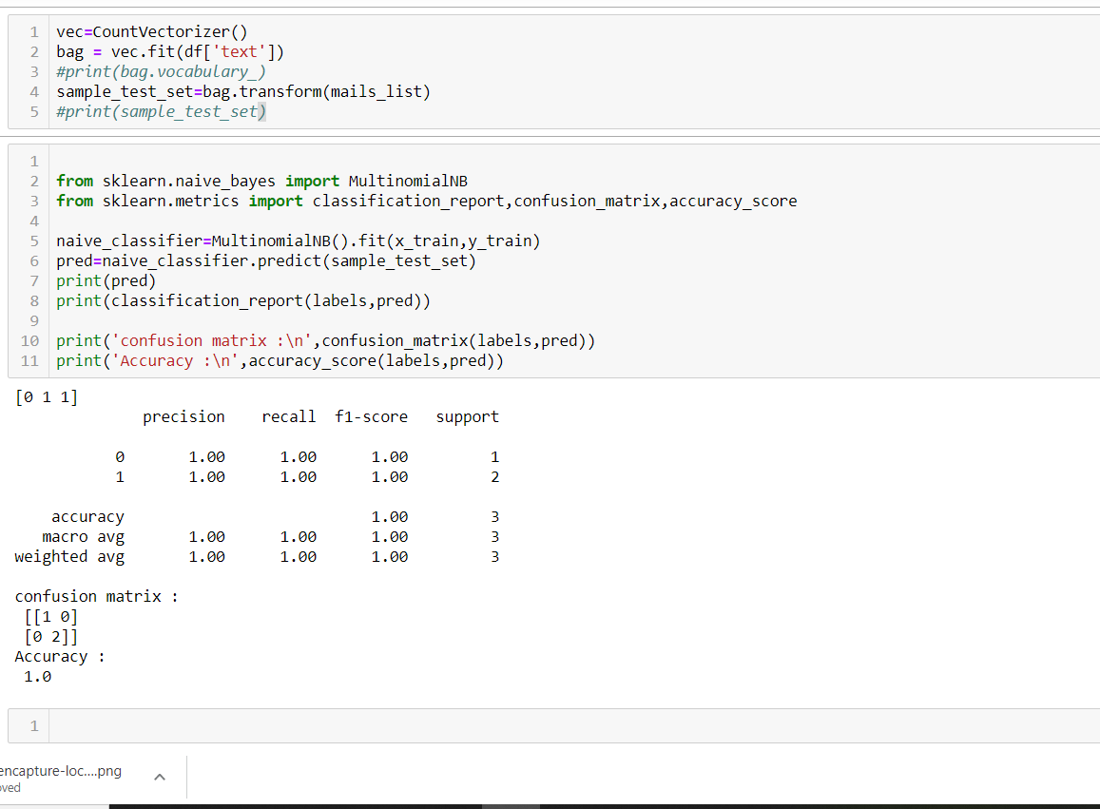
Output:
Correctly classified the retrieved mail

Slide 28
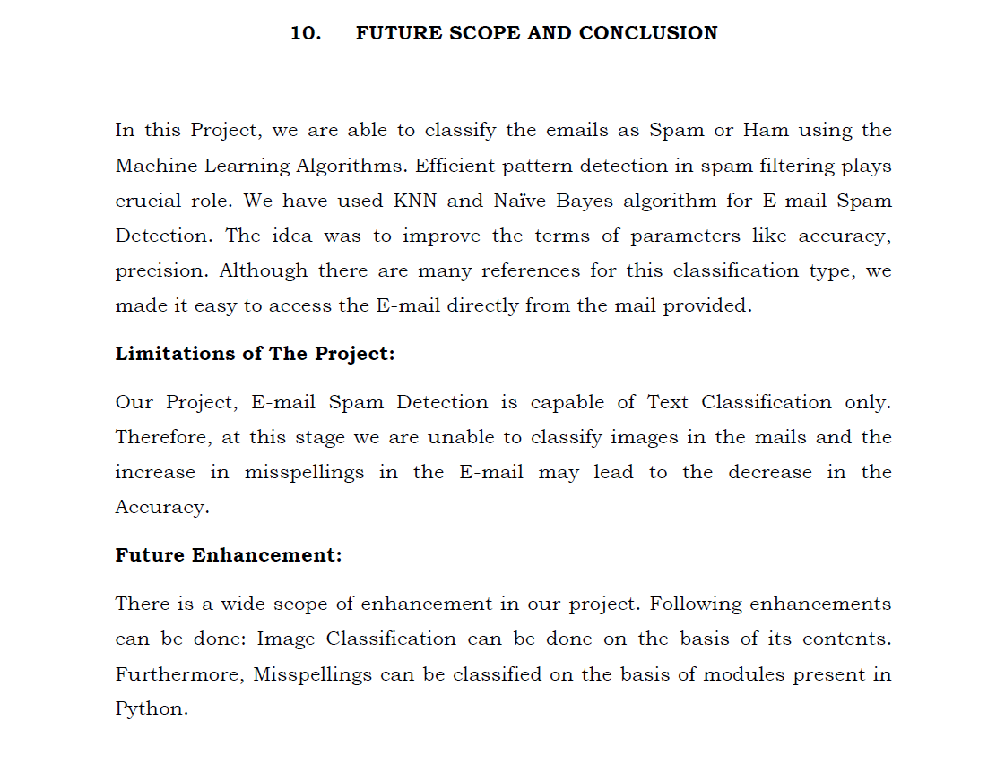

Slide 29


