Slide 1

សាកលវិទ្យាល័យភូមិន្ទភ្នំពេញ
Hotel Management System
បង្រៀនដោយសាស្ត្រាចារ្យ​៖ Dan Vournpheng ​​​
ថ្នាក់​ A4
សមាជិក
១. រុំ​ វីរះ ២. ប៉ាត​ មូលសក្តា​ ៣​. នឹម​ រត្តនៈ ៤. នូ និចាន់ ​​ ៥. នឿន តុណា ​​​​​​​​​​​​​​

Slide 2
Hotel Management System
Desktop Application | C# Windows Forms
Layered Architecture · 5 Design Patterns · 12 Operational Forms
Objective
Functionalities
Design Patterns
Conclusion
Demo
Forms 1–12
5 Patterns

Slide 3
OBJECTIVE
Objective
What the Hotel Management System is capable of doing
System Purpose
Core Capabilities
The Hotel Management System is a comprehensive
C# Windows Forms desktop application designed to
digitize and streamline all daily hotel operations
from a single, unified interface.
▸ Replaces manual paper-based hotel operations
▸ Reduces human error in booking & billing
▸ Real-time visibility into hotel room status
▸ Automates housekeeping task assignment
▸ Role-based access: Admin · Receptionist · Housekeeping
🔒 Authentication
Secure login, SHA-256 hashing, role-based access
👤 Guest Management
Register, search, edit guests & view booking history
🛏 Room Management
4 room types, status tracking, visual dashboard
📅 Booking
Create, confirm, check-in / check-out, cancel
🧾 Invoicing
Auto-generate invoice, 10% tax, discount support
💳 Payment
Cash & Credit Card, styled receipt & print
🧹 Housekeeping
Auto-create tasks on checkout, smart staff assignment
👥 Staff Management
CRUD accounts, role & password management
📊 Reports
Daily operations dashboard & key metrics
Hotel Management System · C# Windows Forms · Layered Architecture · 5 Design Patterns

Slide 4
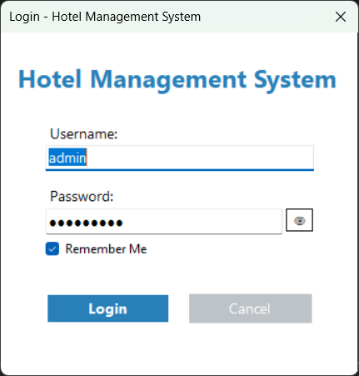
FORM 1
Form 1 — Login Form
LoginForm.cs
Form Description
📌 Purpose
Entry point — authenticates users before granting access
Key Features & Functions
• Username & password fields with visibility toggle (🔒/👁)
• SHA-256 + salt password hash verification
• 'Remember Me' stores credentials in app settings
• On success → stores user in SessionManager & opens MainForm
• On failure → shows error, clears password field
• Role-based access control: Admin / Receptionist / Housekeeping
📷 [ Login Form — Form Screenshot ]
💡 Uses Singleton: SessionManager.CurrentUser
Hotel Management System · C# Windows Forms · Layered Architecture · 5 Design Patterns

Slide 5
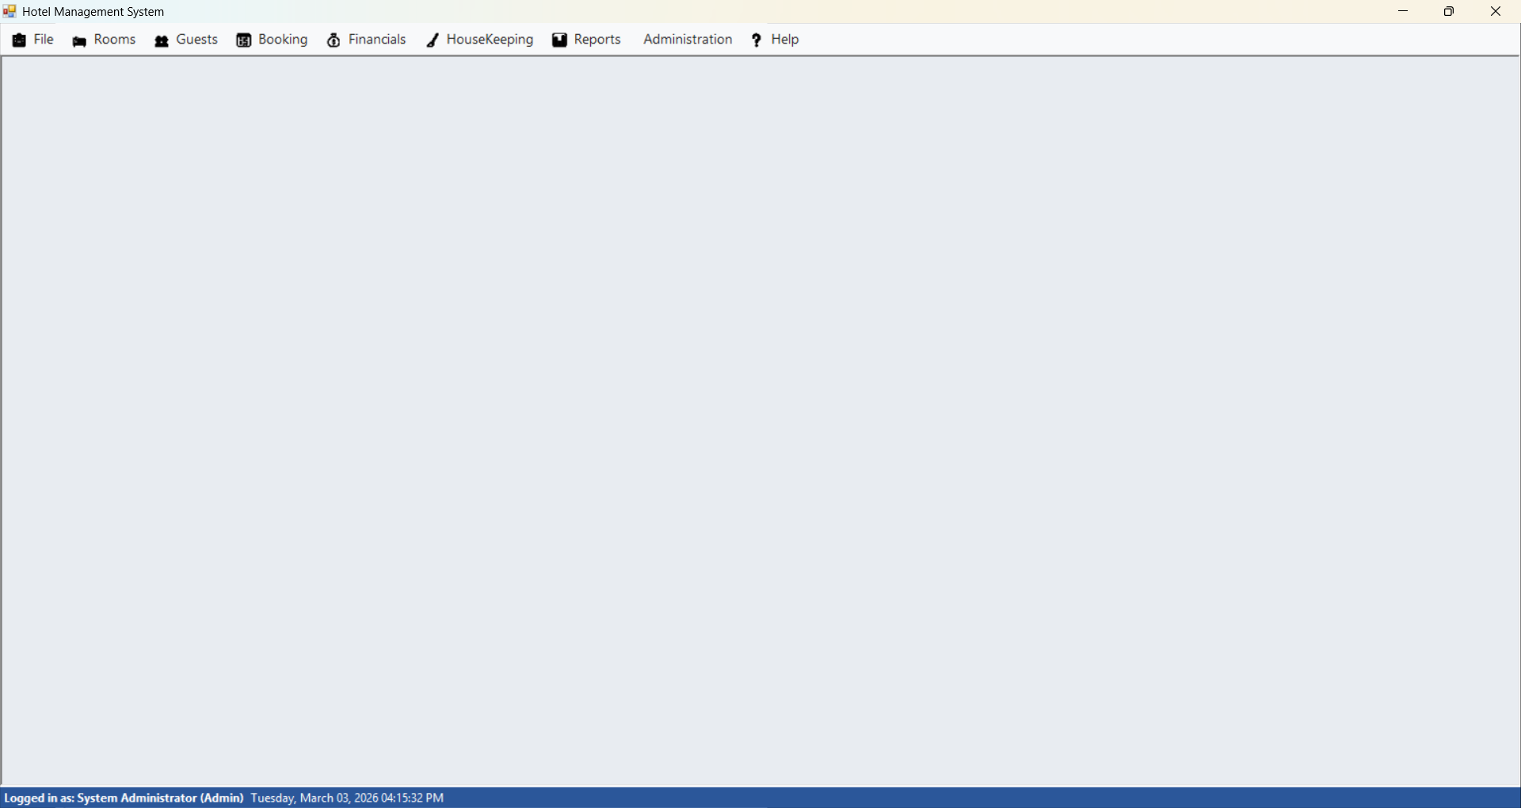
FORM 2
Form 2 — Main Form (MDI Hub)
MainForm.cs
Form Description
📌 Purpose
Central navigation container for all system modules
Key Features & Functions
• MDI (Multiple Document Interface) parent window
• Menu bar: Booking, Guest, Room, Housekeeping, Invoices, Payments, Reports, Settings, Admin
• Status bar: current user, role, live clock (updates every second)
• Initializes Observer pattern on startup:
• RoomSubject.Instance.Attach(new HousekeepingObserver())
• Midnight-blue theme with Segoe UI typography
📷 [ Main Form (MDI Hub) — Form Screenshot ]
💡 Observer pattern initialized here — central event hub
Hotel Management System · C# Windows Forms · Layered Architecture · 5 Design Patterns

Slide 6
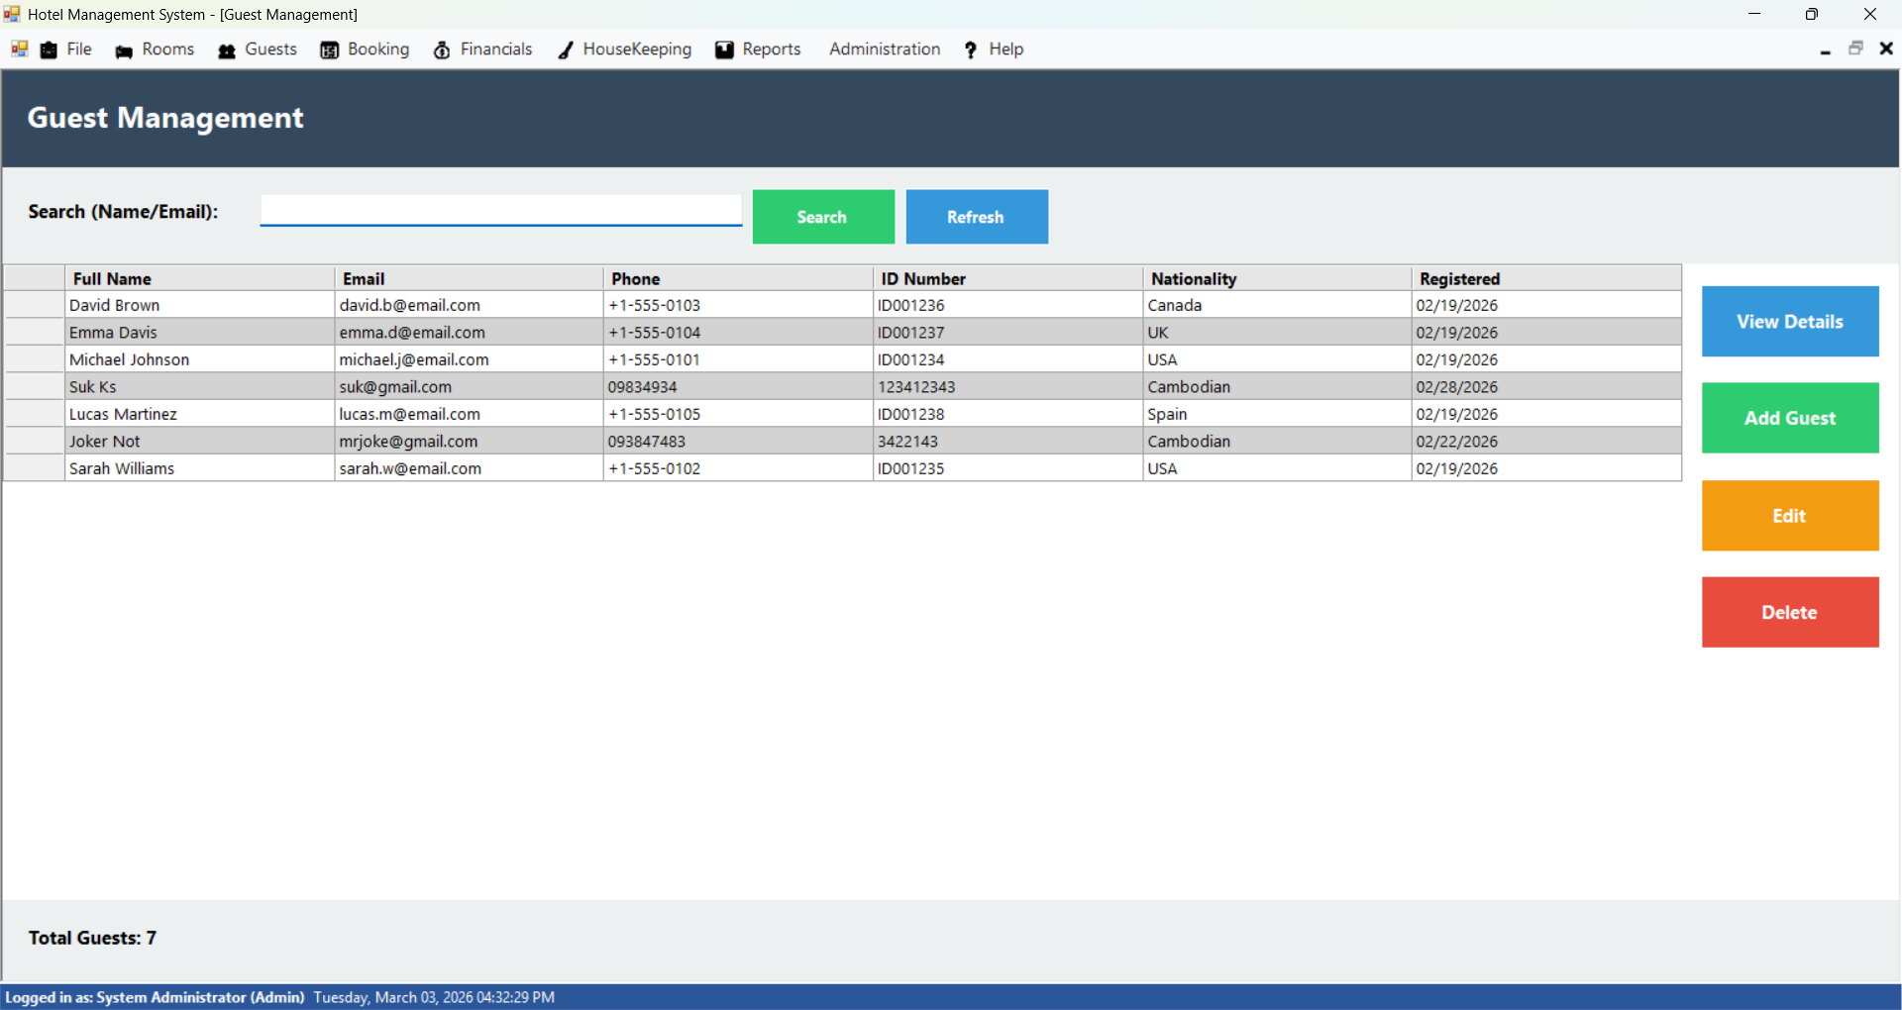
FORM 3
Form 3 — Guest Management
GuestManagementForm.cs
Form Description
📌 Purpose
Full CRUD interface for managing all hotel guests
Key Features & Functions
• DataGridView listing all active guests
• Columns: Name, Email, Phone, ID Number, Nationality
• Search by name, email, or phone number
• Add Guest → opens AddEditGuestDialog (insert new record)
• Edit Guest → opens dialog pre-populated with data
• Delete Guest → soft delete (sets IsActive = 0)
• View Details → opens GuestDetailsDialog (full profile)
📷 [ Guest Management — Form Screenshot ]
💡 Soft delete preserves history — data is never hard-deleted
Hotel Management System · C# Windows Forms · Layered Architecture · 5 Design Patterns

Slide 7
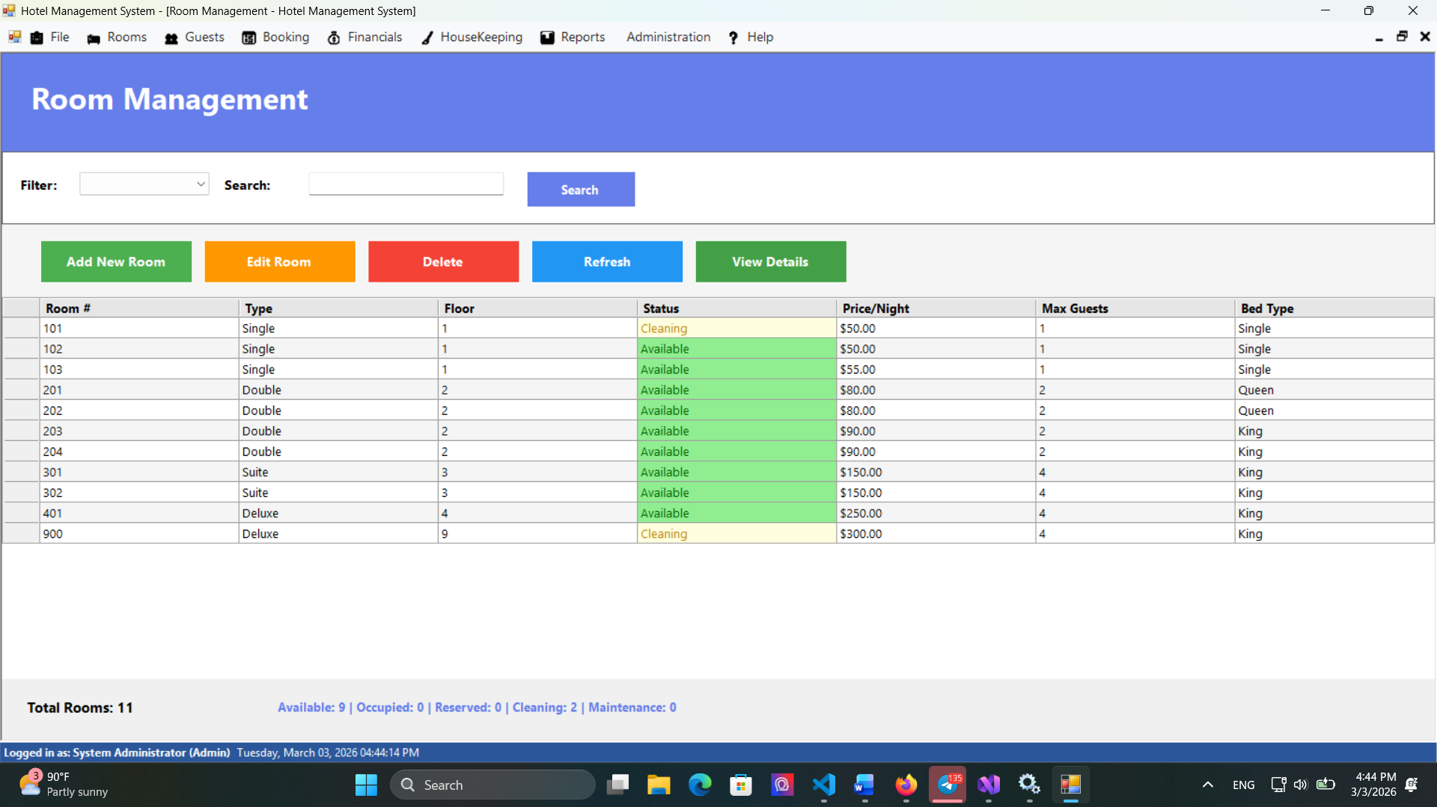
FORM 4
Form 4 — Room Management
RoomManagementForm.cs
Form Description
📌 Purpose
Manage hotel rooms with a visual status dashboard
Key Features & Functions
• Room list filterable by type and status
• Add Room → RoomFactory.CreateRoom() (Factory Pattern)
• 4 types: Single · Double · Suite · Deluxe
• Edit Room / Delete Room (soft delete → Maintenance)
• Room Status Dashboard — color-coded card overview
• Statuses: Available · Occupied · Reserved · Maintenance · Cleaning
📷 [ Room Management — Form Screenshot ]
💡 Factory Pattern: room creation logic centralized in RoomFactory
Hotel Management System · C# Windows Forms · Layered Architecture · 5 Design Patterns

Slide 8
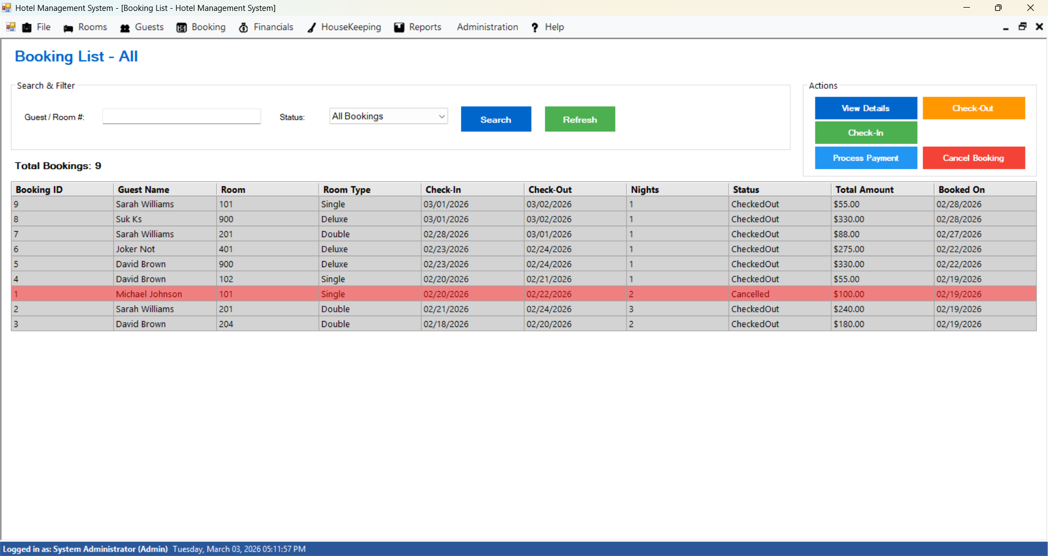
FORM 5
Form 5 — Booking List
BookingListForm.cs
Form Description
📌 Purpose
Central hub for all booking operations and status management
Key Features & Functions
• DataGridView with color-coded booking status rows
• 🟡 Pending 🟢 Confirmed 🔵 CheckedIn ⚪ CheckedOut �� Cancelled
• Search & filter by guest name, room number, or status
• Check-In → validates status, sets room to Occupied
• Check-Out → sets room to Cleaning, auto-generates invoice, triggers Observer (auto-creates housekeeping task)
• Process Payment → opens PaymentForm
• Cancel Booking → prompts reason, frees the room
📷 [ Booking List — Form Screenshot ]
💡 Checkout triggers Observer → auto housekeeping task created
Hotel Management System · C# Windows Forms · Layered Architecture · 5 Design Patterns

Slide 9
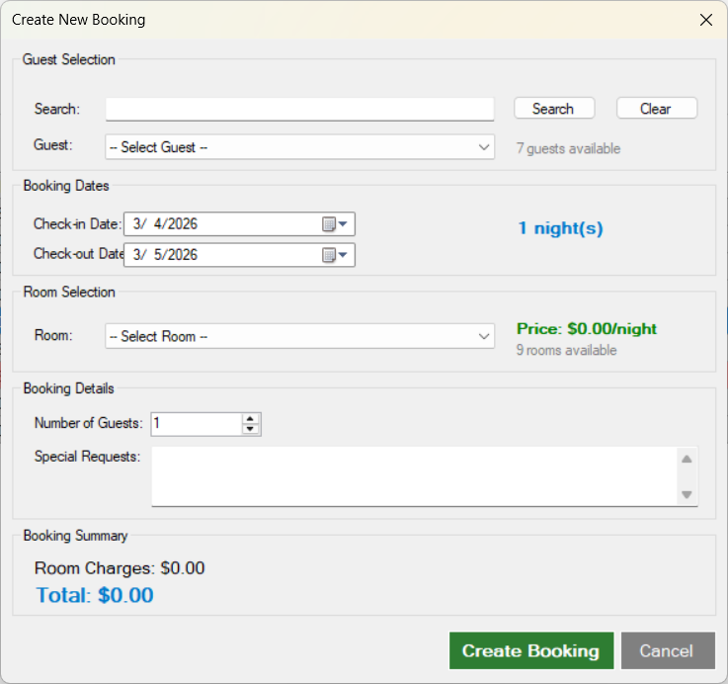
FORM 6
Form 6 — New Booking
NewBookingForm.cs
Form Description
📌 Purpose
Wizard-style form for creating new reservations
Key Features & Functions
• Guest selection from registered guest list
• Room selection filtered by availability and date range
• Check-in / Check-out date pickers with conflict detection
• Auto charge calculation: BasePrice × Number of Nights
• Total with 10% tax via BookingFacade.CalculateTotalAmount()
• Facade Pattern orchestrates the full 8-step booking workflow
• Booking created with Status = Pending
📷 [ New Booking — Form Screenshot ]
💡 Facade Pattern: CreateBooking() hides 8 internal steps
Hotel Management System · C# Windows Forms · Layered Architecture · 5 Design Patterns

Slide 10
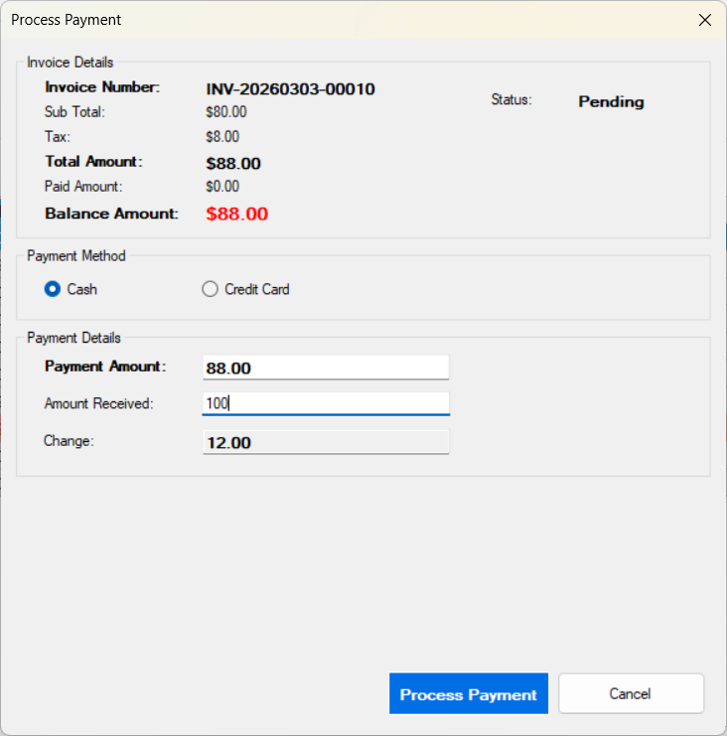
FORM 7
Form 7 — Payment Form
PaymentForm.cs
Form Description
📌 Purpose
Processes guest payments using the Strategy design pattern
Key Features & Functions
• Displays invoice: subtotal, tax, total, paid, balance due
• Cash mode: enter amount received → auto change calculation
• → Uses CashPaymentStrategy
• Credit Card mode: card number (Luhn validation), holder, expiry, CVV → simulated gateway (95% success rate)
• → Uses CreditCardPaymentStrategy
• Card number masked — only last 4 digits stored in DB
• On success → automatically opens Receipt Form
📷 [ Payment Form — Form Screenshot ]
💡 Strategy Pattern: payment algorithm selected at runtime
Hotel Management System · C# Windows Forms · Layered Architecture · 5 Design Patterns

Slide 11
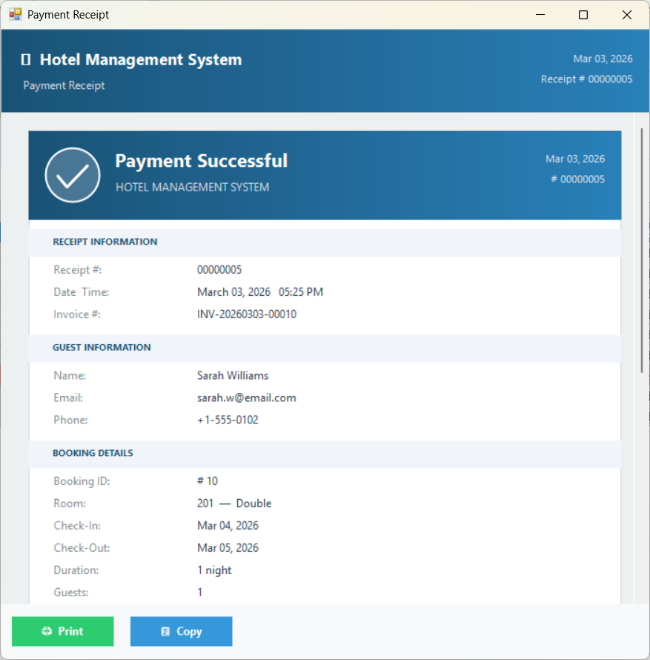
FORM 8
Form 8 — Receipt Form
ReceiptForm.cs
Form Description
📌 Purpose
Styled visual receipt displayed after successful payment
Key Features & Functions
• Gradient blue header with checkmark + 'Payment Successful'
• Section cards: Receipt Info · Guest Info · Booking Details · Financial Breakdown · Payment Info
• Status badge: ✓ PAID IN FULL (green) · ◑ PARTIALLY PAID (orange) · ○ PENDING (red)
• Action buttons: Print · Export PDF · Copy to Clipboard · Close
• Custom GDI+ drawing with LinearGradientBrush for header
📷 [ Receipt Form — Form Screenshot ]
💡 Professional receipt — supports print & PDF export
Hotel Management System · C# Windows Forms · Layered Architecture · 5 Design Patterns

Slide 12
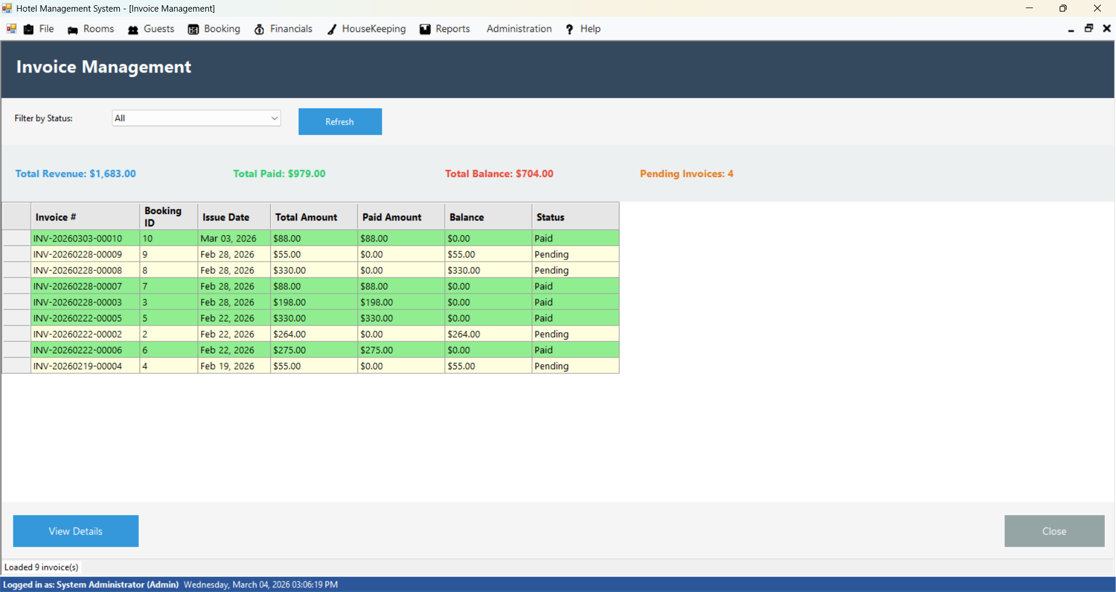
FORM 9
Form 9 — Invoice Management
InvoiceListForm.cs / InvoiceForm.cs
Form Description
📌 Purpose
View and manage all invoices generated from bookings
Key Features & Functions
• List all invoices with status filtering
• Statuses: Pending · Paid · Partially Paid · Cancelled
• Invoice details: subtotal, 10% tax, discounts, total
• View full details via InvoiceDetailsDialog
• Track complete payment history per invoice
• Auto-generated at guest checkout — no manual entry needed
📷 [ Invoice Management — Form Screenshot ]
💡 Invoices are auto-generated on checkout — zero manual work
Hotel Management System · C# Windows Forms · Layered Architecture · 5 Design Patterns

Slide 13
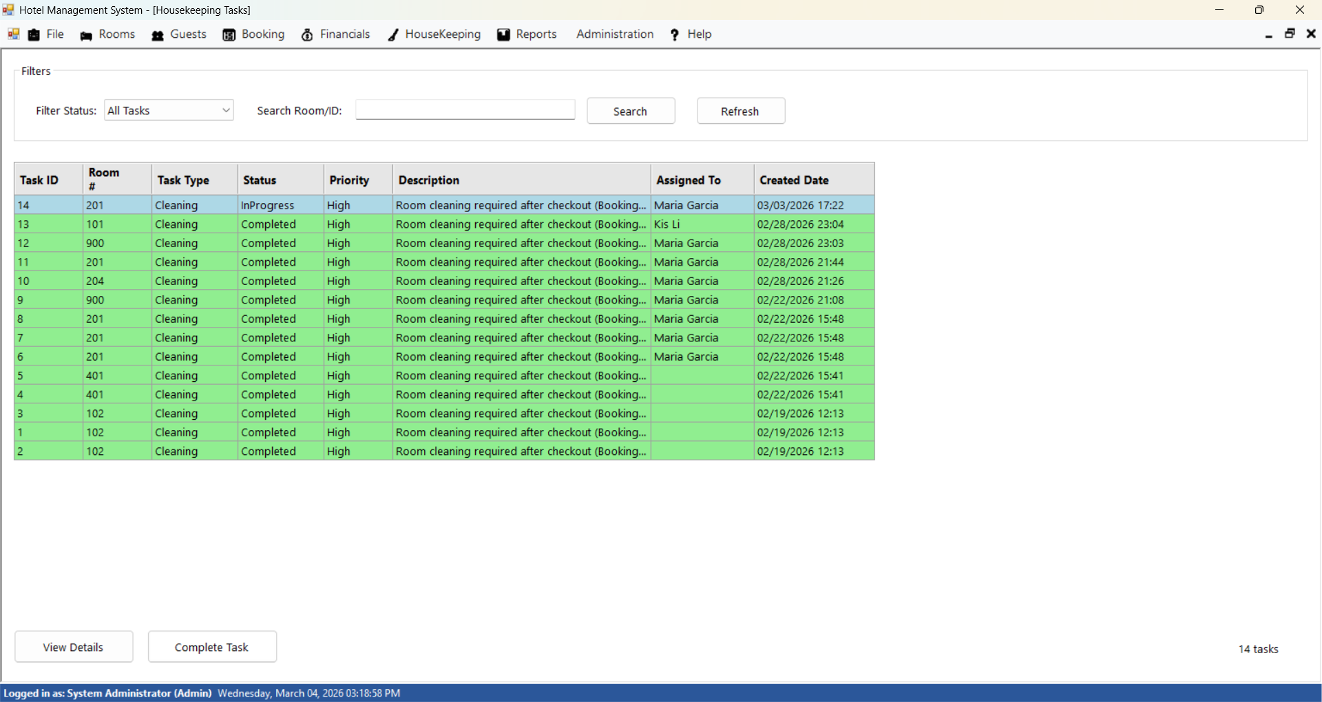
FORM 10
Form 10 — Housekeeping Tasks
HousekeepingTasksForm.cs
Form Description
📌 Purpose
Manage all cleaning and maintenance tasks for rooms
Key Features & Functions
• Lists tasks with: status, priority, room number, assigned staff
• Tasks auto-created by Observer pattern when guest checks out
• Auto-assignment: least-busy housekeeping staff algorithm
• Manual assignment override also available
• Status workflow: Pending → In Progress → Completed
• Priority levels: High (post-checkout) / Normal (routine)
📷 [ Housekeeping Tasks — Form Screenshot ]
💡 Observer Pattern: task creation is fully automated on checkout
Hotel Management System · C# Windows Forms · Layered Architecture · 5 Design Patterns

Slide 14
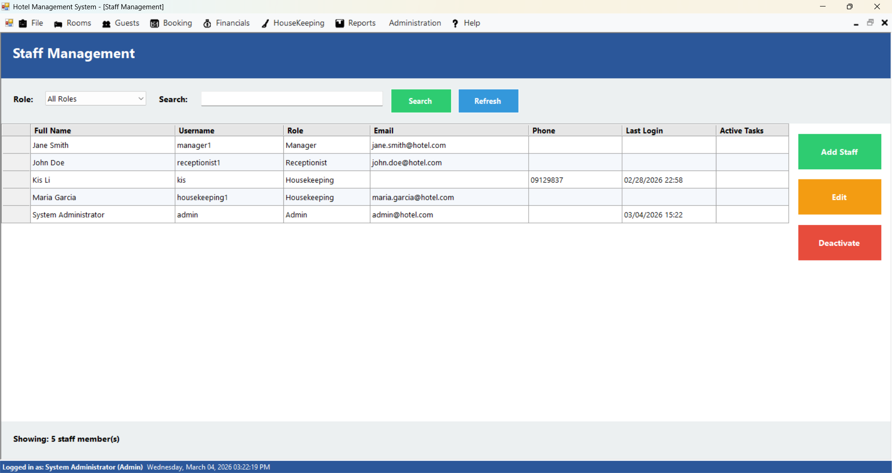
FORM 11
Form 11 — Staff Management
StaffManagementForm.cs
Form Description
📌 Purpose
Admin-only interface for managing all system user accounts
Key Features & Functions
• Full CRUD operations for staff accounts
• Add / Edit via AddEditStaffDialog
• Role assignment: Admin · Receptionist · Housekeeping
• Password management with SHA-256 secure hashing
• Admin can reset any staff member's password
• Restricted access — visible only to Admin role
📷 [ Staff Management — Form Screenshot ]
💡 Admin-only: role-based access control enforced
Hotel Management System · C# Windows Forms · Layered Architecture · 5 Design Patterns

Slide 15
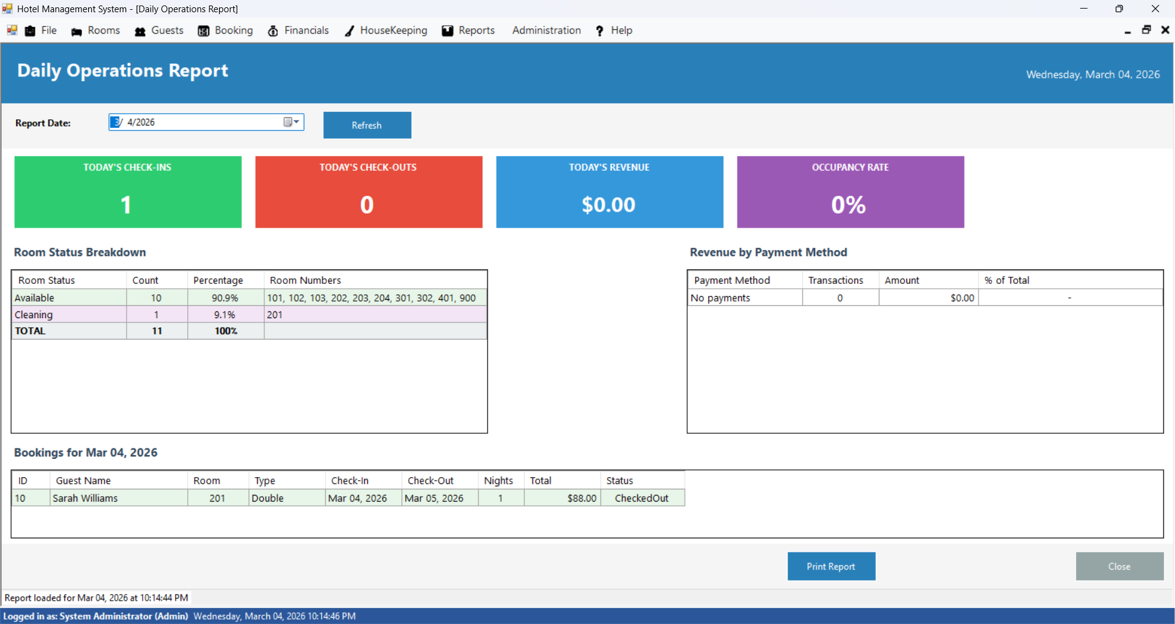
FORM 12
Form 12 — Daily Operations Report
DailyOperationsReportForm.cs
Form Description
📌 Purpose
Dashboard providing a real-time overview of hotel operations
Key Features & Functions
• Daily operations summary at a glance
• Key metrics: occupancy rate, bookings, revenue
• Active bookings, pending check-ins, pending check-outs
• Outstanding invoices and payment summaries
• Housekeeping task completion status
• Management tool for informed decision-making
📷 [ Daily Operations Report — Form Screenshot ]
💡 Real-time management dashboard — all KPIs in one view
Hotel Management System · C# Windows Forms · Layered Architecture · 5 Design Patterns

Slide 16
PATTERNS
Design Patterns — Overview
5 patterns implemented from textbook
Each pattern solves a real architectural challenge, demonstrating Separation of Concerns, Loose Coupling, and the Open/Closed Principle.
🔷 Singleton
🏭 Factory Method
♟ Strategy
1
DatabaseManager · RoomSubject
2
RoomFactory · Room subclasses
3
IPaymentStrategy · Cash · CreditCard
Guarantees only ONE instance of critical resources exists at all times.
Creates the correct room type object without exposing creation logic to UI.
Swaps payment algorithms at runtime — add new methods without touching existing code.
👁 Observer
🎨 Decorator
4
RoomSubject · HousekeepingObserver
5
RoomDecorator · 3 Concrete Decorators
Auto-triggers housekeeping task creation every time a guest checks out.
Dynamically adds room add-ons (breakfast, extra bed, transfer) without modifying Room.
Hotel Management System · C# Windows Forms · Layered Architecture · 5 Design Patterns

Slide 17
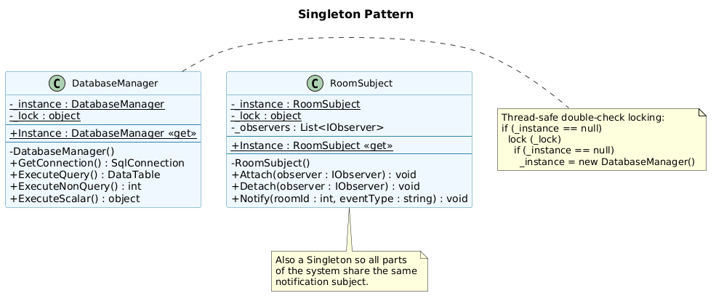
PATTERN 1
Pattern 1 — Singleton
Files: DAL/DatabaseManager.cs · Patterns/RoomSubject.cs
🔷 Singleton Pattern
📌 Purpose
Ensures only ONE instance of a class exists throughout app lifetime
Where It's Used
• DatabaseManager — single shared database connection pool
• Thread-safe double-check locking (lock + null check x2)
• Private constructor prevents external instantiation
• RoomSubject — single event hub for all Observer notifications
• Every Repository uses DatabaseManager.Instance to query DB
Why It Matters
▸ Prevents connection pool exhaustion from multiple instances
▸ Guarantees state consistency across multi-threaded UI events
▸ Centralizes DB connection management in one place
Hotel Management System · C# Windows Forms · Layered Architecture · 5 Design Patterns

Slide 18
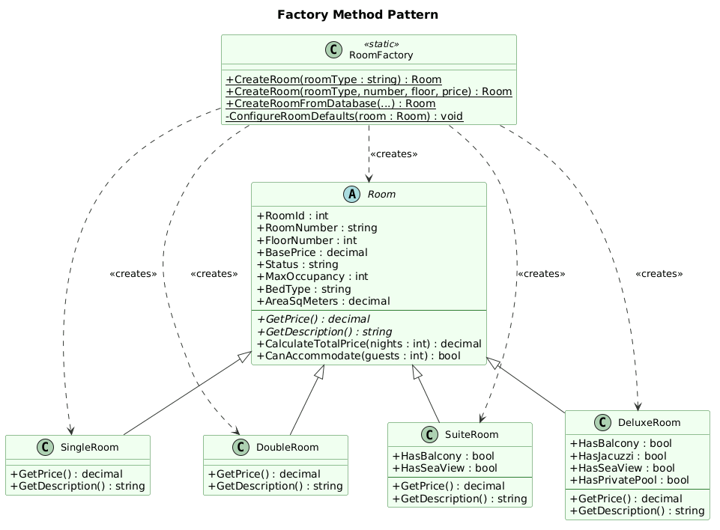
PATTERN 2
Pattern 2 — Factory Method
Files: BLL/Factories/RoomFactory.cs · Models/Room.cs + 4 subclasses
🏭 Factory Method Pattern
📌 Purpose
Encapsulates creation of different room types without exposing concrete classes
Where It's Used
• RoomFactory.CreateRoom(type) returns correct subclass
• Single → MaxOccupancy 1 · $50/night · Single bed · 20 m²
• Double → MaxOccupancy 2 · $80/night · Queen bed · 30 m²
• Suite → MaxOccupancy 4 · $150/night · King · Balcony
• Deluxe → MaxOccupancy 4 · $250/night · King · Jacuzzi
• CreateRoomFromDatabase() reconstructs rooms loaded from SQL
Why It Matters
▸ UI forms never reference concrete room classes directly
▸ All default configs (bed, area, price) defined in one location
▸ New room type = add one new subclass only, no UI changes
Hotel Management System · C# Windows Forms · Layered Architecture · 5 Design Patterns

Slide 19
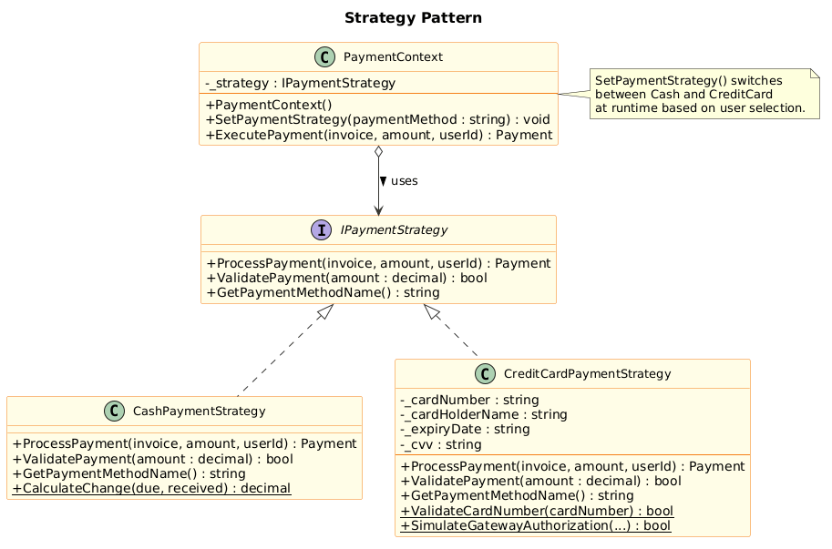
PATTERN 3
Pattern 3 — Strategy
Files: Patterns/IPaymentStrategy.cs · CashPaymentStrategy.cs · CreditCardPaymentStrategy.cs · PaymentContext.cs
♟ Strategy Pattern
📌 Purpose
Defines interchangeable payment algorithms — selected at runtime
Where It's Used
• IPaymentStrategy interface: ProcessPayment() + Validate()
• CashPaymentStrategy → calculates change, creates Cash payment
• CreditCardPaymentStrategy → Luhn validation, CVV check, gateway simulation (95% success), masks card number
• PaymentContext.SetStrategy('Cash'/'CreditCard') at runtime
• PaymentForm selects strategy based on user's radio button
Why It Matters
▸ Adding Mobile Pay / Bank Transfer = one new class only
▸ Existing payment code is never modified (Open/Closed Principle)
▸ Each strategy is independently testable
Hotel Management System · C# Windows Forms · Layered Architecture · 5 Design Patterns

Slide 20
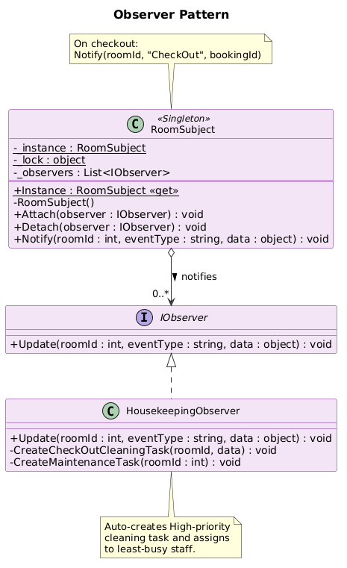
PATTERN 4
Pattern 4 — Observer
Files: Patterns/IObserver.cs · Patterns/RoomSubject.cs · Patterns/HousekeepingObserver.cs
👁 Observer Pattern
📌 Purpose
One-to-many event system — dependents notified automatically on state change
Where It's Used
• RoomSubject (Singleton) holds a list of registered IObservers
• MainForm.ctor → RoomSubject.Instance.Attach(new HousekeepingObserver())
• BookingListForm checkout → RoomSubject.Notify('CheckOut', roomId)
• HousekeepingObserver.Update() → auto-creates High-priority Cleaning Task
• Smart assignment: finds housekeeping staff with fewest active tasks
• Also handles 'Maintenance' event type for maintenance tasks
Why It Matters
▸ Booking module and Housekeeping module are fully decoupled
▸ New automated actions on checkout = add a new Observer only
▸ No changes needed to existing checkout or booking code
Hotel Management System · C# Windows Forms · Layered Architecture · 5 Design Patterns

Slide 21
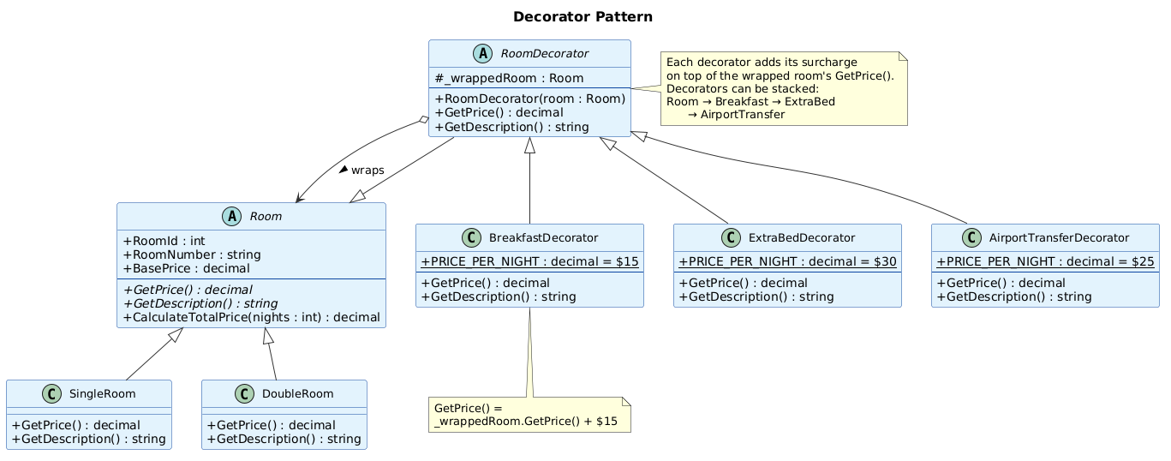
PATTERN 5
Pattern 5 — Decorator
Files: Patterns/RoomDecorator.cs · BreakfastDecorator.cs · ExtraBedDecorator.cs · AirportTransferDecorator.cs
🎨 Decorator Pattern
📌 Purpose
Attaches additional responsibilities to objects dynamically without subclassing
Where It's Used
• RoomDecorator — abstract base class wrapping any Room instance
• BreakfastDecorator → adds +$15/night breakfast service charge
• ExtraBedDecorator → adds +$30/night extra bed service charge
• AirportTransferDecorator → adds +$25/night airport transfer
• NewBookingForm stacks decorators from user-selected checkboxes
• decorated.GetPrice() - baseRoom.GetPrice() = total add-on charges
Why It Matters
▸ Add-ons applied at runtime — no Room subclass modifications needed
▸ Decorators stack: all three services combine transparently
▸ Open/Closed Principle: new add-on = one new class, zero changes elsewhere
Hotel Management System · C# Windows Forms · Layered Architecture · 5 Design Patterns

Slide 22
CONCLUSION
Conclusion
Summary of the system's development and key achievements
Secure Authentication
Automated Workflows
Flexible Payments
🔐
SHA-256 hashing with random salt — user passwords are never stored in plain text.
🤖
Observer pattern: guest checkout auto-triggers housekeeping task creation with smart staff assignment.
💳
Strategy pattern: new payment methods require only one new class — no existing code modified.
Clean Data Layer
Simplified Booking
Robust Validation
🗄
Generic IRepository<T> with 7 implementations — consistent, parameterized, injection-safe SQL.
🏛
Facade pattern reduces an 8-step multi-repository workflow to a single validated method call.
✅
ValidationHelper covers email, phone, Luhn (credit card), date ranges, and numeric inputs.
The Hotel Management System delivers a fully functional platform covering the complete hotel lifecycle: guest registration → booking → check-in → stay → checkout → payment → housekeeping, underpinned by 6 design patterns and a clean 3-layer architecture.
System Architecture Summary
Presentation Layer : 15+ Windows Forms — Login, Booking, Payment, Receipt, Housekeeping, Reports …
Business Logic Layer : BookingFacade · RoomFactory · PasswordHelper · ValidationHelper
Design Patterns : Singleton · Factory Method · Strategy · Observer · Repository · Facade
Data Access Layer : DatabaseManager (Singleton) + 7 Repository implementations
Hotel Management System · C# Windows Forms · Layered Architecture · 5 Design Patterns

Slide 23
DEMO
Demo — Live System Operations
Run the program and demonstrate actual CRUD and workflow operations
➕ Insert
✏️ Update
🔍 Search
🗑 Delete
Add a new guest
Add a room
Create a booking
Edit guest profile
Modify room details
Confirm a booking
Search guest by name
Filter rooms by status
Filter bookings
Soft-delete a guest
Cancel a booking
Remove staff account
🔐 Login
💳 Payment
🧹 Housekeep
📊 Report
Login as Admin
Login as Receptionist
Compare role views
Process cash
Process credit card
View styled receipt
Check out a guest
See auto-task created
Update task status
View daily dashboard
Check occupancy rate
Review invoices
Hotel Management System · C# Windows Forms · Layered Architecture · 5 Design Patterns

