Slide 1

សាកលវិទ្យាល័យភូមិន្ទភ្នំពេញ
Hotel Management System
បង្រៀនដោយសាស្ត្រាចារ្យ​៖ Dan Vournpheng ​​​
ថ្នាក់​ A4
សមាជិក
១. រុំ​ វីរៈ ២. ប៉ាត​ មូលសក្តា​ ៣​. នឹម​ រត្តនៈ ៤. នូ និចាន់ ​​ ៥. នឿន តុណា ​​​​​​​​​​​​​​

Slide 2
CONTENTS
Table of Contents
Objective
03
Form 8 — Receipt
11
Form 1 — Login Form
04
Form 9 — Invoice Mgmt
12
Form 2 — Main Form
05
Form 10 — Housekeeping
13
Form 3 — Guest Mgmt
06
Form 11 — Staff Mgmt
14
Form 4 — Room Mgmt
07
Form 12 — Daily Report
15
Form 5 — Booking List
08
Design Patterns (7 patterns)
16 – 23
Form 6 — New Booking
09
Conclusion
24
Form 7 — Payment
10
Demo
25

Slide 3
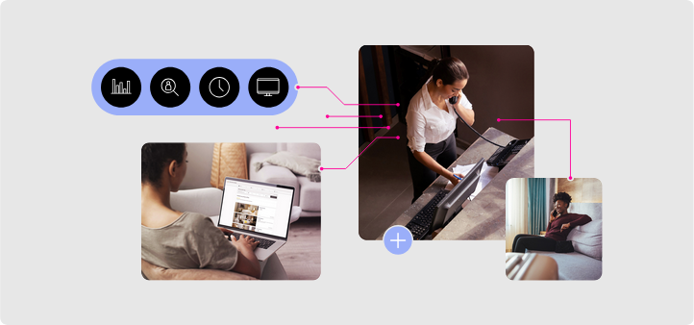
OVERVIEW
Objective
• Desktop hotel management platform built in C# Windows Forms
• Covers complete lifecycle: booking → check-in → checkout → payment
Staff management
Daily Report
• Role-based access: Admin, Receptionist, Housekeeping, Manager
• 12 operational forms, 5 design patterns
ប៉ាត មូលសក្តា

Slide 4
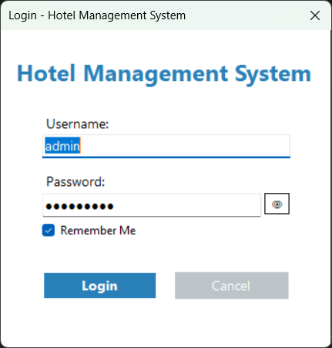
FORM 1
Login Form
Secure login — SHA-256 password hashing with random salt
Four roles: Admin / Receptionist / Housekeeping/ Manager
"Remember Me" — credentials persisted in app settings
Wrong credentials → error shown, password field cleared
ប៉ាត មូលសក្តា

Slide 5
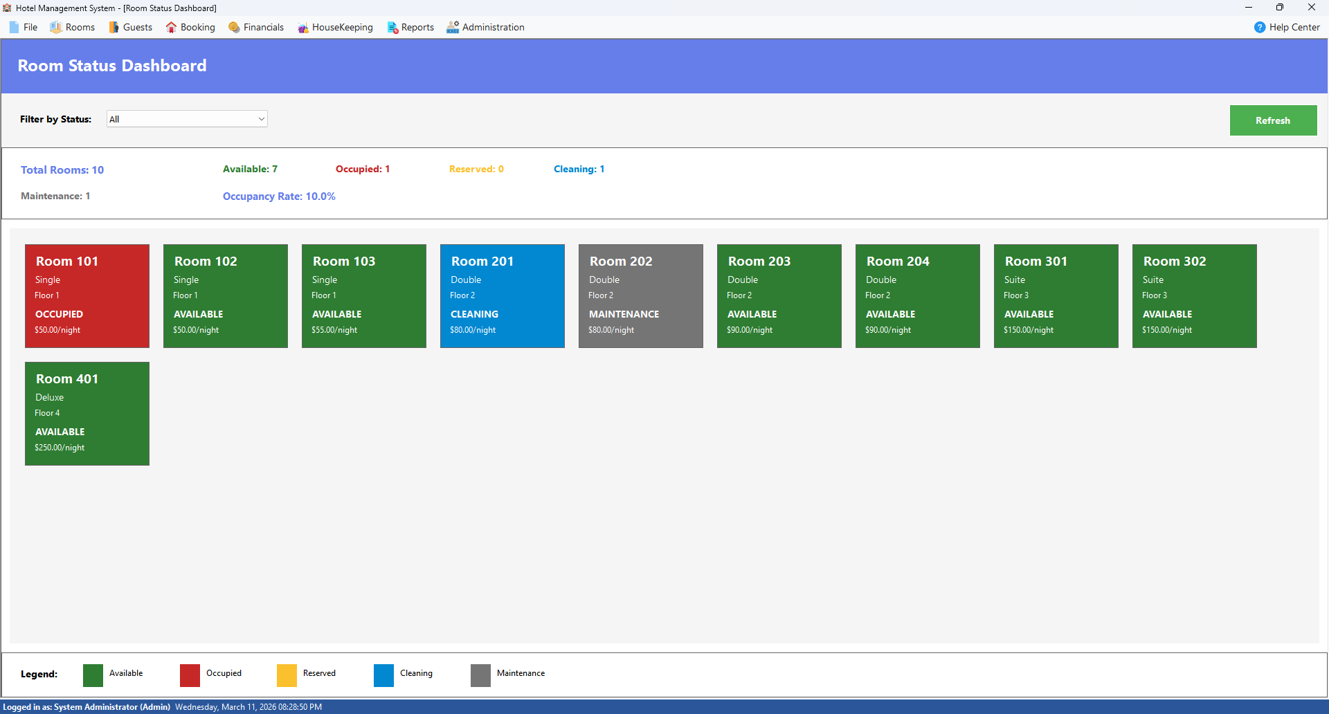
FORM 2
Main Form — MDI Hub
• Central navigation hub for all modules
• Menu bar: Booking ,Guest ,Room ,Housekeeping, Reports
• Status bar shows logged-in user, role, and live clock
• Observer pattern initialized here on startup
ប៉ាត មូលសក្តា

Slide 6
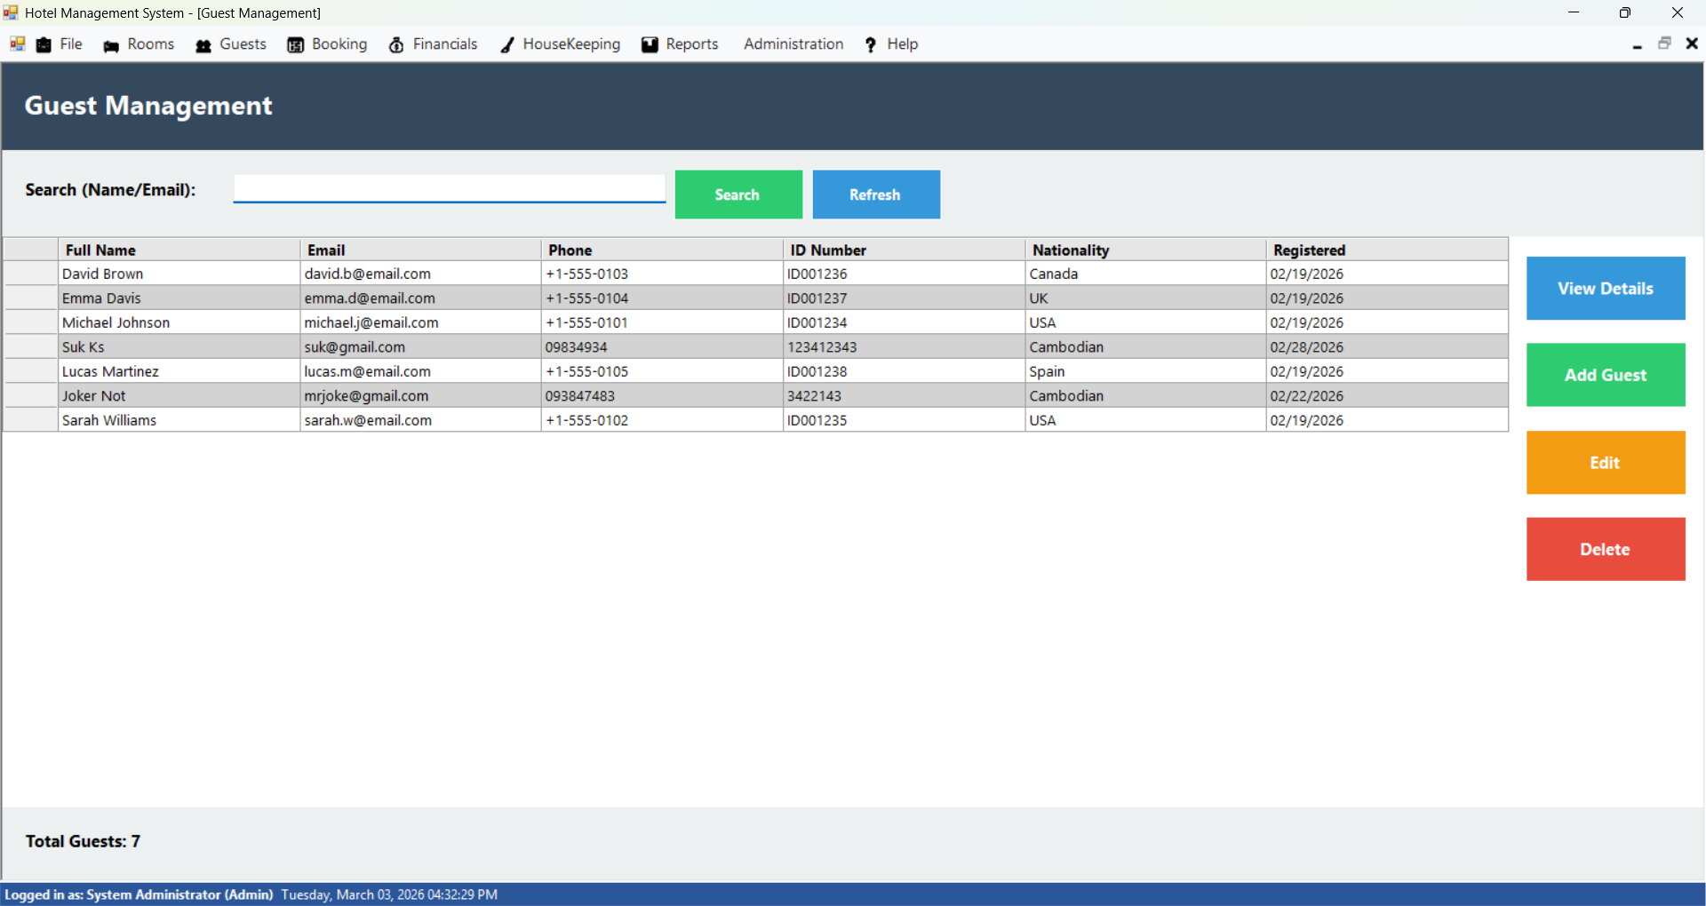
FORM 3
Guest Management
• Add, edit, and soft-delete guest records
• Search by name, email, or phone number
• View full guest profile and booking history
នឹម រត្តនៈ

Slide 7
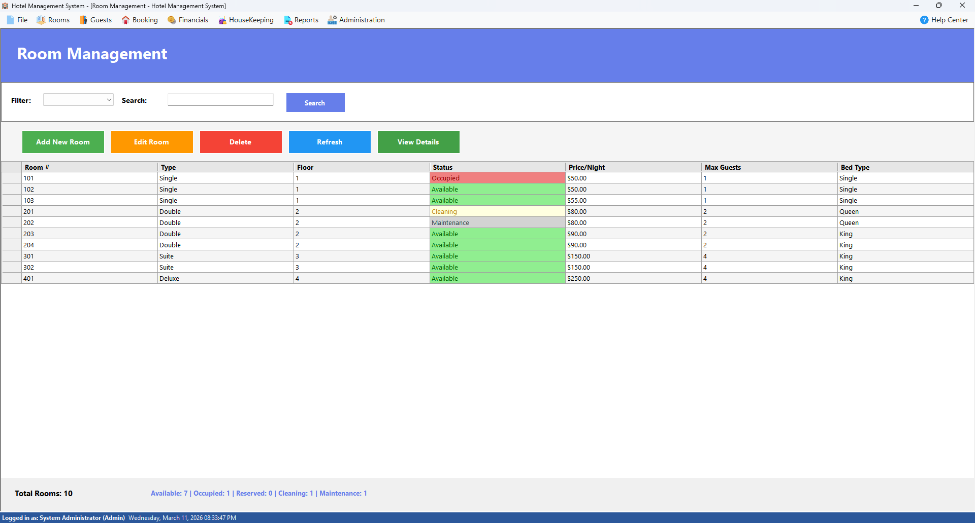
FORM 4
Room Management
• Four room types: Single ,Double, Suite, Deluxe
• Track status: Available, Occupied, Reserved, Maintenance
• Features: Add, edit, update, delete room, search, view detail of room
នឹម រត្តនៈ

Slide 8
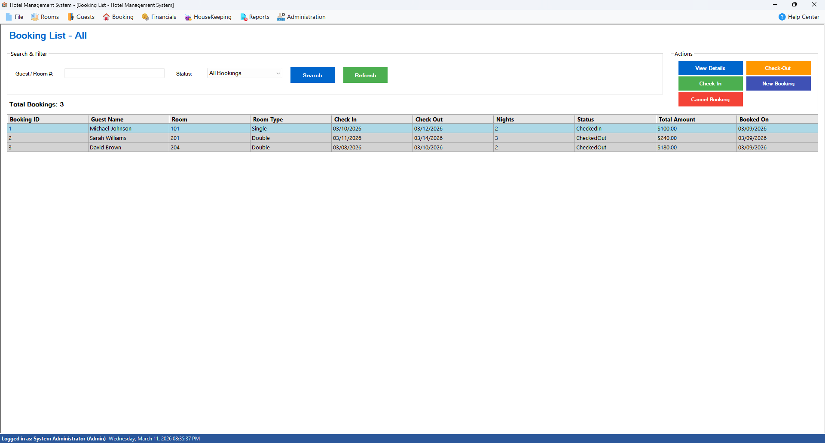
FORM 5
Booking List
• All bookings shown with color-coded status rows
• Actions: Check-In ,Check-Out, Process Payment, Cancel, new booking
Search by name or Id
នឹម រត្តនៈ

Slide 9
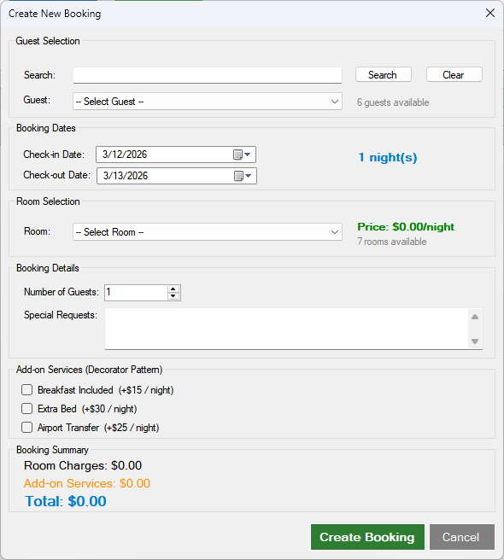
FORM 6
New Booking
Select guest, room, and date range
Auto-calculates: Base Price × Nights + 10% tax
Add-ons: Breakfast, Extra Bed, Airport Transfer
នឹម រត្តនៈ

Slide 10
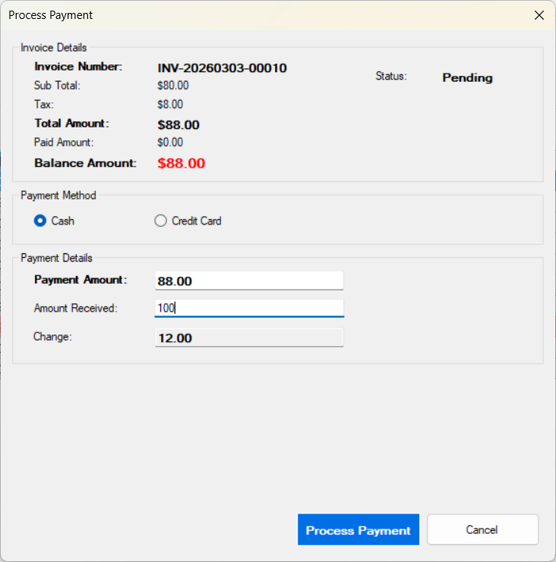
FORM 7
Payment Form
Cash — enter amount, change calculated automatically
Credit Card — Luhn validation + simulated gateway (95% success)
Strategy Pattern: payment method switched at runtime
Success -> Receipt Form displayed automatically
នូ និចាន់

Slide 11
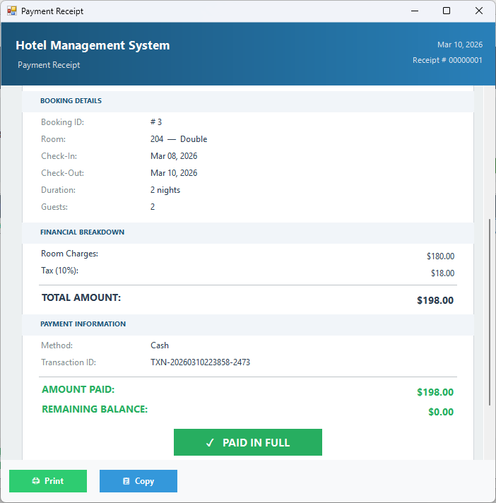
FORM 8
Receipt Form
Styled receipt shown after successful payment
Sections: Guest info, Booking details, Financial breakdown
Status badge: Paid / Partially Paid / Pending
Actions: Print, Copy to Clipboard
នូ និចាន់

Slide 12
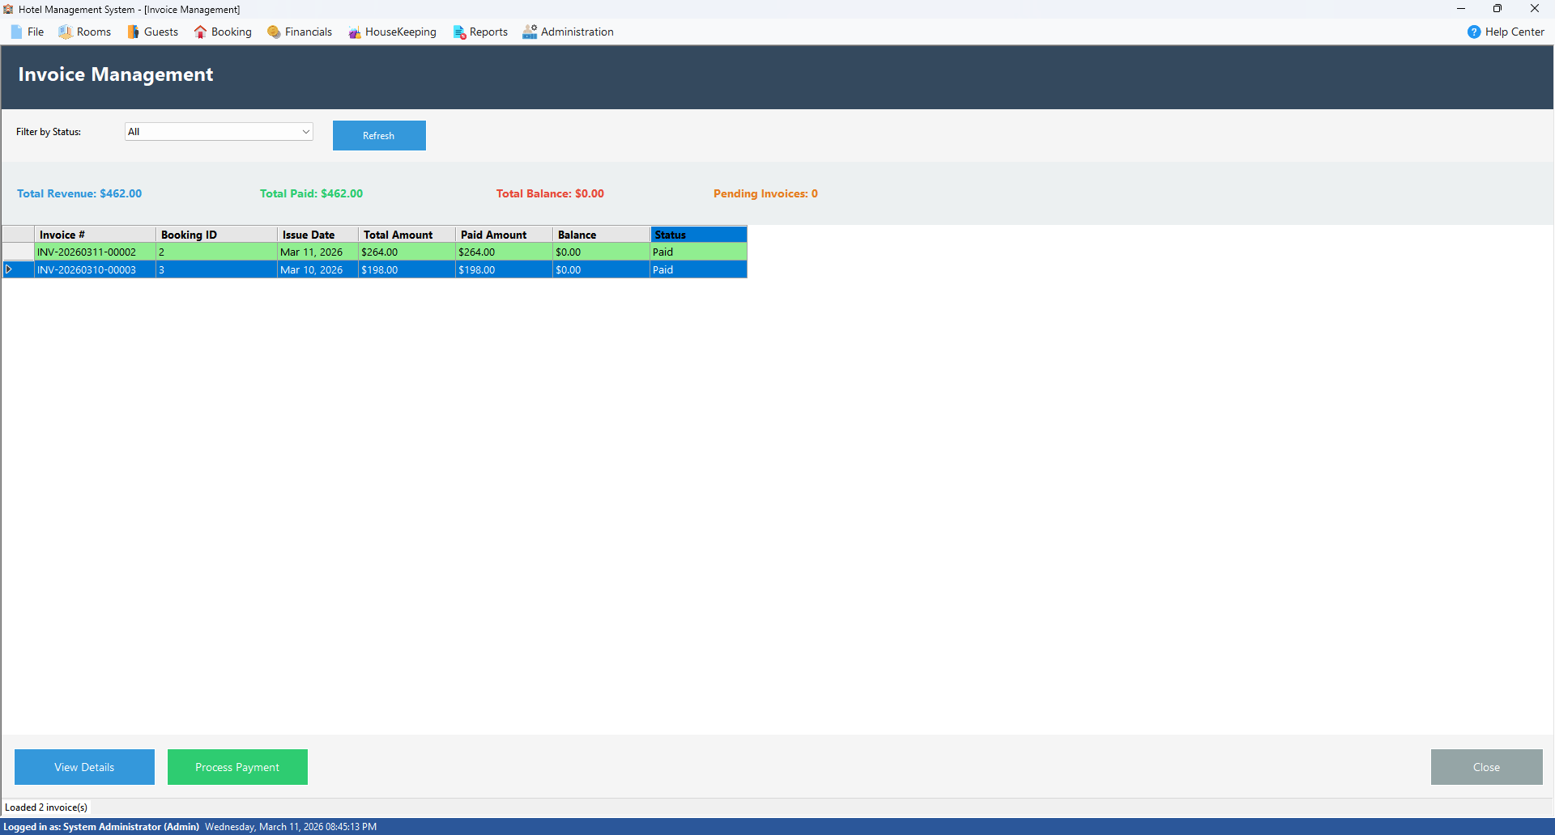
FORM 9
Invoice Management
• Invoices auto-generated on guest checkout
• Subtotal + 10% tax + discounts applied automatically
• Status tracking: Pending, Paid, Partially Paid, Cancelled
Process payment after checkout
នូ និចាន់

Slide 13
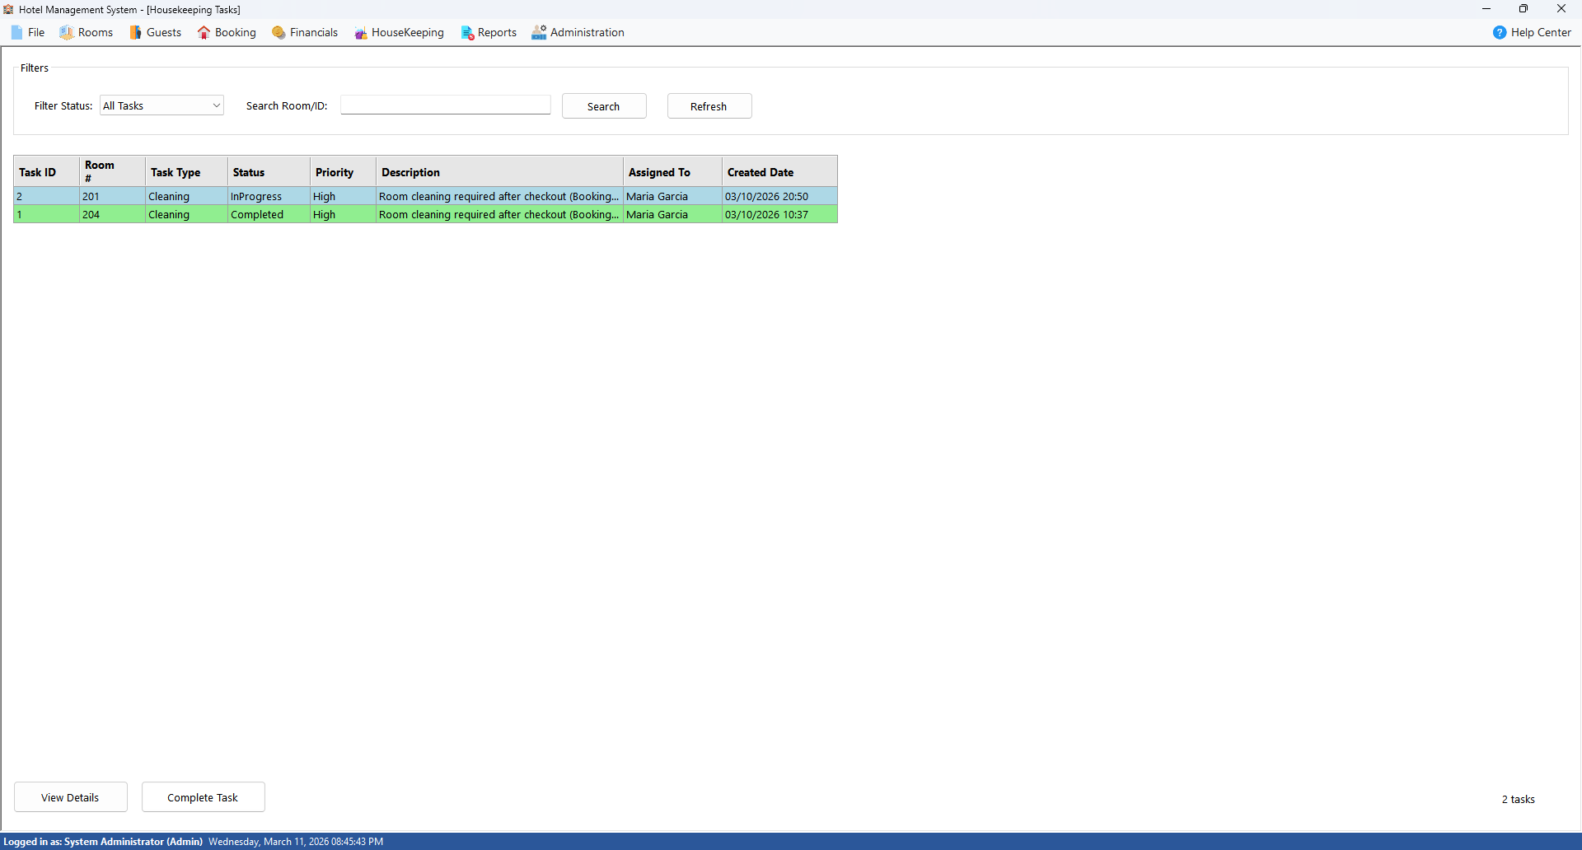
FORM 10
Housekeeping Tasks
• Cleaning tasks auto-created on checkout (Observer Pattern)
• Smart assignment — least-busy staff selected automatically
• Status workflow: Pending → In Progress → Completed
នូ និចាន់

Slide 14
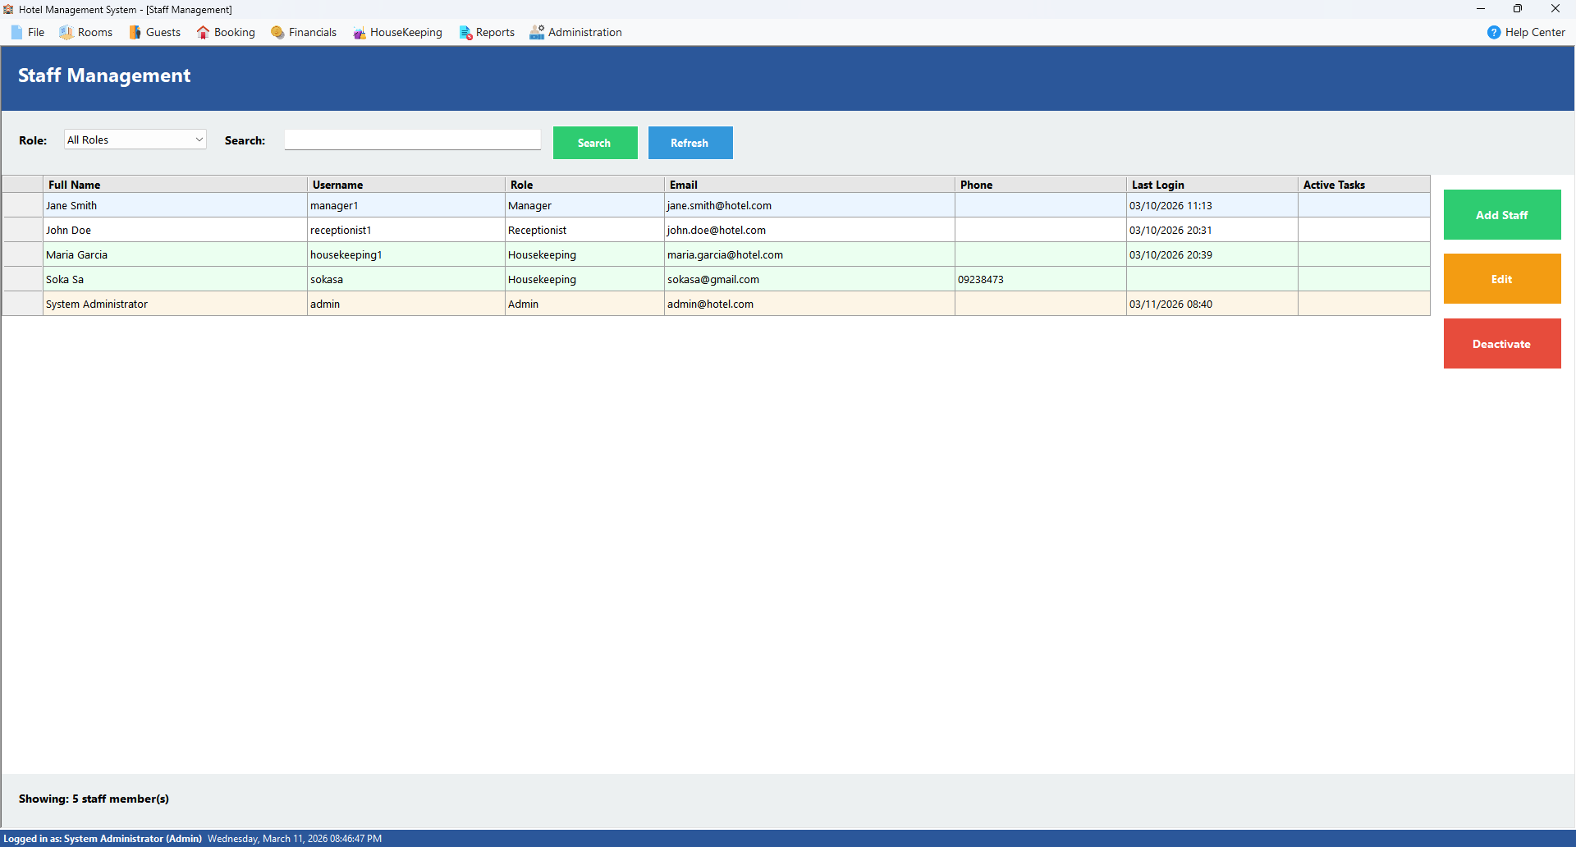
FORM 11
Staff Management
• CRUD operations for all staff accounts
• Role assignment: Admin, Receptionist, Housekeeping, Manager
• Secure password management with SHA-256 hashing
នឿន តុណា

Slide 15
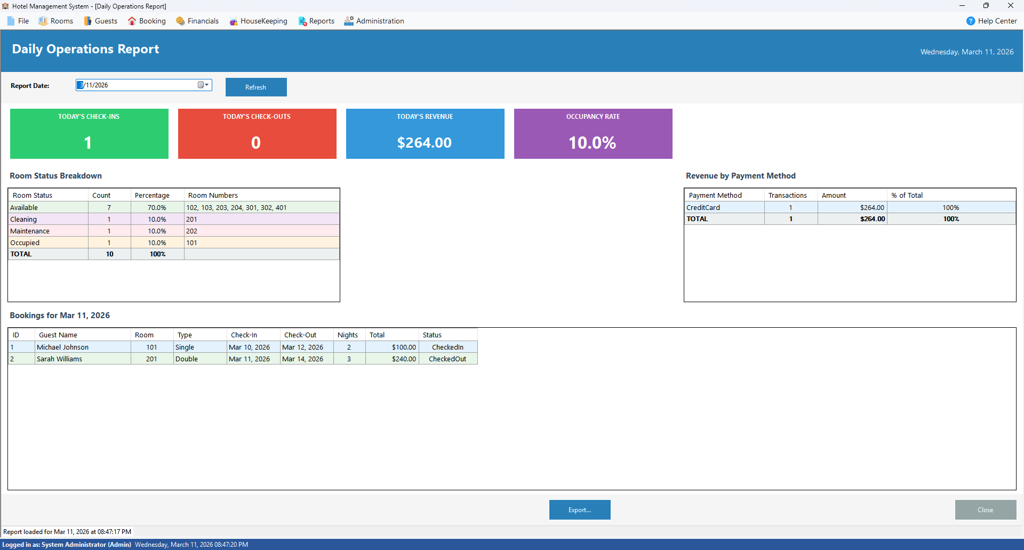
FORM 12
Daily Operations Report
• Dashboard of daily hotel metrics
• Tracks occupancy, bookings, payments, and outstanding tasks
Export to Excel or PDF
នឿន តុណា

Slide 16
PATTERNS
Design Patterns — 5 Implemented
• 1. Singleton — single shared instance
• 2. Factory — creates correct room type objects
• 3. Strategy — interchangeable payment algorithms
• 4. Observer — auto-triggers housekeeping on checkout
• 5. Decorator — stackable room add-on services
រុំ វីរៈ

Slide 17
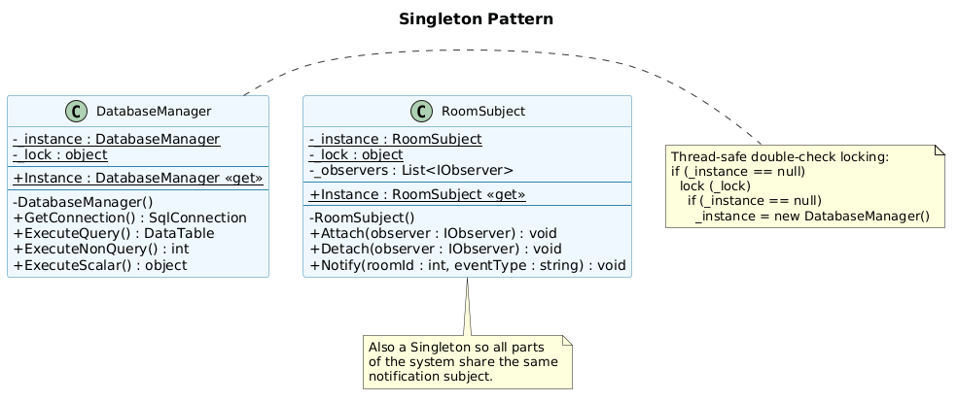
PATTERN 1
Singleton
• Guarantees only one instance exists throughout the app
• DatabaseManager — single thread-safe connection pool
• RoomSubject — one central observable event hub
• Double-check locking ensures thread safety
រុំ វីរៈ

Slide 18
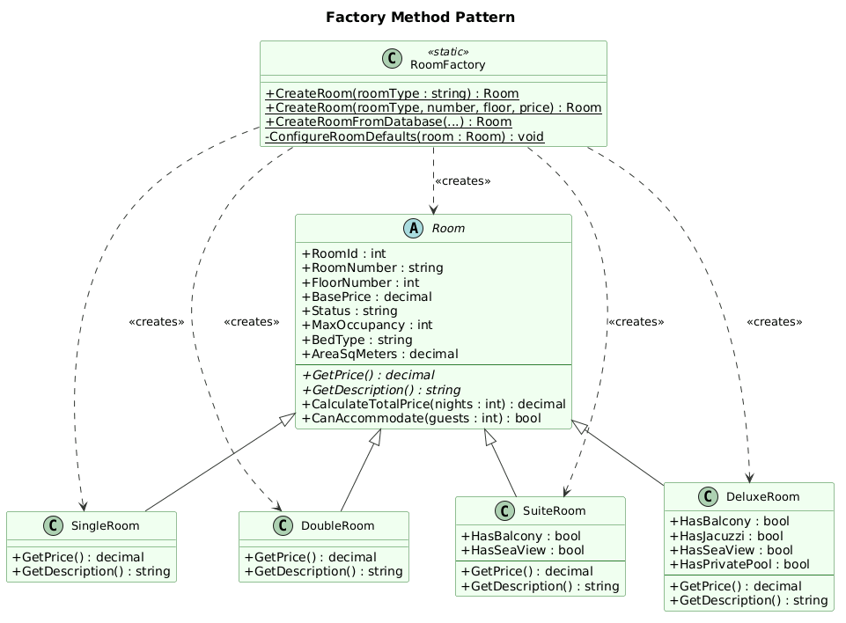
PATTERN 2
Factory Method
RoomFactory.CreateRoom(type) returns the correct subclass
4 types: Single, Double, Suite, Deluxe
Each type carries preset defaults: price, bed, area, occupancy
UI never references concrete room classes directly
រុំ វីរៈ

Slide 19
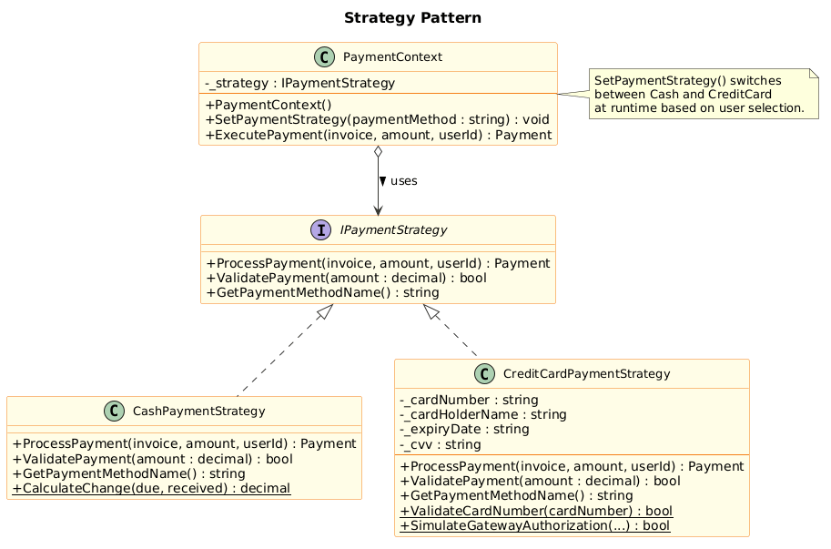
PATTERN 3
Strategy
Defines interchangeable payment processing algorithms
CashPaymentStrategy — records transaction and computes change
CreditCardPaymentStrategy — Luhn check + gateway authorisation
PaymentContext switches strategy at runtime based on user choice
រុំ វីរៈ

Slide 20
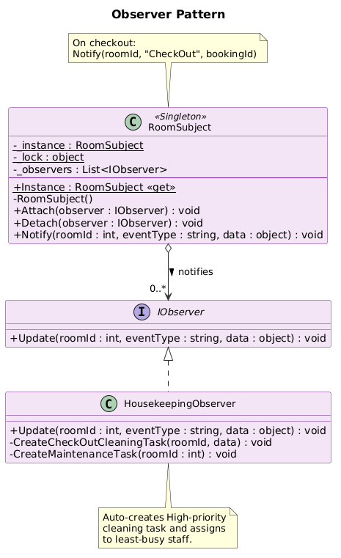
PATTERN 4
Observer
RoomSubject broadcasts room events to all registered observers
On checkout → HousekeepingObserver auto-creates cleaning task
Smart assignment: least-busy housekeeping staff selected
Checkout code stays decoupled — only calls Notify()
រុំ វីរៈ

Slide 21
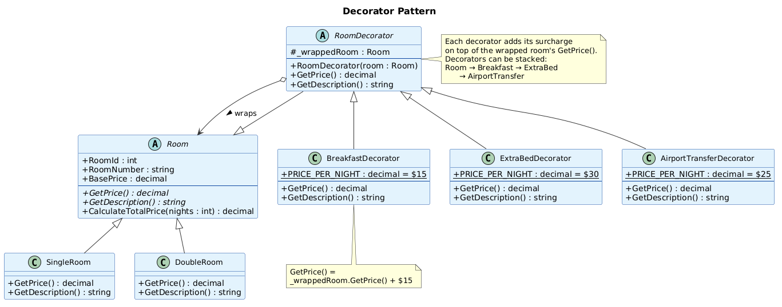
PATTERN 5
Decorator
• Dynamically adds services to any room type at booking time
• Breakfast +$15/night · Extra Bed +$30/night · Airport Transfer +$25/night
• Decorators stack: Double($80) + Breakfast + Extra Bed = $125/night
• Open/Closed — new services added without touching existing code
រុំ វីរៈ

Slide 22
CONCLUSION
Conclusion
Covers complete hotel lifecycle end-to-end
7 design patterns applied to real architectural challenges
Secure: SHA-256 hashing · Role-based access · Luhn validation
Extensible: new payment methods and services add without touching existing code
នឿន តុណា

Slide 23
DEMO
Project Demo🎬
នឿន តុណា

