Slide 1
Wikipedia Langchain Bot
Viren Kathpal

Slide 2
Project Objectives
Following are the project objectives that we focused on:
Develop a Functional Bot
Utilize Large Language Models (LLMs)
Integrate Lang Chain Framework
Retrieve Data from Wikipedia API
Ensure Accuracy and Relevance
Open Source Development
User-Friendly Interaction

Slide 3
Key Features of our Project
Some of the key features of our project are as follows:
Natural Language Understanding.
Wikipedia Article Retrieval.
Lang Chain Integration
Open Source Framework
Research Assistance
User-Friendly Interface
Customization Potential

Slide 4
Technical Implementations
The bot employs natural language processing to understand user
queries and generate accurate responses.
The bot offers a user-friendly interface.
Future Directions and Enhancements
Advanced Language Models
Multimodal Capabilities
Personalization Features
Expanded Language Support
Domain-Specific Versions
Natural Language Generation Improvements

Slide 5
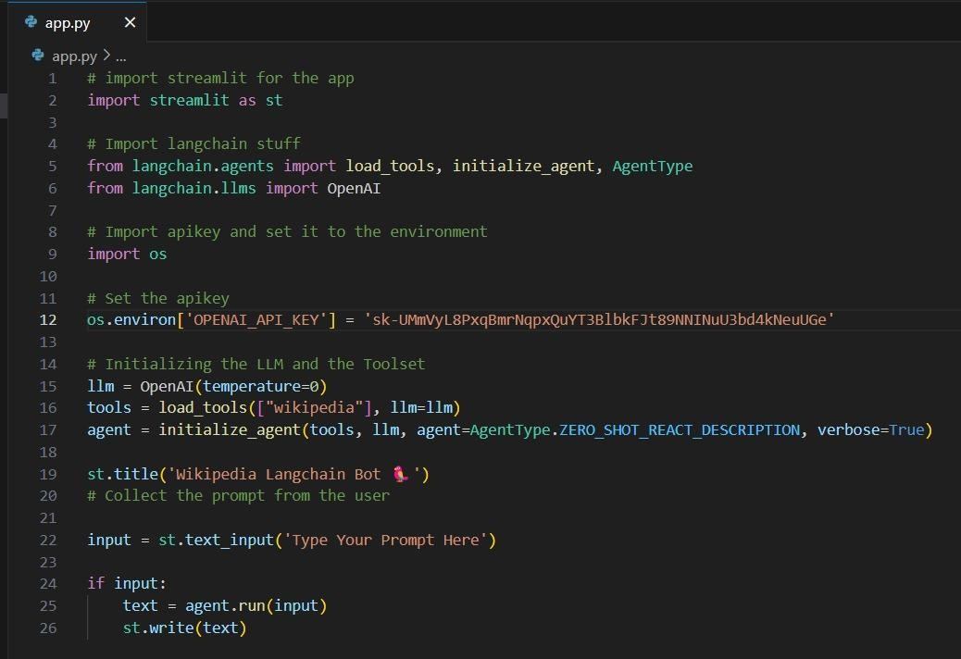
Stream Lit App Screenshots

Slide 6
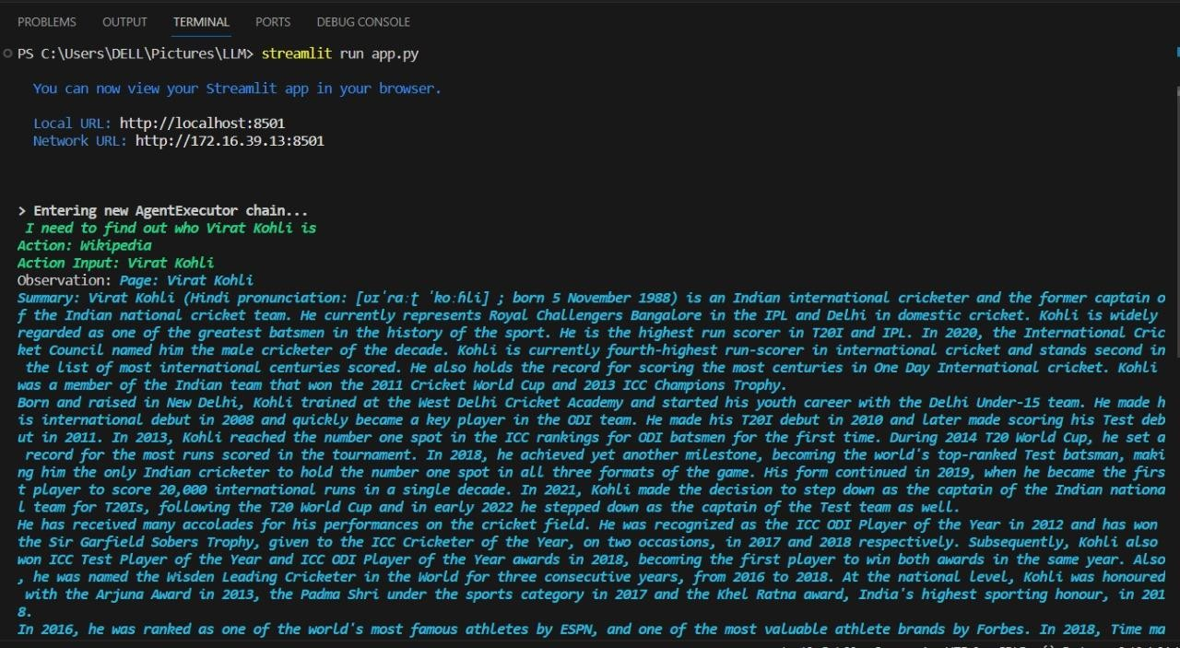

Slide 7
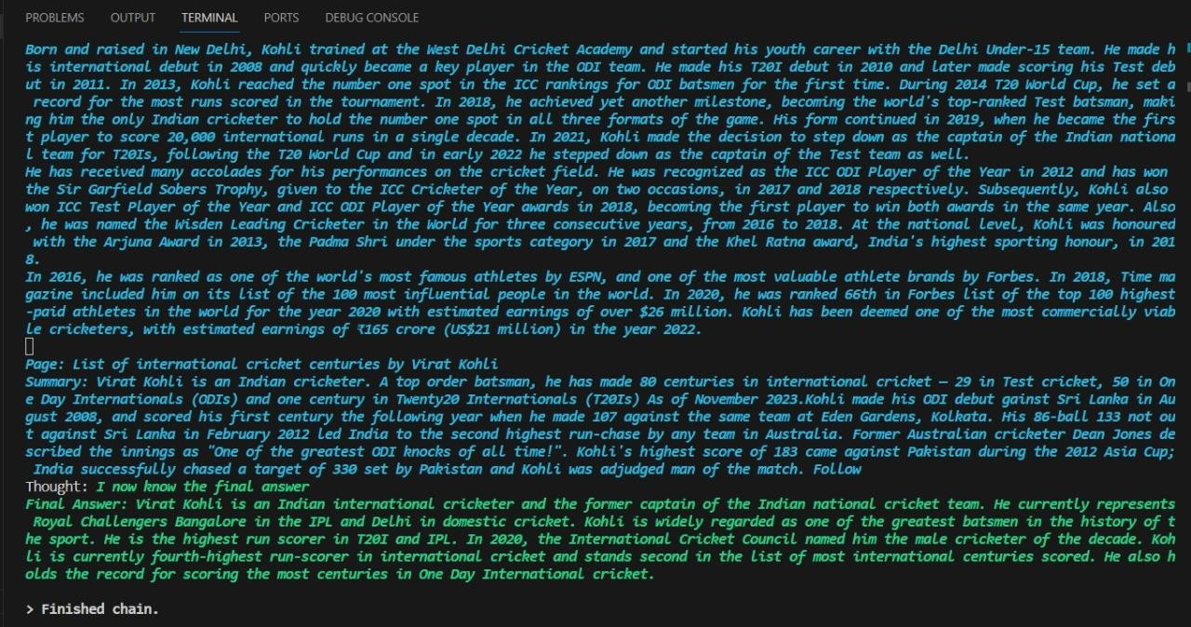

Slide 8
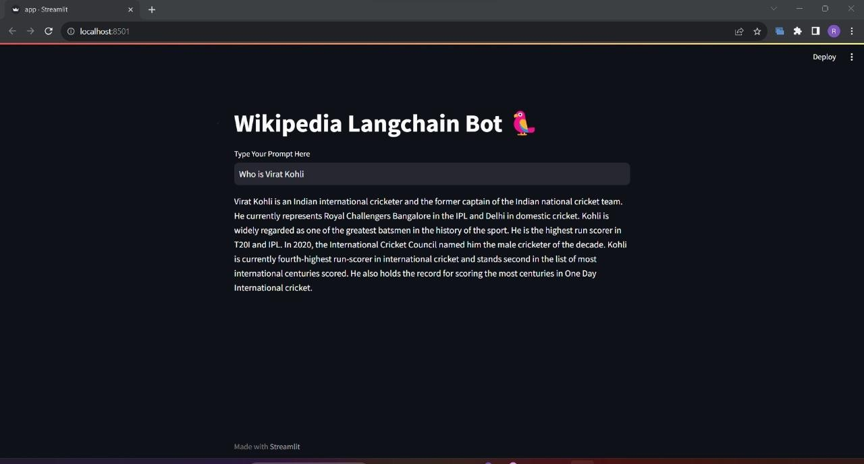

Slide 9
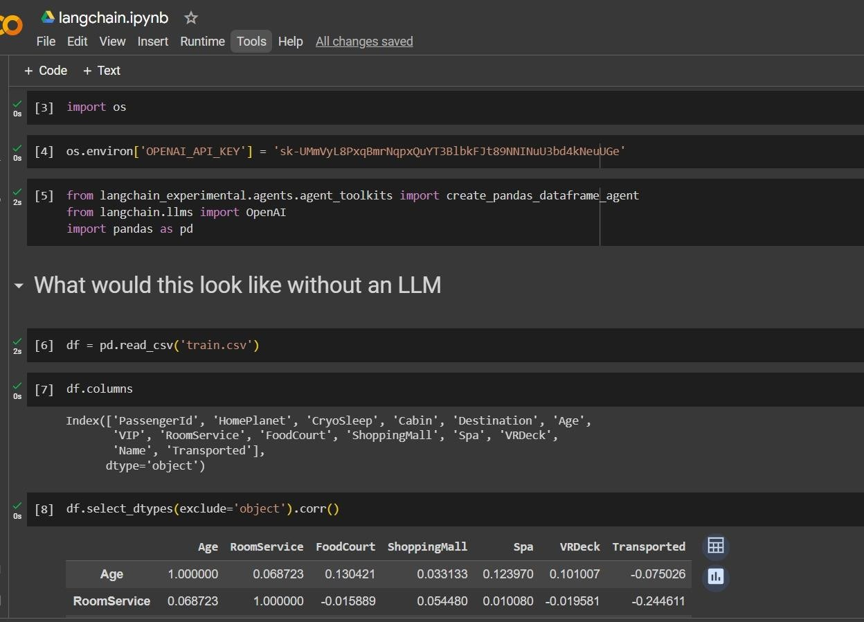
How we learn LLMs and Langchain

Slide 10
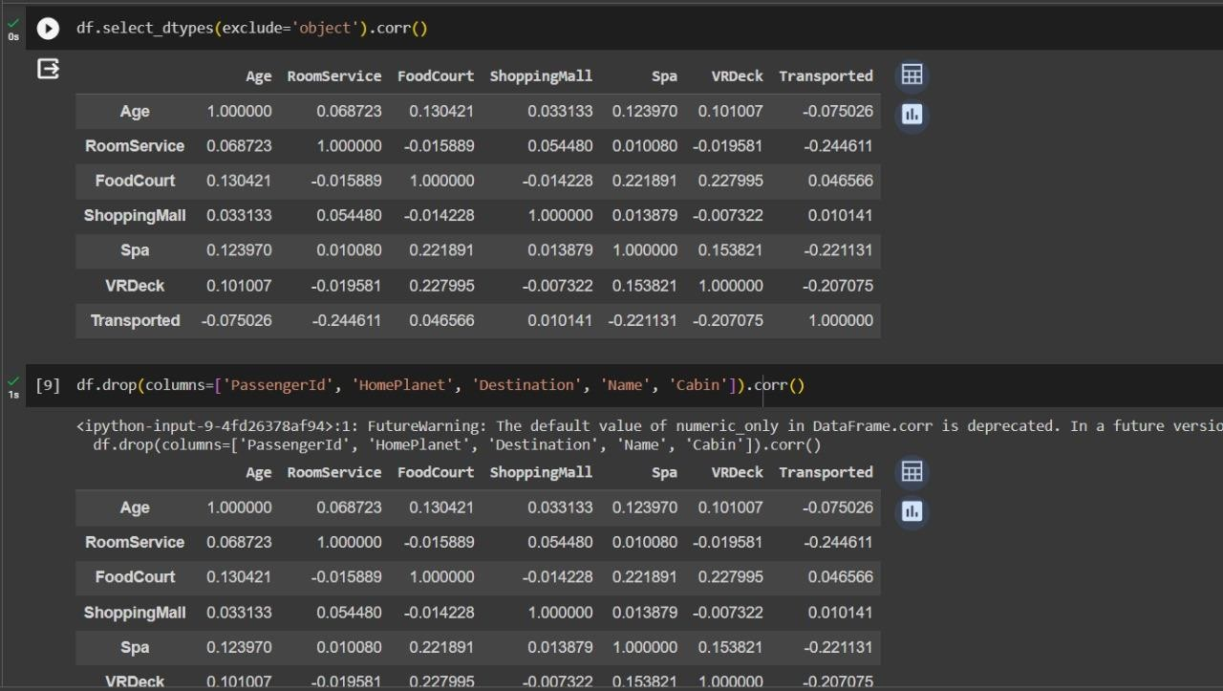

Slide 11
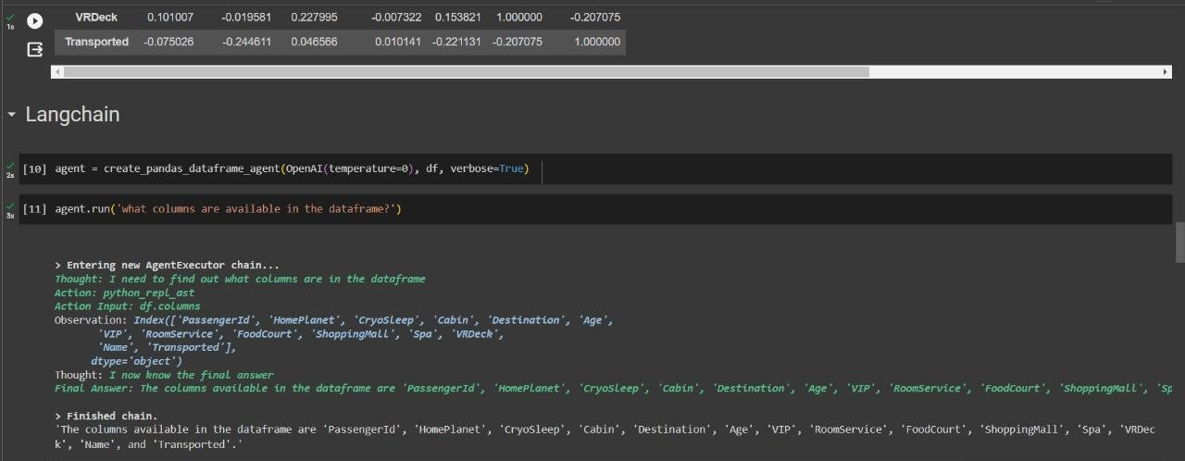

Slide 12
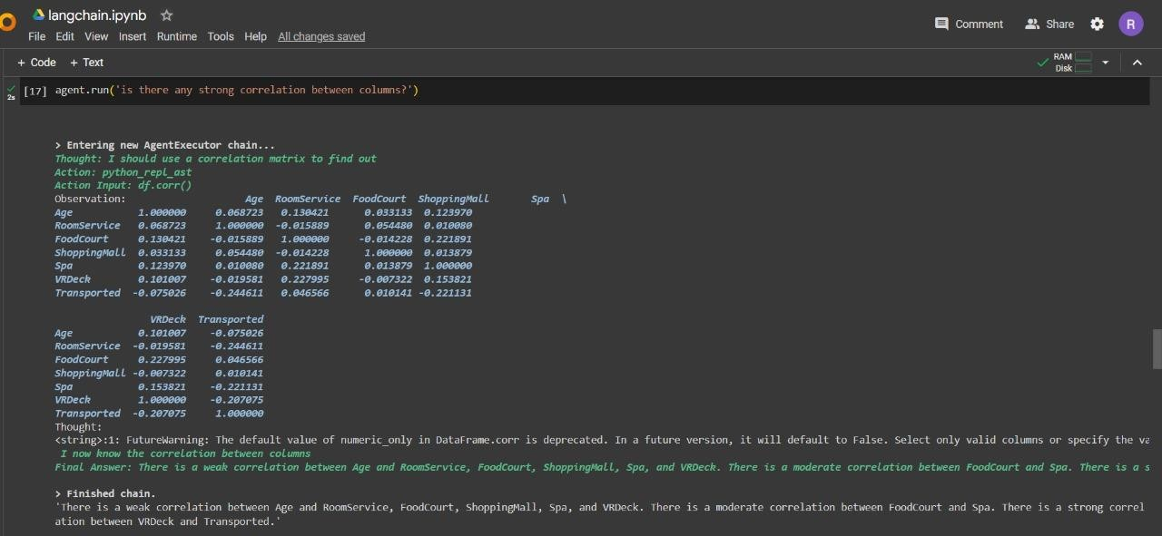

Slide 13
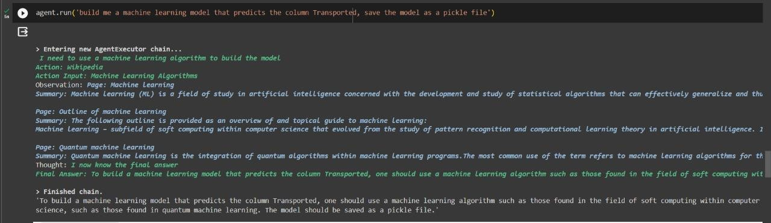

Slide 14
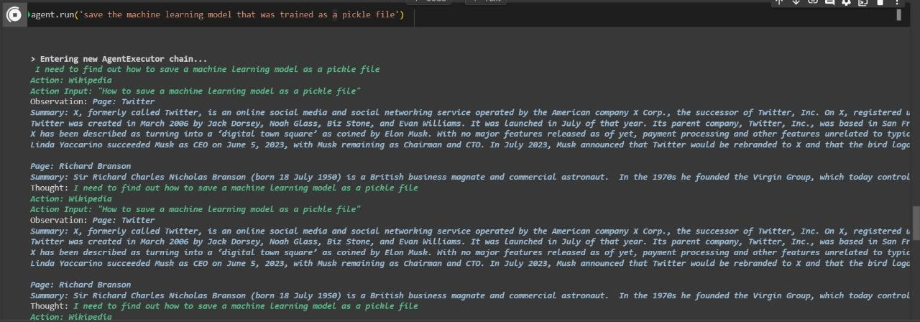

Slide 15
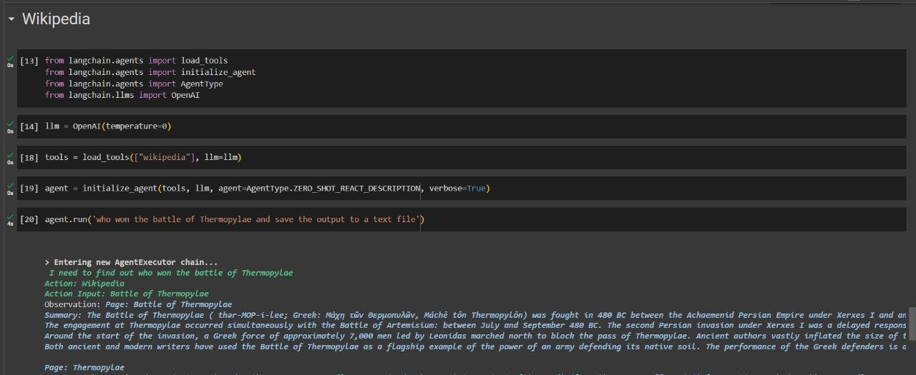

Slide 16
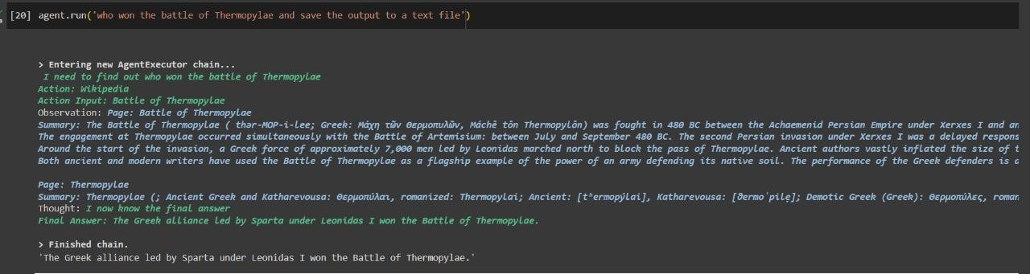

Slide 17
Thankyou

