Slide 1

Inventory Management System
TEAM MEMBERS:
Utkarsha Kavathekar
Vivek Kushwaha
Sanjana Ekanayake
Sravya Dyavarishetty
Viren Adwani
Vishakha Sharma
Siddhardha Atluri

Slide 2

INTRODUCTION
Today, inventory management has become vital for the survival of an organization. If you do not have good control over your inventory, the day is not far when you will lose control of your profits. Hence, for every Organization Inventory management system is must.

Slide 3

PROBLEM STATEMENT
To Design an Inventory Management System such that the company would be able to keep track of the inventory, to make good profits.

Slide 4

OBJECTIVES
To create a simple interface through which an organization or their members can keep track of goods availability and can manage them

Slide 5

Technologies
Front-End:
HTML
CSS
JavaScript
Back-End:
Maven
Spring Boot
MySQL

Slide 6

Proposed System
We intend to create a dynamic website through which the user can login and update the information about the quantity of products he has and be able to update the status of the available products.

Slide 7

SYSTEM FEATURES
Check the availability of products.
Get details about the products.
Update the Stock.
Authentication, Authorization, and other security features for enterprise applications.
Searching for the products.

Slide 8

Screenshots

Slide 9
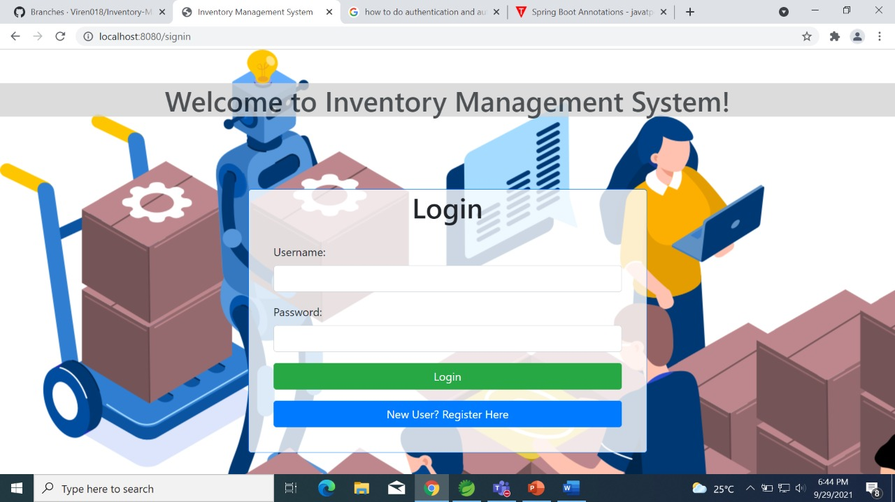

Slide 10
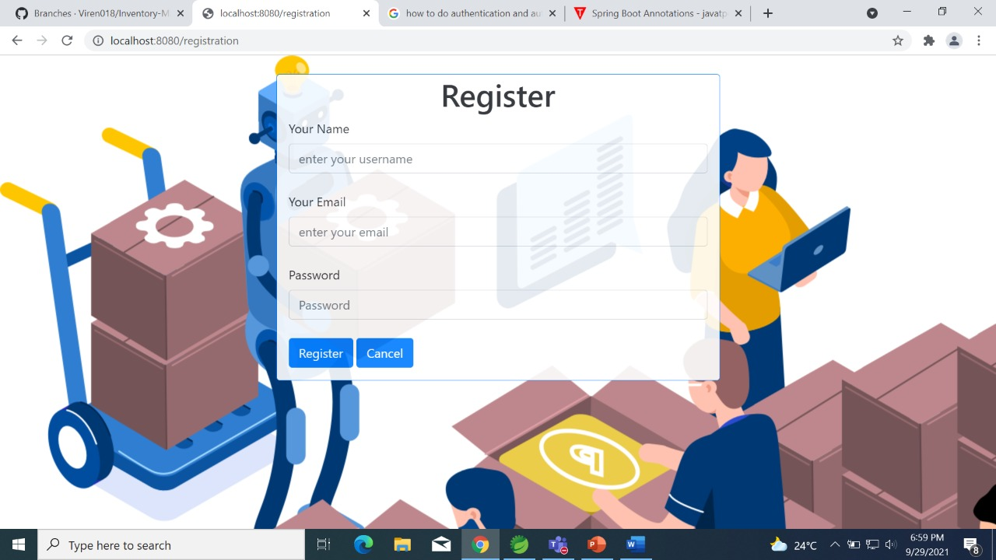

Slide 11
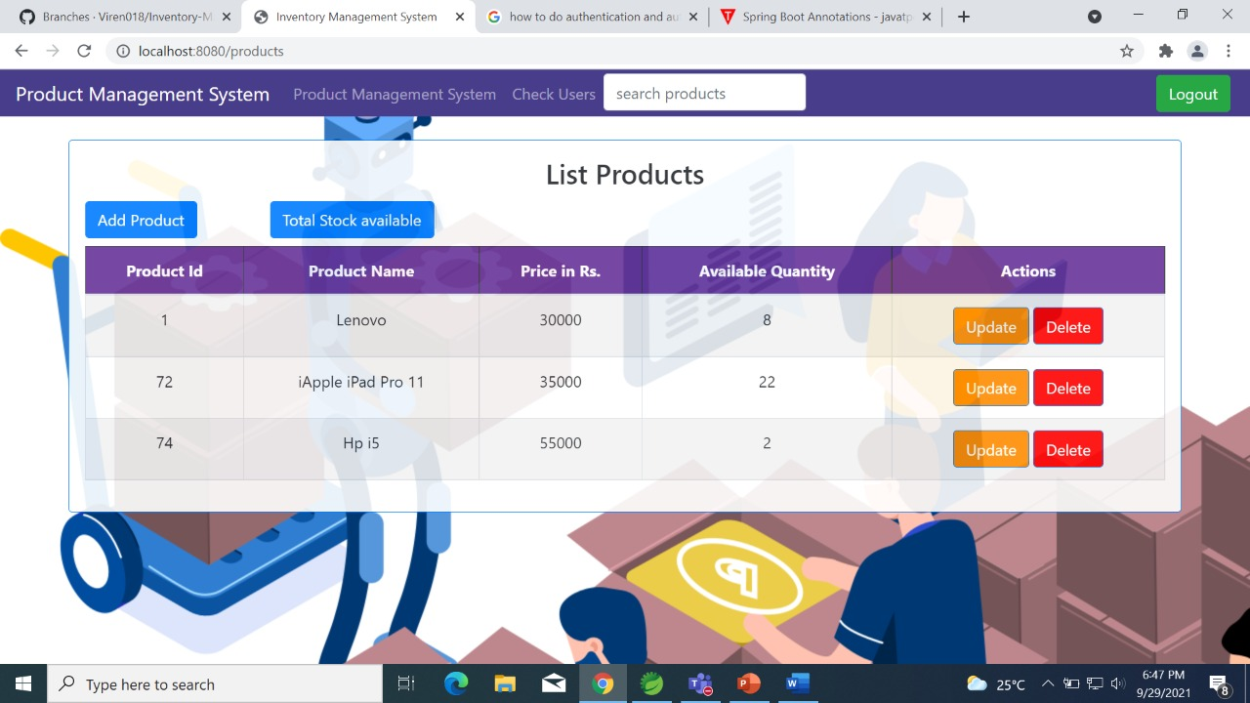

Slide 12
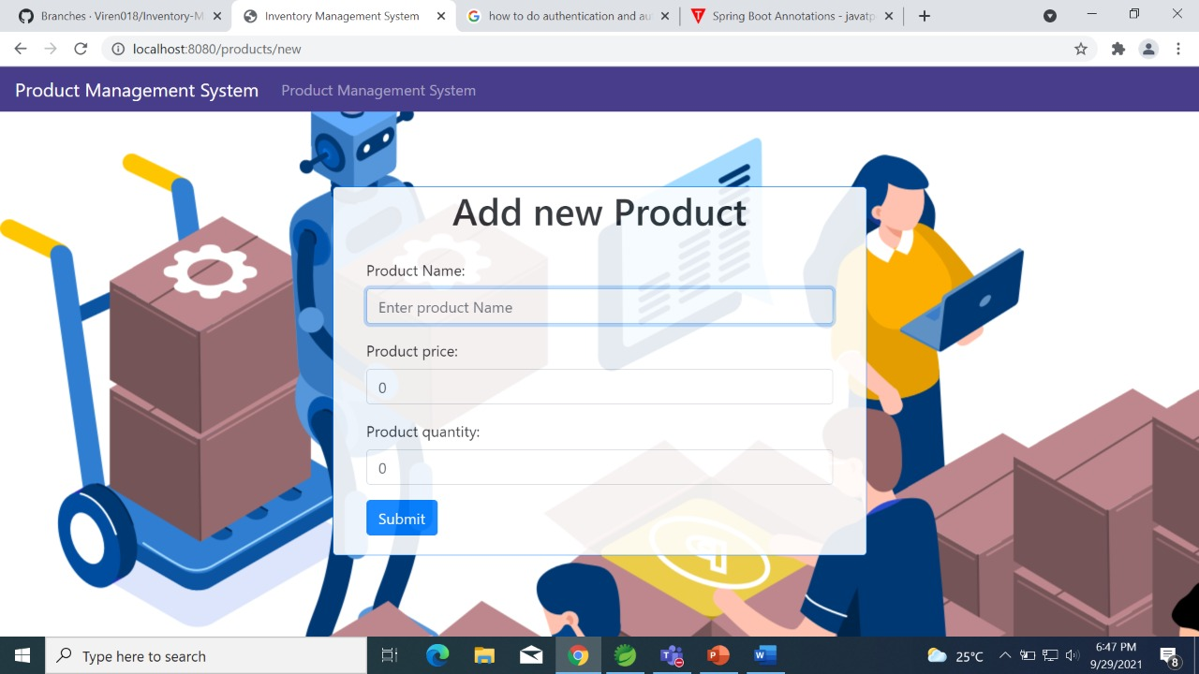

Slide 13
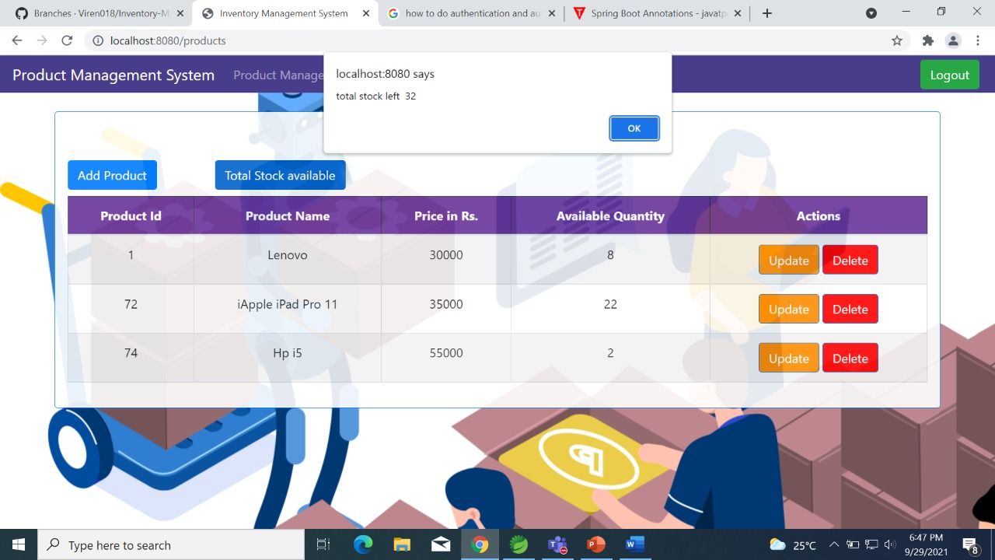

Slide 14
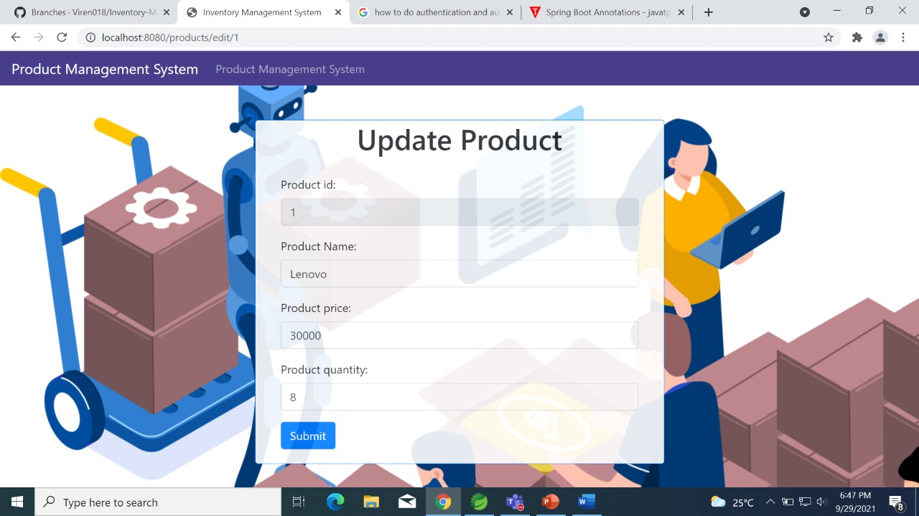

Slide 15
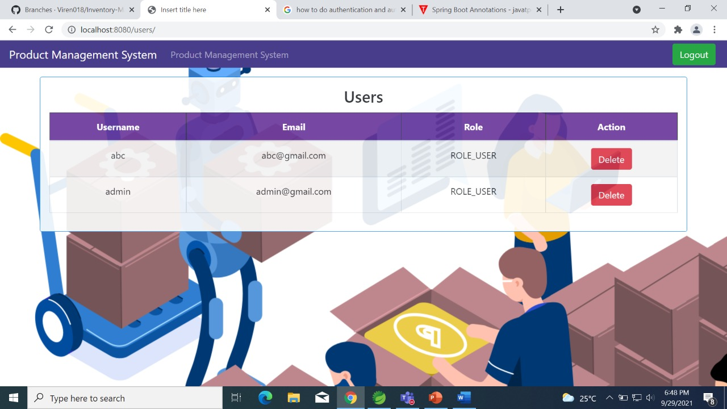

Slide 16
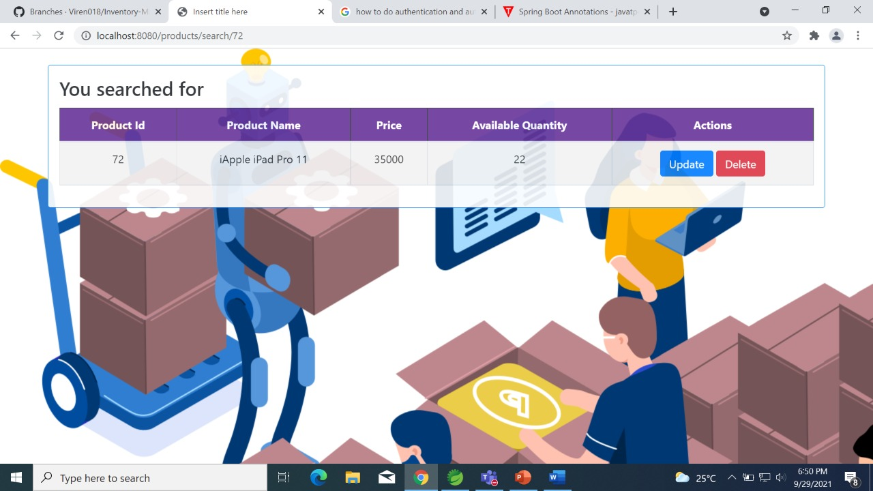

Slide 17
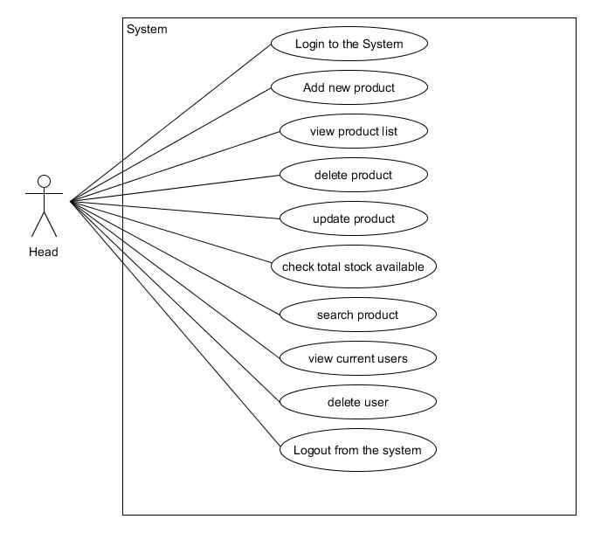
Use Case Diagram

Slide 18
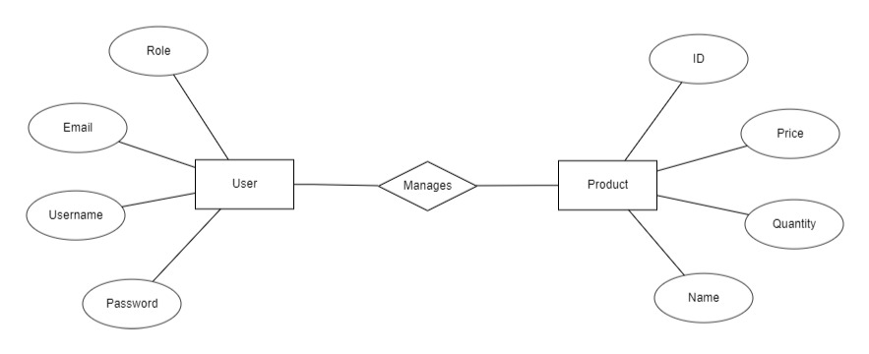
ER Diagram

Slide 19
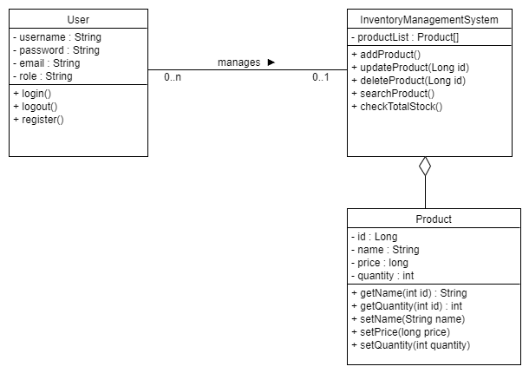
Class Diagram

Slide 20





Product
Database
Analysis
Update
Quantity Check
Process Flow Diagram

Slide 21
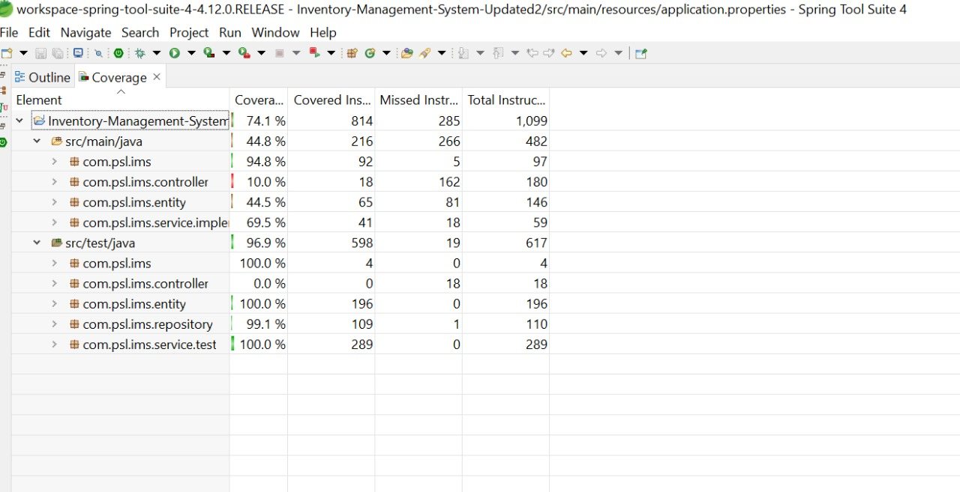
Code Coverage Report

Slide 22

CONCLUSION
This application is designed to reduce human work and efficiently maintaining the stock and thus help in getting an insight on the overall sale at the store.

