Slide 1

Insights
From Feedback Data
From Sales Data

Slide 2
Insights From Feedback Data

Slide 3
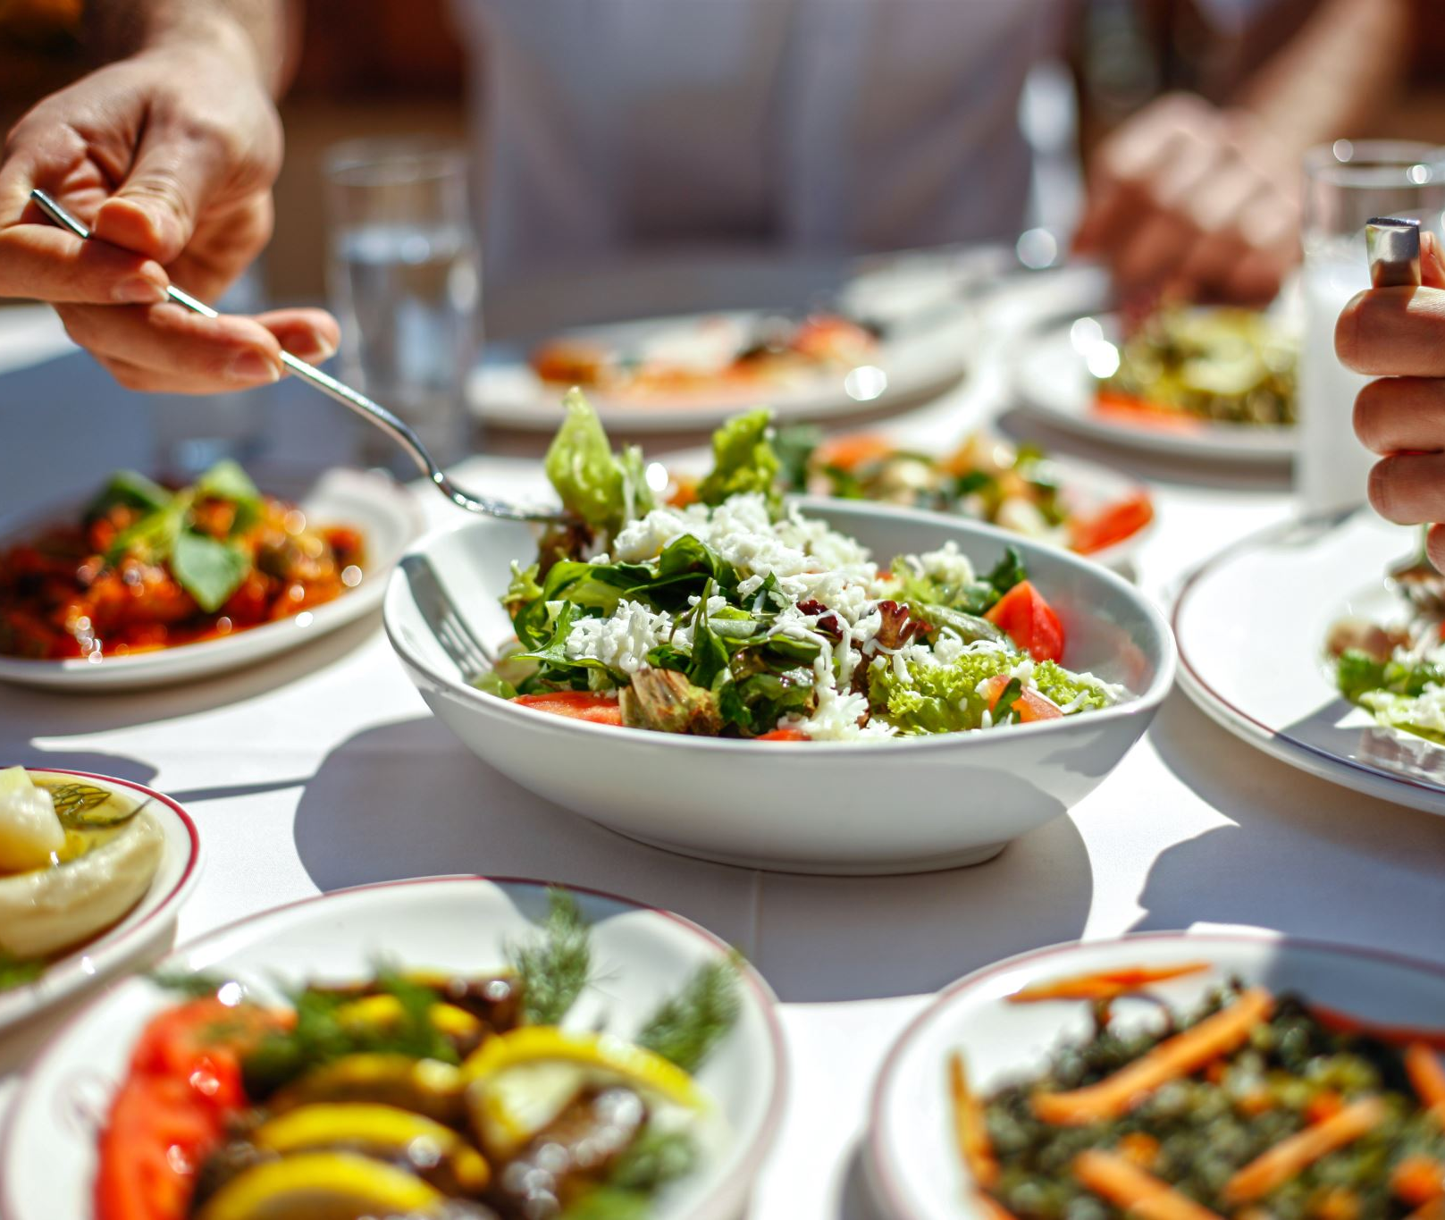
Insights
Average Rating of a Restaurant
Most Common Comments

Slide 4
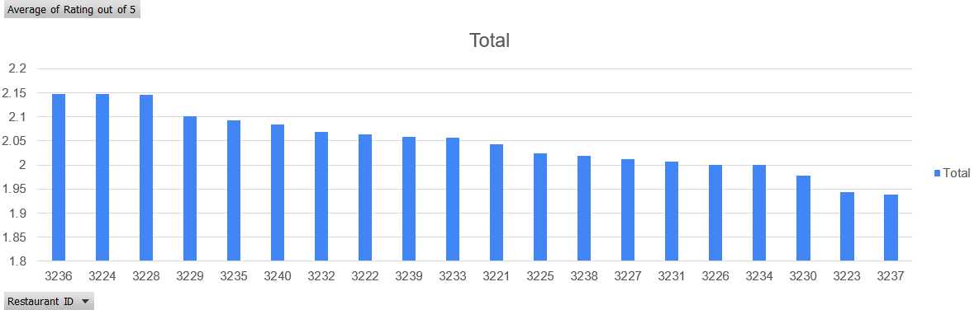
Average Rating of a Restaurant
Act as a proof for organization’s (Eg : Wipro) to penalize/incentivize a restaurant.

Slide 5
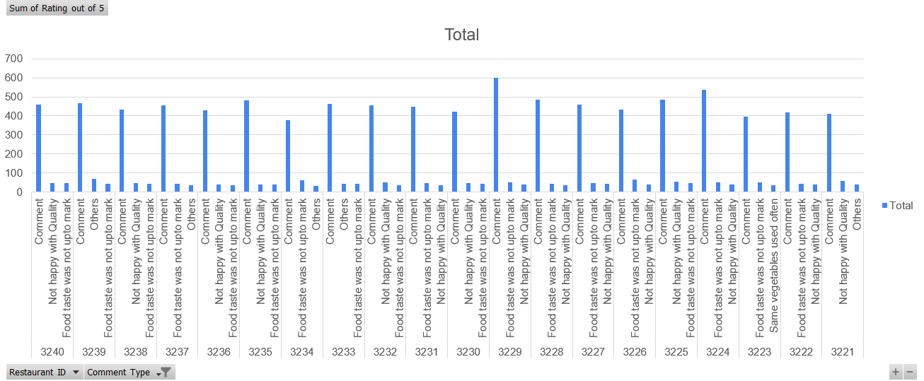
Top comments for a restaurant
Can act as a feature from HB that will help end user’s in deciding which Restaurants to order from.

Slide 6
Insights From Sales Data

Slide 7
Insights
Based On Number
Based On Revenue

Slide 8

Based on Numbers
Most Popular Restaurant
Special Products of a restaurant
Well-Known Dish
Frequency of Item Price
Most Active Time of Day

Slide 9
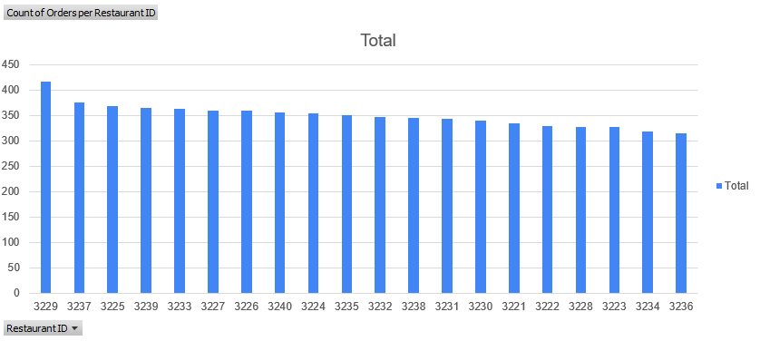
Most Popular Restaurant
Might go as a recommendation from HB to it’s end users.

Slide 10
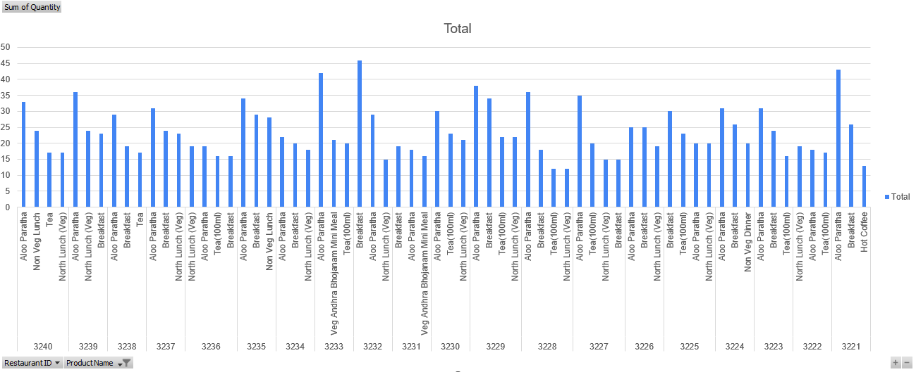
Top Products of an Individual Restaurant
Act as a feature for Restaurants listed on HB that will help them to prepare their inventory better.
Also an opportunity for Restaurants to tweak and bring new variations of the product.

Slide 11
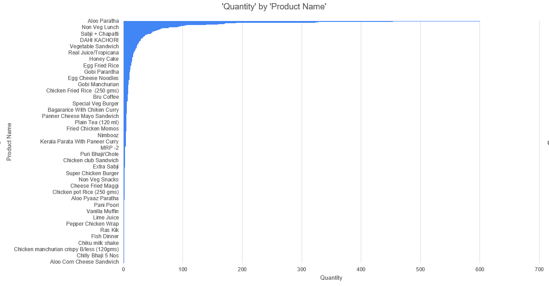
Well-known Dish
Will enable HB to provide this data to selected Restaurants which opt for let’s say “Empowering Restaurants” service of HB.

Slide 12
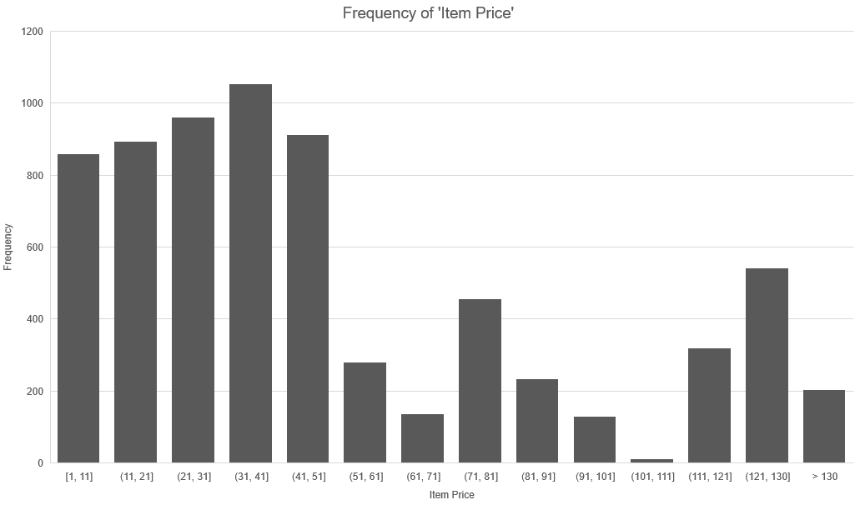
Frequency of Item Price
Empower HB to analyze the F&B space price sensitivity closely.

Slide 13
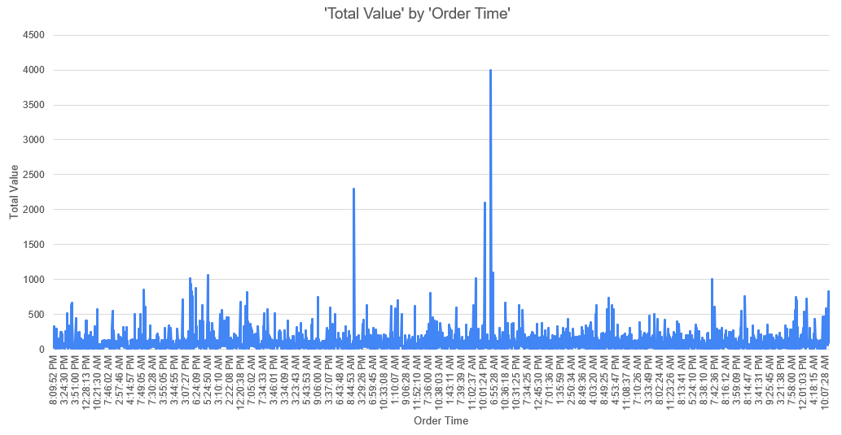
Most Active Time of Day
Empower HB/Restaurant to form an idea regarding at which time of day (Breakfast, Lunch, Dinner) food is most sought after.

Slide 14

Based on Revenue
Maximum sold product by value
Top value generating products per restaurant

Slide 15
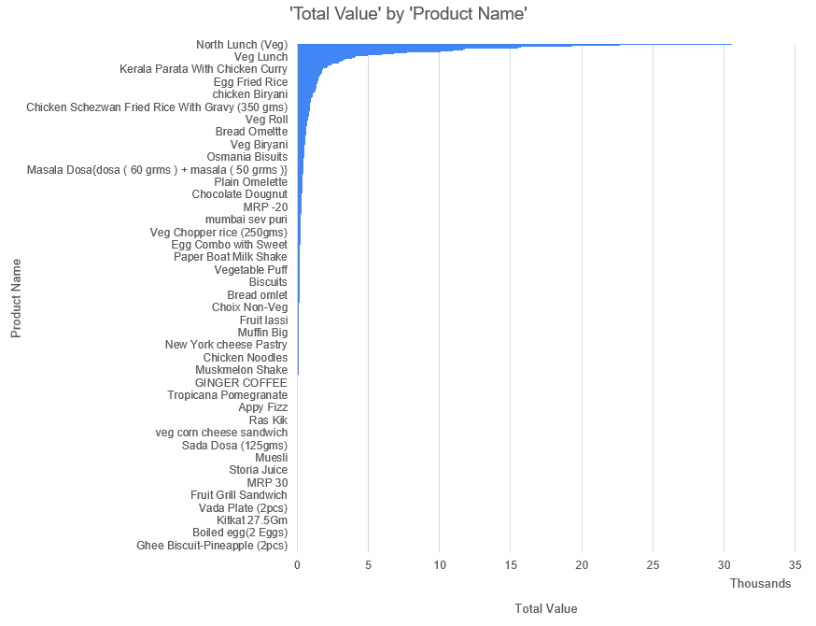
Maximum sold product by value
Will enable HB to provide this data to selected Restaurants which opt for let’s say “Empowering Restaurants” service of HB.

Slide 16
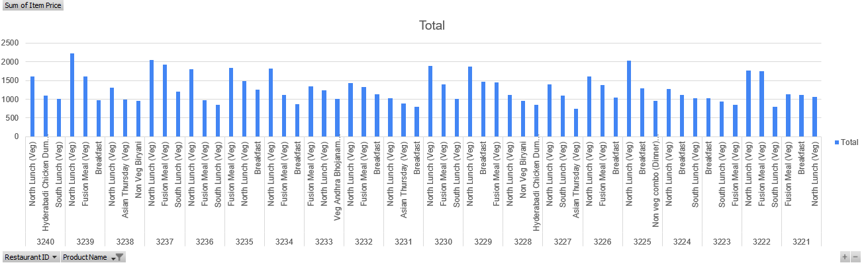
Top Revenue Generating Products per Restaurant
Act as a feature for Restaurants listed on HB that will help them to get an overview of their revenue better.
Also an opportunity for Restaurants to perform some price modifications in order to generate more revenue.

Slide 17

Method of Analysis & Steps Applied
Open Excel Sheet
Go to Analyze Data under Analysis section
Write some queries to get results (For Ex : Frequency of Item Price )
Visualize the results in form of graphs

Slide 18

Why Low no of Feedbacks ?

Slide 19
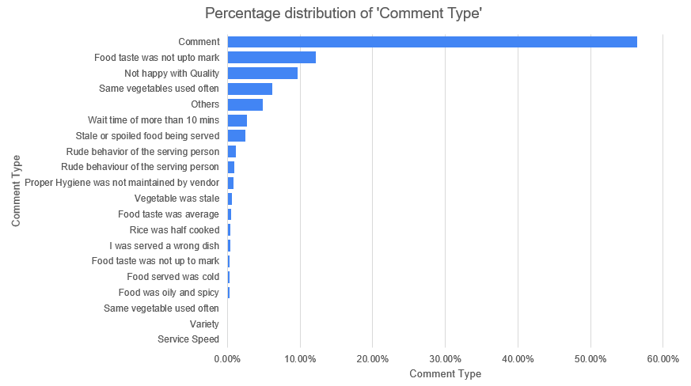
As of now majority prefers to write comment instead of selecting from choices given.

Slide 20
Possible Reasons
User may find it irritating ?
Time Consuming ?
No incentives ?
Lack of Personalization ?

Slide 21
Actionable Items
Keeping questions short and simple –
Being specific about questions
Multiple Choice –
Less time consuming therefore more likely to be answered
More likely to be answered if categorized
Add Colour & Humour –
Attractive feedback will attract more users ( Use some emoji’s, masoct )

Slide 22
Actionable Items
Incentives –
Coupon Code etc. to attract feedbacks
Give 1-way offers to get feedback about HB
Personalization –
Asking personalized Questions
make user feel connected
( Ex : If a user disliked Aloo Prantha previously, If ordered again We may ask – “Better than the last one?” )

Slide 23
Made By :-)
Viren
19UCS152

