Slide 1
Product Design
Coffee Vending Machine

Slide 2
Overview
Business Objective
User Problems
Solutions

Slide 3
Business Objective
Increasing Revenue
Exploiting the established network

Slide 4
User Problems
Waiting Time
Hard to Handle
Failed/Cancelled Orders

Slide 5

Waiting Time
Scenario : Employee want to go and have coffee just after lunch/snacks or in between work hours
Issue : Long waiting time/not sure how many people are waiting in for coffee

Slide 6
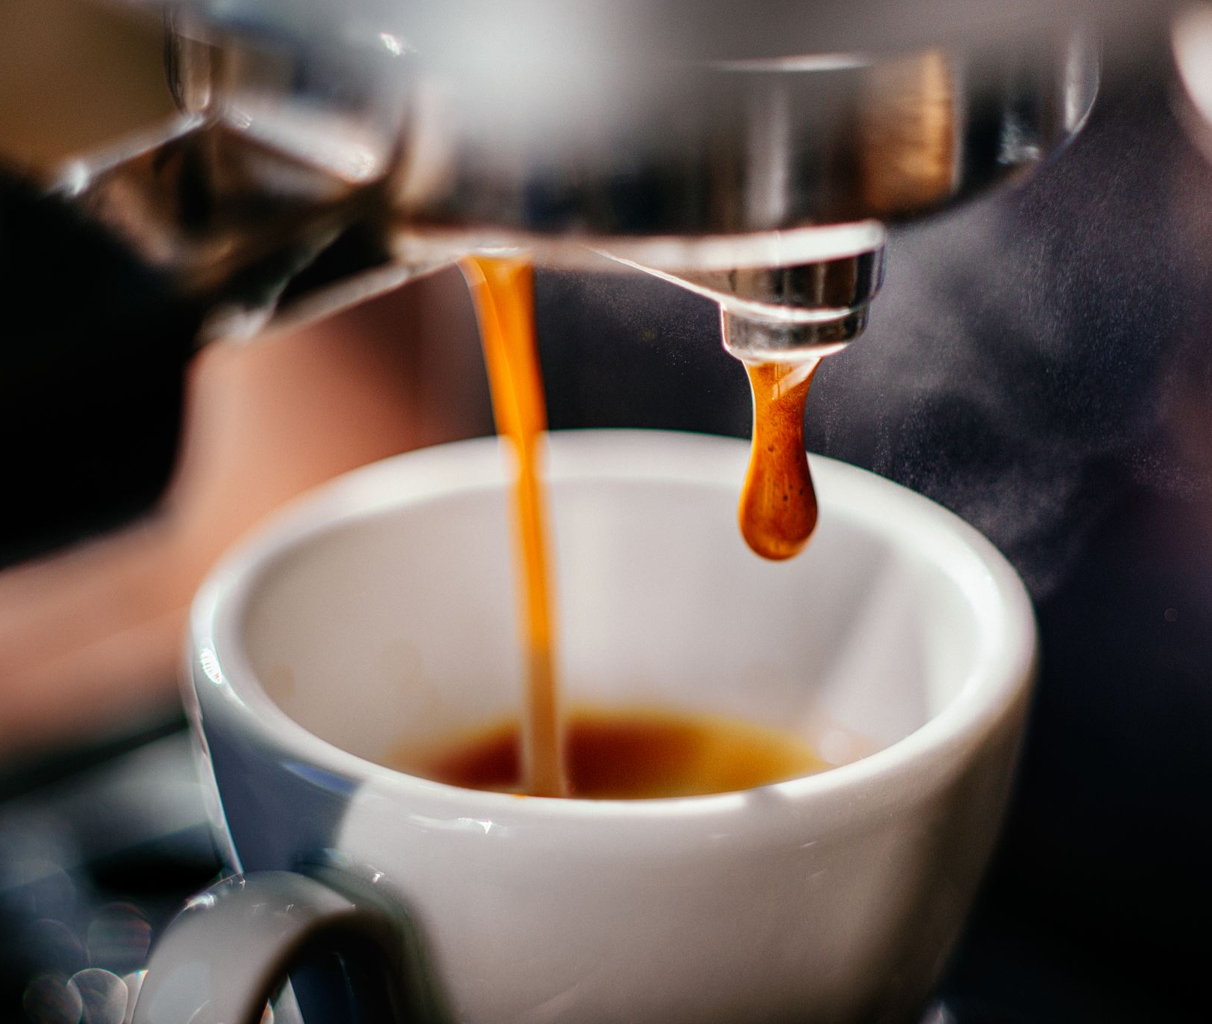
Hard To Handle
A person is required to operate the coffee machine.
More labour means more cost.

Slide 7

Failed/Cancelled Orders
Major issue of Refunds.
Rupee Note stuck.
Less satisfied Consumers.

Slide 8
Solutions
App integration
Hassle Free Management
Pre-Order

Slide 9

App integration
Features :
Place order for a coffee from app.
Notify user for :
Which coffee machine is available
Time for coffee to get ready

Slide 10

Hassle Free Management
Inventory Tracking : If ingredients like beans , milk has finished then a notification to cafeteria manager will be sent to refill it.
Smooth Functioning : If the coffee machine breaks down or require maintenance/service the app will let the manager know in advance .

Slide 11

Pre-Order
For Daily Users :
Place order for upcoming day/week beforehand.

Slide 12

Targeting Potential Clients
Use historical sales data to identify :
Places where most coffee is sold
Most demanded coffee types
Identify price sensitivity.

Slide 13
Owner Benefits
Remote Monitoring
Inventory Management
More Orders More Revenue

