Slide 1
ONLINE FOOD ORDERING SYSTEM (OFOS)
by :-
TEAM-8

Slide 2
Functional requirements
• Login / Sign In: Login screen would display asking user to enter ‘User Id’ & ‘Passwd’. If the supplied user credentials are valid the HomePage would be displayed, else appropriate Login error message would be displayed .
• First time users Register: First time new users/customers would use this screen to create their profile (userId and password). On click of ‘Submit’ button new user entry (user id & password) would be saved into database table for further user authentication purpose.

Slide 3
Functional requirements
• Home Page: On successful user authentication (validation of userid/password provided by the user in login screen) the homepage would be displayed. The Homepage would contain below sections/contents:
• Header section: The header section would be common across all the pages and would mainly have –
Sign In Link – On click it would take to Login page
Search – Should search based on Food, Price, Rating,
FoodStore, FoodType, etc.

Slide 4
Functional requirements
• Main content section: It would display generic Welcome message giving overview of the site.

Slide 5
Project Modules
MODULES | Team member name
CUSTOMER | MEHUL JAIN
FOOD_ITEMS | VIRENDRA SINGH JHALA
FOOD_STORES | KRITIKA ARORA
EMPLOYEE | SUBIN JACOB
ORDERS | PRATEEK JOSHI

Slide 6
1. Customers Module
Registration
Sign up / Log in
Update Profile

Slide 7
2. Food_Items Module
Food Items can be added.
Food Items can be deleted.
Food Items can be modified.

Slide 8
3. Food_Stores Module
Food Stores can be added.
Food Stores can be deleted.
Food Stores can be modified.

Slide 9
4. Employee Module
View Food Store/Food Item Details
Add/Modify/Delete food items to cart
Make Payment for the order

Slide 10
5. Order Module
Add food items to cart
Submit cart to create orders
Display order history
Display order details

Slide 11
ADMINISTRATOR
Administrator can add , manage , modify , view food store details as well as food item details.

Slide 12
USER / CUSTOMER
Customers are allowed to order their favorite food and make payments.

Slide 13
TECHNOLOGY USED
C# as LANGUAGE
ASP.NET WEB API as HTTP FRAMEWORK
ANGULAR as CLIENT SIDE FRAMEWORK
BOOTSTRAP as UI FRAMEWORK
ENTITY FRAMEWORK

Slide 14
ABOUT THE TECHNOLOGY USED
MICROSOFT SQL SERVER MANAGEMENT 2014 as Database
Microsoft SQL Server Management Studio Express (64-bit) is a free, easy-to-use graphical management tool for managing SQL Server 2005 Express Edition and SQL Server 2005 Express Edition with Advanced Services. SSMSE can also manage instances of the SQL Server Database Engine created by any edition of SQL Server 2005.

Slide 15
ABOUT THE TECHNOLOGY USED
MICROSOFT VISUAL STUDIO 2019 as IDE
Improved IntelliSense performance for C++ file
Local development with many common emulators
Simplified test access in Solution Explorer
Git management and repo creation in the IDE
Kubernetes support now included in Microsoft Azure workload

Slide 16
ABOUT THE TECHNOLOGY USED
MICROSOFT VISUAL CODE as Code Editor
It debugs code right from the editor. It launches or attach to your running apps and debug with break points, call stacks, and an interactive console.
It made working with Git and other SCM providers easier. User can review diffs, stage files, and make commits right from the editor. User can push and pull from any hosted SCM service.

Slide 17
ABOUT THE TECHNOLOGY USED
ANGULAR as CLIENT SIDE FRAMEWORK
Angular puts USERS in control over scalability. Meet huge data requirements by building data models on RxJS, Immutable.js or another push-model.
Users can build features quickly with simple, declarative templates.
Users can extend the template language with your own components and use a wide array of existing components.

Slide 18
ABOUT THE TECHNOLOGY USED
WEB API as HTTP SERVER TECHNOLOGY
The ASP.NET Web API is an extensible framework for building HTTP based services that can be accessed in different applications on different platforms such as web, windows, mobile.

Slide 19
ABOUT THE TECHNOLOGY USED
WEB API as HTTP SERVER TECHNOLOGY
The ASP.NET Web API is an extensible framework for building HTTP based services that can be accessed in different applications on different platforms such as web, windows, mobile.

Slide 20
ABOUT THE TECHNOLOGY USED
BOOTSTRAP as UI ENHANCEMENT TOOL
Bootstrap is a free collection of tools for creating a websites and web applications.
It contains HTML and CSS-based design templates for typography, forms, buttons, navigation and other interface components, as well as optional JavaScript extensions..

Slide 21
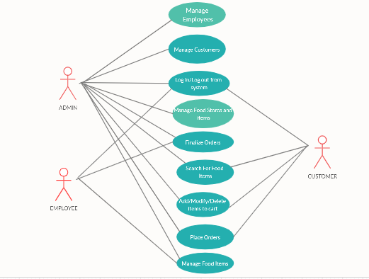
USE CASE DIAGRAM

Slide 22

THANKS!
\

