Slide 1



Call Center Operational Efficiency Analysis
Linked In
Github

Slide 2
Problem Statement
The company aims to enhance the operational efficiency of its call center by closely analyzing agent performance, call handling quality, and customer interactions with the IVR system. The primary objective is to identify patterns and factors contributing to high call drop rates and escalations, thereby enabling targeted improvements that lead to better customer satisfaction, reduced operational costs, and improved first-call resolution rates.

Slide 3
Objectives
1. Agent Performance Optimization
Measure call volume handled per agent to identify workload distribution.
Track Average Handling Time (AHT) to assess efficiency.
Monitor escalation rate per agent for quality control.
Evaluate customer satisfaction scores (if available) to link performance with customer experience.
2. Call Handling Quality Assessment
Analyze call duration distribution to identify abnormal handling patterns.
Review hold times and transfer rates to reduce customer frustration.
Classify call resolution status (Resolved, Escalated, Dropped) to pinpoint service bottlenecks.
3. IVR System Effectiveness
Identify drop-off points within IVR menu to optimize flow and reduce abandonment.
Measure time spent navigating IVR before reaching an agent to improve accessibility.
Track menu option selection trends to align options with user behavior.

Slide 4
Tools & Technologies
Power BI for visualization
MySQL for data storage and SQL analysis
AWS EC2 for computing
Data Overview
2 tables: call_data and agent_details
1,000 recent IVR call records
Connected via primary key

Slide 5
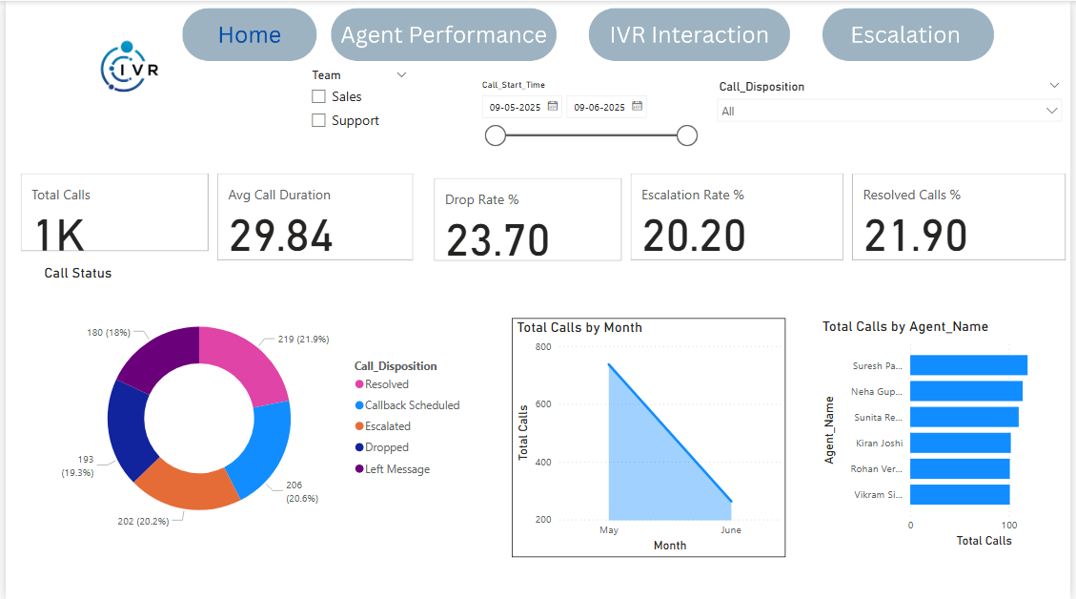
Dashboard - Home Page

Slide 6
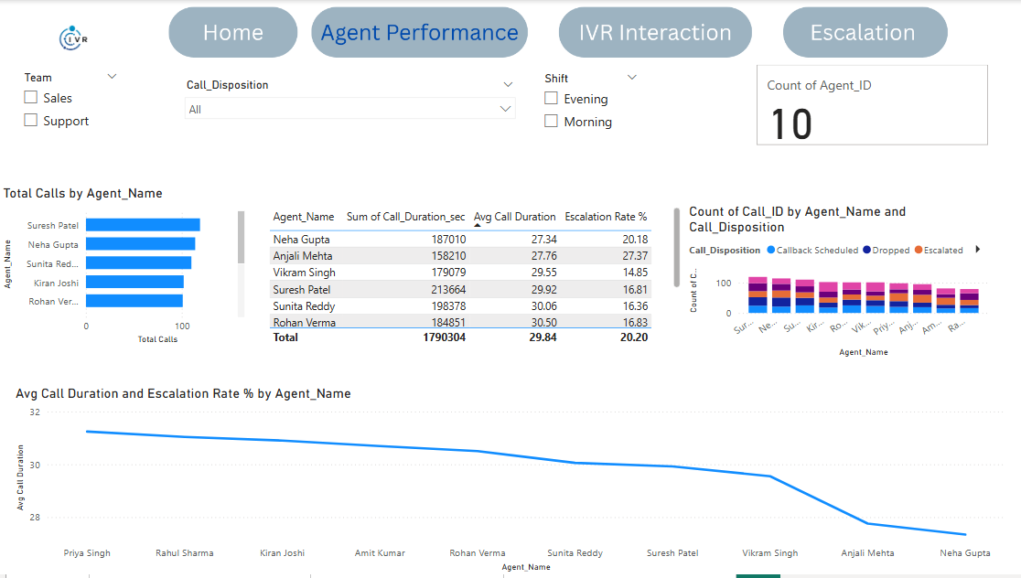
Agent Performance

Slide 7
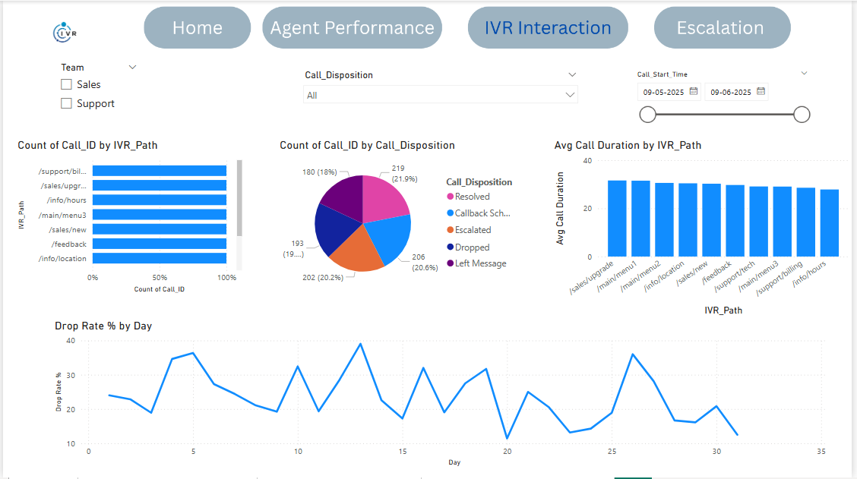
IVR Interaction

Slide 8
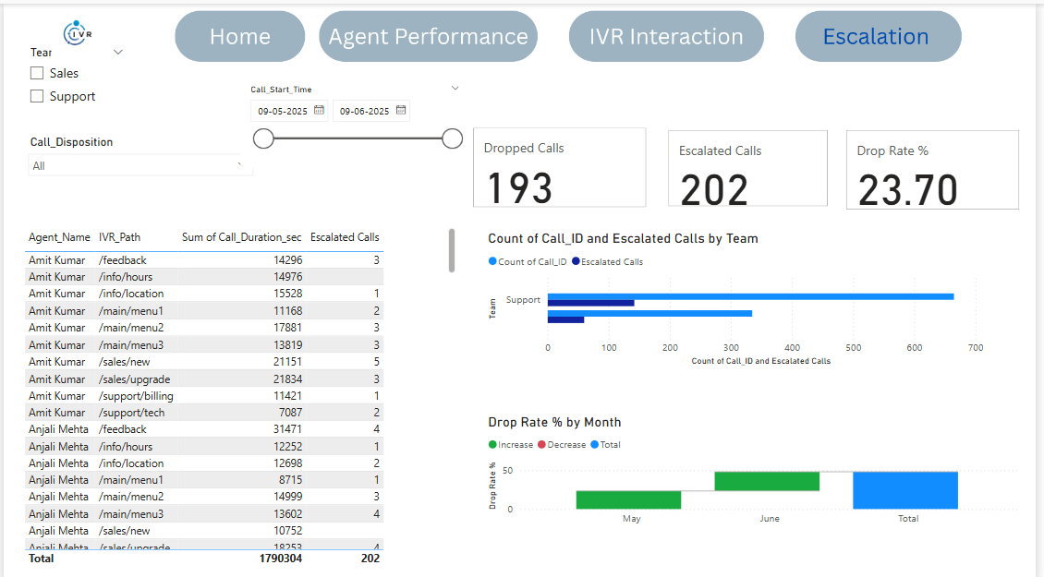
Escalation Analysis

Slide 9
Key Insights
Call drop rate is currently around 24%, which is too high. It needs to be brought down below 10%.
Resolved call rate is under 50%, which is not ideal and needs improvement.
Escalation rate is 20%, which is manageable but can be optimized further.

Slide 10
Recommendations
Reduce Call Drop Rate (~24%) Simplify IVR flow and improve menu clarity to lower drop-offs.
Increase Resolved Call Rate (<50%) Enhance agent training and upgrade IVR to handle common queries better.
Optimize Escalation Rate (~20%) Add decision support tools for agents; route smartly to reduce escalations.
Monitor Call Volume Trends Align sales/service strategies to maintain consistent call traffic.
Improve IVR System Performance Strengthen infrastructure and introduce AI-driven call routing.
Use Call Path Insights Identify common issues from long-duration paths to enhance self-service option

Slide 11
Conclusion
The analysis revealed key inefficiencies in IVR performance and call resolution rates.
High call drop (24%) and low resolved call rate (<50%) indicate urgent areas for improvement.
Escalation levels are manageable (20%) but can be optimized further.
IVR interaction data offers valuable insights to enhance customer experience.
Consistent monitoring and targeted improvements will drive operational efficiency and customer satisfaction.

Slide 12


