Slide 1


GUJARAT TECHNOLOGICAL UNIVERSITY Chandkheda, Ahmedabad Affiliated GOVERNMENT ENGINEERING COLLEGE BHAVNAGAR DEPARTMENT OF INFORMATION TECHNOLOGY
A Presentation On : DeskBook
Under subject of
Summer Internship(3170001)
B. E. IV, Semester –VIII (Information Technology)
Submitted by:
Name of student: Patel Virenkumar Rameshbhai
Enrolment No.: 190210116063
External Mentor
Revant Patel
Internal Mentor
Prof.Sweta Garasia
Academic year
2023

Slide 2
Outline
Introduction
Requirement Analysis
Objective
Features
Tool and technology
Conclusion
References

Slide 3

Introduction
The DeskBook web-application offers a digital solution for managing and assigned seats for employees. With this system, employees can easily view available seats for the day, book a seat, and request for approval. This system provides a convenient way to manage the mode of work and make seating arrangements more flexible.

Slide 4
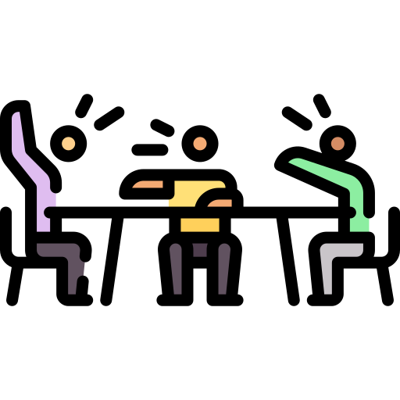

Requirement Analysis
companies are adapting new work environments where employee can work on offline or online mode based on their requirement.
It can leads to situations where more people come to the office than there are available seats.
This can cause delays, frustration and reduced productivity for employees who are unable to find a seat.

Slide 5
Objective
Create a user-friendly digital solution for managing and assigning seats.
providing real-time information on seat availability and allowing employees to reserve their seats in advance.
Improve work efficiency and make seating arrangements more flexible.
Managing company resourses of more efficiantly.
Enable companies to focus on other core activities.

Slide 6
Features
Seat Availability: View real-time seat availability.
Seat Booking: Book a seat for the day.
Approval System: Manager approval of seat bookings.
Dashboard: View seat bookings and approval status.
Customizable: Customize seating arrangements and availability based on company policies and preferences.
Integration: Integration with other applications, such as calendar and meeting scheduling tools, to streamline work processes.

Slide 7
Side Project : 1Medify

Slide 8
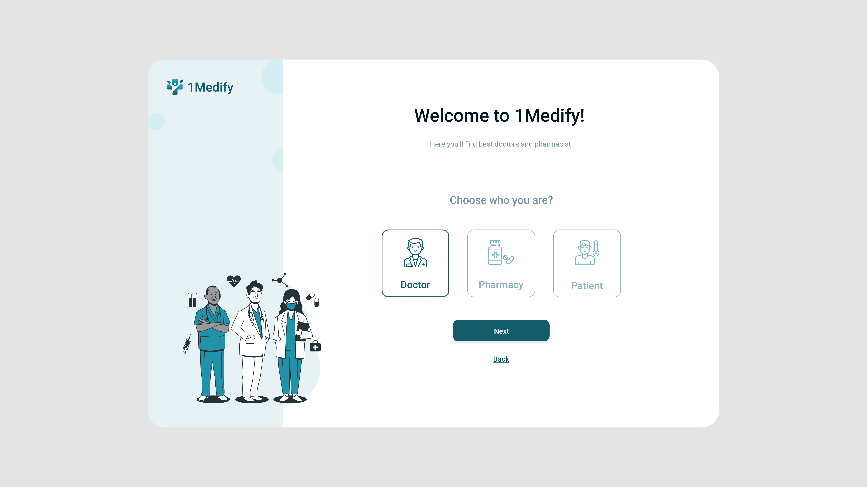
Work Done: Welcome Screen

Slide 9
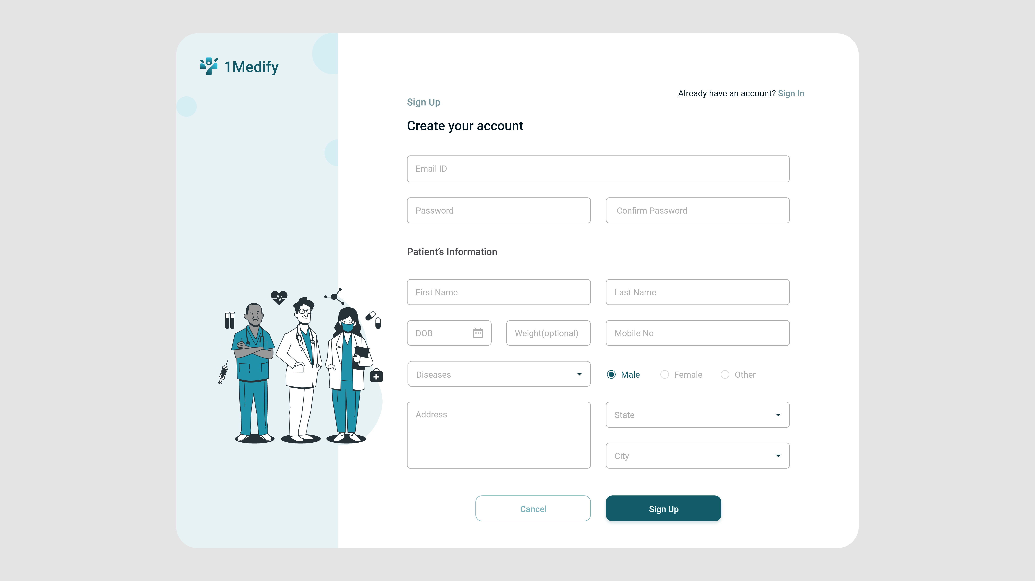
SignUp Page

Slide 10
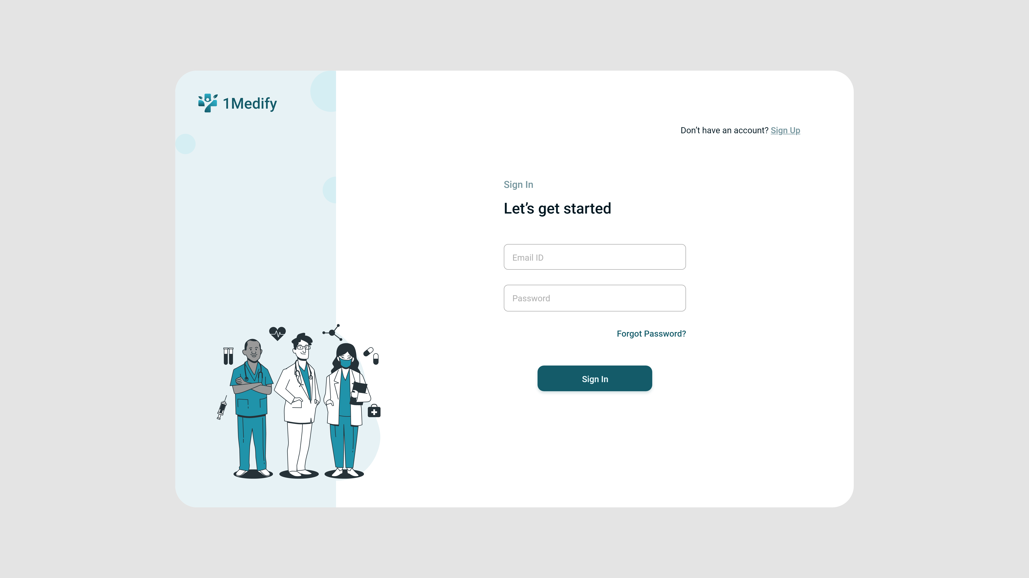
Login Page

Slide 11
Tools & Technology
Backend: Programming Language – Java
Frontend: HTML, CSS, Bootstrap and Angular
Database: MSSQL Server
Frameworks : Spring 5, Spring Security 5, Spring Boot 2.0, .NET Frameworks
DevOps: Jenkins, SonarQube, Maven[java], .Net Build, Nexus, Ansible

Slide 12
Conclusion
The DeskBook application provides a digital solution for managing office seating arrangements, enabling employees to easily book available seats and work in a flexible and efficient manner. By optimizing office space utilization and enhancing employee experience, DeskBook helps companies adapt to changing work environments and improve productivity.

Slide 13
References
Text Books/Reference Books: -
E-Books: -
Website :
-https://www.zippia.com/advice/hybrid-work-statistics
-https://sequre.app/seat-booking-app

Slide 14
Thank You

