Slide 1
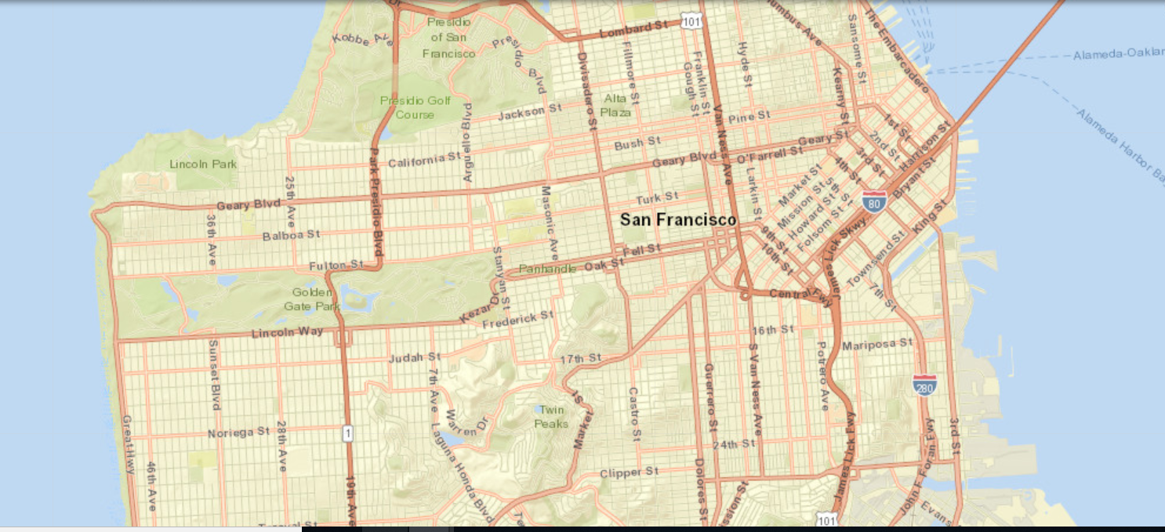
SAN FRANCISCO CRIME
2018

Slide 2
Data Science Capstone Project
SAN FRANCISCO CRIME DATA 2018
The project is about in-depth study of the city of San Francisco. It is mainly focused on analyzed to improving and prevent crime of the city .
This project also provide deeper understanding on how many crimes succed in the city.
Reports included are those for incidents that occurred starting January 1, 2018.

Slide 3
AIM OF ANALYSIS
The description of the crimes is varied and the objective of this analysis is to be able to identify if crimes with the same description have a correlation with a particular area in order to act in the future in a preventive manner.
To make this analysis and to group crimes based on different characteristics we can use different types of cluster analysis which we will analyze later.
We don't know if exist any common group of crime wich are related on particular characteristics and we can't assert which number of group is more efficient to do on future an analysis to prevents them.

Slide 4
DATASET
Reports included are those for incidents that occurred starting January 1, 2018.
The dataset is open source and can be downloaded and made available on the website of the US state.Dataset has 533 rows and 22 columns.
Each crime is identified by specific ID and Case Number of reports submitted by an agent. The variables 'Description', 'Name of District' and the location (indates with two variables 'Community Area' and 'Location') are fundamentals to do a cluster analysis. The coordinates can be used to build a map.

Slide 5
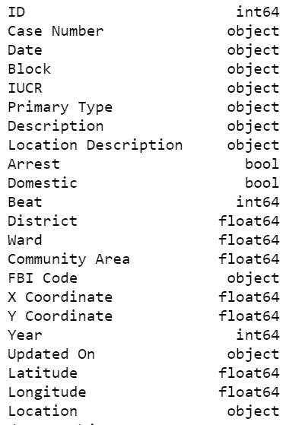
There are variable avaiable for the analysis. Each variable is fundamental to our analysis.
With the coordinate we can plot the map of the city with respective cluster of crime, based on Location and Community Area. it is also possible to frame the most skilled districts in detecting the crimes of the city.

Slide 6
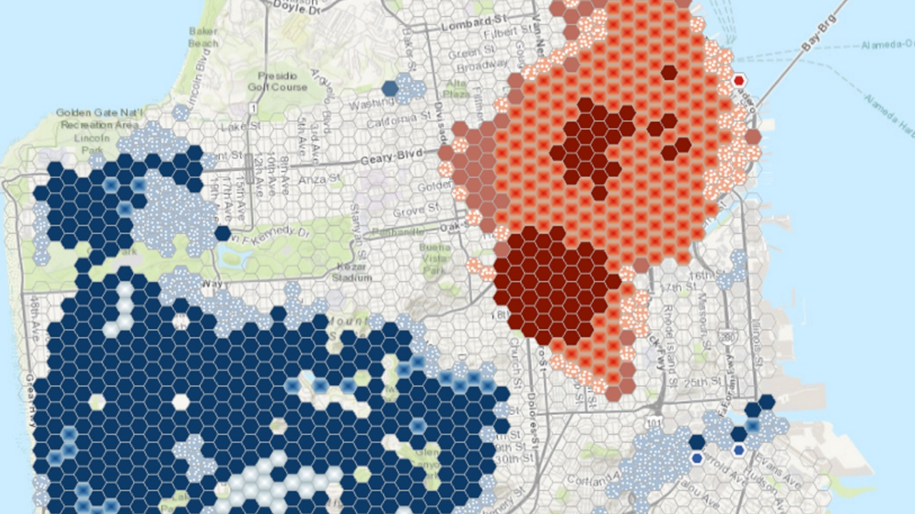
METHODOLOGIES USED:
CLUSTER ANALYSIS with K-MEANS

