Slide 1
Arrays
Presented Quentin Ochem
university.adacore.com

Slide 2
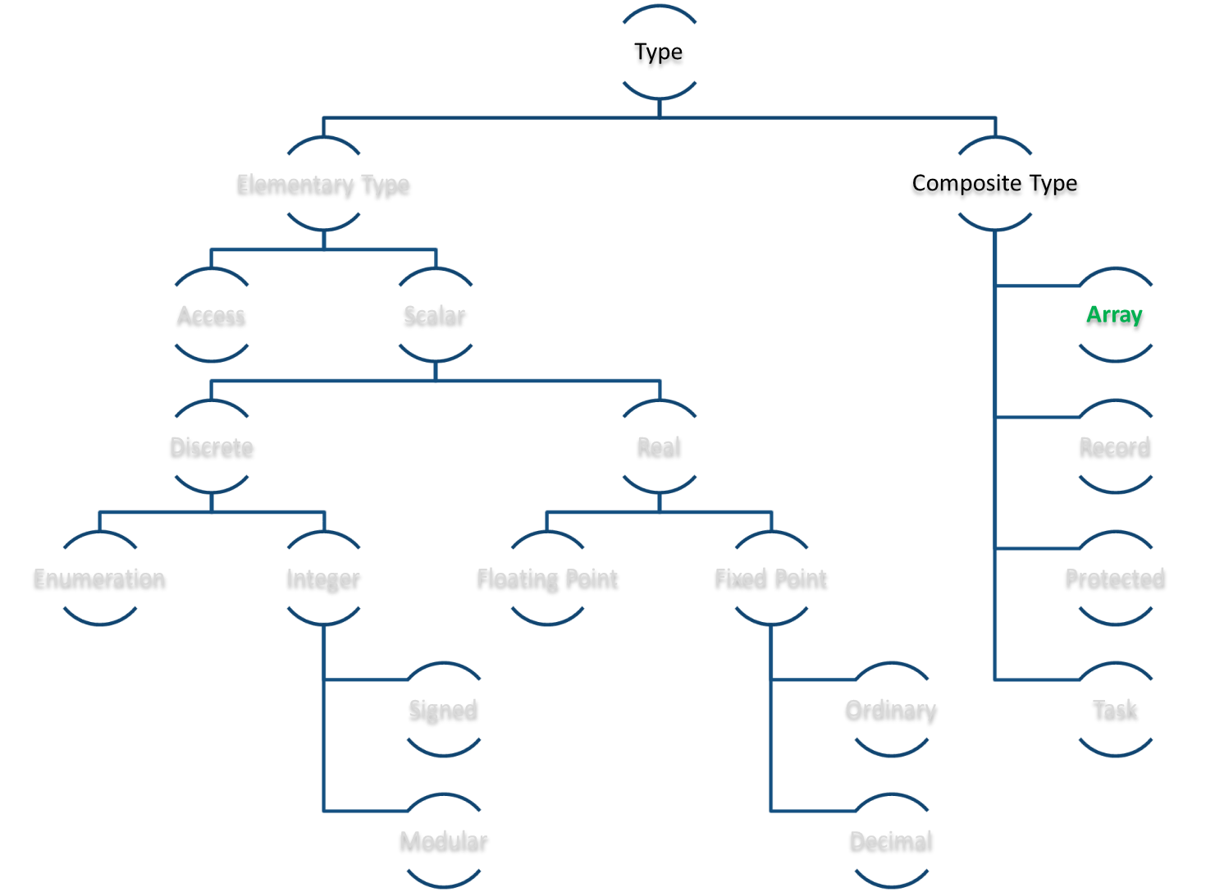
Ada Type Model

Slide 3
Arrays are First Class Citizens
All arrays are (doubly) typed
Arrays types properties are
  The index type (can be any discrete type, with optional specific boundaries)
  The component type (can be any definite type)
Arrays objects properties are
  The array type
  Specific boundaries
  Specific values
C++
type T is array (Integer range <>) of Integer; A : T (0 .. 14); | int * A = new int [15];
Ada

Slide 4
Definite vs. Indefinite Types
Definite types are types that can be used to create objects without additional information
  Their size is known
  Their constraints are known
Indefinite types need additional constraint
Array types can be definite or indefinite
Components of array types must be definite
type Definite is array (Integer range 1 .. 10) of Integer; type Indefinite is array (Integer range <>) of Integer; A1 : Definite; A2 : Indefinite (1 .. 20);

Slide 5
Array Indices
Array indexes can be of any discrete type
  Integer (signed or modular)
  Enumeration
Array indexes can be defined on any contiguous range
Array index range may be empty
Array indexes are computed at the point of array declaration
type A1 is array (Integer range <>) of Integer; type A2 is array (Character range 'a' .. 'z') of Integer; type A3 is array (Integer range 1 .. 0) of Integer; type A4 is array (Boolean) of Integer;
X : Integer := 0; type A is array (Integer range 1 .. X) of Integer; -- changes to X don't change A instances after this point

Slide 6

Accessing Array Components
Array components can be directly accessed
Array types and array objects offer ‘Length, ‘Range, ‘First and ‘Last attributes
On access, bounds are dynamically checked and raise Constraint_Error if out of range
type A is array (Integer range <>) of Integer; V : A (1 .. 10); begin V (1) := 0;
type A is array (Integer range <>) of Float; V : A (1 .. 10); begin V (0) := 0.0; -- NOK

Slide 7
Array Copy
Array operations are first class citizens
In copy operations, lengths are checked, but not actual indices
type T is array (Integer range <>) of Integer; A1 : T (1 .. 10); A2 : T (1 .. 10); begin A1 := A2;
type T is array (Integer range <>) of Integer; A1 : T (1 .. 10); A2 : T (11 .. 20); A3 : T (1 .. 20); begin A1 := A2; -- OK A1 := A3; -- NOK

Slide 8
Array Initialization
Array copy can occur at initialization time
If the array type is of an indefinite type, then an object of this type can deduce bounds from initialization
type T is array (Integer range <>) of Integer; A1 : T (1 .. 10); A2 : T (11 .. 20) := A1;
type T is array (Integer range <>) of Integer; A1 : T (1 .. 10); A2 : T := A1; -- A2 bounds are 1 .. 10

Slide 9
Array Slices
It’s possible to consider only a part of the array using a slice
  For array with only one dimension
Slices can be used where an array object is required
type T is array (Integer range <>) of Integer; A1 : T (1 .. 10); A2 : T (1 .. 20) := …; begin A1 := A2 (1 .. 10); A1 (2 .. 4) := A2 (5 .. 7);

Slide 10
Array Literals (Aggregates)
Aggregates can be used to provide values to an array as a whole
They can be used wherever an array value is expected
Finite aggregate can initialize variable constraints, lower bound will be equal to T'First
({[<position> => ] <expression>,} [others => <expression>]) (1, 2, 3) -- finite positional aggregate (1 => 1, 2 => 10, 3 => 30) -- finite named aggregate (1, others => 0) -- indefinite positional aggregate (1 => 1, others => 0) -- indefinite named aggregate
type T is array (Integer range <>) of Integer; V1 : T := (1, 2, 3); V2 : T := (others => 0); -- NOK (initialization) begin V1 := (others => 0); -- OK (assignment)

Slide 11
Array Concatenation
Two 1-dimensional arrays can be concatenated through the “&” operator
  The resulting array lower bound is the lower bound of the left operand
An array can be concatenated with a value
type T is array (Integer range <>) of Integer; A1 : T := (1, 2, 3); A2 : T := (4, 5, 6); A3 : T := A1 & A2;
type T is array (Integer range <>) of Integer; A1 : T := (1, 2, 3); A2 : T := A1 & 4 & 5;

Slide 12
Array Equality
Two 1-dimensional arrays are equal if
  Their size is equal
  Their components are equal one by one
Actual indexes do not matter in array equality
type T is array (Integer range <>) of Integer; A1 : T (1 .. 10); A2 : T (1 .. 20); begin if A1 = A2 then -- ALWAYS FALSE

Slide 13
Loops over an Array
Through an index loop
Through an object loop
type T is array (Integer range <>) of Integer; A : T (1 .. 10); for I in A'Range loop A (I) := 0; end loop;
type T is array (Integer range <>) of Integer; A : T (1 .. 10); for V of A loop V := 0; end loop;

Slide 14
Matrices
Two dimensional arrays
Attributes are 'First (dimension), 'Last (dimension), 'Range (dimension)
Arrays of arrays
type T is array (Integer range <>, Integer range <>) of Integer; V : T (1 .. 10, 0 .. 2); begin V (1, 0) := 0;
type T1 is array (Integer range <>) of Integer; type T2 is array (Integer range <>) of T1 (0 .. 2); V : T (1 .. 10); begin V (1)(0) := 0;

Slide 15
Strings
Strings are regular arrays
There is a special String literal
The package ASCII provides names for Character values
type String is array (Positive range <>) of Character;
V : String := "This is it"; V2 : String := "Here come quotes ("")";
V : String := "This is nul terminated" & ASCII.NUL;

Slide 16
Default Component Values
By default, arrays do not come with default values
It’s possible to force a default value initialization through a static expression (value known at compile-time)
For performance reasons, the above may not be desirable
type T is array (Integer range <>) of Integer; V : T (1 .. 20); begin Put_Line (Integer'Image (V (1))); -- Displays an uninitialized value
type T is array (Integer range <>) of Integer with Default_Component_Value => 0; V : T (1 .. 20); begin Put_Line (Integer'Image (V (1))); -- Displays 0

Slide 18
(1/10)
type My_Int is new Integer range 1 .. 10; type T is array (My_Int) of Integer; V : T; begin V (1) := 2;

Slide 19
(1/10)
type My_Int is new Integer range 1 .. 10; type T is array (My_Int) of Integer; V : T; begin V (1) := 2;
Everything is OK

Slide 20
(2/10)
type T is array (Integer) of Integer; V : T; begin V (1) := 2;

Slide 21
(2/10)
type T is array (Integer) of Integer; V : T; begin V (1) := 2;
This can actually compile fine,
but will fail at compilation due to the
amount of data reserved on the stack

Slide 22
(3/10)
type T1 is array (Integer range <>) of Integer; type T2 is array (Integer range <>) of Integer; V1 : T1 (1 .. 3) := (others => 0); V2 : T2 := (1, 2, 3); begin V1 := V2;
Notes:
Assignment is wrong, V1 and V2 are not of the same type.

Slide 23
(3/10)
type T1 is array (Integer range <>) of Integer; type T2 is array (Integer range <>) of Integer; V1 : T1 (1 .. 3) := (others => 0); V2 : T2 := (1, 2, 3); begin V1 := V2;
Compilation error, V1 and V2 are not of the same type
Notes:
Assignment is wrong, V1 and V2 are not of the same type.

Slide 24
(4/10)
type T is array (Integer range <>) of Integer; V : T := (1, 2, 3); begin V (0) := V (1) + V (2);
Notes:
Access is wrong, boundaries are equals to ‘First, ‘First + 1 and ‘First + 2

Slide 25
(4/10)
type T is array (Integer range <>) of Integer; V : T := (1, 2, 3); begin V (0) := V (1) + V (2);
These three accesses are wrong, V is constrained between Integer’First .. Integer’First + 2
Notes:
Access is wrong, boundaries are equals to ‘First, ‘First + 1 and ‘First + 2

Slide 26
(5/10)
type T is array (Integer range <>) of Integer; V1 : T (1 .. 2); V2 : T (10 .. 11) := (others => 0); begin V1 := V2;

Slide 27
(5/10)
type T is array (Integer range <>) of Integer; V1 : T (1 .. 2); V2 : T (10 .. 11) := (others => 0); begin V1 := V2;
Everything is OK. The assignement will slide the values of V2 in the correct indexes.

Slide 28
(6/10)
X : Integer := 10; type T is array (Integer range 1 .. X) of Integer; V1 : T; begin X := 100; declare V2 : T; begin V1 := V2;

Slide 29
(6/10)
X : Integer := 10; type T is array (Integer range 1 .. X) of Integer; V1 : T; begin X := 100; declare V2 : T; begin V1 := V2;
No problem. Even if the value of X changes, the array declaration is not impacted
V1 and V2 have the same boundaries

Slide 30
(7/10)
type T is array (Integer range <>) of Integer; V1 : T (1 .. 3) := (10, 20, 30); V2 : T := (10, 20, 30): begin for I in V1'Range loop V1 (I) := V1 (I) + V2 (I); end loop;

Slide 31
(7/10)
type T is array (Integer range <>) of Integer; V1 : T (1 .. 3) := (10, 20, 30); V2 : T := (10, 20, 30): begin for I in V1'Range loop V1 (I) := V1 (I) + V2 (I); end loop;
V2 (I) will raise an exception because the range is different from the one of V1

Slide 32
(8/10)
type T is array (Integer range 1 .. 10) of Integer; V : T (2 .. 9);

Slide 33
(8/10)
type T is array (Integer range 1 .. 10) of Integer; V : T (2 .. 9);
The boundaries of T are fixed, can’t be changed at object declaration
Notes:
T2 doesn’t work because TS is already constrained.

Slide 34
(9/10)
type String_Array is array (Integer range <>) of String;

Slide 35
(9/10)
type String_Array is array (Integer range <>) of String;
Array can only contain constrained objects
Notes:
String has to be constrained for this to work.

Slide 36
(10/10)
X : Integer := 0; type T is array (Integer range <>) of Integer with Default_Component_Value => X; V : T (1 .. 10);

Slide 37
(10/10)
X : Integer := 0; type T is array (Integer range <>) of Integer with Default_Component_Value => X; V : T (1 .. 10);
X is not a static expression
(unknown at compile-time)

