Slide 1
My super awesome MTEC 2250 Idea
By Virgilio Samo III

Slide 2
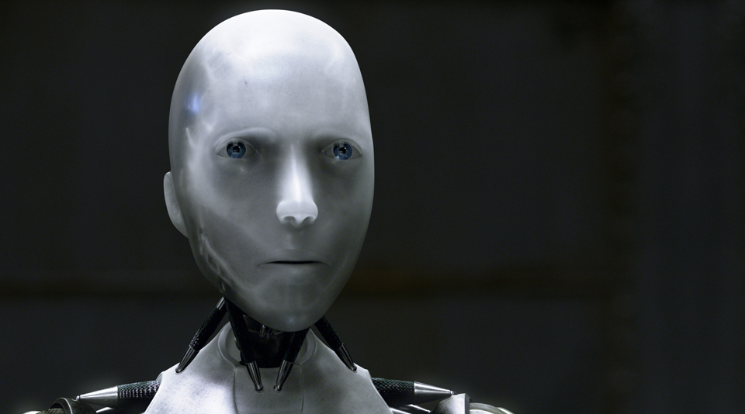
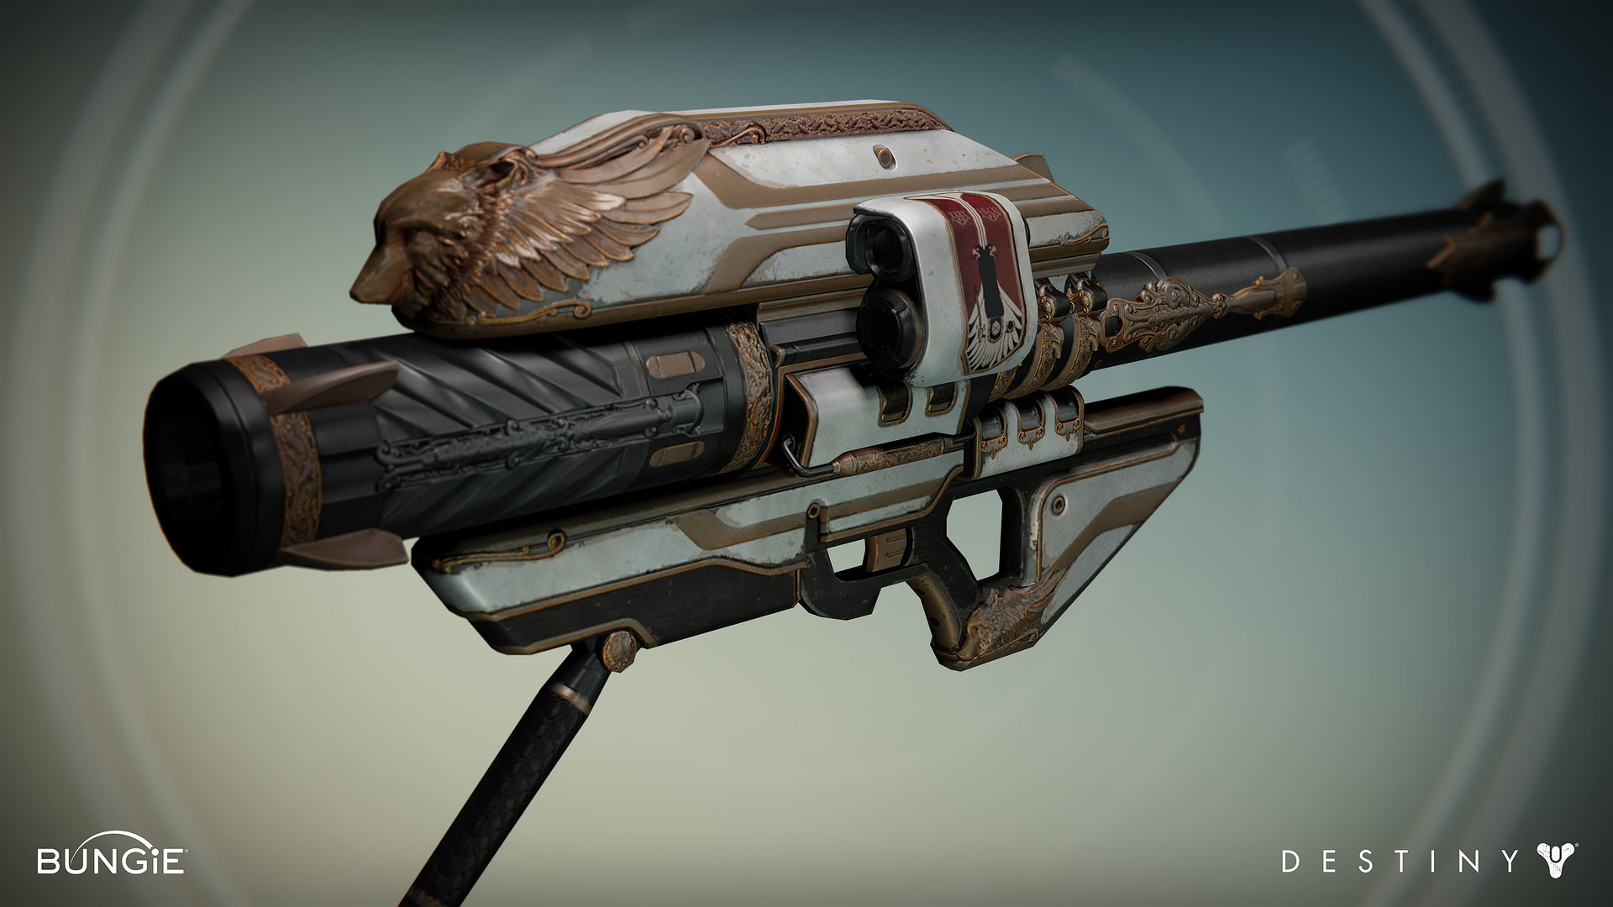
Shifting the balance between good and evil. What form will this idea take?
Robot?
Weapon?

Slide 3
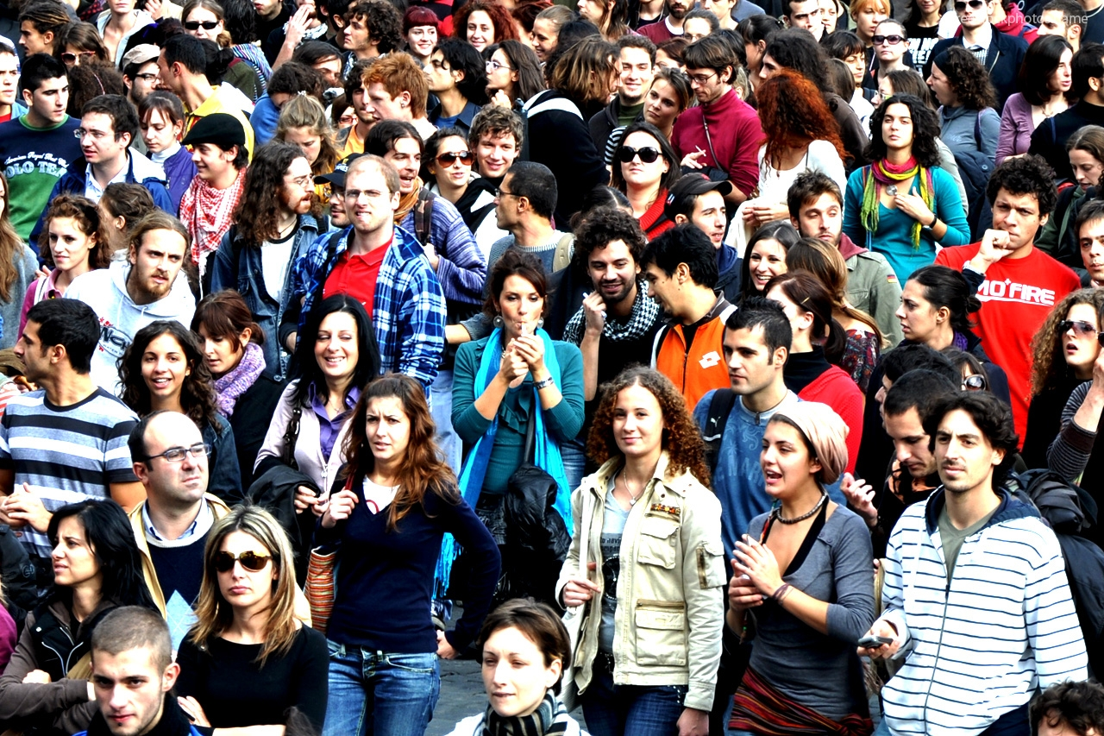
Who is the intended audience?

Slide 4
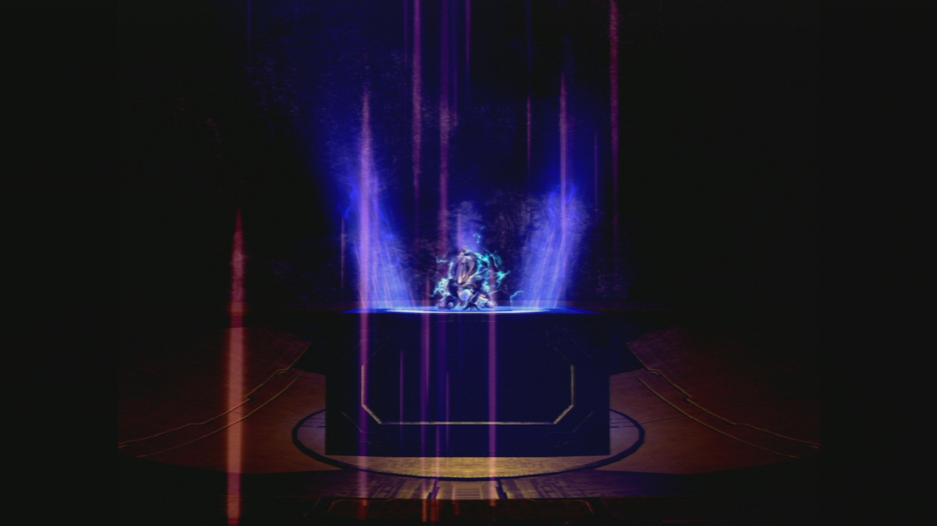
Why was this idea created?
Victim of bullying.
Hated for no reason.
Under-appreciated.
Hatred for the Illuminati.
People thinking they're above the law.
Desire to protect and help the innocent.
Parents and friends.

Slide 5
Decisions, decisions, decisions (how will it judge you?)
Yes
No
Ability to change
Levels of aggression
Brainwave patterns
Stress levels
Human interaction
Truth
Appearance
Past mistakes
Emotions
Commitment
Skills
Talents

Slide 6
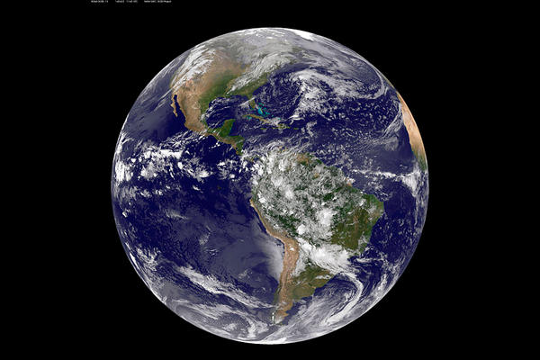
Where will this be deployed?

Slide 7
When will this idea be a reality?
20 years from now (maybe less).
Advanced engineering.
Human history.
Artificial Intelligence.
Programming.

Slide 8
Treat others the way you want to be treated.
The Ultimate Golden Rule
The life of good is more rewarding than the life of evil.

Slide 9
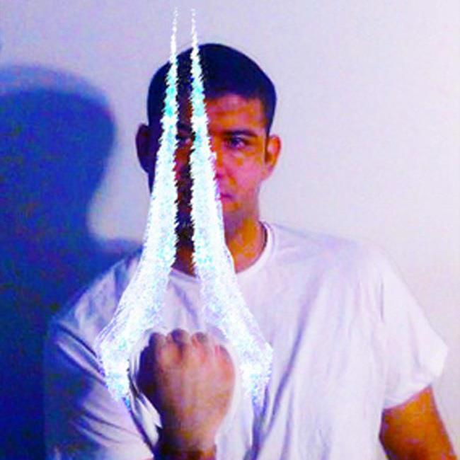
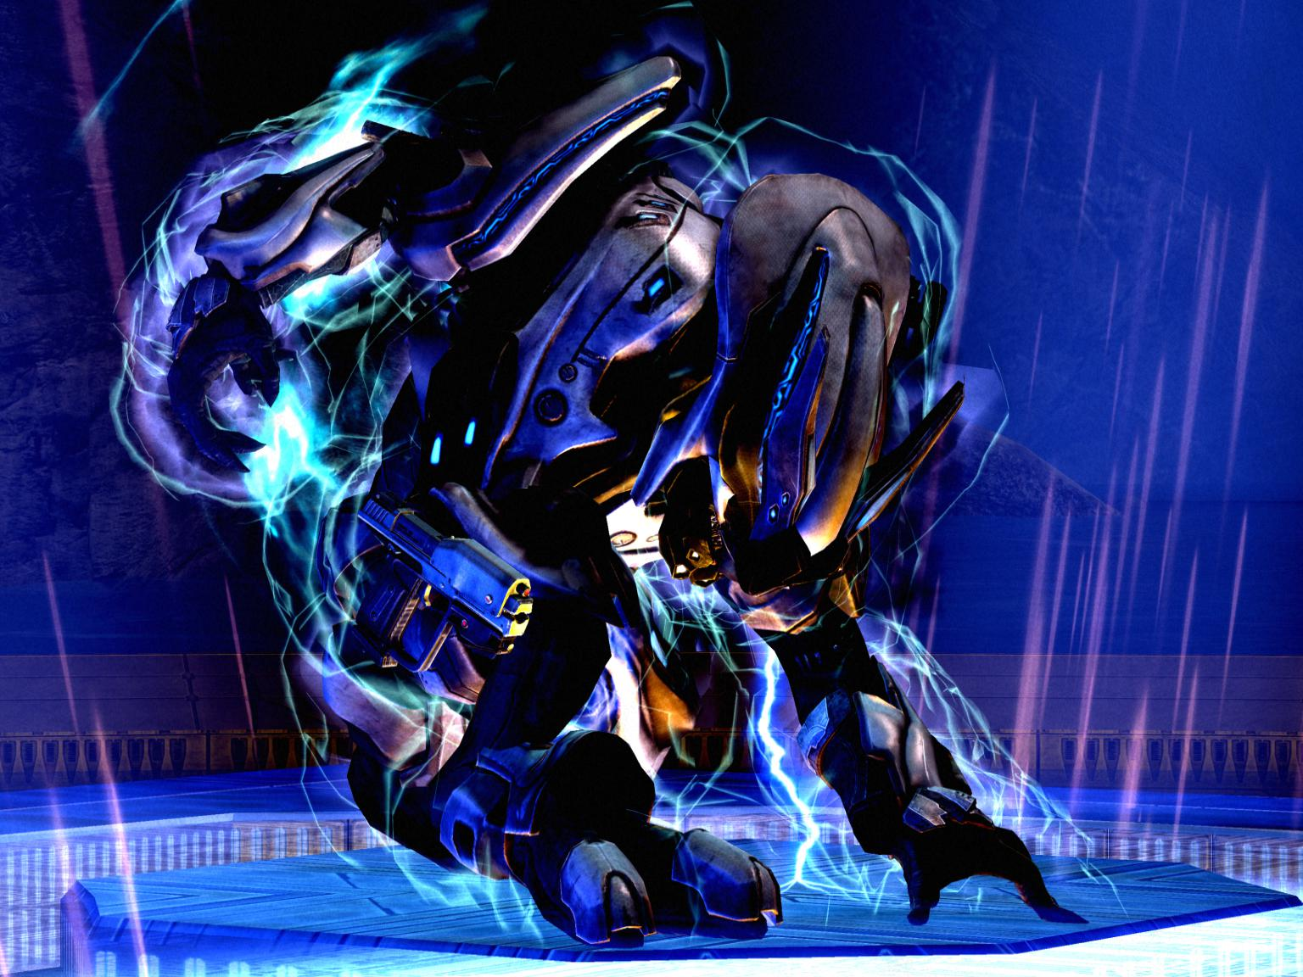
Thank you and any questions, thoughts, etc.?

