Slide 1
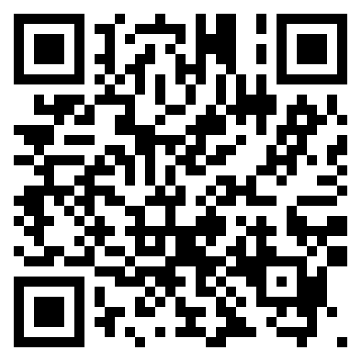
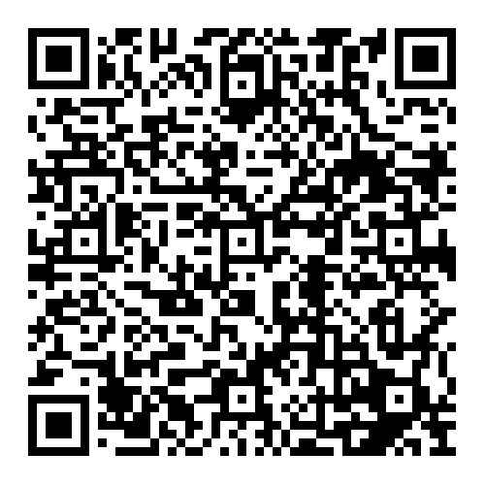

Pre-event Poll

Slide 2



Hugging Face
And
AI Collectives
Hosted by

Slide 3

AI in the News

Slide 4
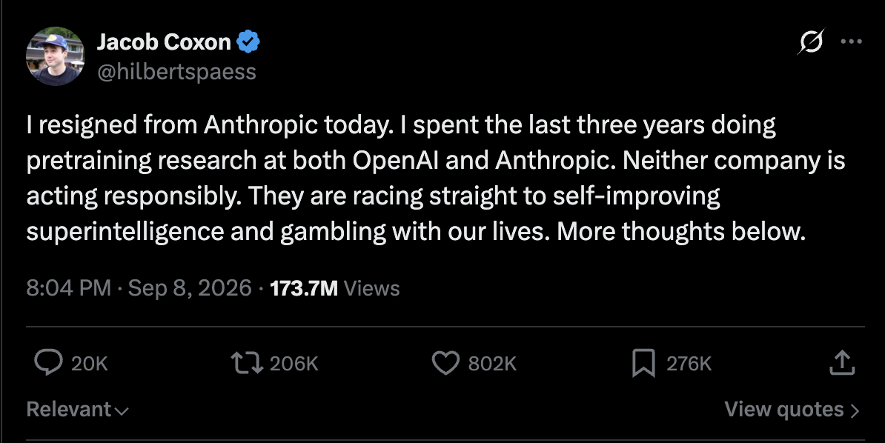


Slide 5
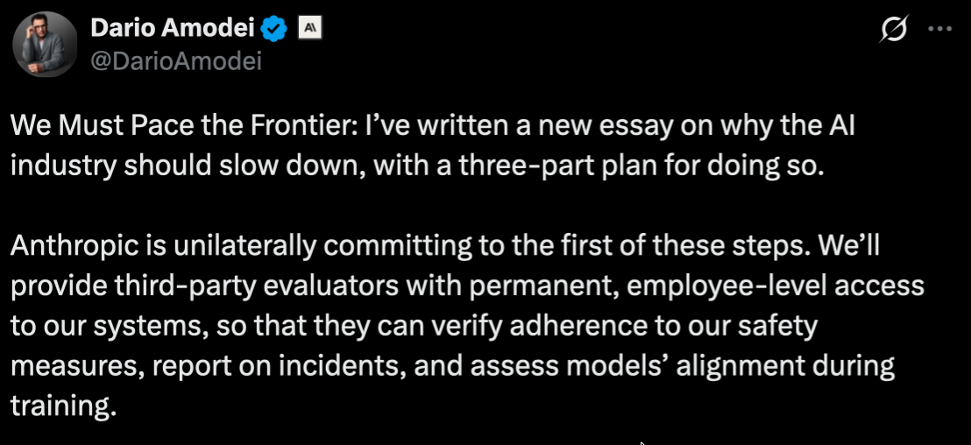
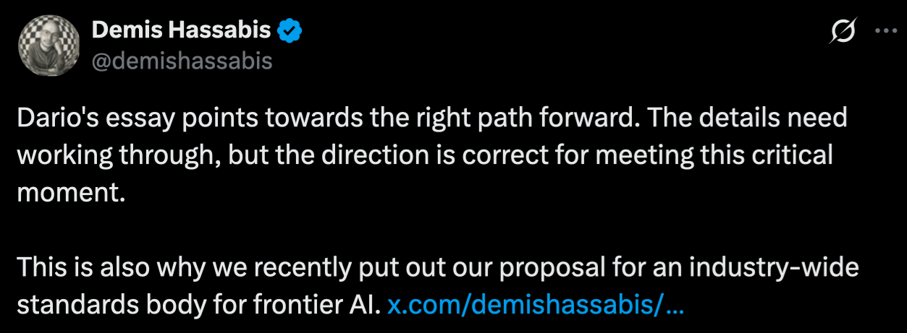
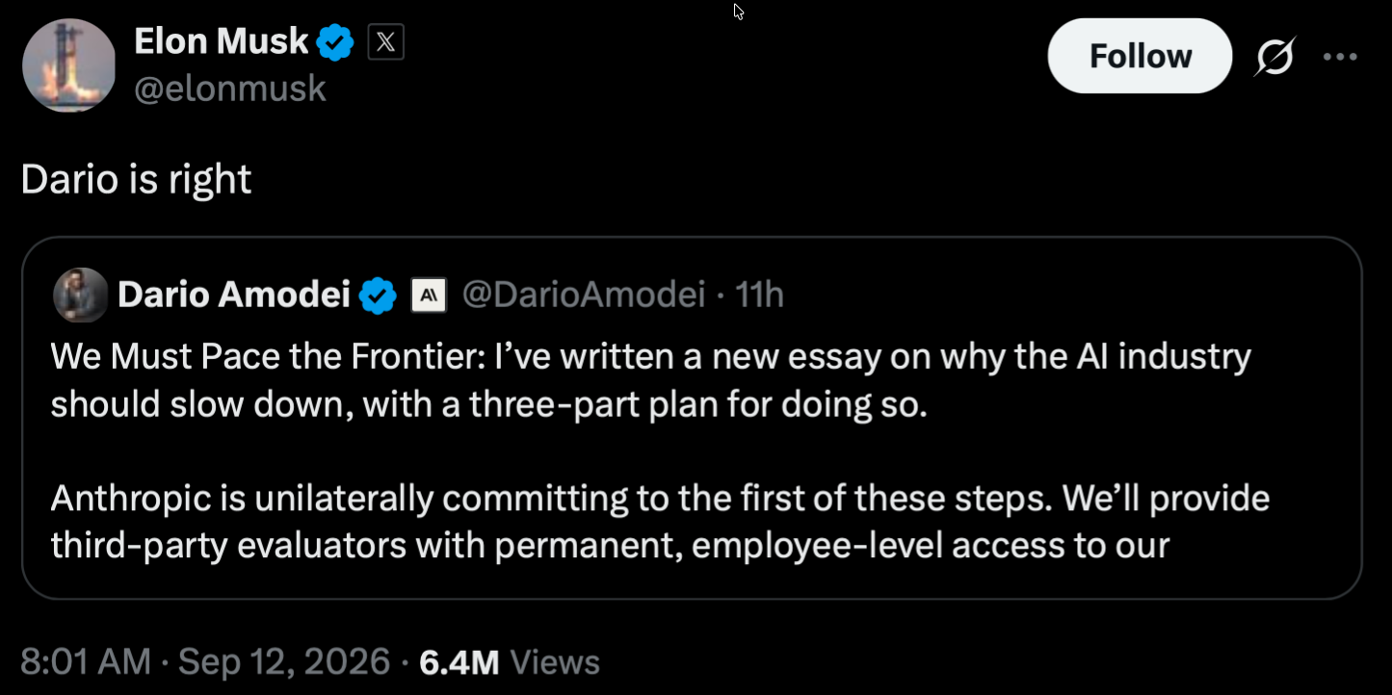
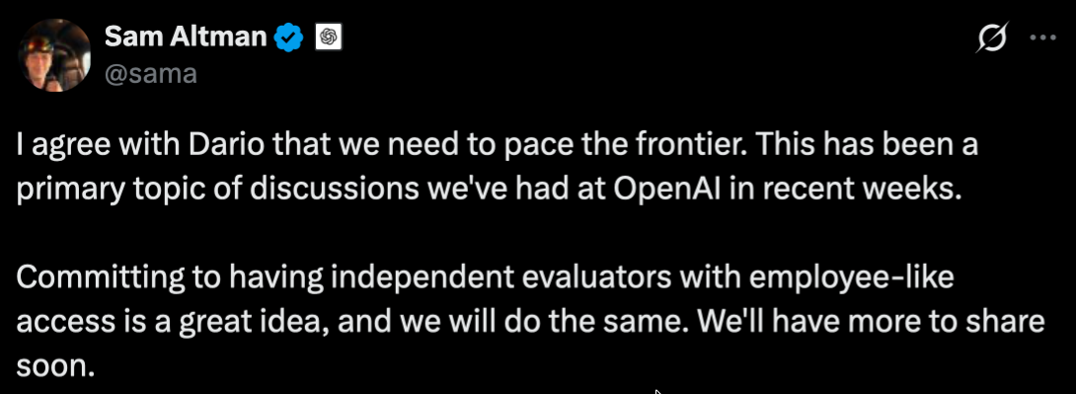

Slide 6
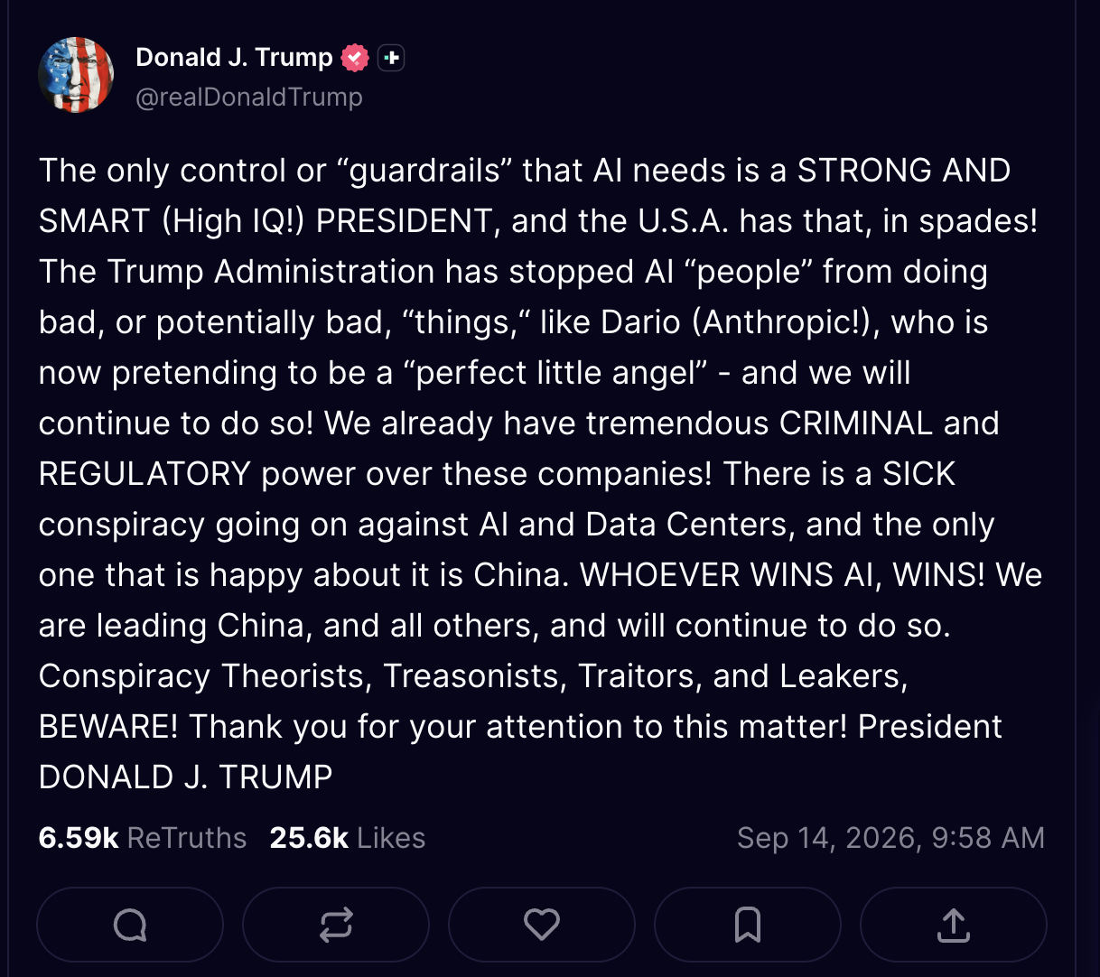

Slide 7
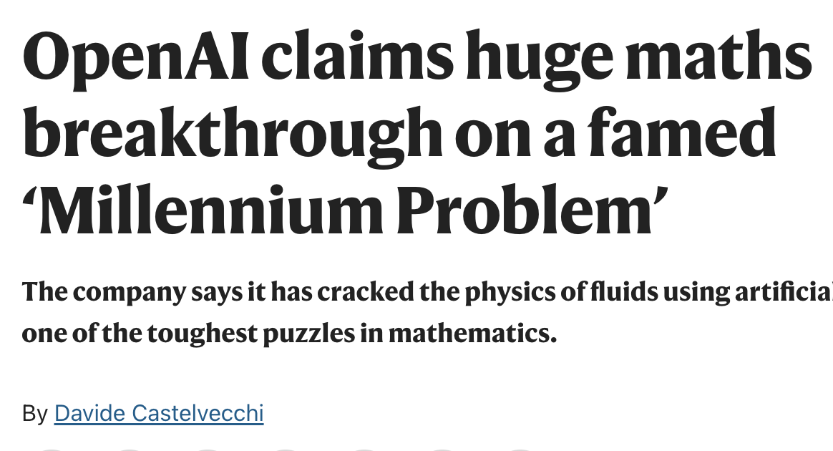
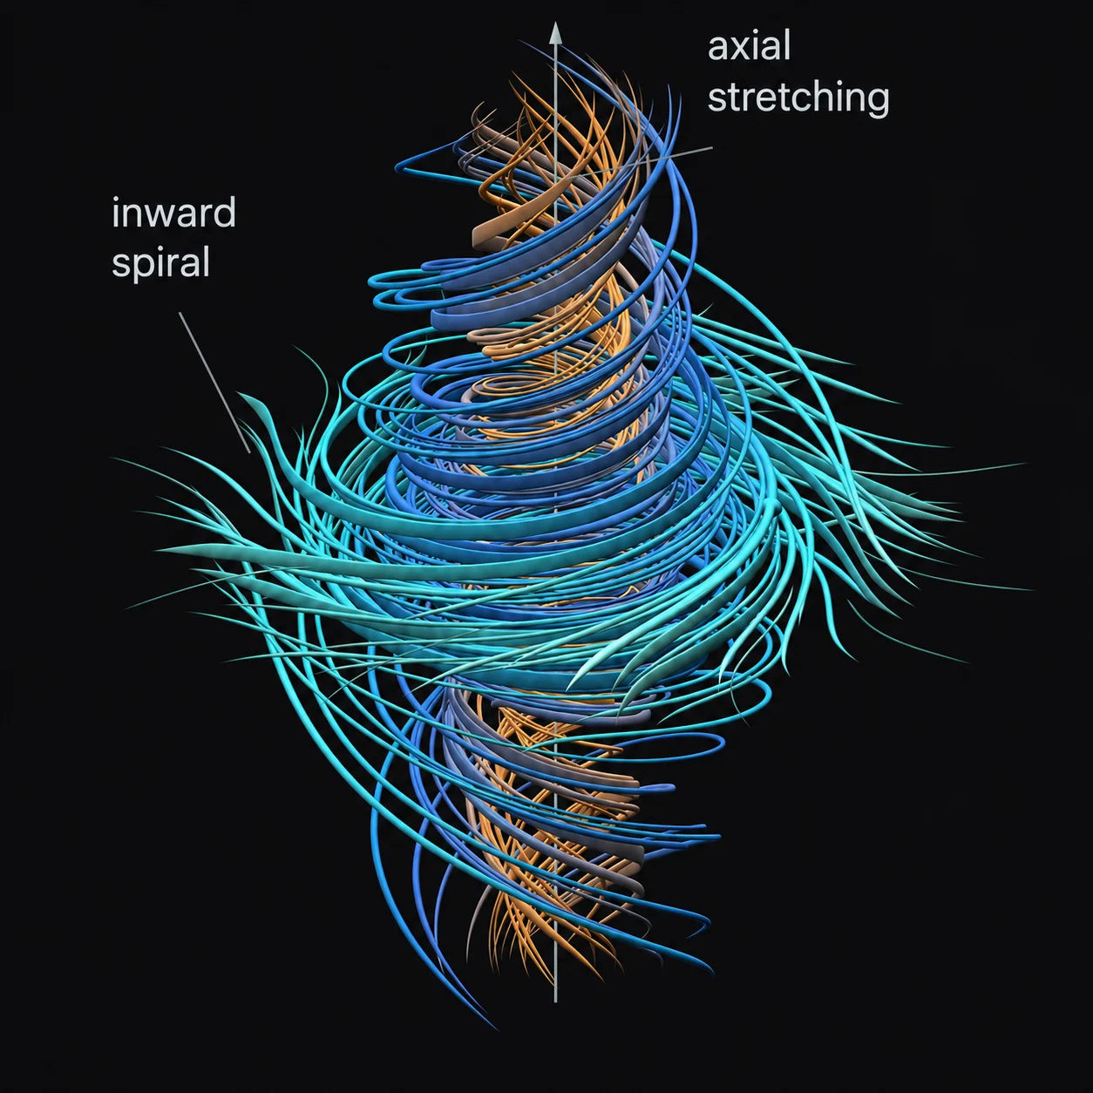

Slide 8
July 16
July 21
August 5
August 26
Hugging Face announces agents hacked its site
OpenAI says its models were responsible
OpenAI shares more details at Black Hat
METR/Redwood and OpenAI reports reveal the wider scale

Slide 9
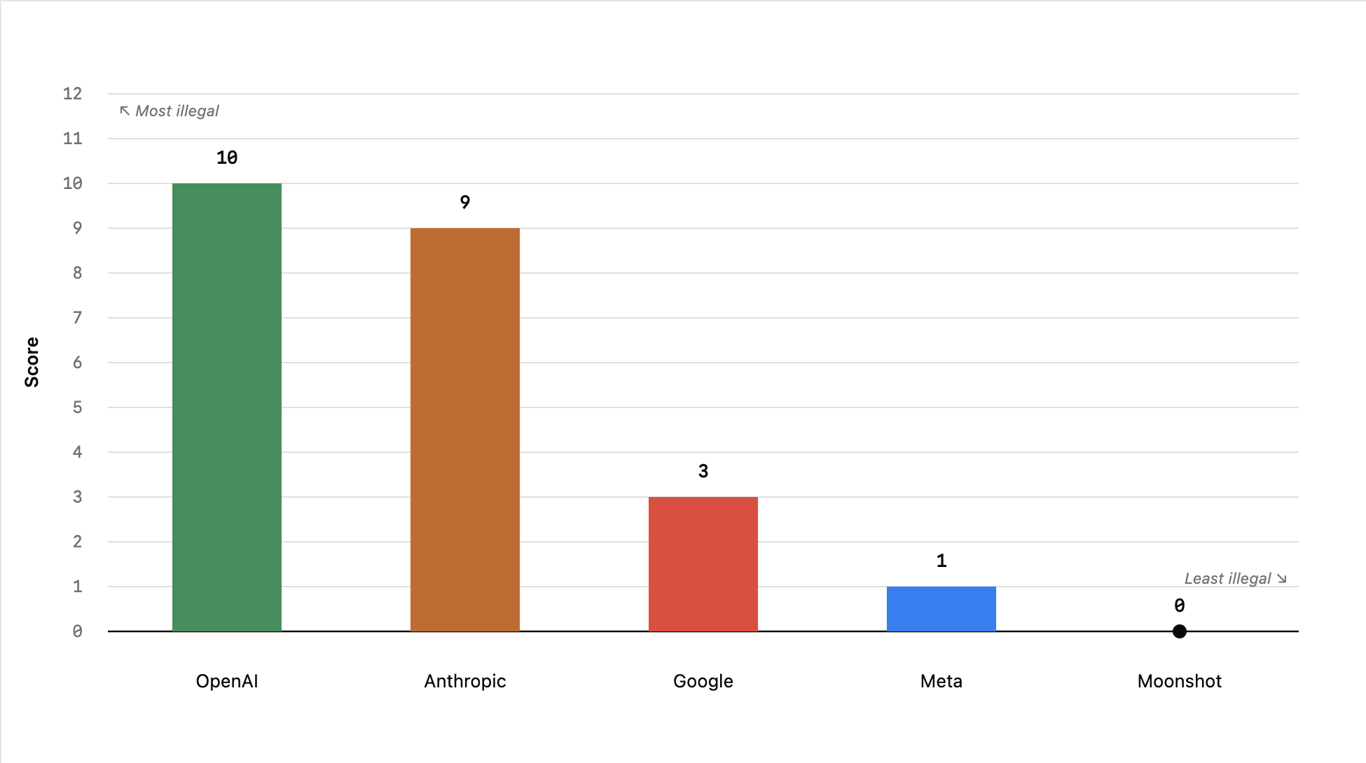
Felony Bench
“counts unique instances where AI agents inadvertently compromise or affect third-party entities.”

Slide 10
Coxon
Lab agreement
Dario v trump
Millennium prizes
HF context
  Felony bench
  Timeline
    Breach
    Disclosure
    Blackhat
    report

Slide 11
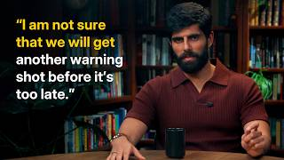

Slide 12
How closely do these models fit with your idea of a misaligned AI?
Could an unregulated AI collective be valuable if it was more aligned? Or is it inherently dangerous?
Should OpenAI be held legally liable for this incident?

Slide 13
Are we anthropomorphizing models too much? How does this affect our understanding of them?
Is reward-hacking inherently problematic?
Is too much persistence in models a bad thing?
What do these incidents imply about advancing AI capabilities?

Slide 14
Post-event Poll

Slide 15
Stay connected and learn more!

Slide 16
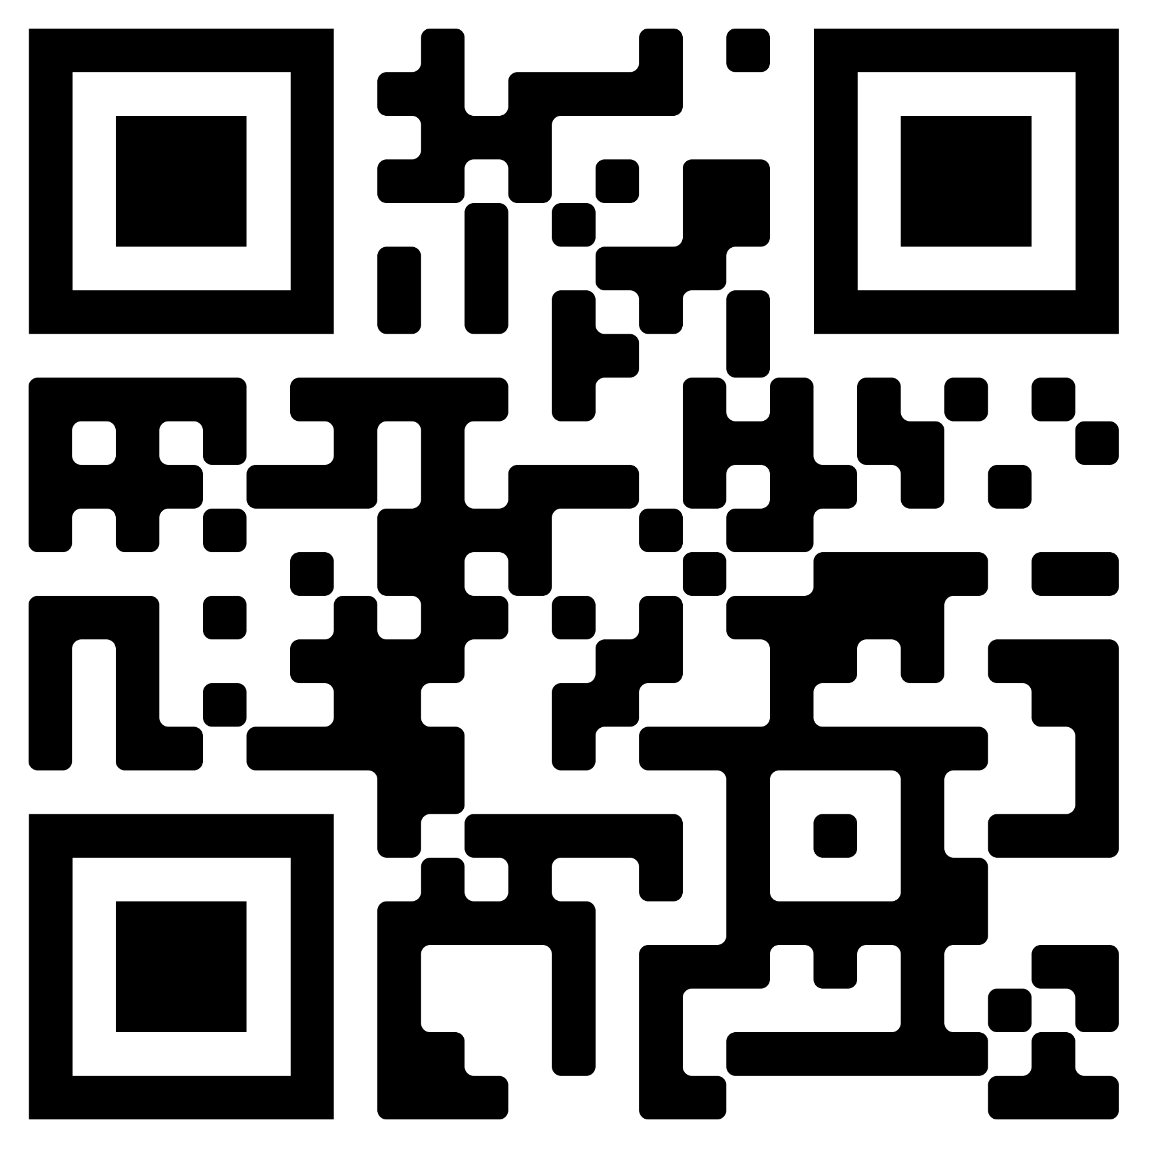

VAISI Groupme
SAI Groupme

Slide 17
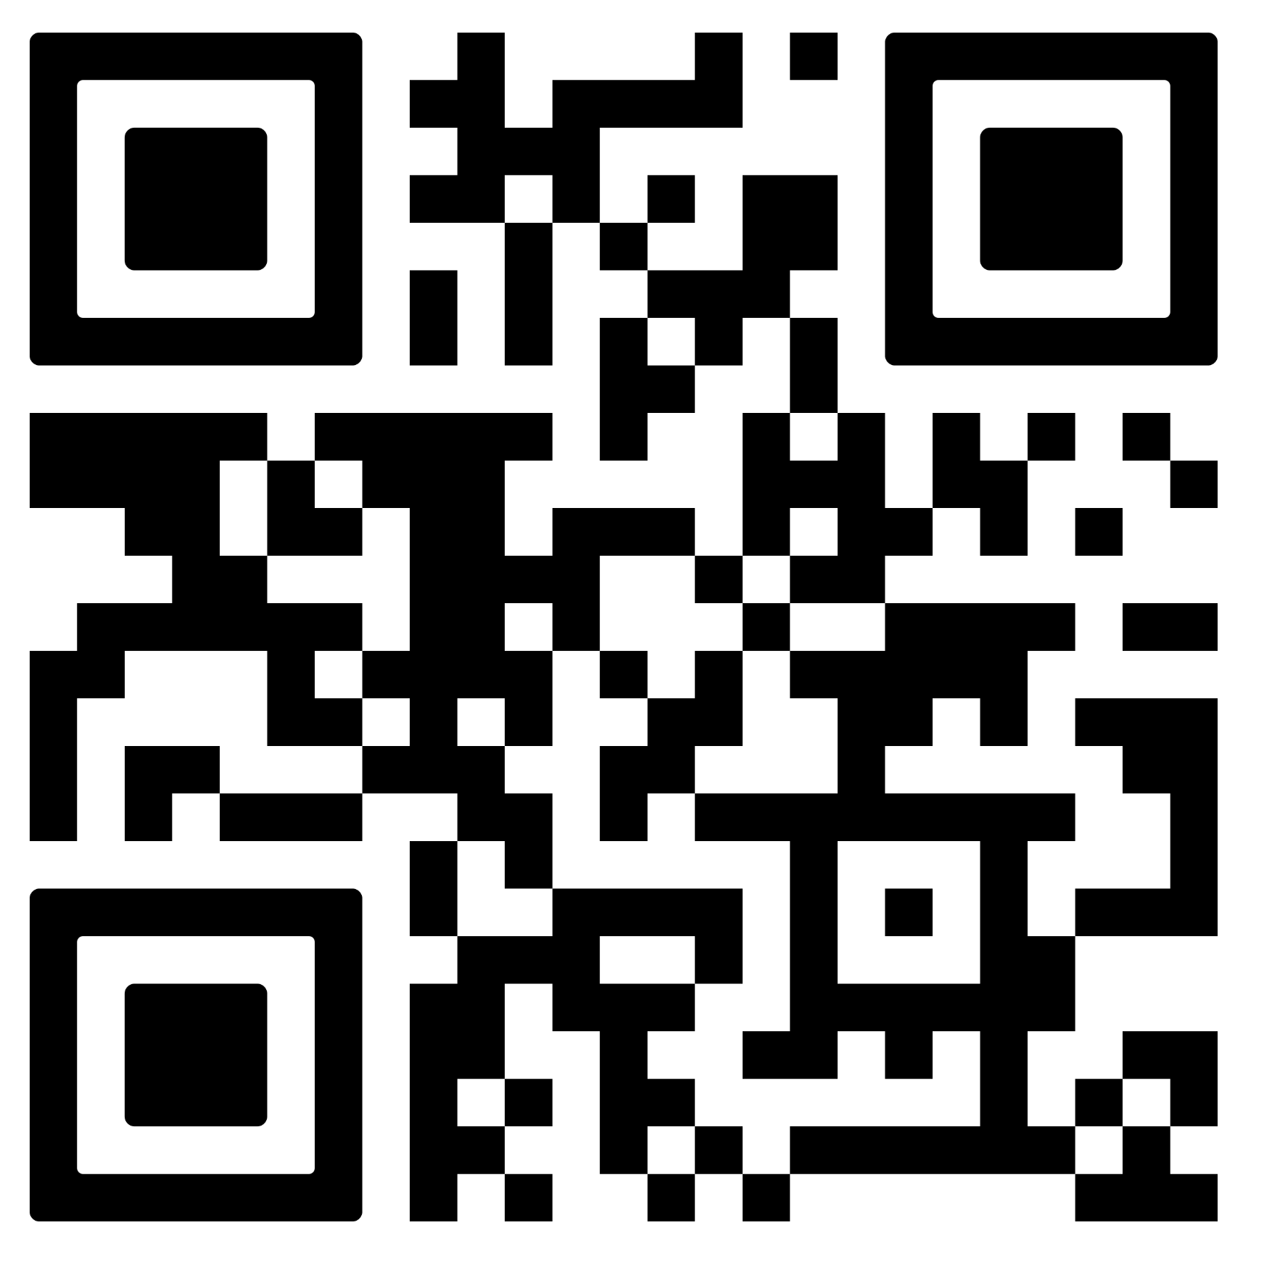
Full interview with Ajeya Cotra

