Slide 1
Rachwani-Santamaria TD/CP Study
Guide to
Analytical Software
Package

Slide 2
Contents
High Level Overview
Project Content Trees
Lists of Calculated Metrics
Examples of Graphical User Aids
Selected Flow Charts of Source Code

Slide 3
High Level Overview
The following slides are a high level visualization of the relationships between the components of the TD/CP study code base.
Arrows indicate the intended progression through the process, by either user or automation.

Slide 4
TD/CP Overall Processing Flow
CleanKinemticData
ProcessKinematicStats
CleanEMGData
ProcessEMGStats
Converts and Filters Kinematic Data
Visually Inspect and Review Kinematic Data
Visually Inspect and Review OpenSHAPA Selected Onsets

Slide 5
CleanKinematicData Processing Flow
Setup
Interpret OpenSHAPA Data
Visually Inspect Kinematic Trials
Prepare Selected Kinematic Trials
Visually Compare OpenSHAPA Onsets to Kinematic Data
Segment Visually Verified Reaching Regions
Select Subject Data
Declare Constants
Load Raw Data into Memory
Collect events that are in categories of interest
Graphical Presentation of each Kinematic Trial
Approve or Reject data from trials individually based on visually inspection of quality
Collate event metadata for Kinematic Reference
Identify and Save Kinematic metadata
Convert Data from Imperial to Metric
Filter Data
BOS, Mark Data, Max Heights of Head and C7 Markers
4Hz 4th Order lowpass Butterworth zero-lag
Graphical Presentation of Position and Velocity Profiles of Kinematic Event compared to OpenSHAPA determined Reach Onset time
Correct any discrepancies between kinematic start of motion and visually observed start of motion
Full Trial Data Saved to Disk
Regions from 500ms prior to verified reaching onset to the OpenSHAPA determined end of event are saved to disk for later statistical analysis.

Slide 6
ProcessKinematicStats Processing Flow
Setup
Interpret OpenSHAPA Data
Base of Support Zone Graphs
3D Reaching Graphs
Calculate Metrics from Reach Data
Select Subject Data
Declare Constants
Load Raw Data into Memory
Collect events that are in categories of interest
Collate event metadata for Kinematic Reference
Calculates percentage of reaching time HeadCOM was:
Within a region defined by 50% of BOS
Within a region defined by BOS
Outside the region defined by BOS
Generates and Saves Illustrations of Above
Generates 3D Illustrations of Reaching Hand’s activity over the Kinematic Event
Illustrations saved to Disk
See Appendices for Full List of Calculated Metrics
Metrics Collated and Saved to Disk for insertion to SPSS

Slide 7
CleanEMGData Processing Flow
Setup
Visually Inspect Frequency Domain of EMG Data
Remove known noise sources from Data
Clean EKG noise from EMG
Select Subject Data
Declare Constants
Load Raw Data into Memory
Step done at User Discretion
60 Hz
84 Hz and Harmonics
Source: Magnetic Tracking System
Option to visually inspect filter efficacy.
4th order Butterworth notch filters, zero-lag
User visually classifies threshold of EKG activity using selected EKG channel
EKG content of each EMG channel estimated as per Saadvra algorithm
User visually compares EMG with and without EKG subtracted against calculated EKG estimate
User can repick EKG threshold and repeat
User individually chooses to apply EKG subtraction
Filter EMG Data
TD Subjects (Thielen and Spencer)
4th Order Butterworth, 10-160Hz Bandpass Filtered, zero-lag
Full Wave Rectification
Box Car Averaged
CP Subjects
Pending Victor’s Documentation
Wrapup
Merge EMG of back muscles if option selected for Subject Group
Convert EMG from V to mV
Save processed EMG to disk
Adjust EMG Data based on Gains settings

Slide 8
ProcessEMGStats Processing Flow
Setup
Review Quiet Segment
Normalize EMG
Determine EMG Activation Regions
Select Subject Data
Declare Constants
Load Raw Data into Memory
Determine Quietest Segment
Length of quiet region set by user
Finds the region with the least total iEMG activity across bins of IEMG activity
Returns average IEMG activity in quiet region
IEMG bin size set by user
Scans EMG across all levels of support collected
Graphical tool that displays EMG data from all levels of support
The region of EMG used for determining the quietest segment is highlighted
Run at the User’s discretion
Normalizes all EMG to :
N is the user defined number of SDs to normalize to.
(IEMG_{bin} - normFac)/normFac
normFac=n*quietSeg_{SD} + quietSeg_{AVG}
As before, the IEMG bin size is set by user
Normalization is done using IEMG
Normalized Data is saved to disk
Regions of Normalized EMG that are potentially activated have values >=1.
Regions of Normalized EMG that are potentially deactivated have values < 1.
When enough consecutive bins of activated data are found, an EMG activation is noted.
A similar process notes EMG deactivations
The number of bins needed in both cases is User determined.
Activation Region Verification
Graphical tool to display and rate the effectiveness of the EMG Activation Region algorithm
Run at the User’s discretion
Calculate Metrics based on Activation Regions
Generate final illustrations
Automatically generates illustrations of EMG activity for each event
Version scaled to region’s own peak activity
Version scaled to the peak activity of a muscle across all levels of support
Muscle activation regions and reach onset indicated in illustrations.
Metrics collated and saved to disk for processing with SPSS.
See Appendices for Full List of Calculated Metrics
Determine Muscular Coactivations
User specified muscle combinations are compared to determine if a coactivation occurred in each event.
Coactivation is determined to be if the muscles in the combination have activation times within 40ms of one another.
Results are collated and saved to disk for further examination.

Slide 9
Code Tree Maps
The following slides lay out how the code in the project is associated between higher and lower level functions.
Code files that have major sub-functions called each have their own slides to illustrate those associations.

Slide 10
TD/CP Code Tree
Top Level
CleanKinematicData
Filters and Organizes the Kinematic Data
ProcessKinematicStats
Calculates and Saves Statistics based on the Kinematic Data
CleanEMGData
Filters and Organizes the EMG Data
ProcessEMGStats
Calculates and Saves Statistics based on the EMG Data

Slide 11
CleanKinematicData
Filters and Organizes the Kinematic Data
CollectKinematicFiles
Retrieves all Files related to Cleaning Kinematic Data from User Selected Directory
FranEraBirdConverter
Converts miniBird Data into a MATLAB friendly format
kinReviewTrials
Allows user to review and approve Kinematic Reaching Trials
reviewReachOnsets
Allows user to compare OSHAPA det. Reach onsets against kinematic data
GroupSpecificSetup
Returns Variables based on Subject Group Membership
buildOutputDirectories
Verifies that all Output dirs exist, builds those that don’t
InterpretOSHAPA
Processes the OpenSHAPA

Slide 12
ProcessKinematicData
Calculates and Saves Statistics based on the Kinematic Data
CollectKinematicFiles
Retrieves all Files related to Processing Kinematic Data from User Selected Directory
calcKinStats
Caculates specified kinematic related statistics and measures
GroupSpecificSetup
Returns Variables based on Subject Group Membership
buildOutputDirectories
Verifies that all Output dirs exist, builds those that don’t
InterpretOSHAPA
Processes the OpenSHAPA
exZoneAnalysis
Analyzes Kinematic Data for total excursion of subject based one defined zones
graph3DReach
Generates customized 3D graphs of subject reaching

Slide 13
CleanEMGData
Filters and Organizes the EMG Data
CollectEMGData
Retrieves all files related to EMG from selected Subject Directory
readGains
Reads in a list of Gains from EMG data
GroupSpecificSetup
Returns Variables based on Subject Group Membership
emgGainAdjust
Adjusts EMG data using given gains
filtNoiseHarmonics
Filters out noisy frequences and harmonics thereof
emgFiltAvgEKG
Assists user in filtering out EKG artifact from their EMG
emgSmoothProcess
Filters/Smoothes EMG data post EKG removal
visMultChans
Visually presents multiple channels of data to user
mergeMuscs
Merges EMG data from multiple channels into a single channel

Slide 14
ProcessEMGStats
Calculates and Saves Statistics based on the EMG Data
CollectEMGFiles
Retrieves all files related to EMG from selected Subject Directory
detQuietSeg
Finds the quietest n ms of data for each channel in the EMG
normalizeEMG
Normalizes the EMG
activationDetection
Procedure to detect activations based on Normalized EMG Data
groupSpecificSetup
Returns Variables based on Subject Group Membership
mergeHeaders
Merges Muscle Channel Headers to Reflect any Muscle Merging that has been done
computeReachRegions
References Kinematic Timing Data to identify reaching regions in EMG data
graphPMKinMV
Generates the multi-channel EMG graphs with onsets indicated
emgCalcReachMetrics
Calculates specified statistics and metrics from the Reach Regions

Slide 15
Lists of Calculated Metrics
These slides are a quick guide to the metrics calculated for the Kinematic and EMG data by the analysis package.

Slide 16
List of Calculated Kinematic Metrics
Path Length Reaching Hand (cm)
Path Speed of Reaching Hand (cm/s)
Peak Velocity of the Reaching Hand (cm/s)
Peak Velocity Onset Time as Percentage of Total Reach Time
Straightness scores of Reaching Hand
Number of movement units of Reaching Hand
Avg ML headTrunkCOM Angle (degrees)
StDev ML headTrunkCOM Angle (degrees)
Min ML headTrunkCOM Angle (degrees)
Max ML headTrunkCOM Angle (degrees)
Avg ML headTrunkCOM Angular Velocity (degress/sec)
Total ML headTrunkCOM Angular Displacement (degrees)
Avg AP headTrunkCOM Angle (degrees)
StDev AP headTrunkCOM Angle (degrees)
Min AP headTrunkCOM Angle (degrees)
Max AP headTrunkCOM Angle (degrees)
Avg AP headTrunkCOM Angular Velocity (degrees/s)
Total AP headTrunkCOM Angular Displacement (degrees)
Avg Resultant headTrunkCOM Speed (degrees/s)
Total Resultant headTrunkCOM Angular Displacement (degrees/s)
Avg ML TrunkCOMCBOS Angle (degrees)
StDev ML TrunkCOMCBOS Angle (degrees)
Min ML TrunkCOMCBOS Angle (degrees)
Max ML TrunkCOMCBOS Angle (degrees)
Avg ML TrunkCOMCBOS Angular Velocity (degrees/s)
Total ML TrunkCOMCBOS Angular Displacement (degrees)
Avg AP TrunkCOMCBOS Angle (degrees)
StDev AP TrunkCOMCBOS Angle (degrees)
Min AP TrunkCOMCBOS Angle (degrees)
Max AP TrunkCOMCBOS Angle (degrees)
Avg AP TrunkCOMCBOS Angular Velocity (degrees/s)
Total AP TrunkCOMCBOS Angular Displacement (degrees)
Avg Resultant TrunkCOMCBOS Speed (degrees/s)
Total Resultant TrunkCOMCBOS Angular Displacement (degrees/s)
Normalized Jerk Squared (Hz)
Total Path Length in AP Axis of Reaching Hand (cm)
Total Path Length in AP Axis of TrunkCOM (cm)
Trunk Coupling of Reach Motion (cm)
Mean Curvature of the Reach (unitless)
Standard Deviation of Curvature of the Reach (unitless)

Slide 17
List of Calculated EMG Metrics
Total Number of Activations
Number of bursts originating in Baseline Stage
Number of bursts originating in APA Stage
Number of bursts originating in CPA Stage
Onset Time of first Baseline Centric Burst (ms)
Offset Time of final Baseline Centric Burst (ms)
Onset Time of first APA Centric Bursts (ms)
Offset Time of final APA Centric Bursts (ms)
Onset Time of first CPA Centric Bursts (ms)
Offset Time of final CPA Centric Bursts (ms)
Total Activation Time in APA Stage (ms)
Total Activation Time in CPA Stage (ms)
Total IEMG of all Baseline Bursts (mV/ms)
Total IEMG of all APA Bursts (mV/ms)
Total IEMG of all CPA Bursts (mV/ms)

Slide 18
Graphical User Aid Examples
These slides are screenshots of the GUI tools that assist the Users in the processing of the data.

Slide 19
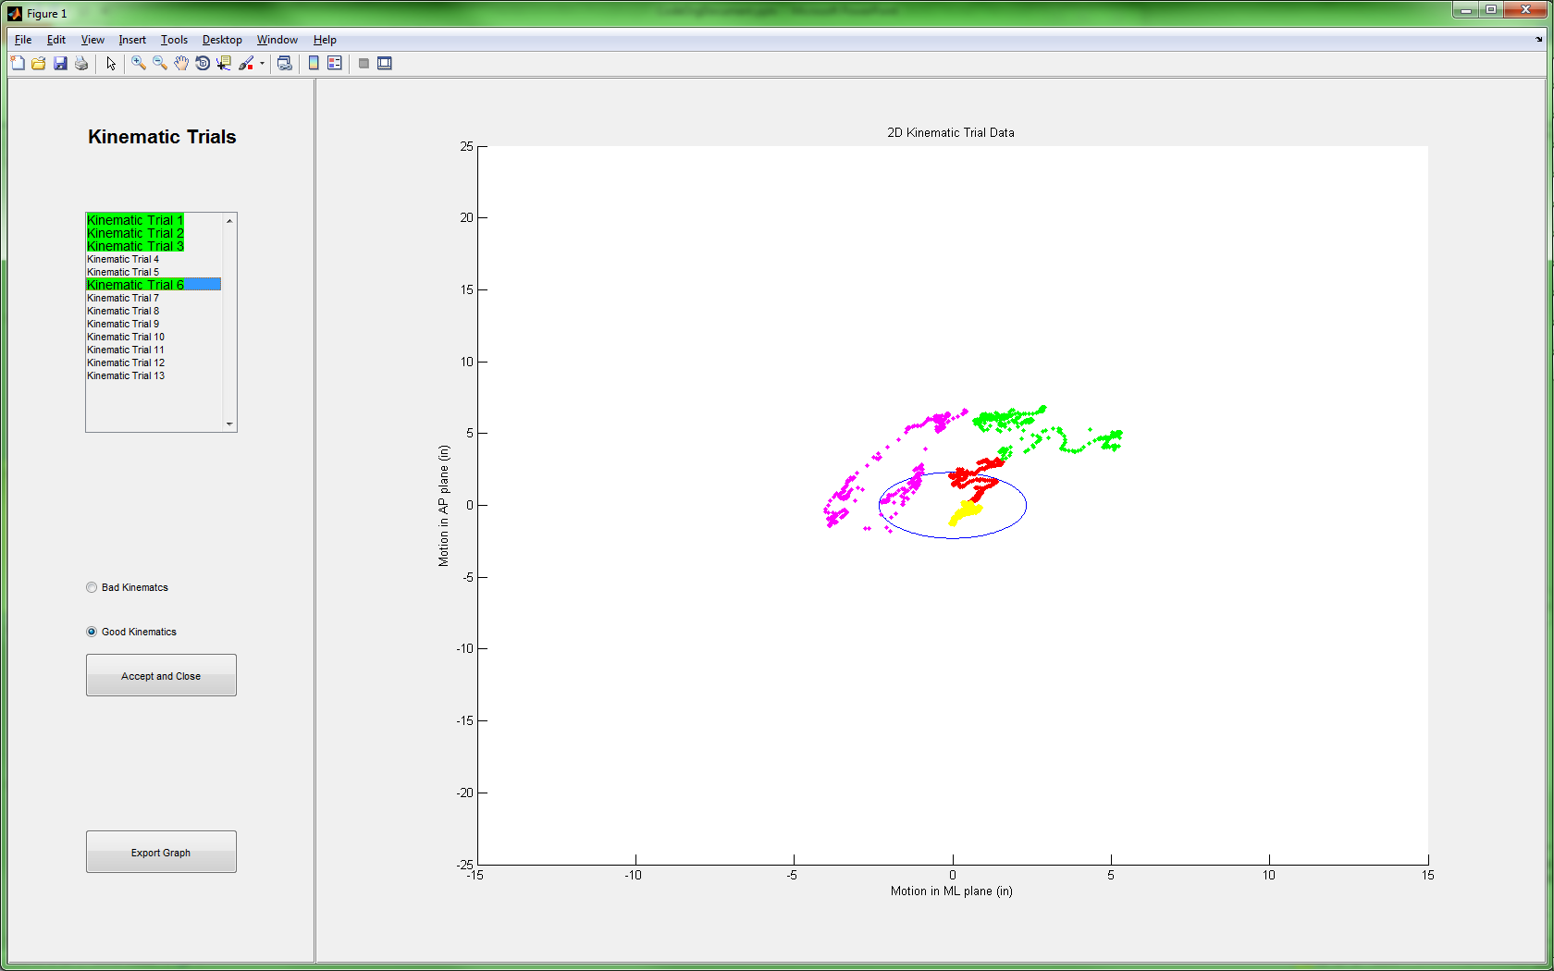
reviewKinTrials Screenshot

Slide 20
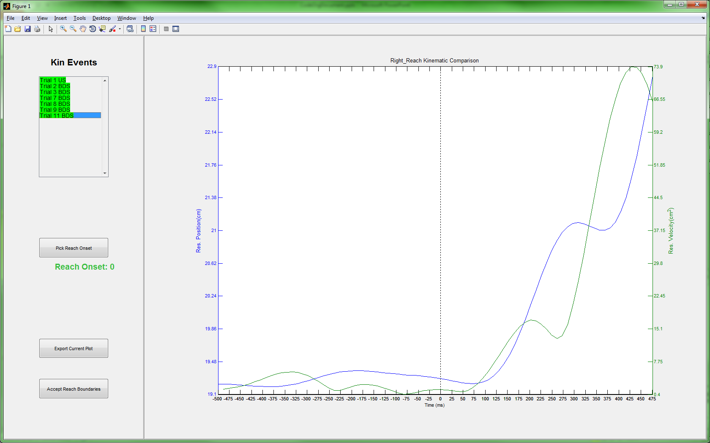
reviewReachOnsets Screenshot

Slide 21
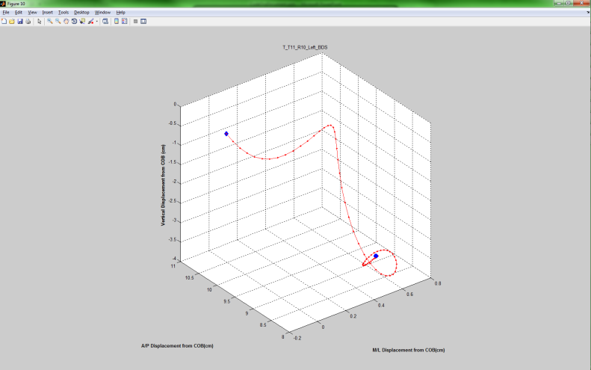
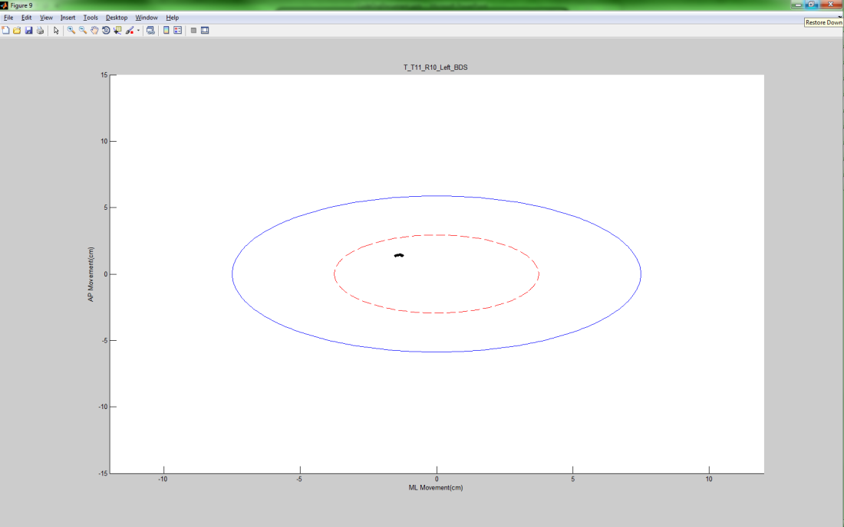
Kinematic Illustrations

Slide 22
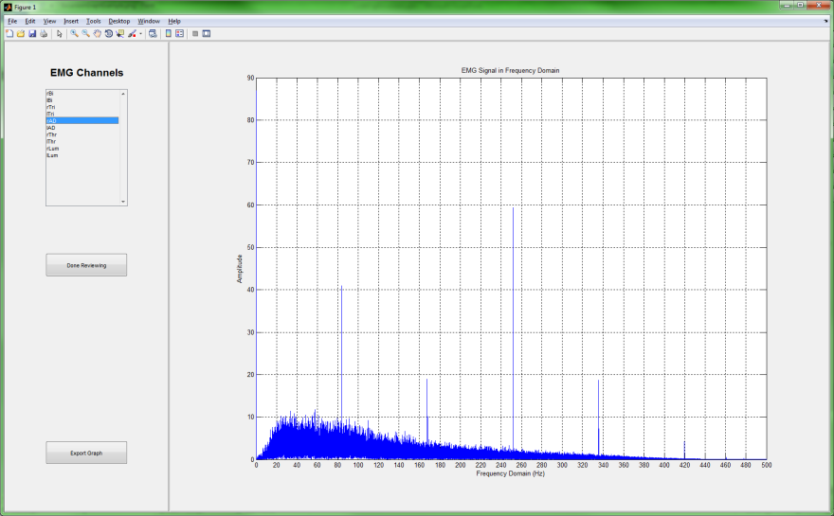
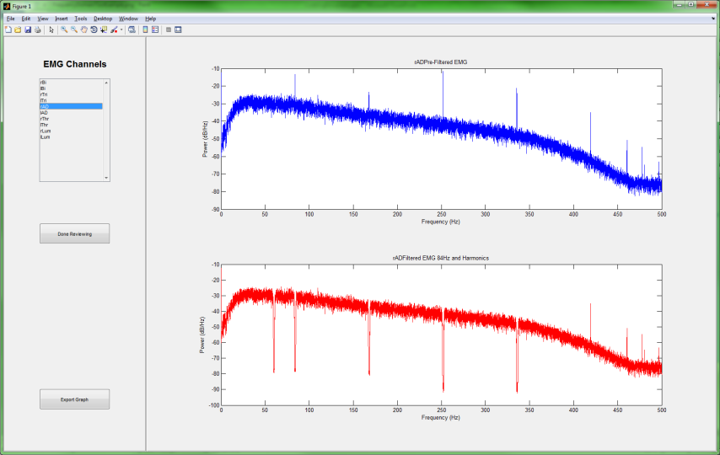
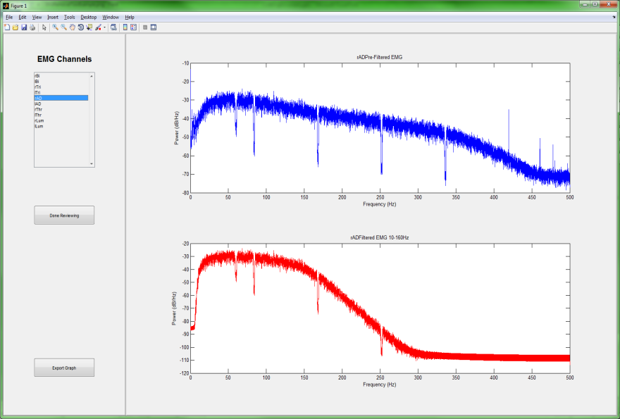
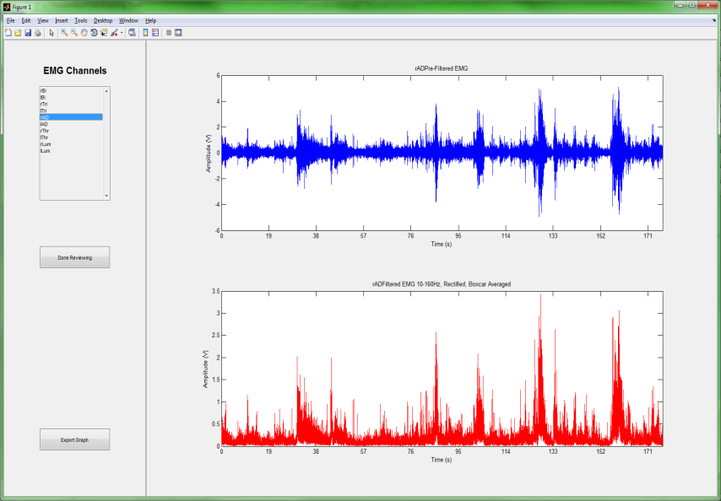
EMG Signal Review Screenshots

Slide 23
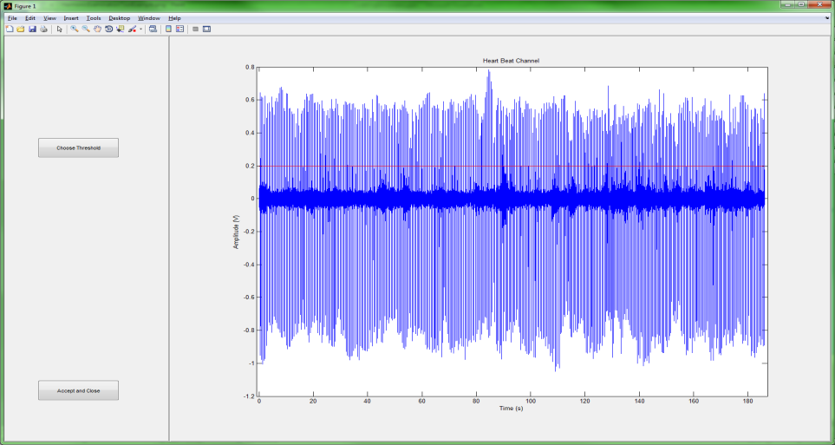
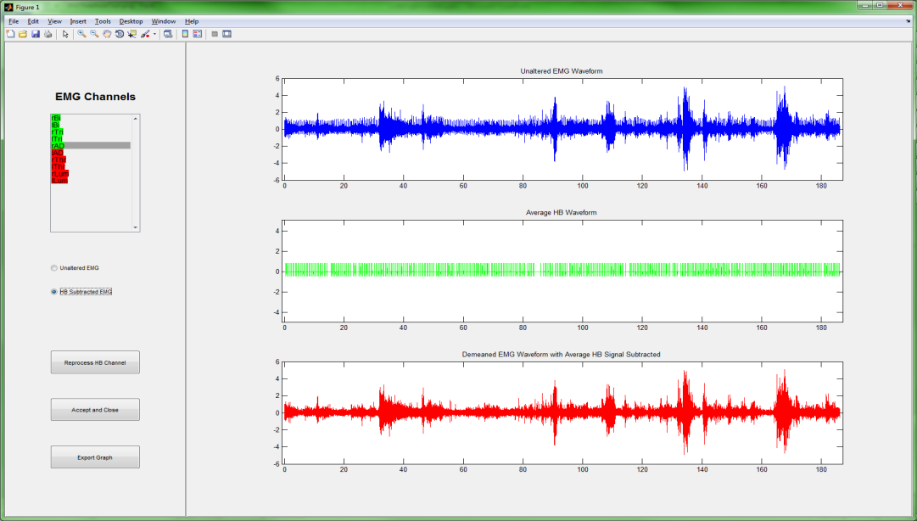
EKG Subtraction Screenshots

Slide 24
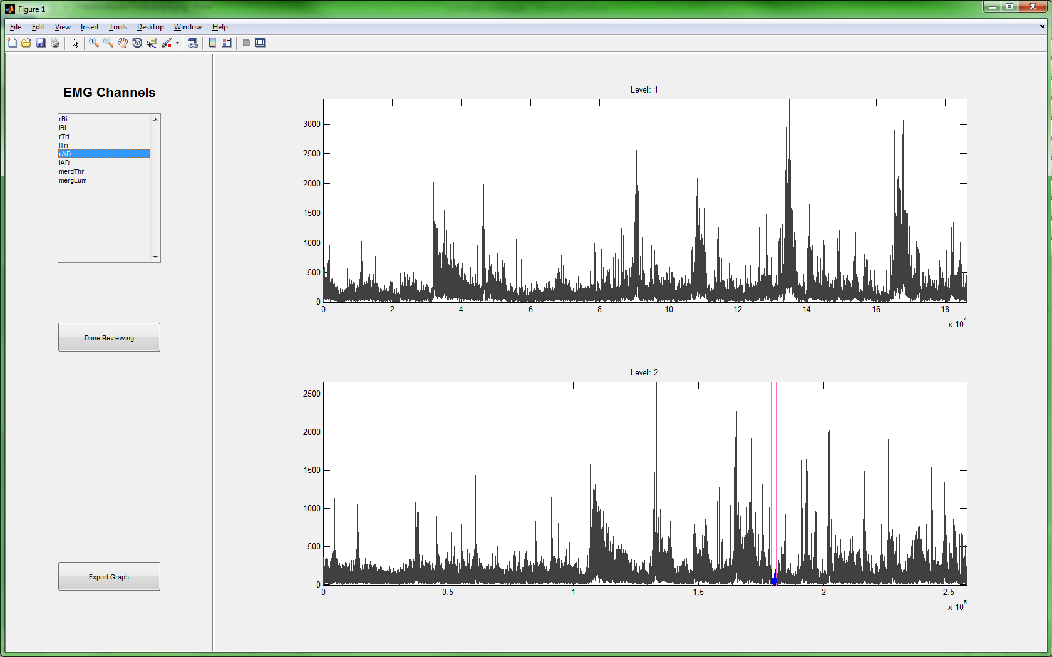
EMG Quiet Segment Review Screenshot

Slide 25
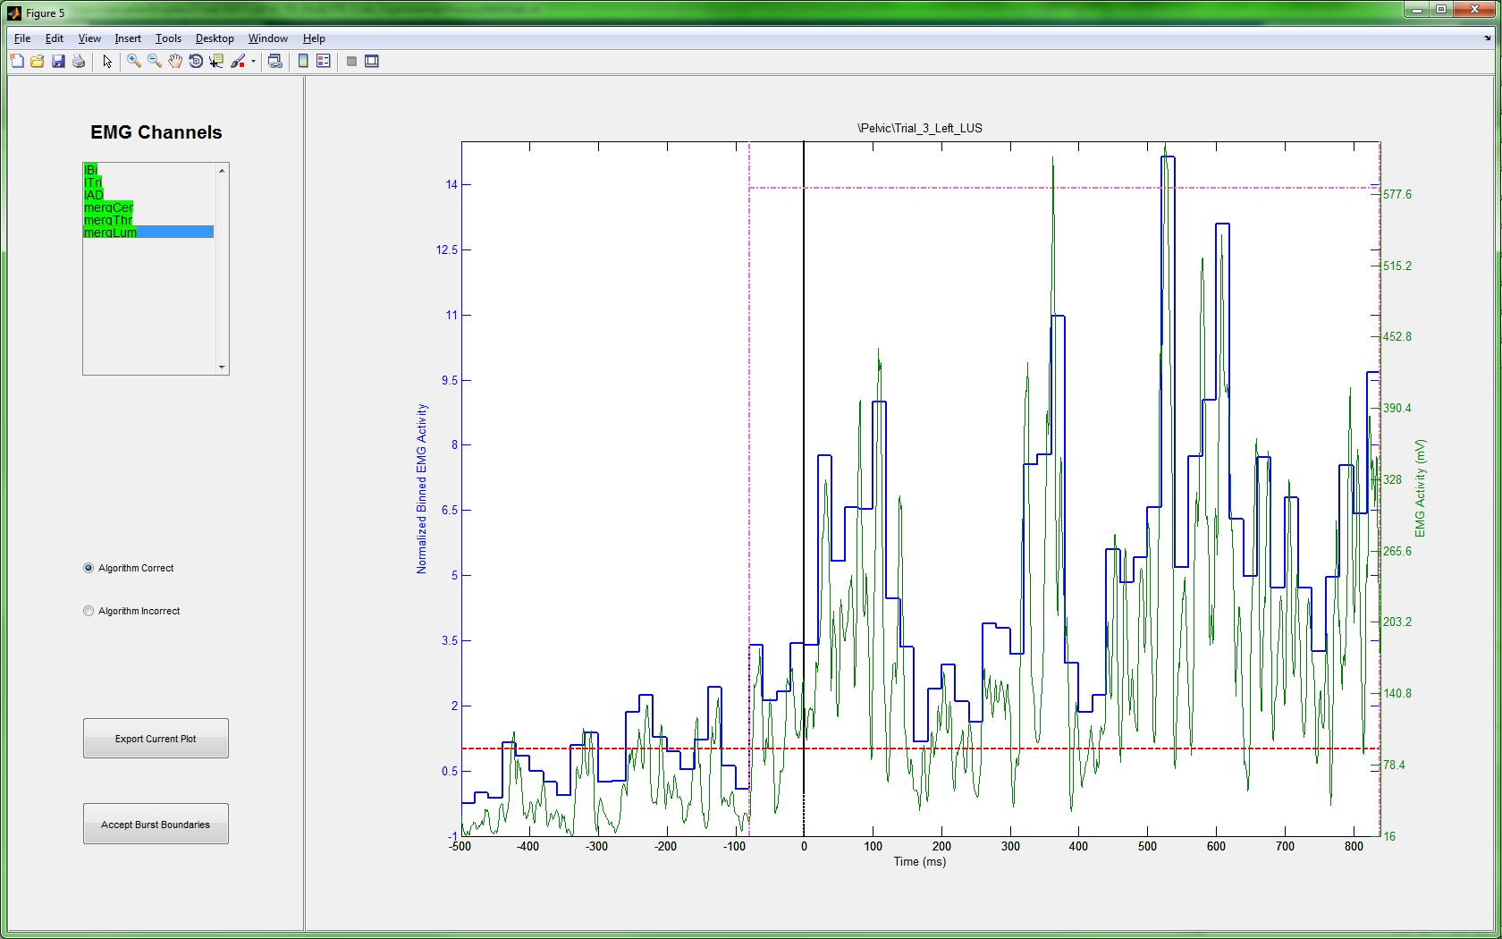
EMG Activation Region Review Screenshot

Slide 26
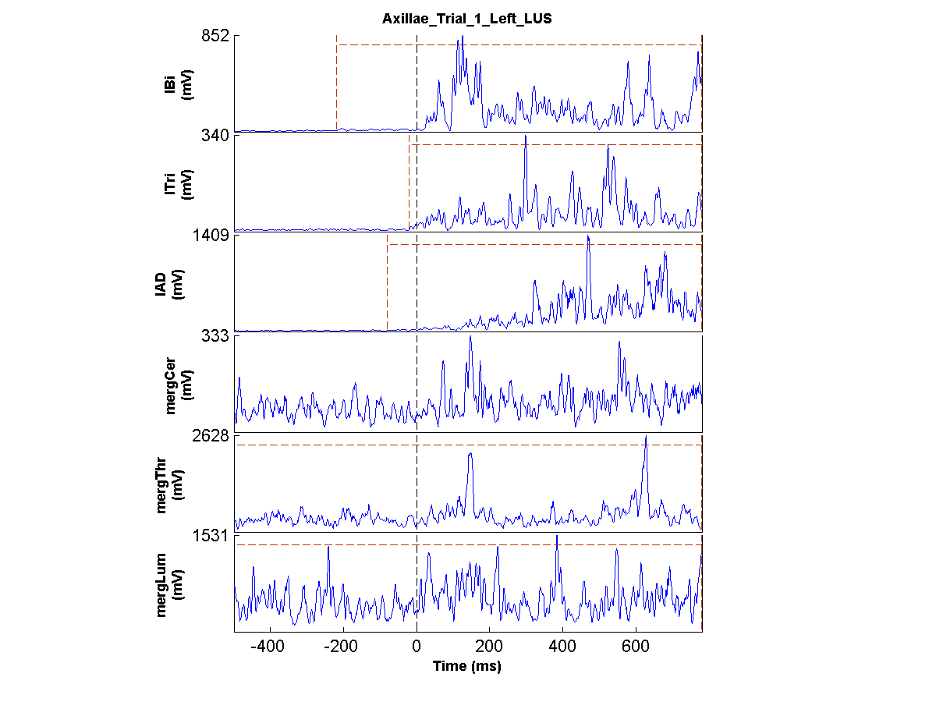
EMG Illustrations

Slide 27
Selected Flow Charts
These slides contain flow charts for a subset of the functions used in the analysis package.

Slide 28
Top Level Functions
These Flow Charts cover the top level scripts that guide the entire analysis process.

Slide 29
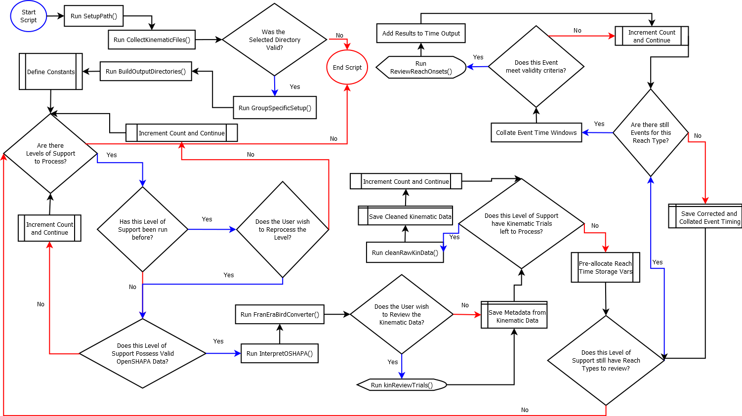
CleanKinematicData.m

Slide 30
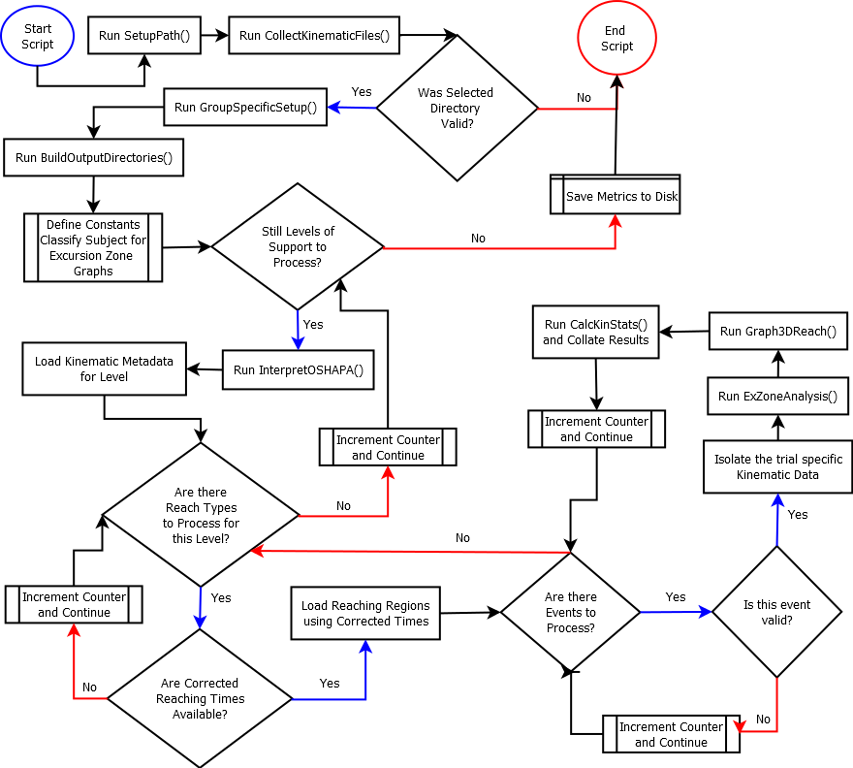
ProcessKinematicStats.m

Slide 31
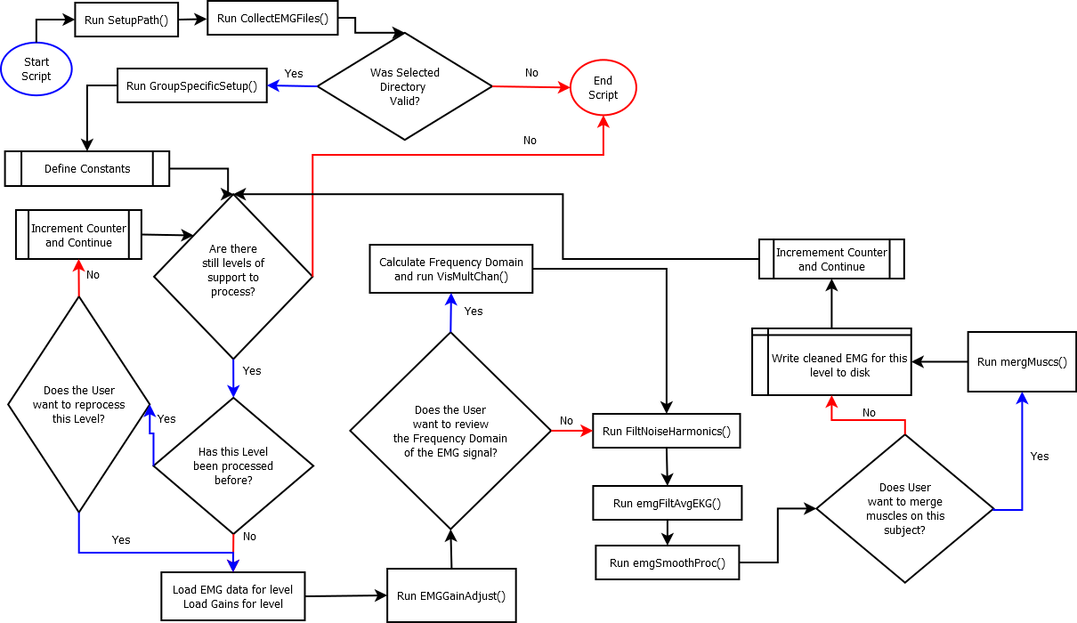
CleanEMGData.m

Slide 32
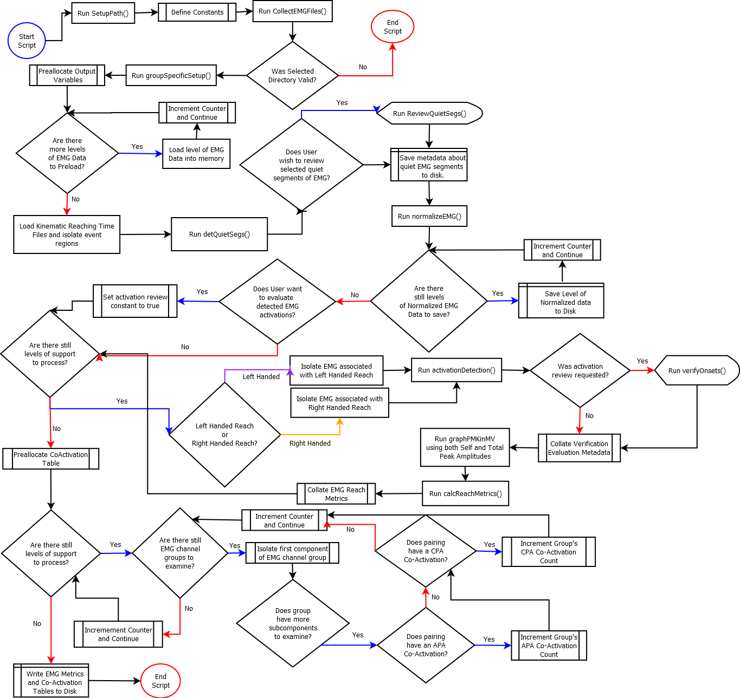
ProcessEMGStats.m

Slide 33
Data Processing Functions
Flow Charts appearing here represent sub-functions that do lower level data processing.

Slide 34
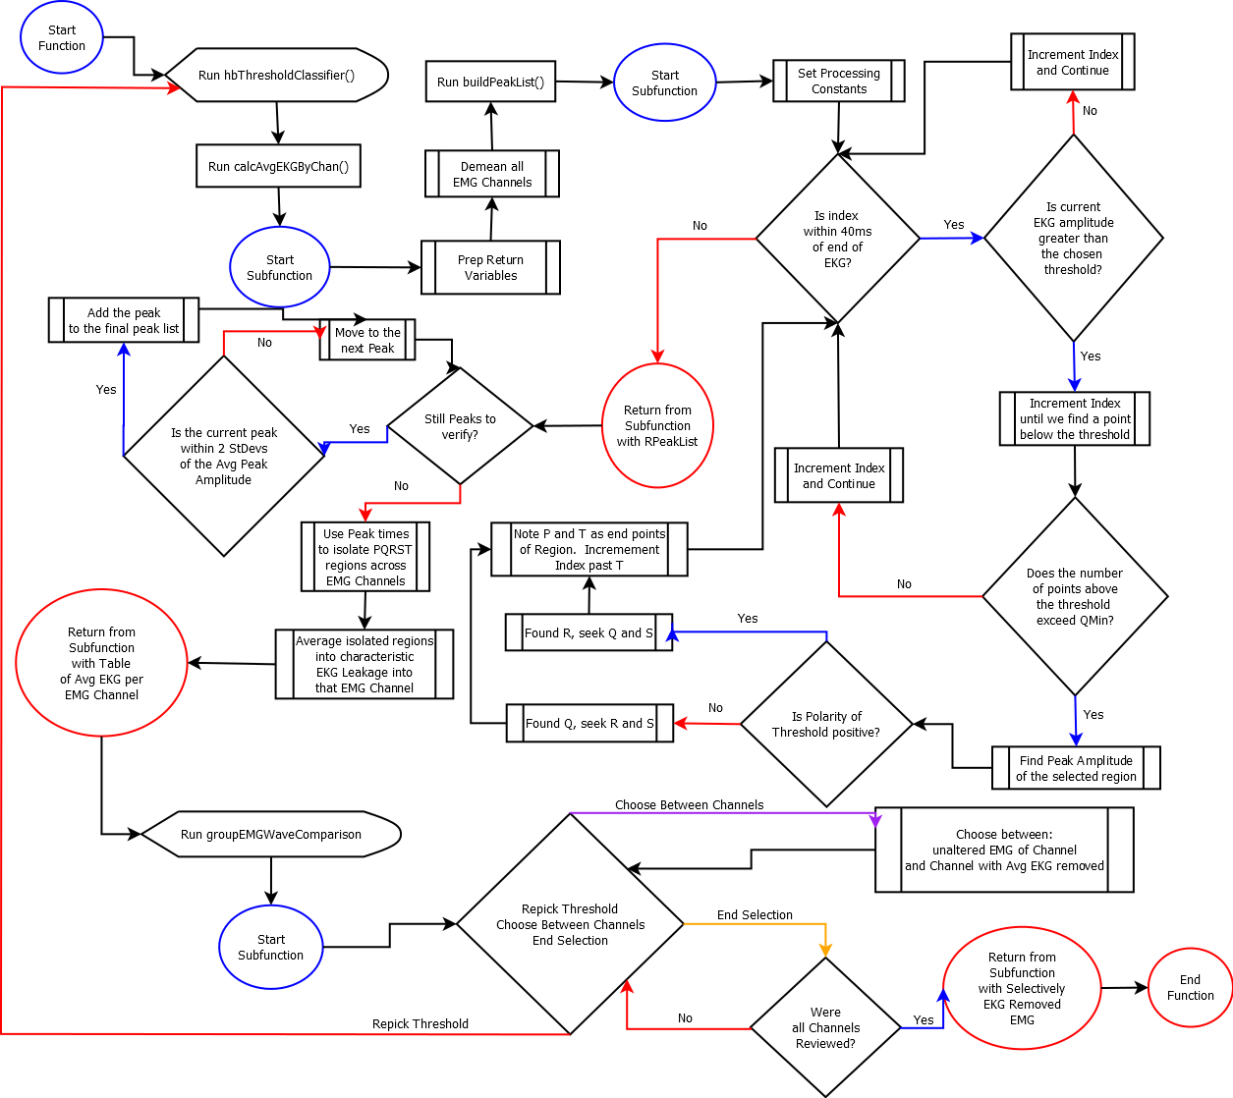
emgFiltAvgEKG.m

Slide 35
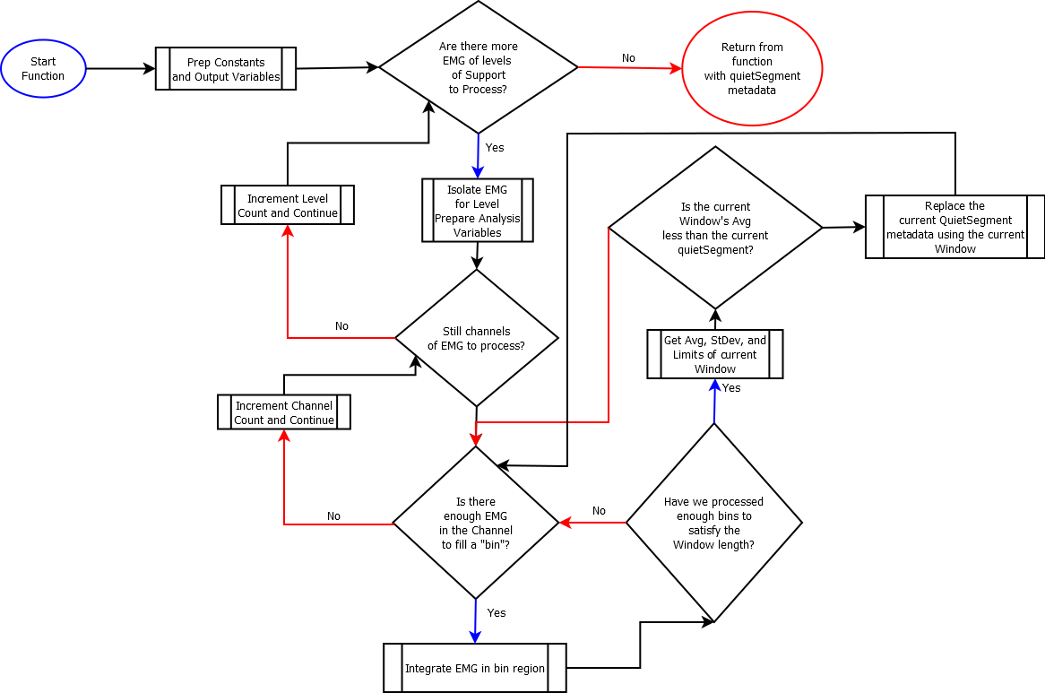
detQuietSeg.m

Slide 36
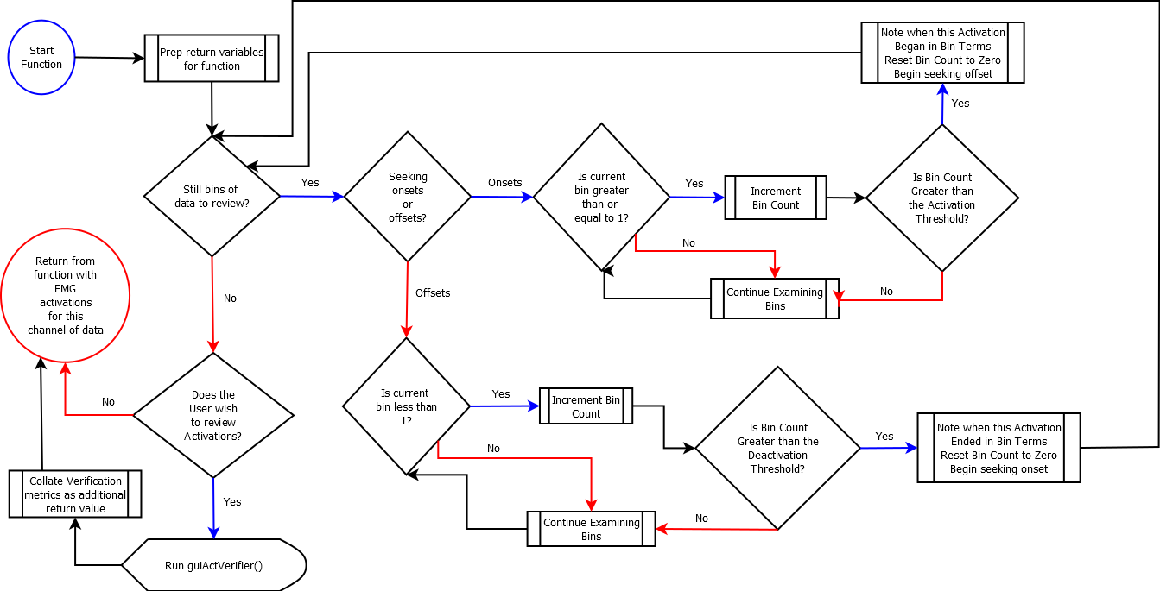
activationDetection.m

