Slide 1
SecureDoc: A SHA-256 Based Cryptographic Integrity Verification System for Digital Signatures Using MongoDB
Presented by:
Virinda Singh V

Slide 2
INTRODUCTION
Digital certificates are widely used but easy to forge.
Manual verification is slow and unreliable.
Visual inspection cannot detect hidden tampering.
SecureDoc provides instant verification using cryptographic hashing.
It follows a Zero-Trust approach for document authenticity.

Slide 3
PROBLEM STATEMENT
Digital documents can be easily modified or forged.
Existing verification depends on manual checks and visual trust.
File names and appearance do not guarantee authenticity.
There is no fast, reliable, and secure way to verify documents.
A tamper-proof verification system is required.

Slide 4
OBJECTIVES
Prevent digital document forgery
Ensure document authenticity
Implement Zero-Trust verification
Use cryptographic hashing (SHA-256)
Eliminate manual verification
Enable instant verification
Maintain single source of truth
Protect document privacy
Avoid storing original files
Support scalable verification

Slide 5
LITERATURE REVIEW
.
Author And Year of Publish | TITLE OF PAPER | JOURNAL | TECHNIQUES USED | DISADVANTAGE
K. G. Srinivasa, R. Ramesh 2018 | A Secure Document Verification System Using Blockchain and Hashing | IEEE Access | Blockchain + Hash Comparison+ SHA-256 | Blockchain latency, high computational overhead
Sania Begum et al., 2025 | Blcokchain solution for Document Intergrity And forgery mitigation | IJRASET | Blockchain + IPFS + Hashing | Complex architecture, inefficient for large document
Devika Sawant et al.,2025 | Digital Document Verification using Blockchain | IJRASET | Hash generation + On-chain verification | Delay in real-time verification
Rasha M. Abd El-Aziz et al.,2020 | Document Verification Scheme using Blockchain | IJARET | Secure cloud + Hash verification | Increased attack surface via cloud
Sharma A. et al.,2021 | Tamper Detection in Digital Documents | IEEE Consumer Electronics Magazine | Hash comparison + Watermarking | SHA-1 insecure, false positives

Slide 6
LITERATURE REVIEW
Author And Year of Publish | TITLE OF PAPER | JOURNAL | TECHNIQUES USED | DISADVANTAGE
Ayush Mishra et al.,2025 | Decentralized Document Verification using Blockchain | JISEM | Blockchain + Hash storage | High cost, difficult deployment
Zeshun Shi et al.,2022 | Automated Data Integrity Verification using Blockchain | arXiv | Hash ledger + Smart contracts | Scalability challenges
Thakkar H., Kumar S.,2021 | Hash-Based Document Authentication Scheme | IEEE Conference | Merkle Tree + Hash validation | Storage overhead, setup complexity

Slide 7
PROPOSED SYSTEM
Algorithm Used
SHA-256 Cryptographic Hash Algorithm
Why SHA-256 is Used
Produces a fixed-length (256-bit) hash
One-way function – cannot be reversed
Ensures data integrity
Strong avalanche effect for tamper detection
Widely accepted secure cryptographic standard
Computationally efficient for verification systems
System Advantages Over Existing Systems
No manual verification required
Does not store original documents
Instant and reliable verification
Tamper-proof authentication
Privacy-preserving design

Slide 8
METHODOLOGY
Tools Used
Python – Core programming language
Flask – Web framework for backend logic
SHA-256 – Cryptographic hashing algorithm
MongoDB – NoSQL database for hash ledger
PyMongo – MongoDB–Python interface
HTML & CSS – Frontend user interface
VS Code – Development environment
Git & GitHub – Version control and collaboration
Algorithm Steps
Upload digital document
Read file as binary data
Generate SHA-256 hash
Store hash with metadata
Upload document for verification
Regenerate document hash
Compare hash with database
Display authenticity result

Slide 9
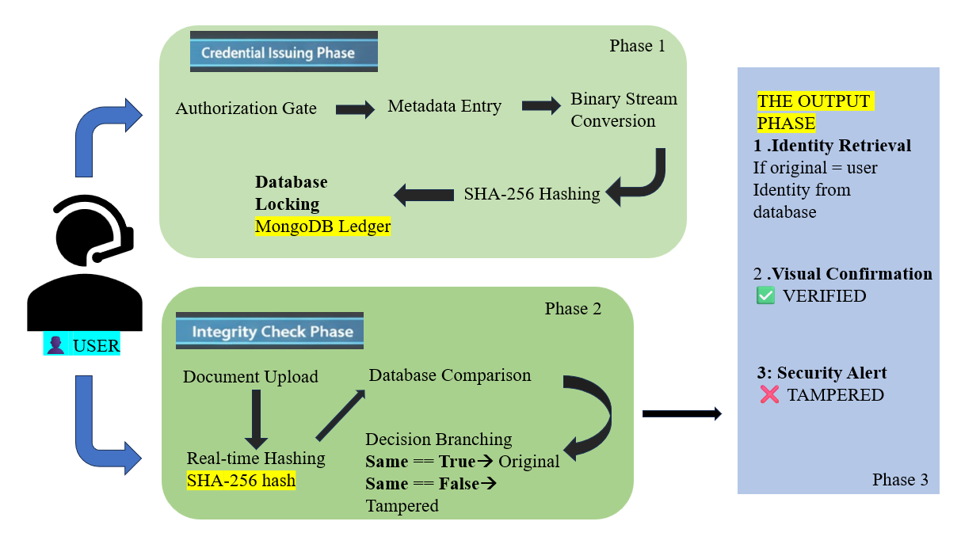
SYSTEM DESIGN/ BLOCK DIAGRAM

Slide 10
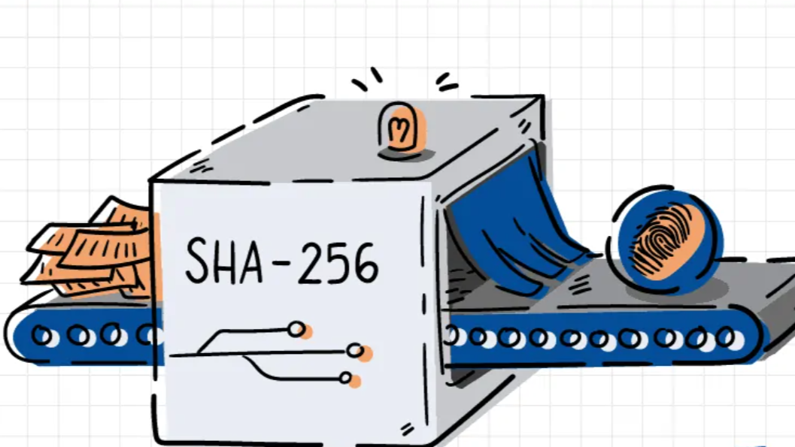
Module 1: The Cryptographic Engine (Security Layer)
Core security component of the system
Uses SHA-256 cryptographic hash algorithm
Reads documents in binary stream format
Generates unique 256-bit document fingerprint
Ensures one-way irreversible hashing
Detects tampering using avalanche effect
Independent from storage and UI layers

Slide 11
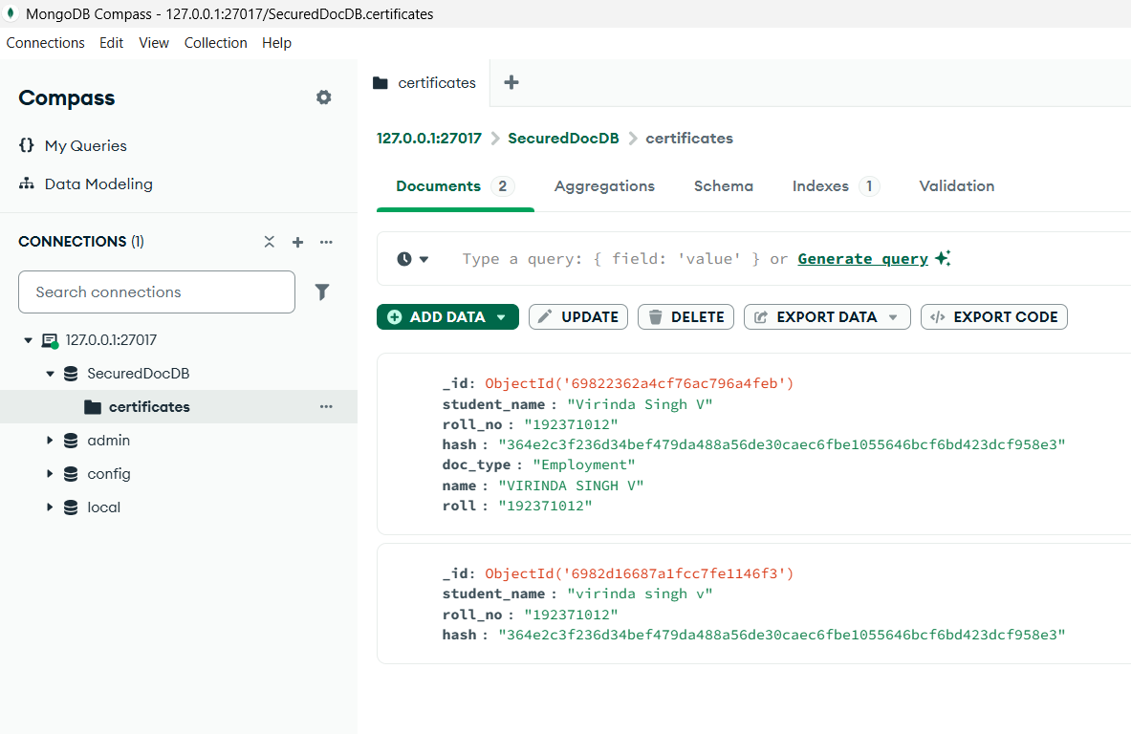
Module 2: NoSQL Ledger Management (Data Layer)
Stores document hash as permanent record
Uses MongoDB NoSQL database
Maintains hash-based verification ledger
Stores only metadata, not original files
Indexed hash enables fast lookup
Prevents duplicate entries using upsert
Ensures data integrity and consistency
Scales efficiently for large datasets

Slide 12
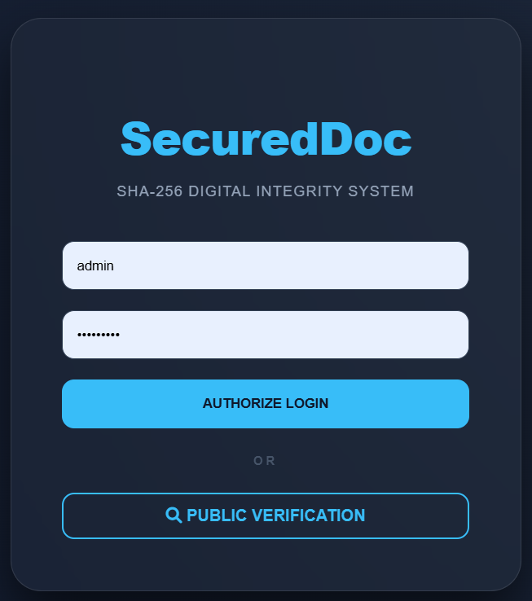
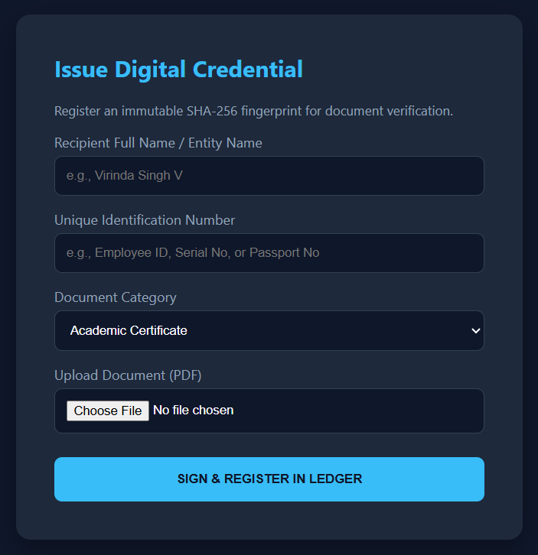
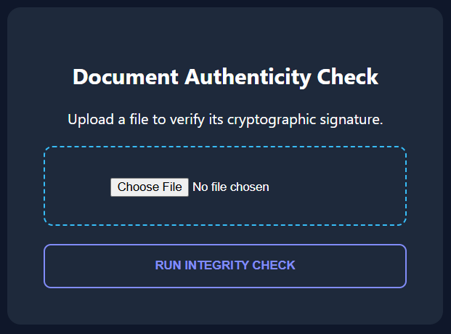
Module 3: Web-Based Verification Portal (Interface Layer)
Provides user interaction with the system
Developed using Flask web framework
Handles document upload and verification
Uses secure POST method for file transfer
Triggers real-time hash generation
Communicates with database for verification
Displays authenticity status to users
Acts as bridge between user and backend

Slide 13
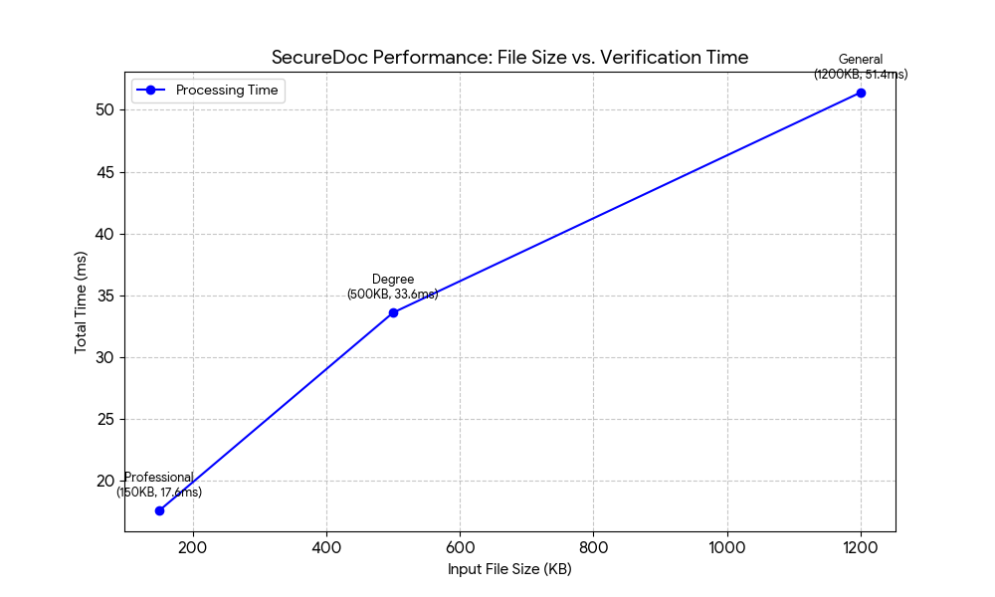
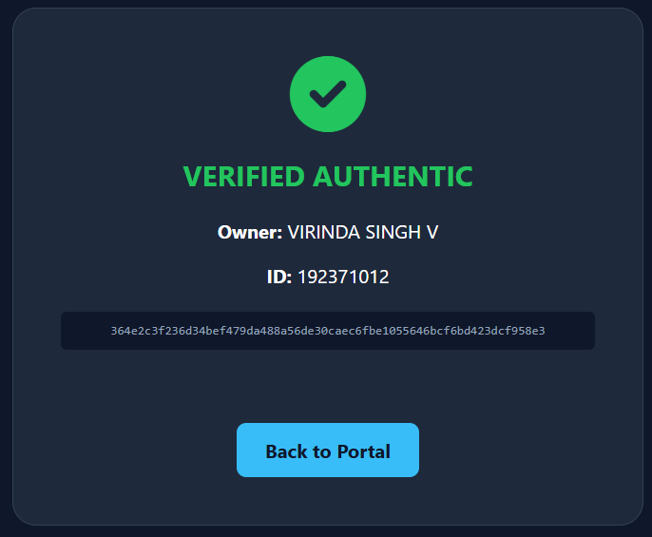
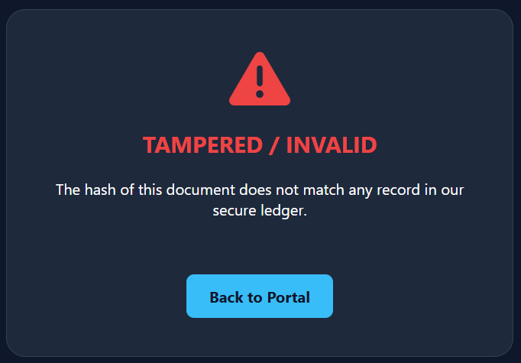
RESULTS
Input File Size (KB) | Certificate Type | Hash Generation Time (ms) | Database Lookup Time (ms) | Total Time (ms)
150 KB | Professional | 12.4 | 5.2 | 17.6
500 KB | Degree | 28.1 | 5.5 | 33.6
1200 KB (1.2 MB) | General | 45.3 | 6.1 | 51.4

Slide 14
RESULTS & CONCLUSION
Results
Successfully generates SHA-256 hash for documents.
Accurately detects any document modification.
Instantly verifies document authenticity.
Displays Authentic / Tampered status.
Shows original owner details for valid documents.
Prevents duplicate or fake registrations.
Ensures fast and reliable verification.
Maintains privacy by not storing documents.
Conclusion
SecureDoc provides a secure digital document verification system.
Ensures authenticity using cryptographic hashing.
Eliminates manual and visual verification.
Follows Zero-Trust security model.
Protects privacy by avoiding document storage.
Offers fast, reliable, and tamper-proof verification.

Slide 15
LIMITATIONS & FUTURE SCOPE
Limitations
Hash verification fails if original document is lost
Cannot recover document from hash value
User must upload exact original file
Does not detect semantic forgery without hash change
Future Scope
Integration with blockchain for immutable ledger
QR code–based instant verification
Certificate expiry and auto-revocation
Mobile-friendly verification application
Multi-organization and global scalability
AI-based fraud pattern detection

Slide 16
REFERENCES
[1] K. G. Srinivasa, “A Secure Document Verification System using Blockchain and Hashing,” IEEE Access, vol. 6, 2018.
[2] R. M. Abd El-Aziz, “Document Verification Scheme Using Blockchain Logics over Secured Cloud,” International Journal of Advanced Research in Engineering and Technology (IJARET), vol. 11, no. 6, 2020.
[3] H. Thakkar, “Hash Based Document Authentication Scheme,” in Proceedings of the IEEE International Conference, 2021.
[4] A. Sharma, “Tamper Detection in Digital Documents using Hash and Watermarking,” IEEE Consumer Electronics Magazine, vol. 10, no. 4, 2021.
[5] S. Begum, “Blockchain Solution for Document Integrity and Forgery Mitigation,” International Journal for Research in Applied Science and Engineering Technology (IJRASET), vol. 13, no. 2, 2025.
[6] D. Sawant, “Digital Document Verification using Blockchain,” International Journal for Research in Applied Science and Engineering Technology (IJRASET), vol. 13, no. 3, 2025.
[7] Z. Shi, “Automated Data Integrity Verification Model using Blockchain,” arXiv preprint, 2022.
[8] A. Mishra, “Blockchain Based Decentralized Document Verification System,” Journal of Information Systems and Engineering Management (JISEM), vol. 10, no. 1, 2025.

Slide 17


