Slide 1
TAPXORA LIMS APP
Best Teaching Method
Follow one patient from login to report printing. That single story helps new users understand the full system quickly.
Detailed Training Guide and Demo Deck
A step by step guide for onboarding, live demos, product training, and day to day laboratory use.

Slide 2
What The App Is
A complete laboratory workflow system.
TAPXORA LIMS APP helps the laboratory register patients, create orders, track samples, enter results, verify reports, collect payments, and monitor stock.The app is designed for real daily work, not just record storage.Its offline first setup is especially important where internet quality may be unstable.

Slide 3
Who Uses The App
Each role sees the tools that match the job.
Admin
Receptionist
Lab Scientist
Creates tests, assigns roles, reviews audit logs, manages settings, and oversees the whole laboratory workflow.
Creates patient records, opens lab orders, confirms patient details, and supports front desk registration.
Receives samples, updates sample status, enters test results, and supports stock usage logging.
Verifier
Accountant
Checks entered results, confirms they are safe to release, and approves final reports.
Monitors invoices, records payments, prints receipts, and reviews daily revenue summaries.

Slide 4
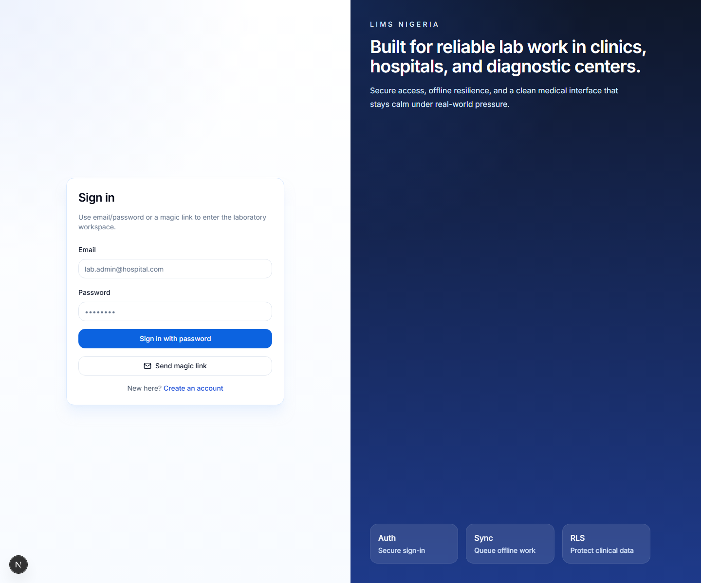
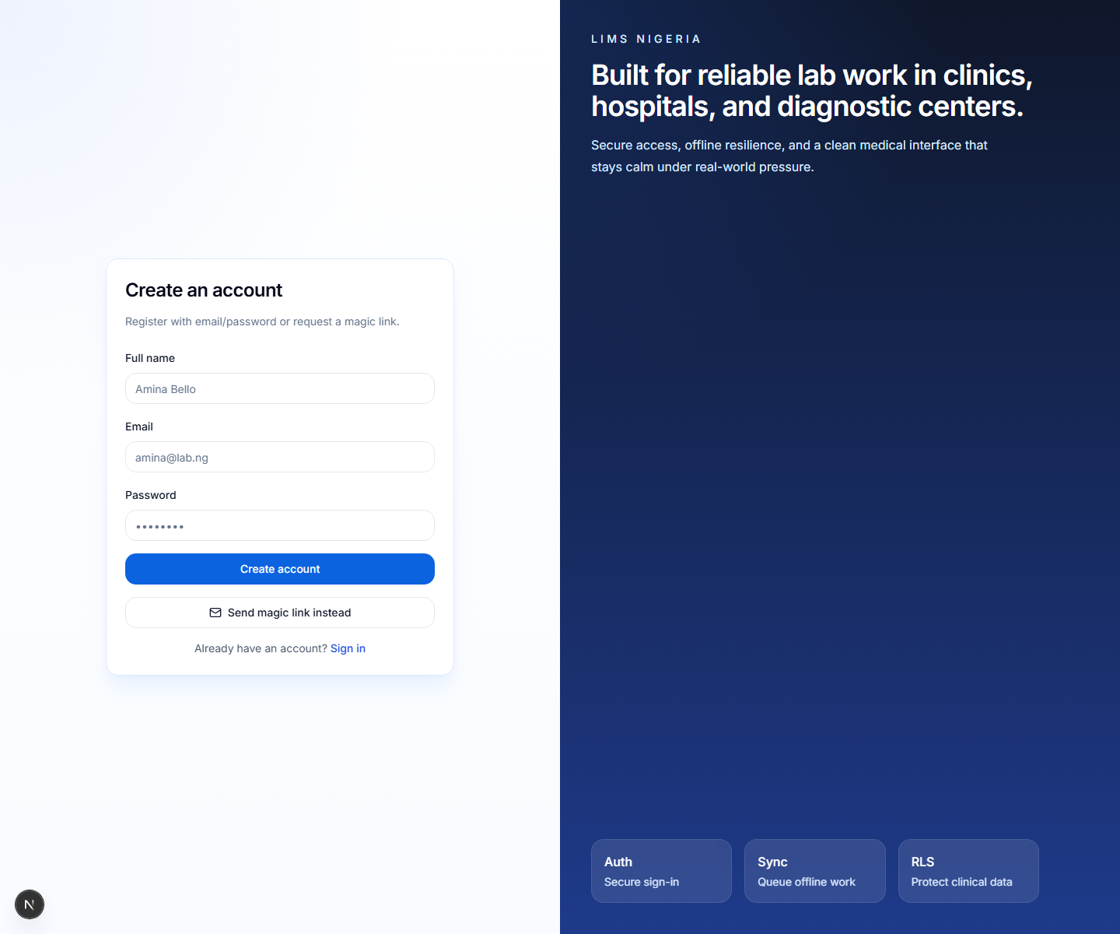
Login And Registration
Real screenshots from the live app.
Login page
Register page

Slide 5
How To Register Users
Simple steps for new staff access.
Open the Register page and enter full name, email, and password.Create the account or use the magic link option.Open user management or profiles and assign the correct role.Confirm the user belongs to the correct facility.Ask the user to sign in again if a role change was made after login.
Training Note
Explain that account creation and role assignment are related but not the same. A user can exist before the final role is assigned.

Slide 6
How To Register A Patient
This is the beginning of the care journey.
Open Patients and click New Patient.Enter name, phone, sex, date of birth, and address.Add extra information such as notes or emergency contact when available.Tick the NDPR consent checkbox.Save the record and confirm the patient appears in the patient list.
Why It Matters
If patient identity is entered correctly here, the later sample and result workflow becomes safer and easier.

Slide 7
How To Search Patients And See History
Useful for returning patients.
Search by patient name, phone number, or lab ID.Open the patient profile to see previous orders.Use patient history to review previous results or repeat investigations.Apply filters when the list becomes large.

Slide 8
Test Catalogue
The master list of services and prices.
Admins create and edit available tests.Each test includes name, price, result type, and reference range.Active tests appear during order creation.Correct test setup keeps results and billing accurate.
Reference Ranges
A range may be numeric, such as a minimum and maximum value, or text when the lab uses a written normal range format.

Slide 9
Creating A Lab Order
This connects the patient to the requested tests.
Open Orders and select the patient.Choose one or more tests from the catalogue.Set priority when needed.Save the order so the system can generate sample work items.
What Happens Next
Once the order is saved, the app can create barcode or QR labels and prepare the sample tracking workflow.

Slide 10
Sample Collection, Labeling, And Storage
One of the most important quality steps.
Print the sample barcode or QR label immediately after the order is created.Attach the label to the correct sample container.Confirm the patient, order, and test match the label.Store the sample in the right location such as tray, rack, fridge, or freezer.Record notes if collection was delayed or unusual.

Slide 11
Sample Reception And Tracking
Track where the sample is and who handled it.
Scan the barcode or type the sample code.Confirm the patient and test.Move status through Registered, Collected, In Progress, Results Entered, Verified, and Reported.Use chain of custody logs to review handling history.
Why Staff Like This
It reduces 'Where is this sample?' confusion and helps the dashboard show real progress.

Slide 12
Results Entry
Different tests can use different result forms.
Open the result queue and choose the right sample.Enter the result using the test's configured type: numeric, text, dropdown, or positive or negative.Review abnormal flags created from the reference range.Save the result for verification.
Safety Reminder
Always confirm the patient and sample code before typing the result value.

Slide 13
Result Verification And Report Printing
A two step process for safer reporting.
Open the verification queue and review the entered result.Check values, comments, patient identity, and flags.Approve the result if correct, or return it for correction if needed.Open Reports and print or download the professional PDF report.

Slide 14
Billing And Receipts
The business side of the laboratory.
Invoices are created from the prices of the ordered tests.Payment status can be unpaid, partial, or paid.Record payment amount and method.Print or download the receipt after payment.
Manager Benefit
Revenue summaries help the lab see daily financial performance without manual calculation.

Slide 15
Inventory Management
Track reagents, consumables, and expiry risks.
Create inventory items and set quantity, lot number, expiry date, and reorder level.Record stock in and stock out transactions.Watch low stock and near expiry alerts.Use this module to reduce interruptions during daily lab work.

Slide 16
Dashboards, Audit Logs, And Offline Work
Control, visibility, and continuity.
Dashboards show today's worklist, turnaround time, test trends, revenue, and alerts.Audit logs let admins review who changed what and when.Offline support lets staff continue working during weak internet and sync later.

Slide 17
Recommended Live Demo Flow
A short script for training sessions.
Show login and registration.Explain the user roles.Register one patient.Create one order with two tests.Show the sample label and storage explanation.Enter one result, verify it, and print the report.Record a payment and show the dashboard and inventory alerts.

Slide 18
Simple Summary
The app helps the lab stay organized.
It helps the lab know who the patient is.It helps the lab know what test was requested.It helps the lab know where the sample is.It helps the lab know what result was entered and whether it was checked.It helps the lab know whether payment and stock records are complete.
Child Friendly Explanation
A patient comes in. The lab writes the details, takes the sample, checks the result, prints the answer, and keeps the work organized from start to finish.

