Slide 1

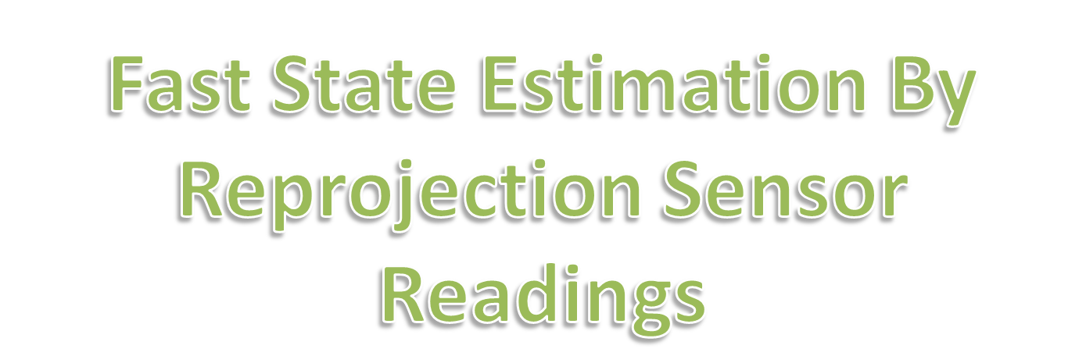

Slide 2
State Estimation ⬄ Localization
The objective of this lab is to develop a fast global localization algorithm that avoids searching in the space of all possible locations or configurations of the robot and faithfully reproduce localization results comparable to other global localization methods such as Markov and Particle Filter methods. See virtual labs on Markov and Particle Filter based localization methods.

Slide 3
Reverse Projection Theory
In this figure obstacles are in red, the robot is shown by a black circle.
The robot scans its surroundings through its sensor rays (shown in green). There are eight such rays in this figure but there could be any number of them.
For example if the robot has a laser range finder such as the SICK range finder, one could get as many as 180 or 360 such readings

Slide 4
Reverse Projection Theory
The robot would now make use of these sensor readings to obtain its location in the map.

Slide 5
Reprojection Explained
The robot or rather the algorithm that runs on the robot goes to every boundary cell in the map and re-projects the 8 sensor rays.
Reprojection is essentially an operation of sending the sensor ray in its opposite direction from the obstacle boundary.

Slide 6
Reprojection Explained
In this map
Obstacle cells in red.
Free cells are in white.
Boundary cells in khaki or
brownish yellow.

Slide 7
Reprojection Explained
The same sensor readings are re-projected from the boundary cells onto the free space.
Place where all the eight sensor re-projections meet is the most likely state or location of the robot
Computations reduced to only boundary cells instead of entire free space.
Hemanth Korrapati and K Madhava Krishna, "Global Localization of Mobile Robots by Reverse Projection of Sensor Readings”,
IEEE International Conference on Robotics and Bio-mimetics, 2008,
IEEE International Symposium on Measurement and Control in Robotics, 2008.

Slide 8
Theoretical Analysis
From each boundary cell 8 reverse projection done. As few of them intersect an obstacle straight away they are not considered for reprojection.
For example for the image on the left only three rays out of eight get reprojected as others intersect the surrounding obstacles

Slide 9
Theoretical Analysis
From each boundary cell re-projection done in all possible directions
Here we show reprojection from three boundary cells along one direction. This is repeated for all directions from each such boundary cell

Slide 10
Theoretical Analysis
Grid with maximum intensity will be the most likely location of the robot, here shown in green.

Slide 11
Accounting For Sensor Noise
To account for sensor noise, the re-projected reading does not update the intensity at just one cell.
It rather does for cells both ahead and before the cell at which the re-projected readings fall.
The cell at which the re-projected reading falls is shown with highest intensity in dark gray and the cells ahead and before it are shown with lesser intensity in gray.

Slide 12

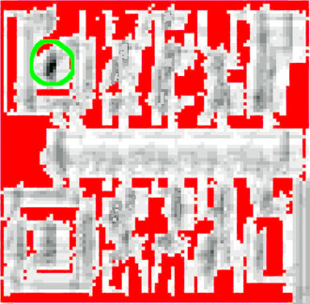
Simulation Result
The figure on the right above shows the intensities at the end of the algorithm at all the free cells in the map. The most likely location of the robot has the densest intensity regions in black encircled in green.

Slide 13
Java Applet Explanation
In this applet (map) red cells denote the boundary cells as well as obstacle cells, blue cells denote free cells, white cell denotes the real robot position and green cell denotes the most likely robot position aka virtual robot position.
Make use of reprojection button find virtual robot position(estimated robot position by algorithm).
Change button can be used for changing the real robot position.
Click the map button for choosing a desired map.

Slide 14
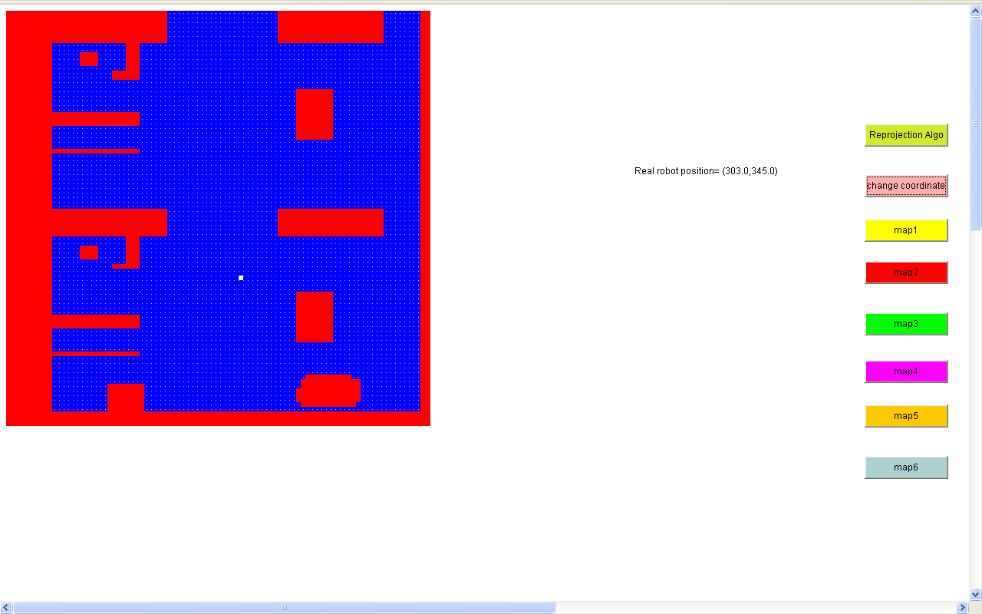
An Applet Run
Obstacle grid
User robot position
Free space grid

Slide 15
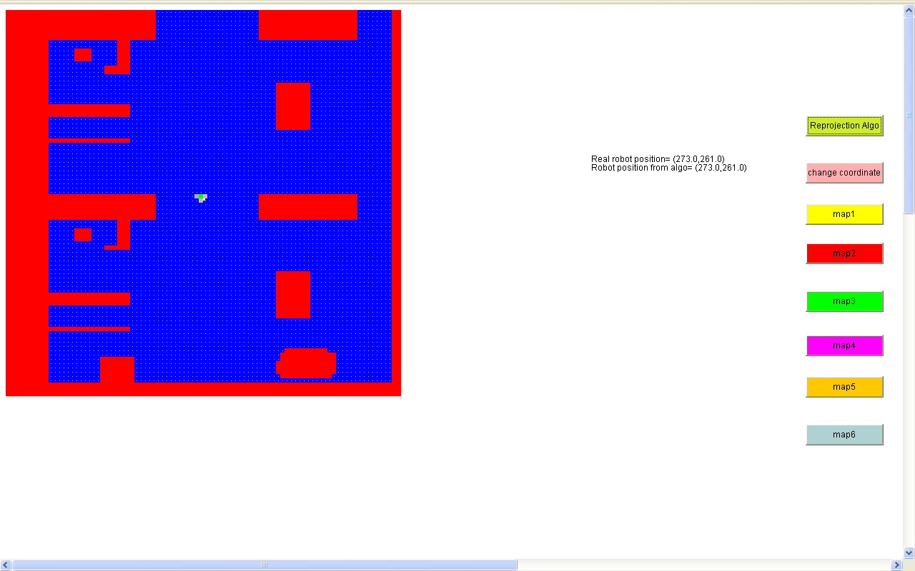
Virtual robot position
User robot position
Grid with intensity more than threshold

Slide 16
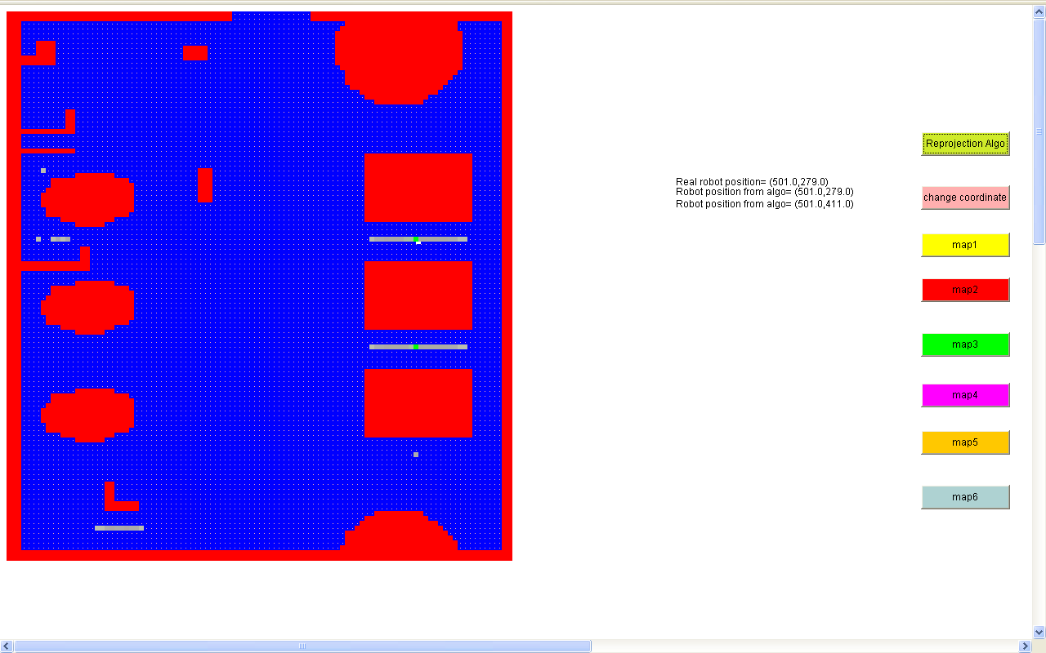
Virtual robot position
Virtual robot position

Slide 17


