Slide 1



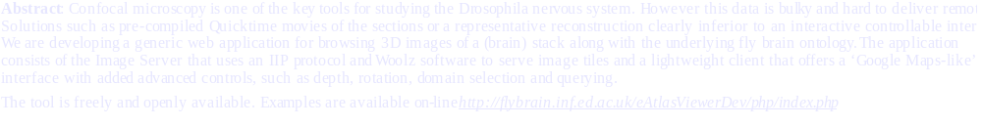
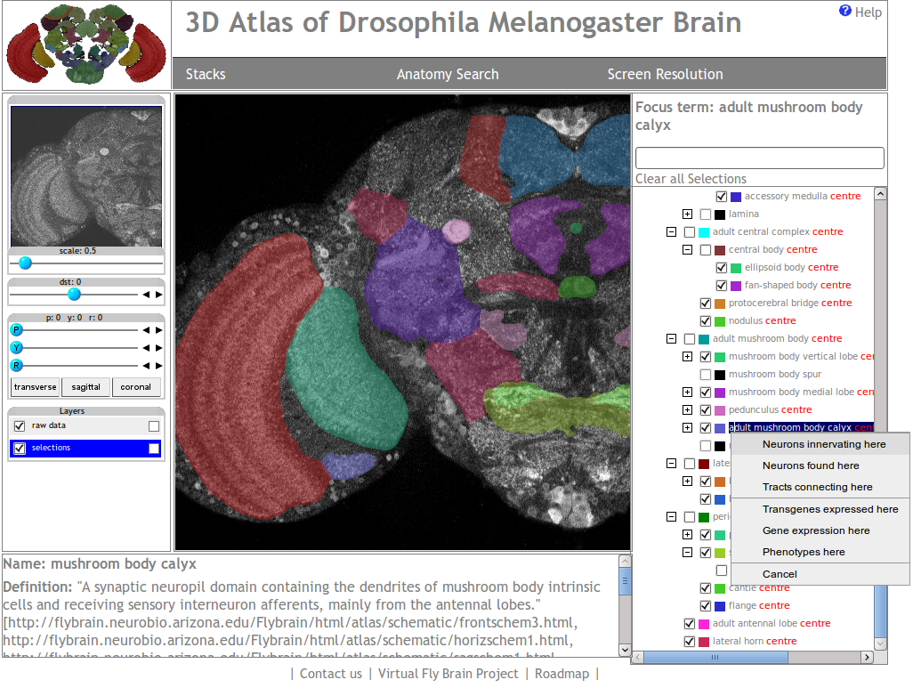
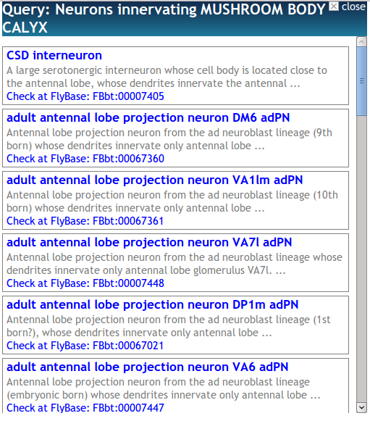
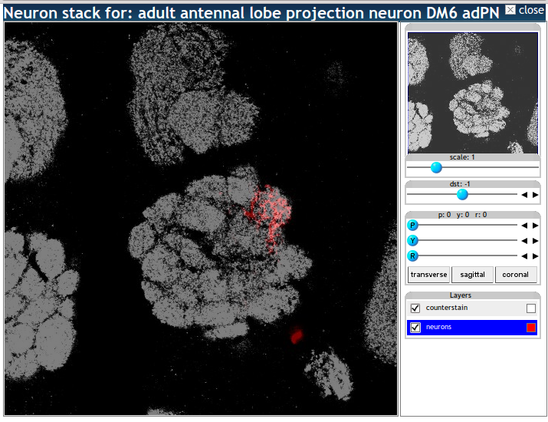
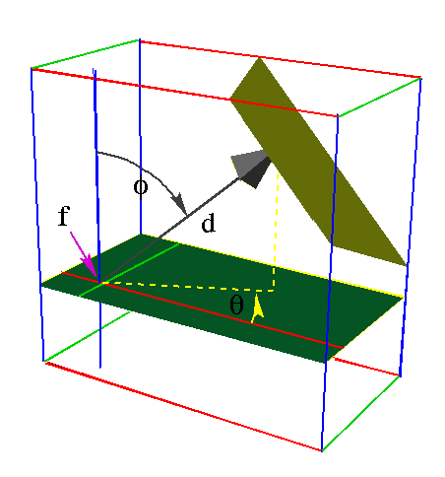
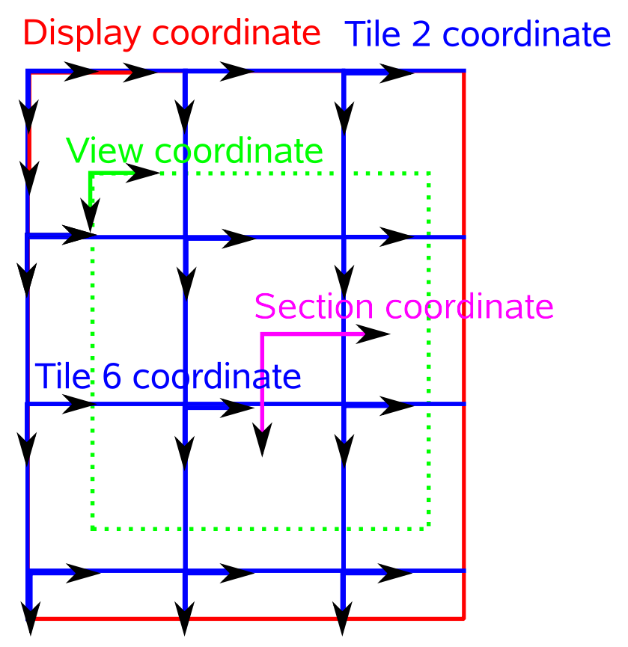

Virtual Fly Brain 3D Interaction Tool
Nestor Milyaev¹, J. Douglas Armstrong¹, David Osumi-Sutherland², Michael Ashburner², Richard A Baldock³, Nicolas Burton³, Zsolt L Husz³
1. Edinburgh University School of Informatics
2. University of Cambridge Department of Genetics
3. MRC Human Genetics Unit, Institute of Genetics and Molecular Medicine
Features
An interactive tool for 3D image and anatomy learning, exploring and interaction
Features: 3D rotation, zoom, navigation, distance, layers, domains, querying
Runs in a standard web browser
Google Maps-like interface, alternative image stacks
Extendible and configurable tools, could be used on any site
AJAX-based, asynchronous loading of tiles preserves bandwidth: only those visible are loaded, at requested resolution
Exploring Brain Anatomy
Anatomical domains are displayed as coloured overlays
The user can specify which domains are visible using the tree
The interactive tree represents brain partonomy
Context-sensitive search on tree nodes
Rich function set on a node with immediate feedback
Context menu for more functions, eg ontology/DB queries
Single layer for all the overlays to save bandwidth
Context
Querying
On tree node
The Woolz software
A 3D image representation and manipulation package.
Allows a stack of images be represented as a 3D volume defined in terms of volume’s spatial boundaries and background values.
Multiple domains can be stored within a single indexed Woolz object => easier maintenance
An arbitrary section plane could be drawn through the volume, defining a view => full 3D navigation of the inside volume
WlzIIP Server
An extension of the popular IIP Server. Main features:
Serves full-size images or tiles to the client according to a user request in IIP format
Server-side image processing based upon the Woolz software
The IIP Protocol
The IIP protocol provides quick access to large image databases over HTTP
Used to request and specify tiled images
Extension for representing a 3D object as Woolz objects instead of a flat image stack called WlzIIP.
The Overall Architecture
Example IIP request: get domain 0 only (grayscale image), fixed point = 256, 233, 62, zoom level=1, distance to the fix point = 0, angle = 0, quality = 80%,
as single whole JPEG:
http://iip/fcgi-bin/wlziipsrv.fcgi?wlz=flybrain.wlz&sel=0,0,0,0,0&fxp=256,233,61&scl=1&dst=0&pit=0&yaw=0&rol=0&qlt=80&cvt=jpeg
Summary: We have built an application for online browsing of 3D images and exploring of the fly brain ontology. Novel approaches used in both the server-side and client interface allowed us to provide novel features such as interactive 3D browsing with immediate visual feedback on anatomy domains while making system maintenance easier and using available bandwidth more efficiently. The system offers a feature set previously only available in desktop-based system and provides an invaluable resource for learning fly brain structure and future collaborative projects in fly brain genetics.

