Slide 1
VFB 1.5 layout suggestions

Slide 2
Aims
Users need to know where they are and what information to focus on.
A page needs a focus and some headings
We need to consider what information users need to view together.
The 2D browser needs a key & controls for what is displayed. This needs to be visible and visibly grouped with the browser.
Canned query menus need to be clearly associated with the term to which they apply

Slide 3
Aims – browser key and controls
Image browser with multiple loaded images needs a color key controls for elements
Color key + controls needs to be:
Compact
Close and visibly linked to the image browser
Same width (although what about different aspect ratio stacks?); boxed together.
Easy to understand:
Image names are quite opaque.
But anatomical type names are long! (hard to make table compact)
Thumbnails are large (table with these can’t be compact or close to image)
Resizing
Prioritise information in key table in order of importance. Resizing => loss of lower priority elements.
Could also have toggle to turn thumbnail view in table on/off.

Slide 4
Layout proposals for laptop 13’’ screen or bigger

Slide 5


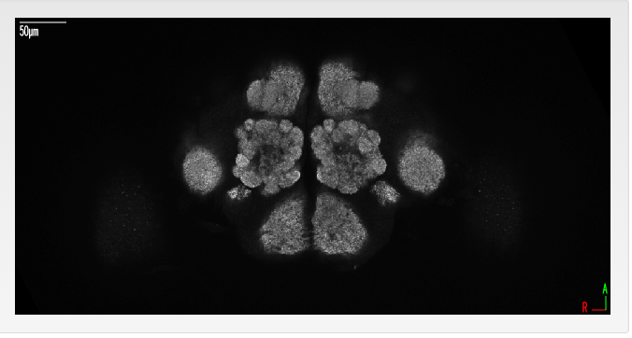
Fixed location and dimensions.
Zoom does not resize viewer panel.

Slide 6

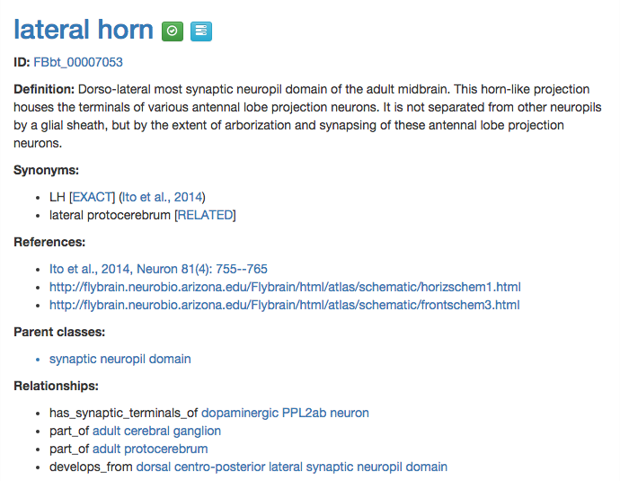

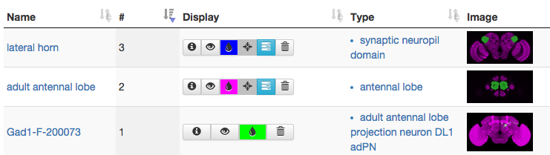
lateral horn
Users can choose stack here.
Term Info
? Unsure about loc.
Resizing wraps text in this panel
This side fixed width
No lower limit.
Use browser scroll to see
full content (if present)
Unnecessary column

Slide 7
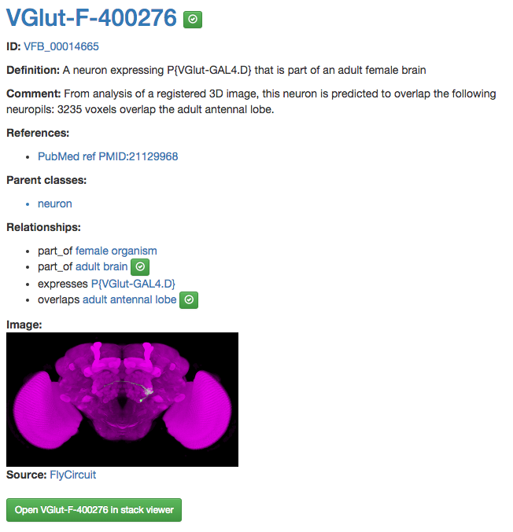
VGlut-F-400276
Having stack and focus term
up here orientates users.
No queries on individuals yet – but maybe in future. e.g. Blast or connectivity query
Term Info
A toggle to turn thumbnails on/off could be
useful for a more compact view.

Slide 8



Display table - type
The name column has both individuals (images, e.g. Gad1-F-200073) and classes (e.g. lateral horn). The type column has the type of thing depicted in the image, OR the superclass of the class displayed in the name column. This is confusing. Potential solution:
Image name | Image | Control panel | Type
LH - painted domain |  |  | lateral horn
AL – painted domain |  |  | adult antennal lobe
Gad1-F-200073 |  |  | adult antennal lobe projection neuron DL1 adPN

Slide 9
To make the new table work
Image name | Image | Control panel | Type
LH – JFRC2010 painted domain |  |  | lateral horn
AL – JFRC2010 painted domain |  |  | adult antennal lobe
Gad1-F-200073 |  |  | adult antennal lobe projection neuron DL1 adPN
DOS to add individuals for all painted domains. Will work as for all other individuals. This will allow choice of painted domains where there is a choice of stacks (e.g. Ito half Brain vs JFRC2010)

Slide 10
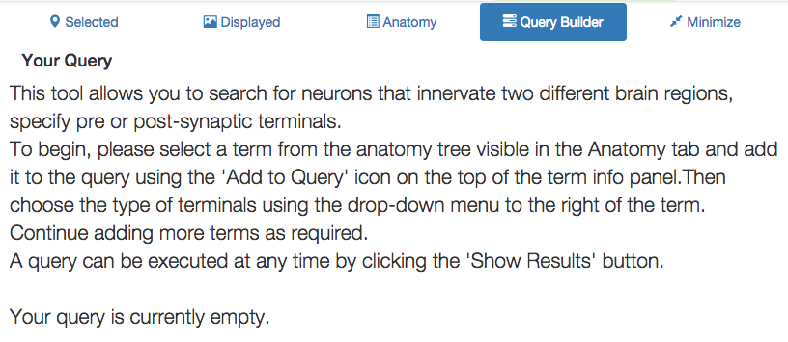

Query builder
Your query is currently empty.
Add content by clicking the icons.

Slide 11
Graph and tree views
Tree view for domains on stack:
Navigation aid + some context for terms.
Alternative controls and key for image browser
Where should it live?
Would be nice to see this at same time as Term Info.
Should it have its own search as in VFB 1?
Connected graph views
Don’t have these yet. Can answer questions like, what is X?, What is X part of? What does X develop from?
=> term neighborhood & context.
Are term focused, so can (should) be tab on term info
Could these replace the tree browser?

Slide 12



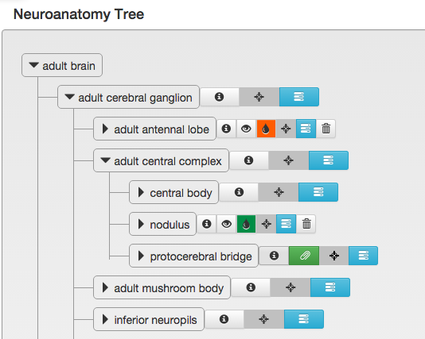
Anatomy Tree
Suggested changes:
1. Rename. 2. Add (back) search. 3. Better highlight displayed terms (not sure best approach) 4. Option to show all displayed nodes.
Tree browser
tree
Show displayed
Do we need this?

