Slide 1
Virtual Fly Brain
- Type/Class vs Individual/Instance

Slide 2
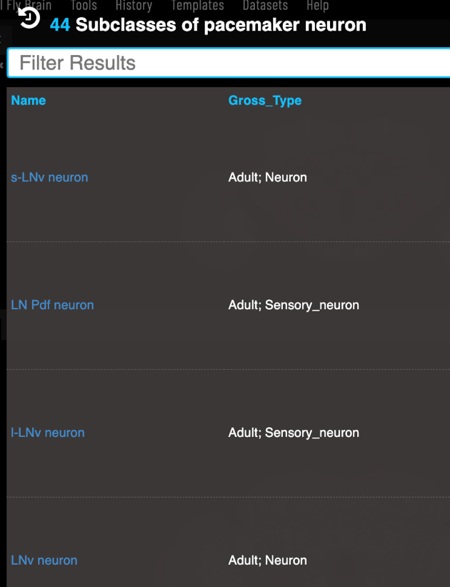
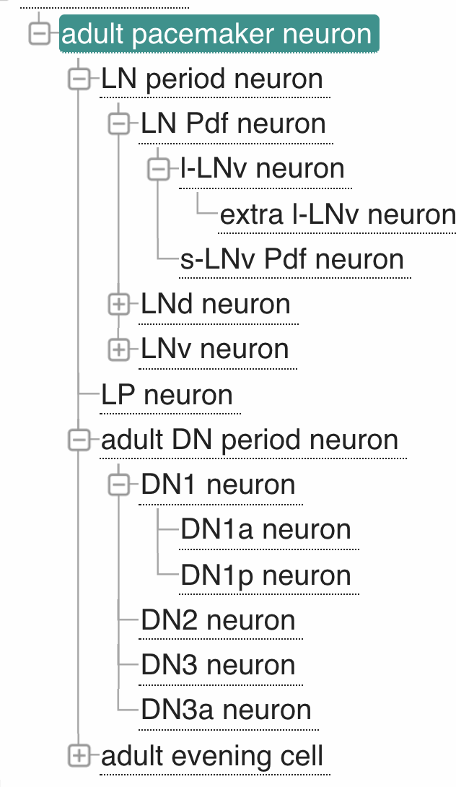
VFB knows about lots of types (classes) of pacemaker neuron & their classification relationships

Slide 3
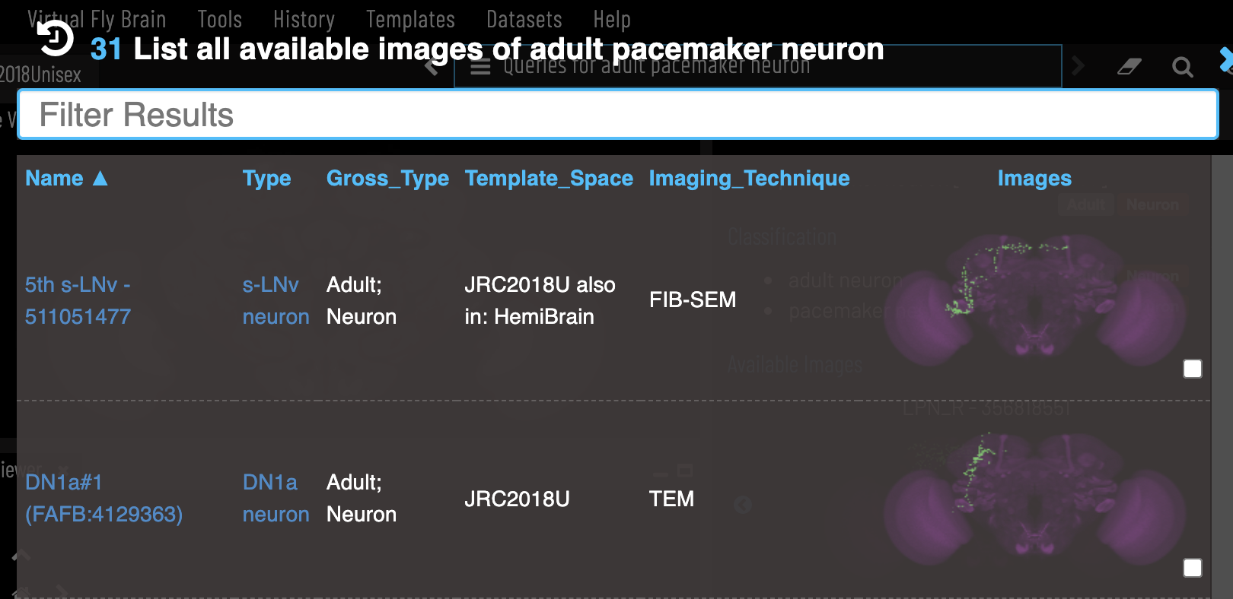
VFB has images and data for many individual pacemaker neurons, AKA instances, of different types & from different source
Abstract classes are useful when searching for individual neurons

Slide 4
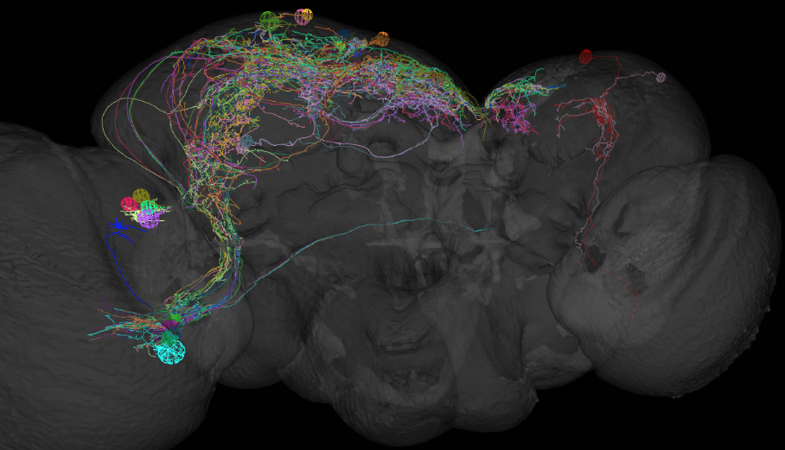
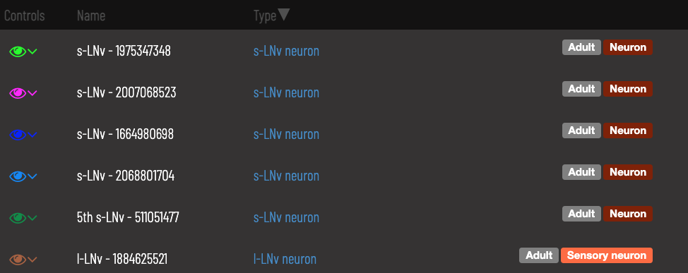

Slide 5
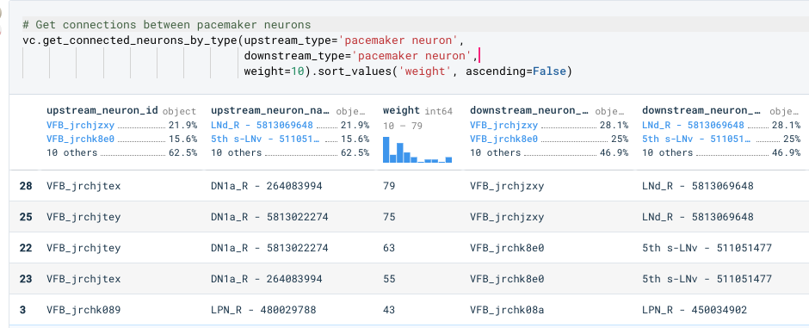
The abstraction provided by the class graph is useful for connectomics queries

Slide 6
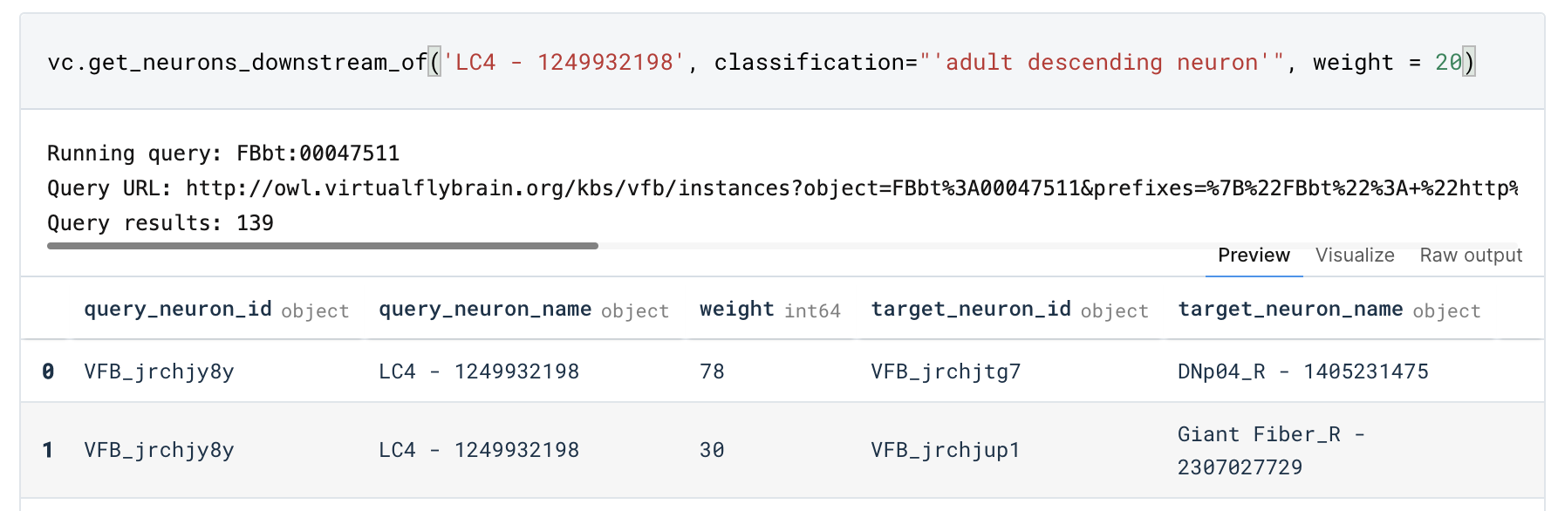
The abstraction provided by the class graph is useful for connectomics queries

