Slide 1

Mapping Ideas The HYIP Project
The basic concept of our mapping

Slide 2

Definition ranges of idea
What is idea..?

Slide 3
Definition on Wikipedia
A concept map or conceptual diagram is a diagram that depicts suggested relationships between concepts. It is a graphical tool that instructional designers, engineers, technical writers, and others use “to organize and structure knowledge”.
Mind mapping is one of the best ways to capture your thoughts and bring them to life in visual form (“maps out”).
Definition of our Mapping Ideas is closer to Concept Map rather than Mind Mapping

Slide 4
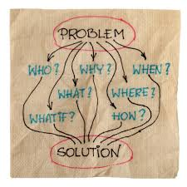
The objective of an idea is to get a solution
General Objective

Slide 5
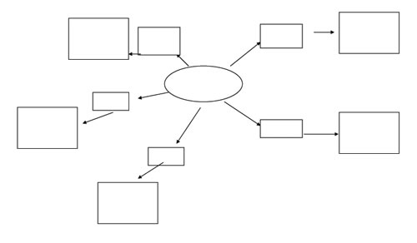
Without a concept can lead to wrong solution..
Concept requirement

Slide 6
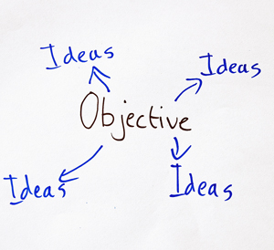
An objective may create many ideas
How to deal with ideas?

Slide 7


People has their own concept. Which one better?
Concept of the idea

Slide 8
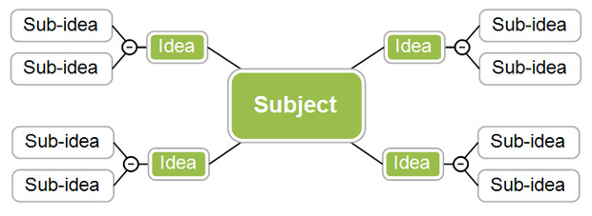
Innovation creates sub-ideas. Shall we look them all?
Sub Ideas

Slide 9
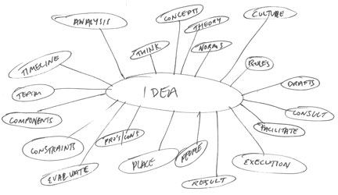
In case of many parameters. Where you should start?
Parameters

Slide 10

You may completely lost..
Too many..

Slide 11
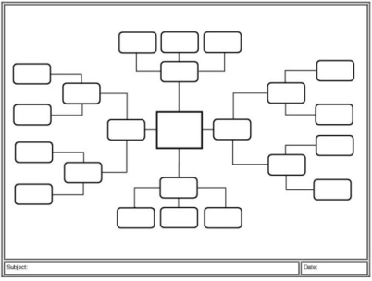
How to map then?
Why not mapping..

Slide 12
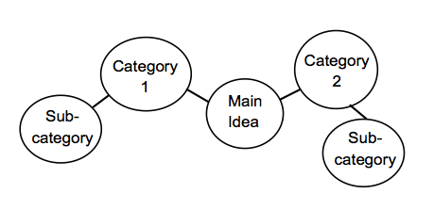
Let’s start from how the ideas are categorized
Starting on Mapping Ideas

Slide 13

Then find the best way and the easiest one to replicate
Step on Mapping Ideas

Slide 14

Slide Title
What is replication of ideas ?
Definition range of replication

Slide 15
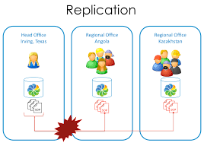
Replication on Organization
Replication is one of the important role on organization development

Slide 16

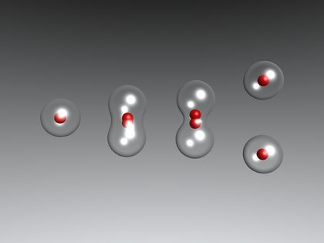
Basic on Replication
Visualization
Process
Replication is happen till a smallest thing - a cell

Slide 17
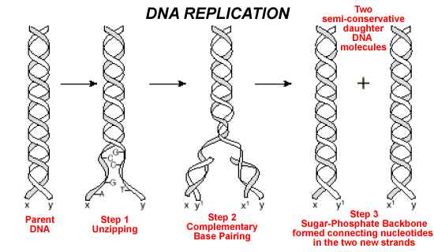
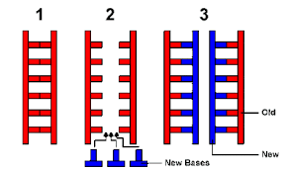
Basic on Replication
Visualization
Structure
There are 3 (three) basic process on replication

Slide 18
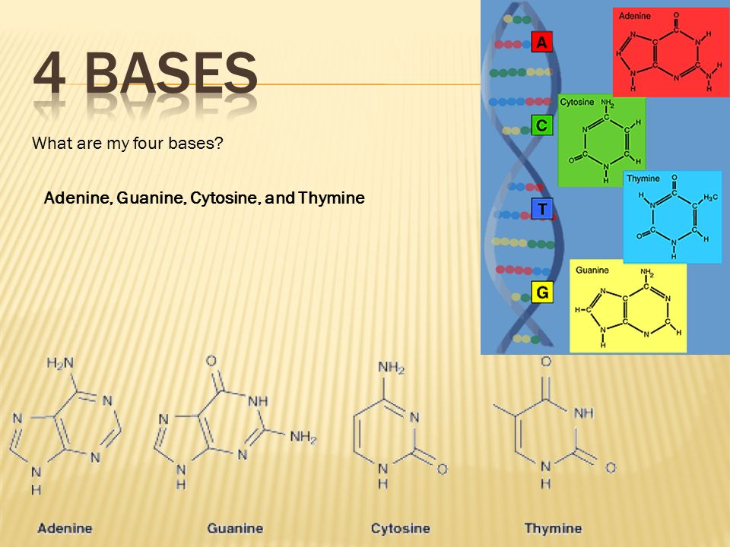
General Case

Slide 19
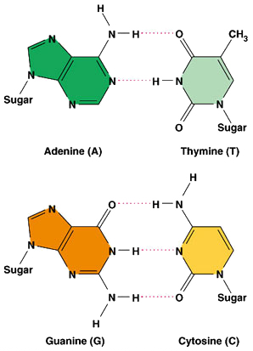
The 4 bases are identical by 2 in pair
General Case

Slide 20
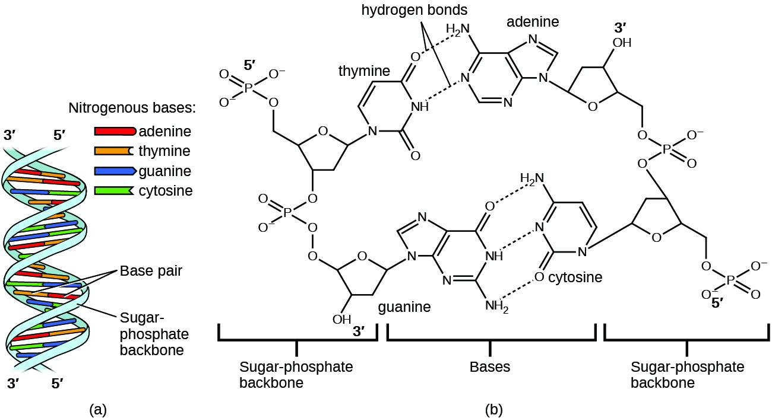
The 4 bases are in between 3’ to 5’ and 5’ to 3’ by 2 in pair

Slide 21
Overview
Our Concept on Ideas
Our Mapping Ideas
Objective to Solutions
Maintain the Best
Easiest to Replicate
Adopt the Nature
2 (two) pairs
3 (three) steps
4 (four) bases
5 (five) frames

Slide 22

Our Mapping Ranges
Mapping Ideas
Mapping Solutions
Mapping Out
Mapping Group
Mapping Relations
Mapping Activities
Mapping Maps

Slide 23
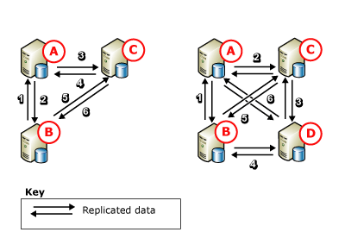
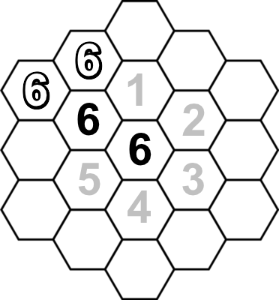
Our Next Mapping
Mapping Solutions
Mapping Out
See you on our next mapping..

