Slide 1

Mapping Out (Project Mapping)
Courtesy of The HYIP Project

Slide 2

Introduction
This presentation is the next stage of our Mapping Ideas and Mapping Solutions.
Here we are going to Map Out both of Mappings and explaining their routes for next Mapping.
It is explaining on structuring ideas and map their resources on building a match solutions.
Let’s start by highlighting the mind set of our previous Mappings.

Slide 3

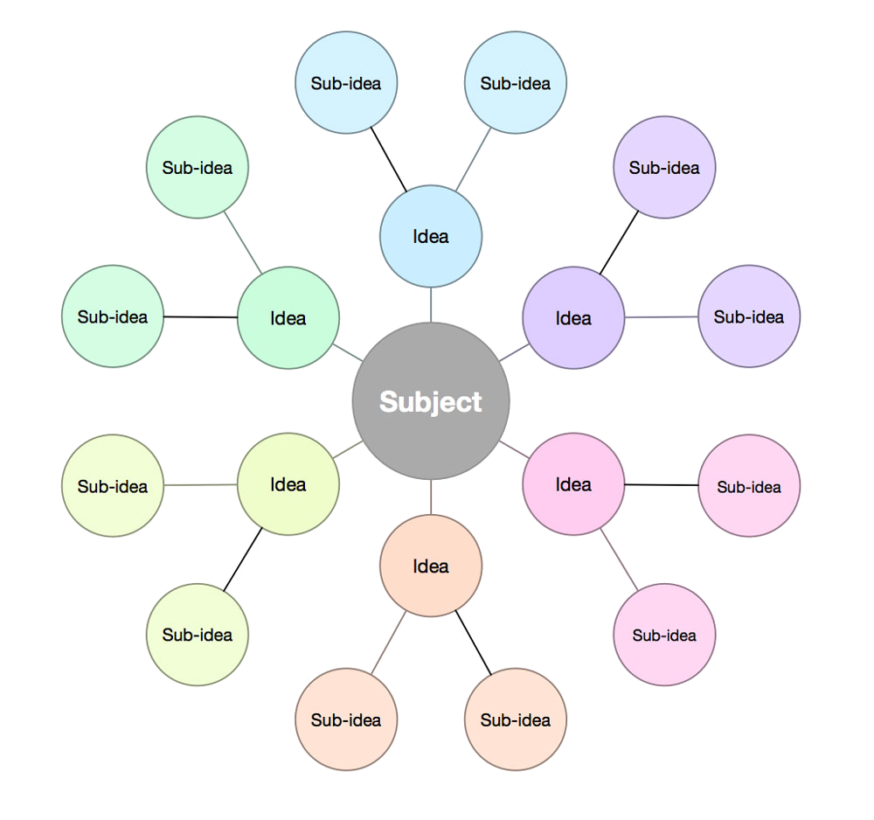
Mapping Ideas
Our Concept on Ideas
Objective to Solutions
Maintain the Best
Easiest to Replicate
Adopt the Nature
Our Mapping Ideas
2 (two) pairs
3 (three) steps
4 (four) bases
5 (five) frames
Highlight on Our Mapping Ideas

Slide 4
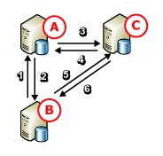

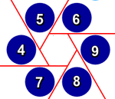
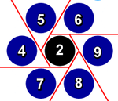
Mapping Solutions
The 3 to 4 are pairs from 7
The 3 has 6 routes
The 4 has 6 routes in pair
The 6 routes are hexagonal
The inner is by 2nd pair
The outer is from 4 to 9
The merging is back to 7
Highlight on Our Mapping Solutions

Slide 5

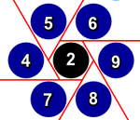
Six (6) Routes
The Mapping has six (6) routes

Slide 6
Uniformity
2 + 6 + 7 = 15
2 + 4 + 9 = 15
2 + 5 + 8 = 15
Sum of each routes are same 15

Slide 7
Three (3) Sets Uniformity
Our Mapping Ideas
2 (two) pairs
3 (three) steps
4 (four) bases
5 (five) frames
2 + 6 + 7 = 15
2 + 4 + 9 = 15
2 + 5 + 8 = 15
Our Mapping Solutions
The 3 to 4 are pairs from 7
The 3 has 6 routes
The 4 has 6 routes in pair
The 6 routes are hexagonal
The inner is by 2nd pair
The outer is from 4 to 9
The merging is back to 7
Correlation to Our Previous Maps

Slide 8
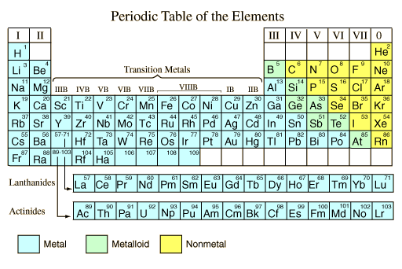
Mapping Elements

Slide 9
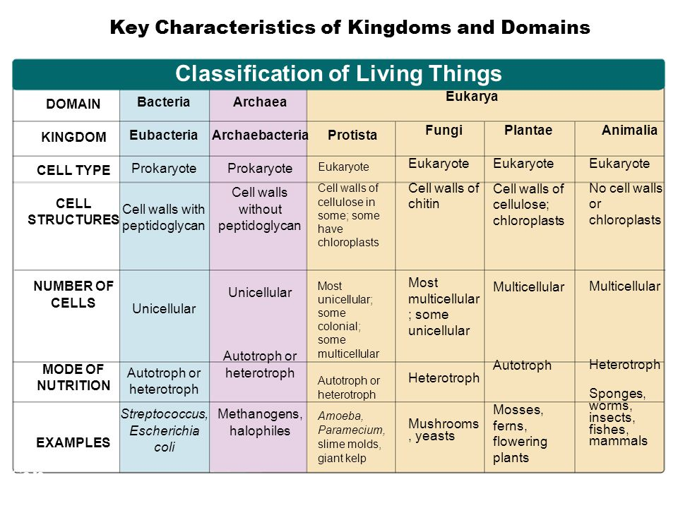
Kingdoms and Domains
Two-Dimensional DNA Nanostructures

Slide 10
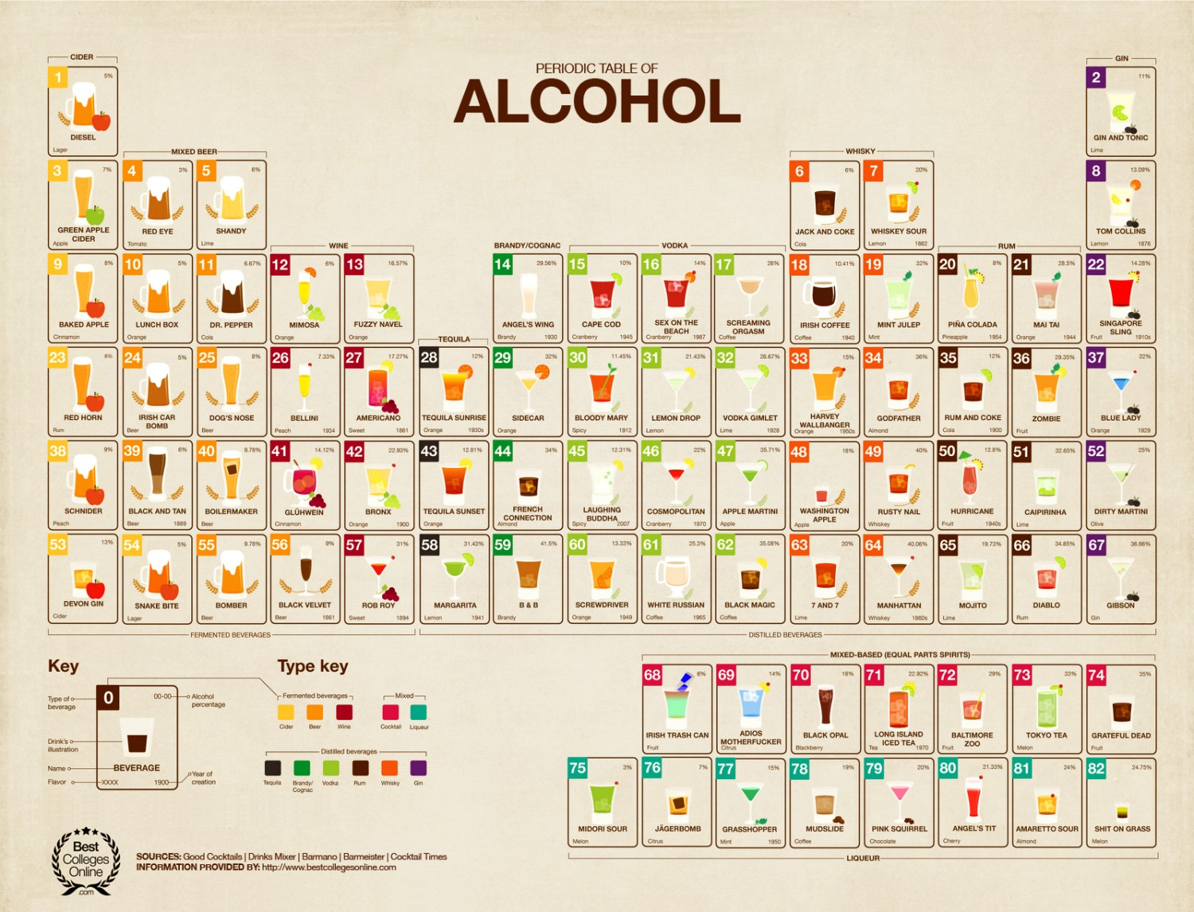
Mapping Ideas
Two-Dimensional DNA Nanostructures

Slide 11
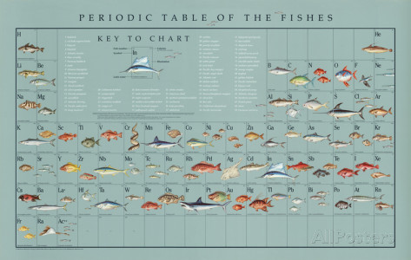
Mapping Ideas
Two-Dimensional DNA Nanostructures

Slide 12
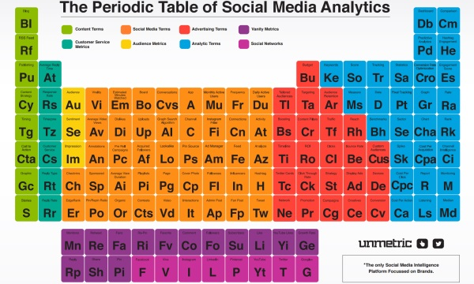
Mapping Ideas
Two-Dimensional DNA Nanostructures

Slide 13
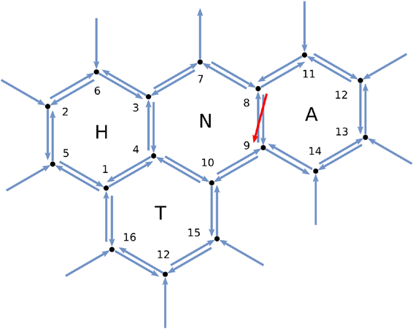
Mapping Ideas
Two-Dimensional DNA Nanostructures

Slide 14
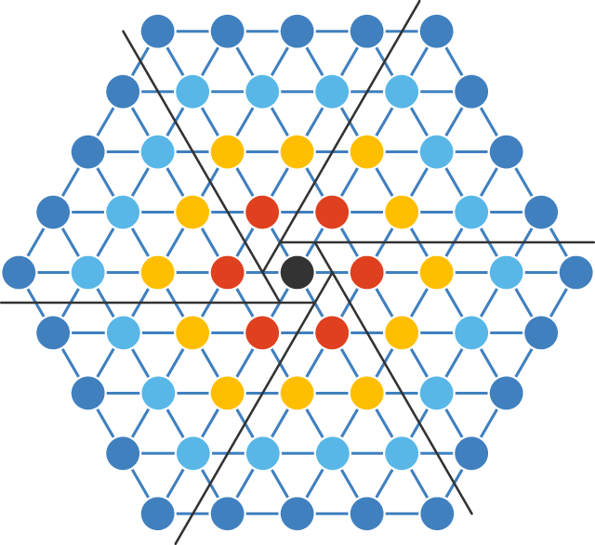
Site Mapping
DNA Structure

Slide 15
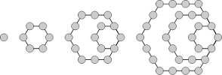
Think Small Think Cell
DNA Structure

Slide 16
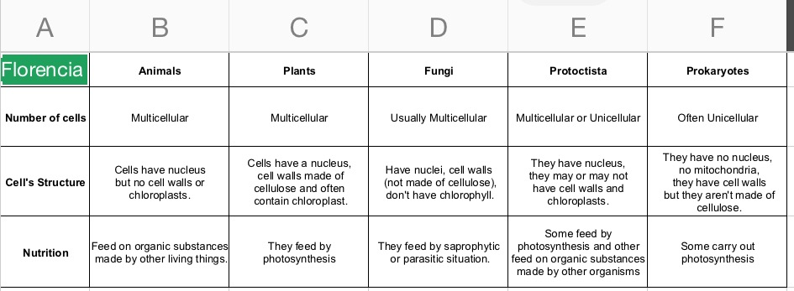
Think Small Think Cell
DNA Structure

Slide 17
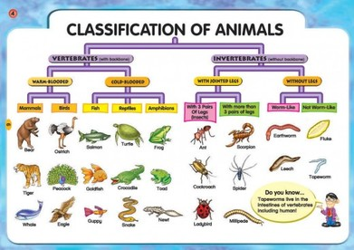
Think Small Think Cell
DNA Structure

Slide 18
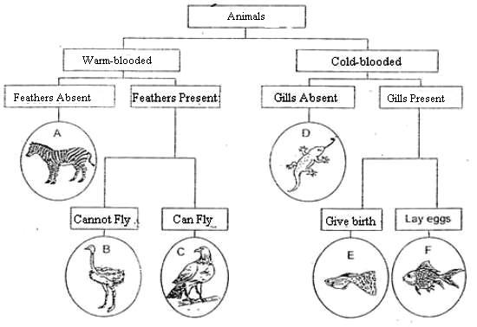
Animals Category
Six (6) Categories

Slide 19
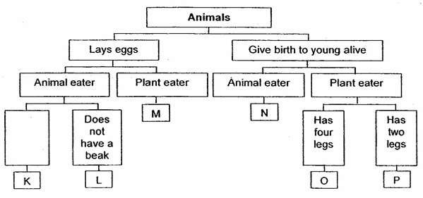
Animals Category
Six (6) Categories

Slide 20
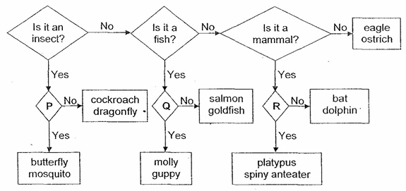
Animals Category
Six (6) Categories

Slide 21
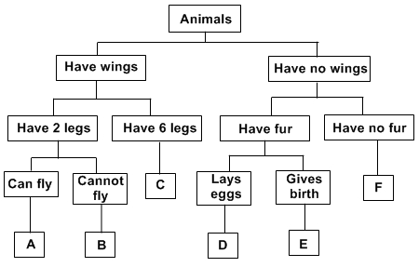
Animals Category
Six (6) Categories

Slide 22
Site Mapping
DNA Structure

Slide 23
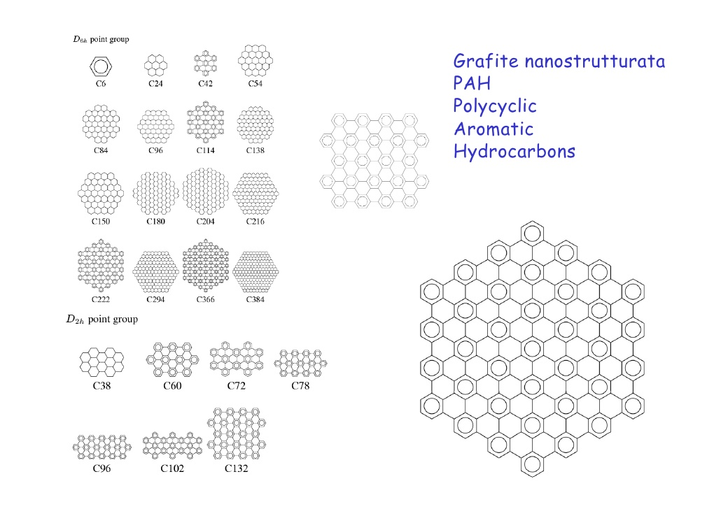
Site Mapping
DNA Structure

Slide 24
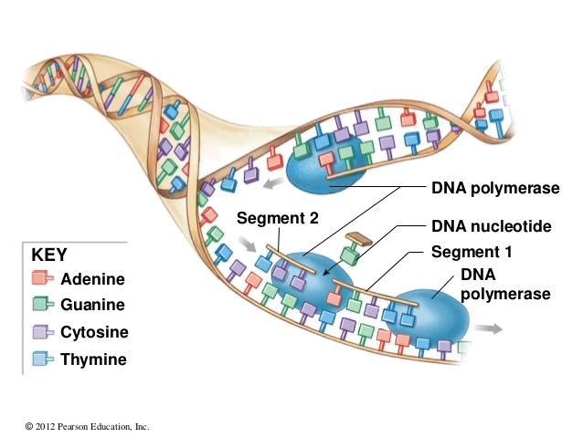
DNA Replication
DNA Structure

Slide 25
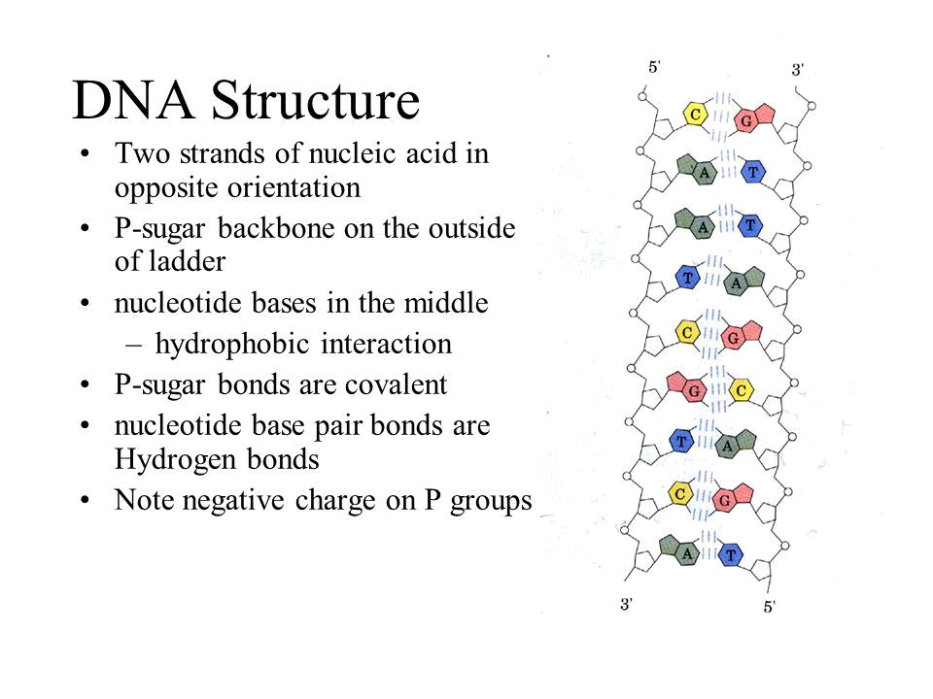
DNA Structure

Slide 26
Slide Title
Make Effective Presentations
Using Awesome Backgrounds
Engage your Audience
Capture Audience Attention

Slide 27
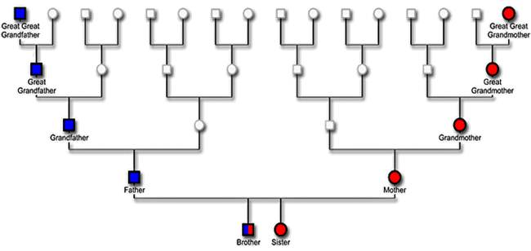
Slide Title

Slide 28
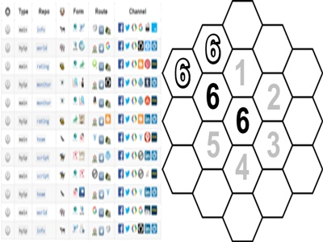
Site Mapping
DNA Structure

Slide 29
Slide Title
Make Effective Presentations
Using Awesome Backgrounds
Engage your Audience
Capture Audience Attention

Slide 30
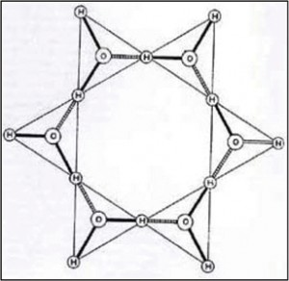



Uniformity
2 + 6 + 7 = 15
2 + 4 + 9 = 15
2 + 5 + 8 = 15
Sum of each directions are same 15

Slide 31
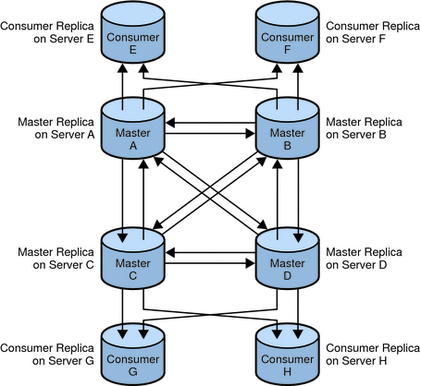
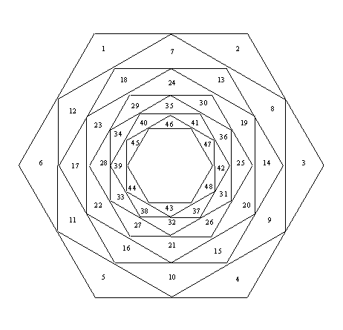
Our Next Mapping
Mapping Group
Mapping Relationship

