Slide 1

Where are you now?

Slide 2

Are you in the circle?

Slide 3
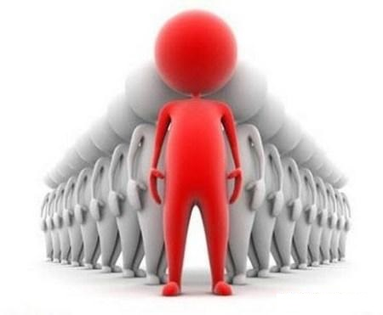
Or you are already on the top..

Slide 4

Are you happy being yourself?

Slide 5
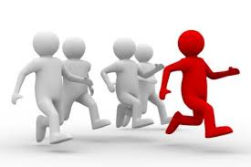
Or you still run for something..

Slide 6

Are you in the right direction?

Slide 7

Or still thinking: Which Way?

Slide 8

Why not mapping..

Slide 9

So from where are you now..

Slide 10

Even if you don’t care..

Slide 11

You can say: “This is my way..”

