Slide 1
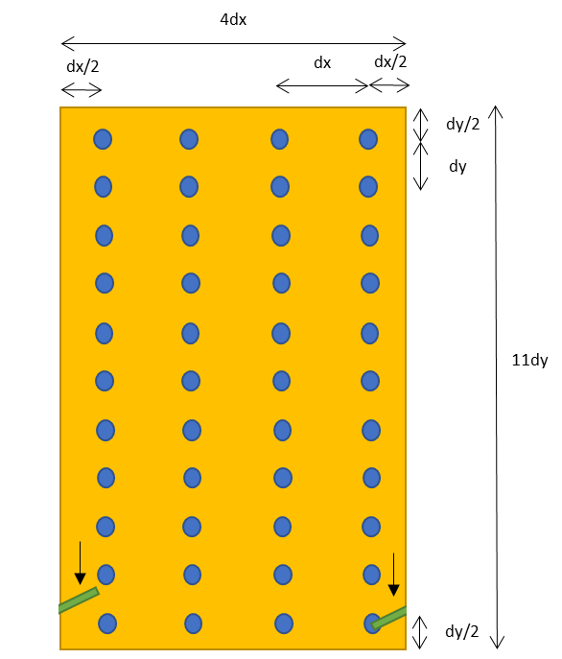
4dx
dx/2
dx
dx/2
dy/2
dy
11dy
dy/2

