Slide 1
Logic
System trigger is a new job
  Includes a start pose, goal pose and start time
Free resources can be found with the job list and the start time of the new job
Travel time and possible collisions are computed
Decisions can be made basing on the modeled information

Slide 2
Inputs & Outputs
Input:
  Planned jobs defined in time and place
  General parameters about the robot or the system state (robot radius, average velocity, system time)
  Information about the new job that should be inserted into plan
Output:
  Calculated travel time
  Collision information
New Job
Job List
Time Calculation
Parameters
Fix
Variable
Travel Time
Collision Information

Slide 3
Software Architecture
Three server responsible for path planning, time stamping and collision checking
One Client that preprocesses information and acts as middleware between planning system and the server
Modular approach ensures the flexible use of the created programs in the whole ROS system
collision_server
Client
path_server
planning
user
time_server

Slide 4
Server Details
path_server
Task: Path planning
Input: start pose and goal pose
Procedure: 1. Static map is divided into equal cells
2. Every cell is weighted depending on the range to obstacles
3. Path is computed based on the weighted grid
Task: Time stamping
Input: Path, starting time and average velocity
Procedure: 1. Starting time is applied to pose [0] of the path
Loop with pose [I] and [i+1]
2. Distance to pose [1] is calculated
3. Duration between [0] & [1] results from distance and
average velocity
4. Computed time is applied to pose [1]
5. The time of the last pose is the travel time
time_server
Loop
collision_server
Task: Collision checking
Input: Two time stamped paths
Procedure: 1. Paths are compared for local collisions
2. If there are collisions the time between the involved
poses is computed
3. Decision has to be made if the time is long enough
or if the collision is inevitable

Slide 5
Algorithm
Trigger(“new job”)
path_server
goal
goal
start
path
path
time_server
timestamped path
collision_server
superior path
inferior path
collision info
t
Collision information, travel time

Slide 6
Planning level
Goal
Start time
collision_server
Time required
PTS
path_server
time_server
PTS
Database
Publisher /Visualizer

Slide 7
Process
PTS initialization
First goal+time
Start position is known path calculation with path_server
Timestamping
No collision checking required
Travel time is send to planning level
Planning level decides if path is valid or not
Second goal+time
Find start position = last position of last path
Path calculation
Timestamping
Collision checking with the previous paths
Y/n by planning level

Slide 8
Database - class
Attributes:
std_msgs::Vector<nav_msgs::Path> plan_r1,
plan_r2 …
Functions:
AddPath()
DeletePath()
FindPose(time t)
FindPath(time t)
Vector: Plan_r1
Vector: Plan_r2
Vector: Plan_r3

Slide 9
Publisher - Visualizer
Input:
Vector plan
Time t
Output:
Path sliced
Current pose
Input: time t
Vector: Plan_r2
Vector: Plan_r3

Slide 10
Actionserver and Client
Client (Superior planning level)
Actionserver (Pathplanning, Collisiondetection)
goal
feedback
result

Slide 11
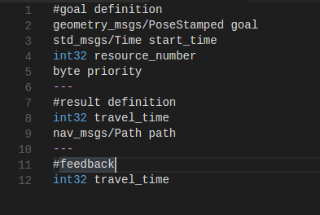
Client (Superior planning level)
Actionserver (Pathplanning, Collisiondetection)
Three topics with three defined message formats
The actionserver is called with the information about the goal and responds with the result.
During the process the interim goals are published over the feedback channel.

Slide 12
Parameter
Goal
Start
Resource id
Positions
(x, y)
Start time
Average velocity
Travel time
Calculated path

