Slide 1
Customer Spending & Loyalty Analysis
Python + MySQL portfolio project
Anuj Yadav | Customer shopping behavior dataset | August 2026

Slide 2
What this project asks
A practical customer-shopping analysis using a static dataset
Where is recorded spend concentrated?
Which customer and product patterns are worth investigating?
How can Python and SQL answer the same business questions?
What should be tested or added before acting on the findings?
02

Slide 3
Dataset at a glance
3,900 records, 18 source fields, and 37 missing review ratings
3,900
customer records
$233K
recorded spend
$59.76
average purchase
3.8 / 5
median rating
Fields cover customer profile, item and category attributes, spend, location, rating, shipping, discount status, subscription status, and prior purchases.
No dates, product costs, inventory fields, or campaign costs are present.
03

Slide 4
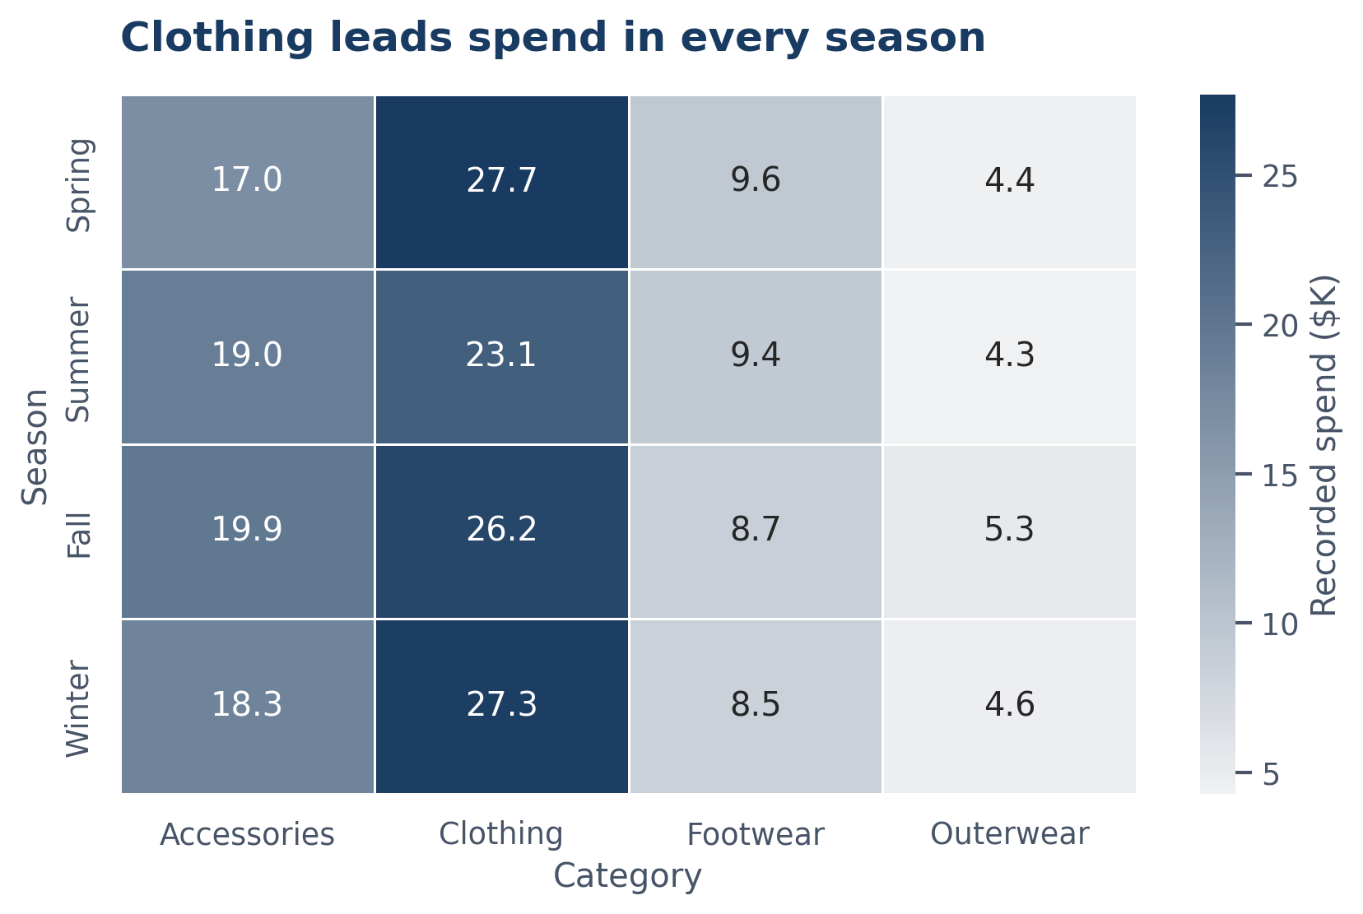
Data preparation
What was done before analysis
Loaded and profiled the CSV with pandas.
Checked full-row duplicates: none found.
Imputed 37 blank review ratings with the dataset median (3.8) for summaries.
Created Age Group, Loyalty Group, and Purchase Band fields.
Exported a clean file that can be loaded into MySQL.
04

Slide 5
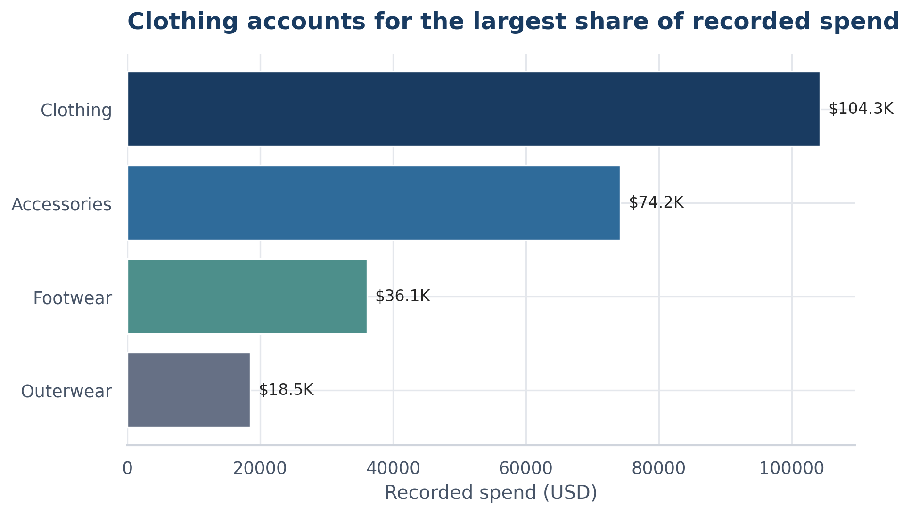
Finding 1 — category concentration
Clothing represents 44.7% of recorded spend
Clothing: $104.3K
Accessories: $74.2K
Start category review with these two groups.
Spend is not profit; margin data is needed before a commercial decision.
05

Slide 6
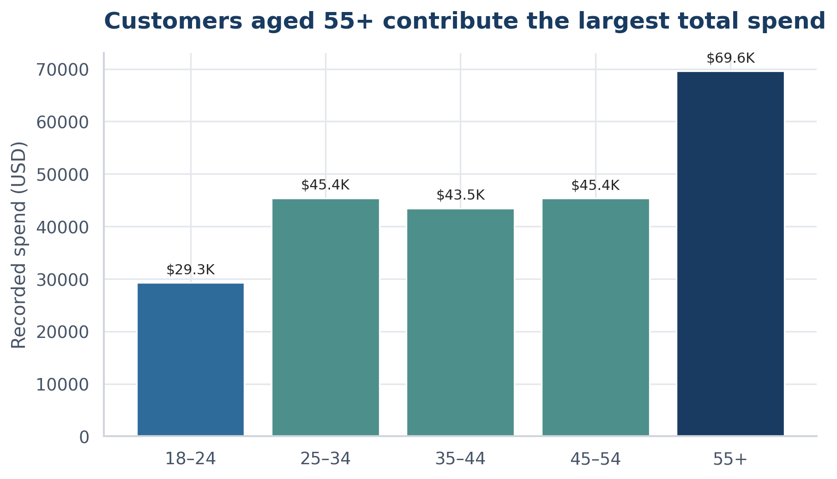
Finding 2 — age profile
55+ is the largest spend group because it is also the largest group
55+ contributes $69.6K of recorded spend.
Average purchase is similar across age groups.
Do not infer that age alone causes higher order value.
06

Slide 7
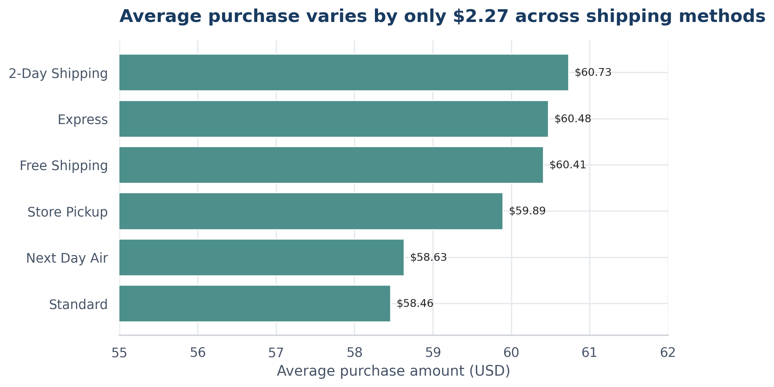
Finding 3 — shipping comparison
Purchase value changes very little by delivery method
Highest average: 2-Day Shipping ($60.73).
Lowest average: Standard ($58.46).
The observed range is only $2.27.
A shipping decision needs delivery cost and satisfaction data too.
07

Slide 8
SQL questions used in the project
The database version makes the analysis reusable
Portfolio baseline — customers, recorded spend, average purchase, rating.
Category scorecard — category-level records, spend, average purchase, and ratings.
Segment, purchase band, location, product, shipping, season, frequency, and payment-method queries.
Data-quality check — loaded rows, distinct customers, null ratings, and null spend.
08

Slide 9
Recommendations
Turn observations into testable next steps
Review Clothing and Accessories alongside availability, margin, and product-level feedback.
Use a controlled experiment before concluding that discounts or subscriptions change spend.
Test a benefit for subscribers and measure repeat purchase, churn, and cost.
Add transaction dates, margin, inventory, and campaign fields in a future version.
09

Slide 10
Project limitations and deliverables
A reproducible student portfolio project—not a claim of business impact
Static customer-level sample: no time-series or causal analysis is possible.
Included: executed notebook, Python script, 12-query MySQL file, report, business problem statement, CSV summaries, charts, and this presentation.
The report documents the methodology and limitations so a reviewer can understand how conclusions were reached.
10

