Slide 1
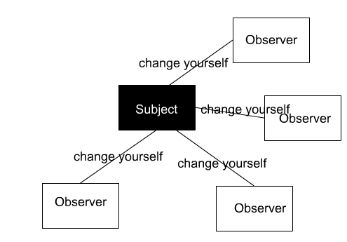
Observer
Design-Pattern

Slide 2
Requirement (usecase)
I have a FriendList UI which include all the friend list info.
I have a main menu scene which has 4 buttons .3 of them will be related to the FriendList and clicking the buttons will update the FriendList UI or any-other UI

Slide 3
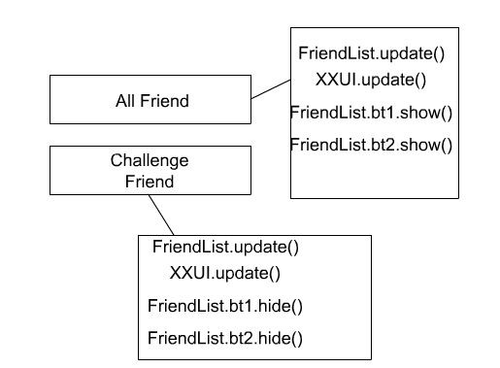

Slide 4
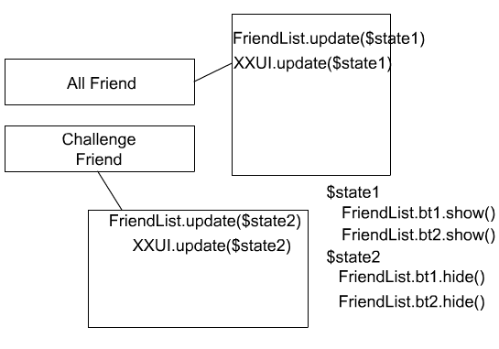
But the issue is if I don’t want to update XXUI anymore or If I want to add new UI what should I do?

Slide 5
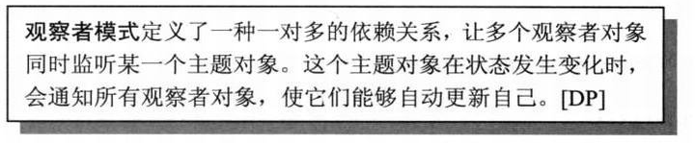
What is Observer

Slide 6
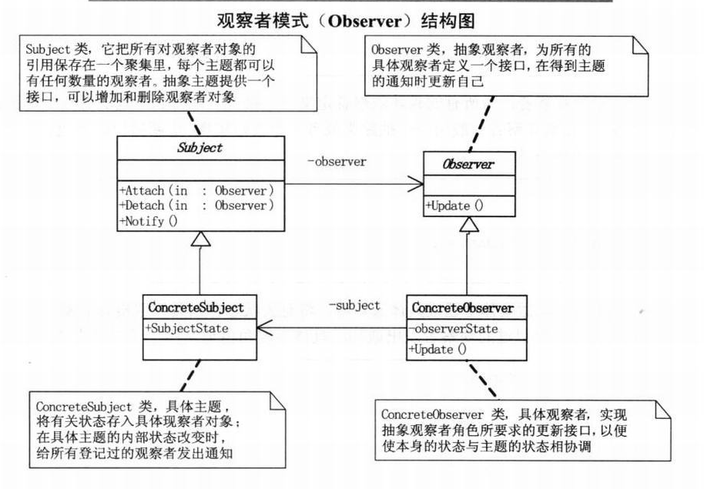

Slide 7
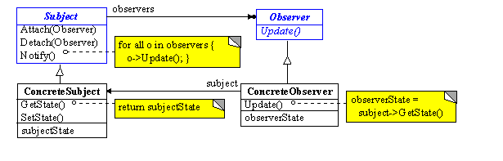

Slide 8
1st create an interface for observer
package com.virtuos.ui.uiInterface
{
public interface IUiObserver
{
function Update($state:String):void;
}
}

Slide 9
Then you must have an Observer Manager that manage all objects that implements IObserver interface.this manager will have 3 public methods: Attach(),Detach(),and Notify();
package com.virtuos.noti
{
import com.virtuos.ui.uiInterface.IUiObserver;
public interface INoti
{
function Attach($obs:IUiObserver):void;
function Detach($obs:IUiObserver):void;
function Notify($NotiState:String):void;
function get NotiState():String;
function set NotiState($value:String):void
}
}

Slide 10
package com.virtuos.noti
{
import com.virtuos.ui.uiInterface.IUiObserver;
public class UiNoti implements INoti
{
private var _obserList:Vector.<IUiObserver>=new Vector.<IUiObserver>;
public function Attach($obs:IUiObserver):void
{
}
public function Detach($obs:IUiObserver):void
{
}
public function Notify($Noti:String):void
{
for each(var obs:IUiObserver in _obserList)
{
obs.Update($Noti);
}
}
}

Slide 11
Now we are ready to work with observer, so we create an object that implements IUiObserver or more.
public class FriendListUI extends BaseUI implements IUiObserver
{
public function Update($Noti:String):void
{
if($Noti==“Get Challenge”)
{
updatedToGC();
}
else if($Noti==“Get All”)
{
updatedToGA();
}
}
}

Slide 12
Subscribe FriendList to manager
_friendListUI=new FriendListUI(res,"friendList");
addChild(_friendListUI);
UiNoti.getInstance().Attach(_friendListUI);

Slide 13
When you want to tell the observer to update :
UiNoti.getInstance().Notify(“note”)

Slide 14
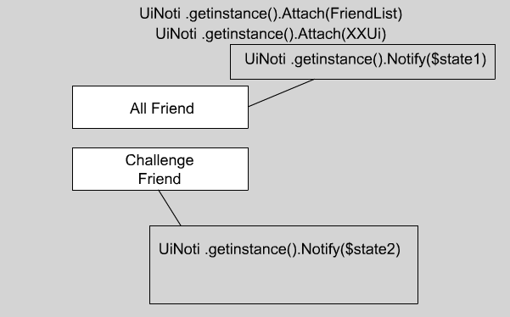
The Final version(Observer)

Slide 15
When shall we use this pattern
When the abstraction has 2 aspects with 1 dependent on the other.(Encapsulation these aspects in sepects in objects will increase the chance to reuse them independently)
When the subject object doesn’t know exactly how many observer objects it has.
When the subject object should be able to notify its observer objects without knowing who these objects are

Slide 16
Event VS Observer
Actually the AS3 Event mode is an Observer Pattern.
addeventListener()==Attach()
removeEventListener()==Detach()
Callback==Update()
dispatchEvent==Notify()

Slide 17
Event implement IEventDispatcher
Observer implement Iobserver
Callback: event is more flexable than Observer.
Observer is a little bit faster than Event

Slide 18
_ob1.addEventListener(NotiEvent.NOTI_EVENT,_ob1.EventHandler);
_ob2.addEventListener(NotiEvent.NOTI_EVENT,_ob2.EventHandler);
MyNotify.getInstance().Attach(_ob1);
MyNotify.getInstance().Attach(_ob2);
Global.TimerNowH=getTimer();
_ob1.dispatchEvent(new NotiEvent(NotiEvent.NOTI_EVENT));
_ob2.dispatchEvent(new NotiEvent(NotiEvent.NOTI_EVENT));
Global.TimerNow=getTimer();
MyNotify.getInstance().Notify();

Slide 19
public function Update():void
{
var T:uint=getTimer();
trace("Update ObsUi1",T-Global.TimerNow);
}
public function EventHandler(e:NotiEvent):void
{
var T:uint=getTimer();
trace("EventHandler ObsUi1",T-Global.TimerNowH);
}

Slide 20
EventHandler ObsUi1 0
EventHandler ObsUi2 1
Update ObsUi1 0
Update ObsUi2 0

Slide 21
If I add obs to 4
EventHandler ObsUi1 1
EventHandler ObsUi2 1
EventHandler ObsUi3 1
EventHandler ObsUi4 1
Update ObsUi1 0
Update ObsUi2 0
Update ObsUi3 0
Update ObsUi4 1

Slide 22
If I add obs to 7
EventHandler ObsUi1 0
EventHandler ObsUi2 1
EventHandler ObsUi3 1
EventHandler ObsUi4 1
EventHandler ObsUi5 2
EventHandler ObsUi6 2
EventHandler ObsUi7 3
Update ObsUi1 0
Update ObsUi2 0
Update ObsUi3 0
Update ObsUi4 1
Update ObsUi5 1
Update ObsUi6 1
Update ObsUi7 1

Slide 23
Observer is easy to maintain
Observer: Attach()
Event:addEventListener()+despatchEvent()

Slide 24
MV
M(subject)V(observer) in MVC
Observer Pattern is a key part in MVC.

Slide 25
Advantage
Decouple:
1 UiNoti(subject) can maintain several UI(observer). If the state of the UiNoti changed all the Observer can get the notes. When UiNoti Notify(), it don’t know who is the observer, and any observer doesnot know the existence of anyother observer.

Slide 26
Advantage
Decouple:
1 UiNoti(subject) can maintain several UI(observer). If the state of the UiNoti changed all the Observer can get the notes. When UiNoti Notify(), it don’t know who is the observer, and any observer doesnot know the existence of anyother observer.
It’s very easy to add or remove observer.

Slide 27
Weakness
Update(). Use Delegate to record the function.

Slide 28
Weakness
Update(). Use Delegate to record the function.
Too much state (if … else… ). But it can be fixed by another design pattern called State .

Slide 29
Weakness
Update(). Use Delegate to record the function.
Too much state (if … else… ). But it can be fixed by another design pattern called State .
For in every observer.

Slide 30
Weakness
Update(). Use Delegate to record the function.
Too much state (if … else… ). But it can be fixed by another design pattern called State .
For in every observer.
I should concern about the object _obserList.
Eg: dispose it when switch scene .

Slide 31
Q&A

Slide 32

Thank you all very much
Stay hungry stay foolish

