Slide 1


ANDROID DEVELOPMENT by cocos2d JS

Slide 2
Contents
1、The strength of cocos2d JS
2、The weakness of cocos2d JS
3、The workflow of developing cocos2d JS on Both web and Android
4、Demo SHOW

Slide 3

What is Cocos2d
Cocos2d is a game development platform with powerful but lightweight game engines, open-source code base, it is a complete toolchain for developing multi-platform games.

Slide 4
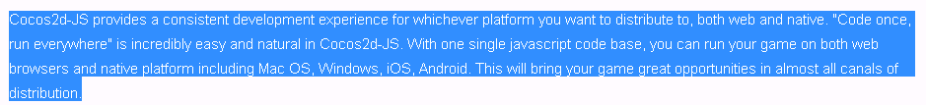

Slide 5
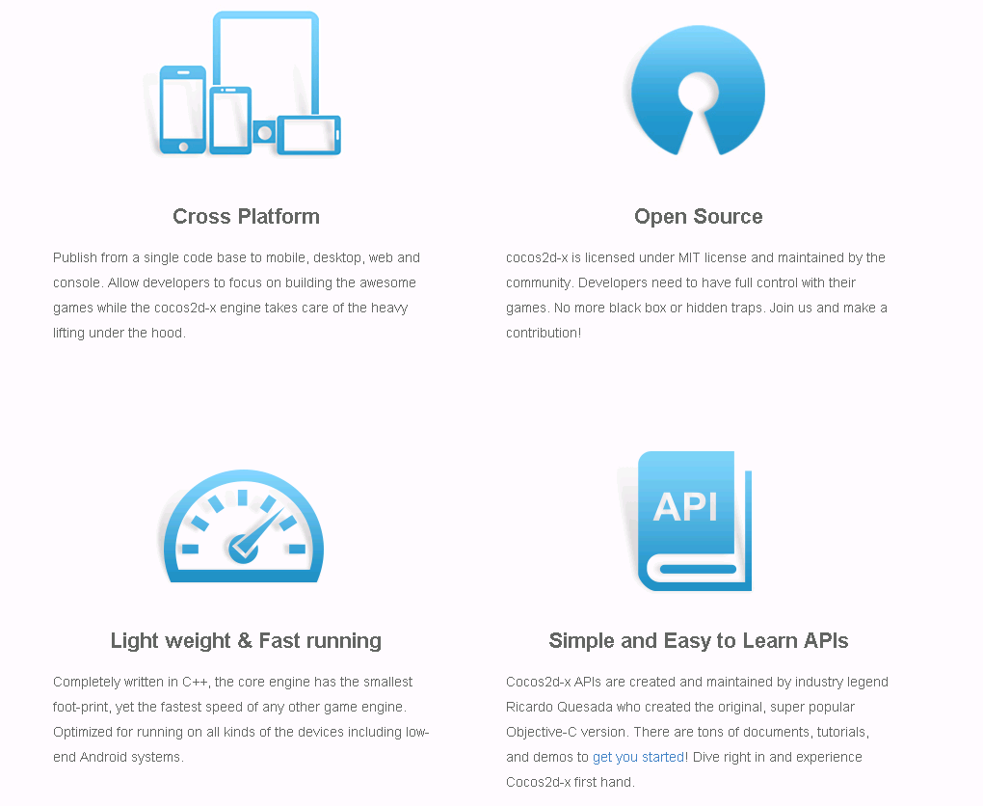
The strength of cocos2d JS

Slide 6
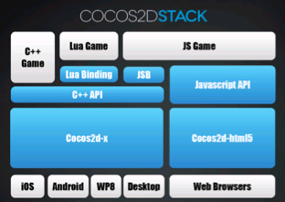
Stack Of V.3.+
Interpreter
What is Cocos2d jsb

Slide 7
The weakness of cocos2d JS
1、Stability
2、Mature workflow
3、Don’t Support 3D game now.
(implemented in “捕鱼达人3”)
JS的优势和劣势

Slide 8
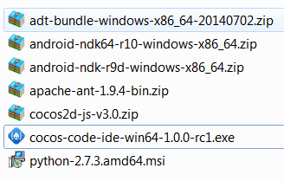
The workflow of developing cocos2d JS on Both web and Android
1、set up the NDK,SDK,ANT and Python2.7.3.
具体配置和打包流程

Slide 9
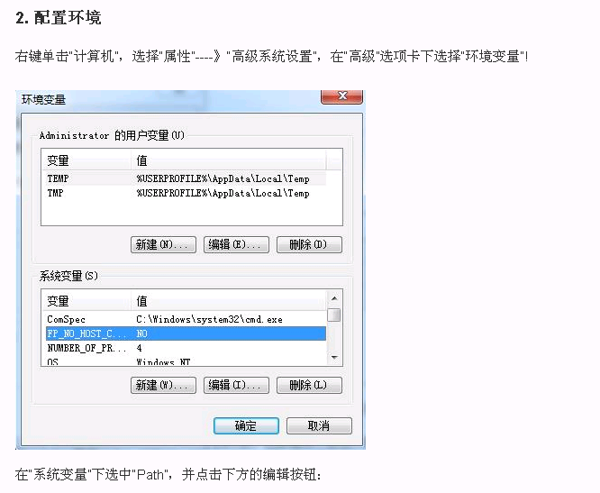
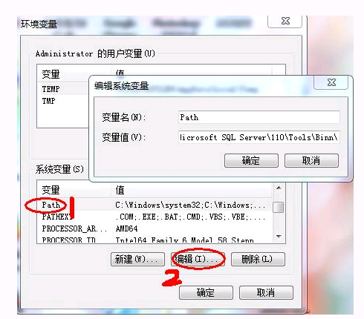

Slide 10
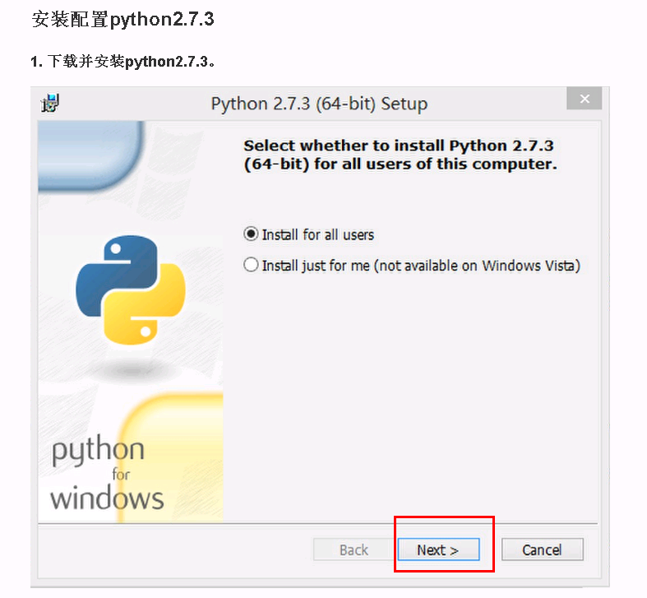

Slide 11
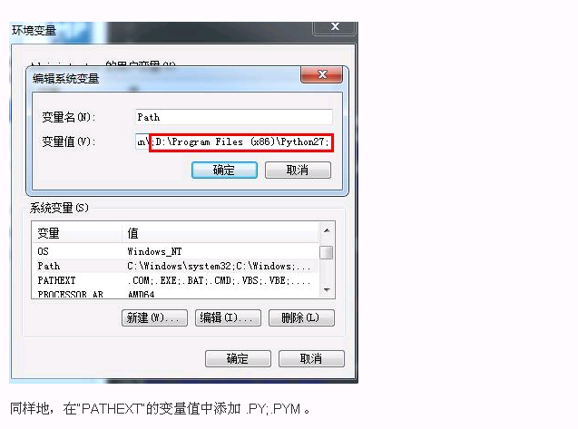

Slide 12
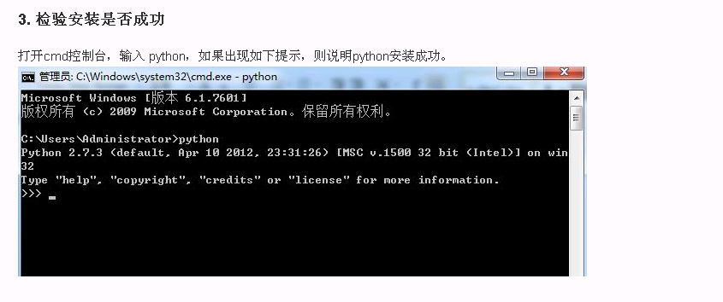

Slide 13

Export the NDK,SDK,ANT to local address

Slide 14
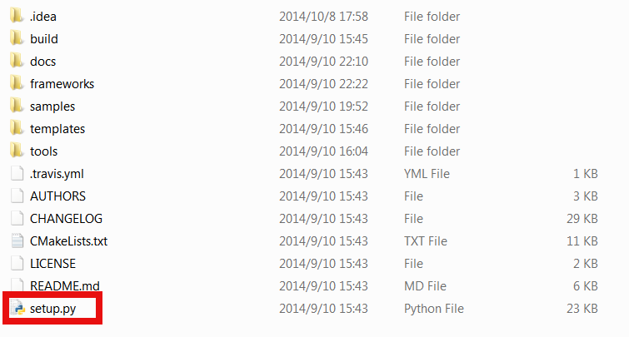
2、Configure the environment Path
You can set up NDK,SDK,ANT configuration by running the setup.py in cocos2d-x root.

Slide 15
If it is your first time to configure the environment, you should type the root path of the NDK,SDK,ANT, COCOS_CONSOLE_ROOT.
Otherwise you can skip this step.

Slide 16
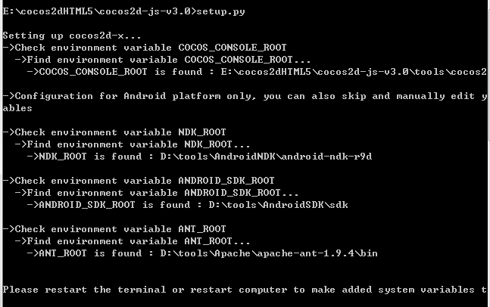
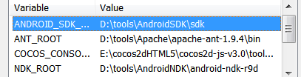

Slide 17

3、Set up the IDE and TexturePacker.

Slide 18
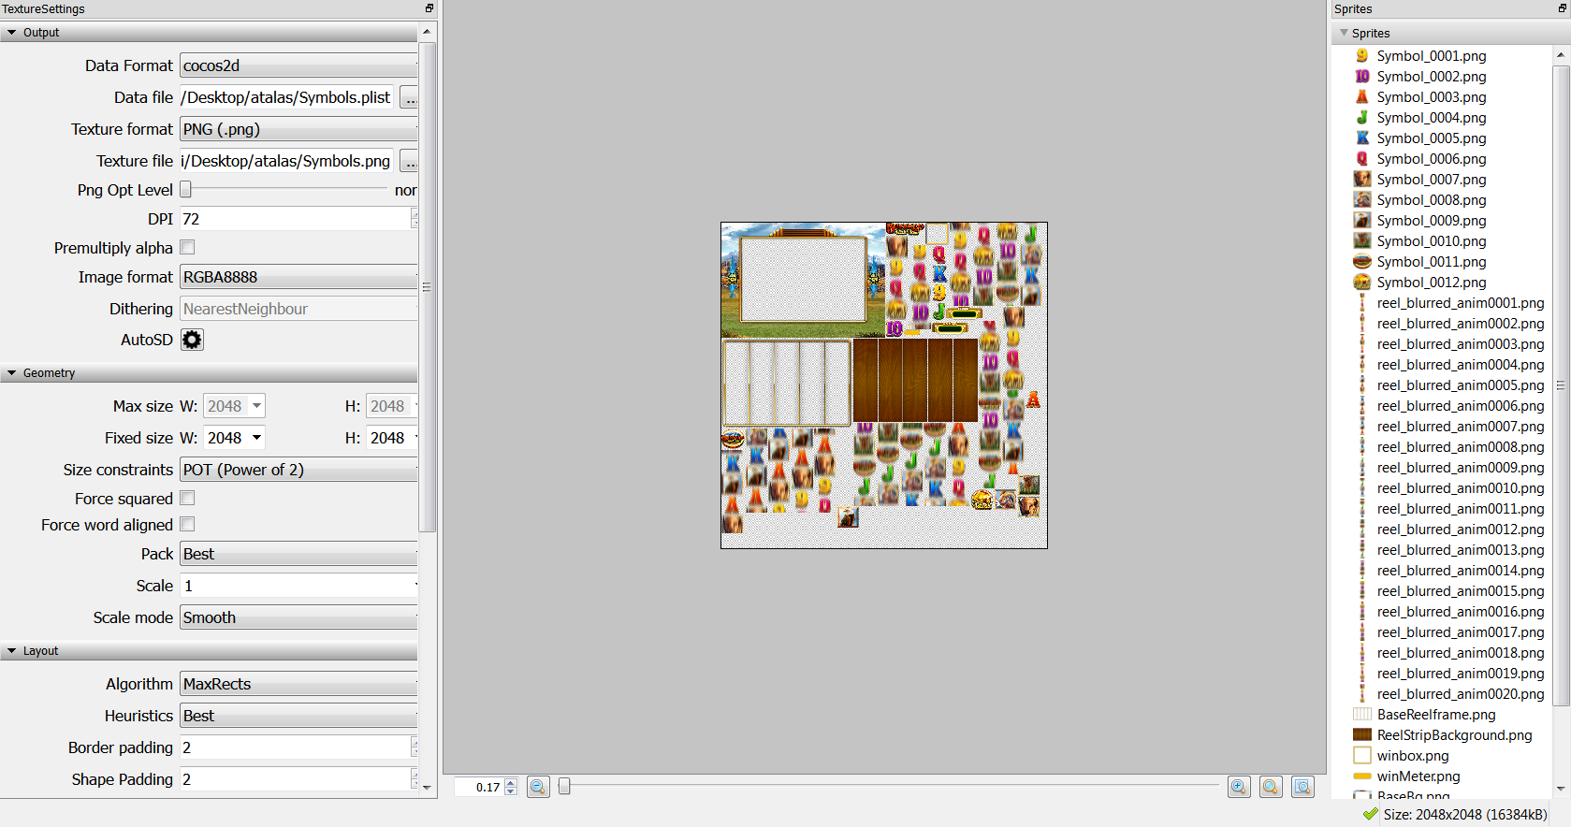
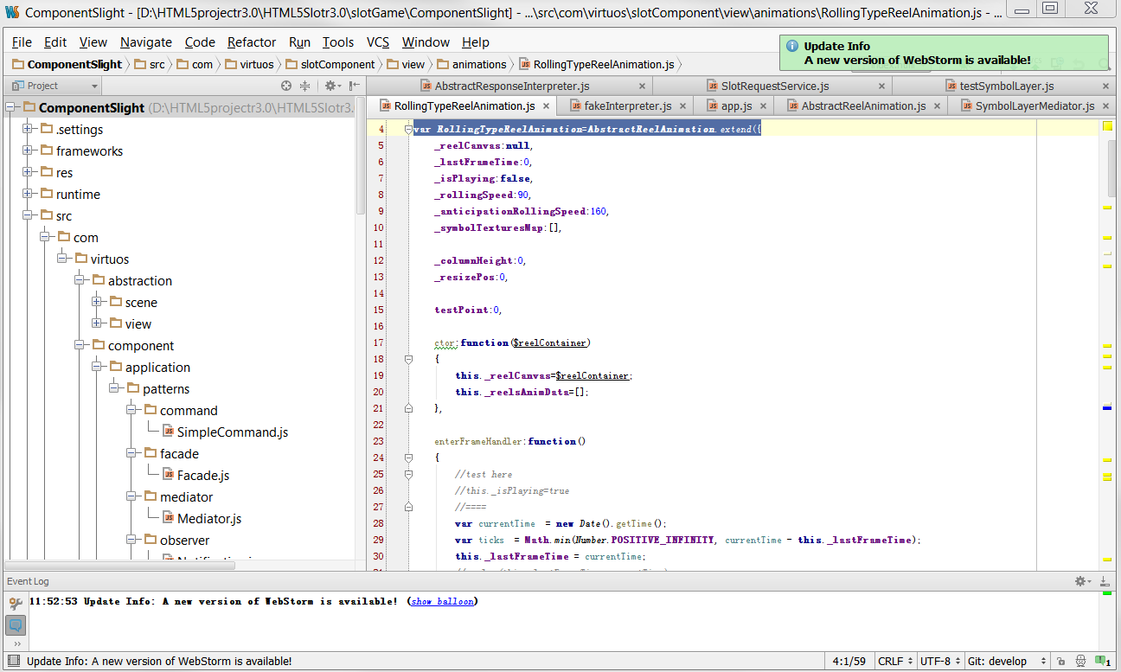

Slide 19
What is NDK?
NDK(Native Development Kit)
Provide a way to develop android by C/C++.

Slide 20
4、Create a new project
cocos new
usage: cocos new [-h] [-p PACKAGE_NAME] -l {cpp,lua,js} [-d DIRECTORY]
[-t TEMPLATE_NAME] [--no-native]
[PROJECT_NAME]
F:cocos2dx>cocos new mygame1 -p com.virtuos -l js -d f:cocos2dxmbgame

Slide 21
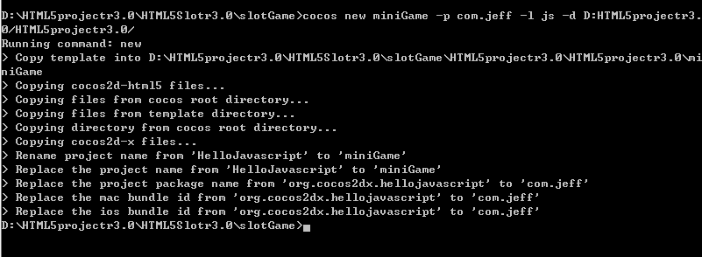

Slide 22
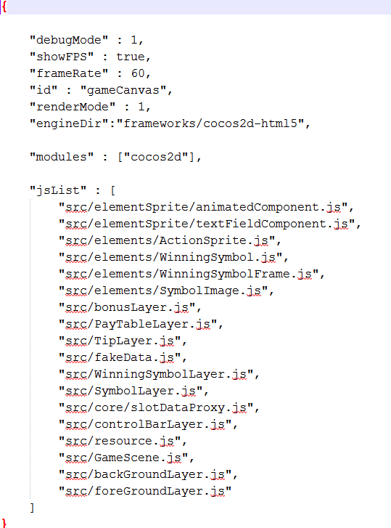
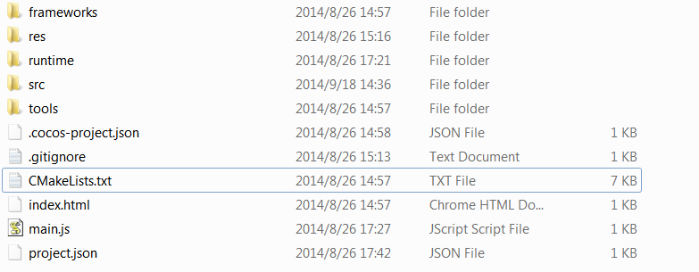

Slide 23
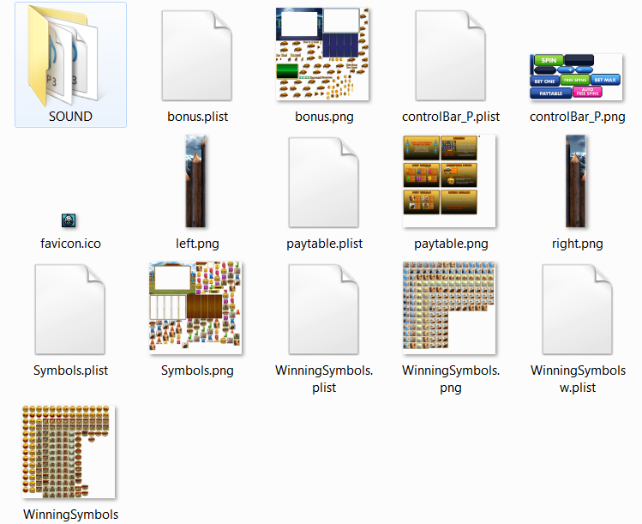

Slide 24

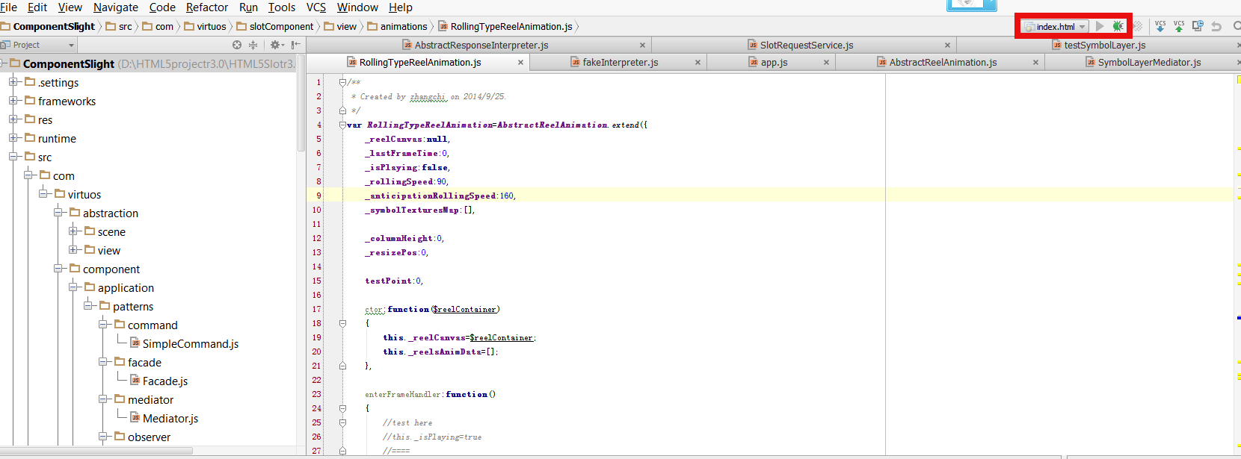
Debugging web project

Slide 25
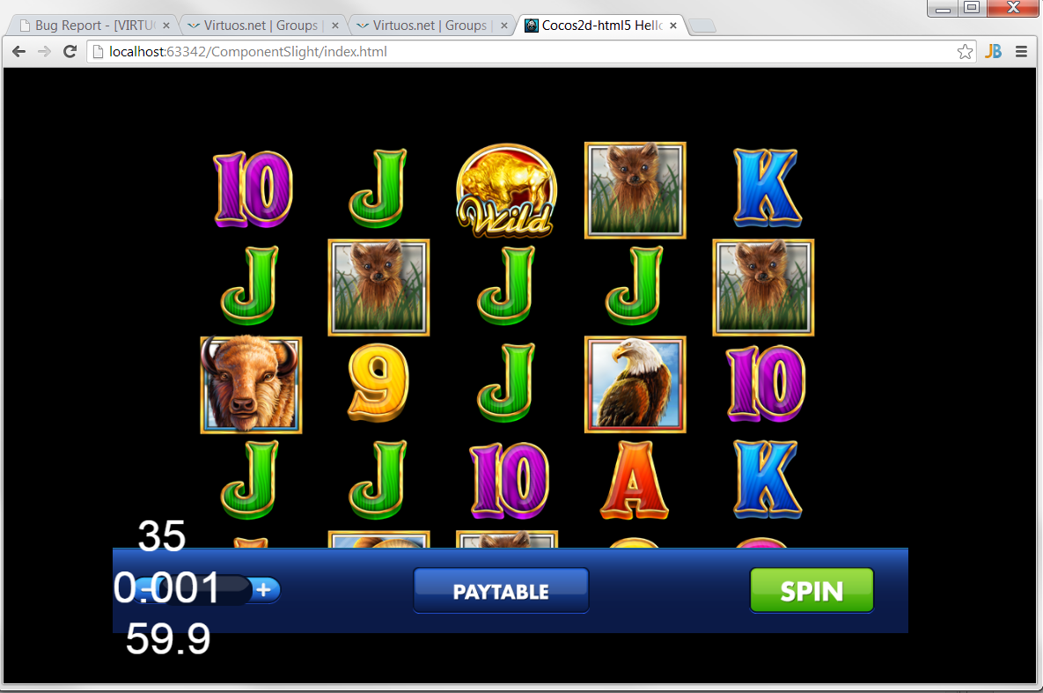

Slide 26
By the way you can also release the web project which can reduce the size of the project.
The way to release the web project is just like the way to release it to android.

Slide 27
5、Compiling and releasing Android APK
cocos compile
usage: cocos compile [-h] [-s SRC_DIR] [-q] [-p PLATFORM] [-m MODE] [-j JOBS]
[--ap ANDROID_PLATFORM] [-- source-map]
F:cocos2dxmbgamemygame1>cocos compile -p android -j 4

Slide 28
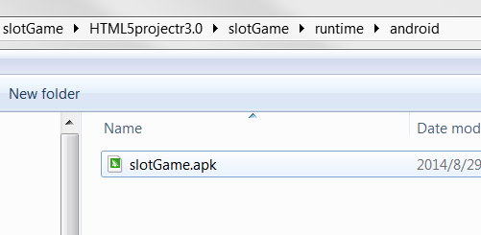
BUILD SUCCESSFUL
Total time: 7 seconds
Move apk to F:cocos2dxmbgamemygame1bindebugandroid
build succeeded.

Slide 29
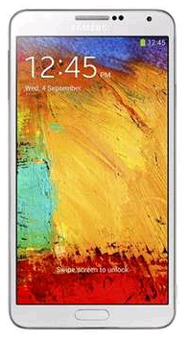

That’s it

Slide 30
THANK YOU!

