Slide 1
A tested early-warning tool for chili prices
What it does, how we know it works, and where it still needs watching
Cabai rawit merah · 6 provinces · Bank Indonesia price data, 2017–2026
Notes:
Presenter 1, ~45 seconds. This deck is structured around trust: what the tool does, how we proved it works, where it's strong, and where it's weak — in that order, deliberately. Institutional buyers don't adopt on sentiment, they adopt once they trust the testing was honest.

Slide 2
What it does
A tool that reads price history, prices in nearby provinces, and rainfall to predict next week's chili price before it happens.
Looks 7 days ahead, for all 6 provinces at once
Built entirely on public data already published by Bank Indonesia and weather services
Refreshes once a day, within minutes of PIHPS publishing its daily prices (~1pm WIB on working days)matches PIHPS's own update cadence.

Slide 3
How we tested it, honestly
Before any of this was built, we set aside a full year of real prices and never let the model see it.
It was scored against that year exactly once, after everything was finalized with no second attempts, no tuning after the fact
That's the only way to know the accuracy numbers on the next slide are real, not optimistic

Slide 4
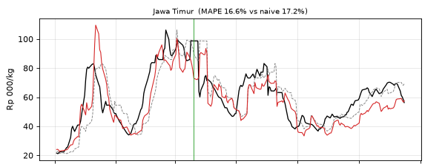
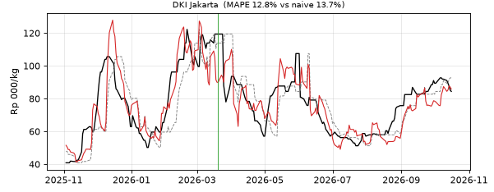
The result: where it's strong
Black = what actually happened. Grey = simply guessing no change. Red = this model. Watch how closely red tracks the big swings up and down.
Jawa Timur
DKI Jakarta
7–15%
≈30%
3 in 4
more accurate overall than assuming prices stay flat, on that held-back year
smaller error on the biggest price jumps and crashes
flagged early-warning alerts turn out to be right that’s twice as reliable as watching recent trends alone
Notes:
This chart is the literal model output on the held-back test year, not an illustration — pulled straight from the notebook. Walk the eye across: red (the model) turns earlier than grey (naive) at spike onsets, and tracks the big up-and-down swings much more closely. Jawa Timur and DKI Jakarta shown here because they anchor two different stories in this deck — Jawa Timur is the leading-indicator province (slide 8), DKI Jakarta is the capital.

Slide 5
The result: where it's weak
We're showing you this the same way we just showed you the wins.
August–October 2026: predictions ran 12–18% below actual prices, while naive was off by at most 9% over the same stretch
For about 3 months of the year, the tool was actually worse than doing nothing not a rounding error, a real reversal

Slide 6
Why it happened, and the fix
Not one bad-economy story several independent, credible stress signals clustered in the same three months, none of which the model currently sees.
Physical disruption, and it broke the normal pattern: nine years of data show dry-season months are usually when prices fall (harvest = more supply). Aug–Sep 2026 flipped because that’s one of Indonesia's worst forest-fire seasons in years (burned area +69% YoY, under a strong El Niño???) disrupted the harvest and transport that normally bring prices down. The seasonal relief that should have happened, didn't.
Not just the model noticing: BPS's own September inflation report named cabai rawit/cabai merah specifically as dominant drivers of that month's national inflation (3.28% YoY).
A stressed financial backdrop, four separate angles: disputed GDP figures (official 5.2–5.6% vs. independent estimates of 4.0–4.9%), falling consumer confidence, and a weakening rupiah.
How we're responding: a monthly accuracy check, an automatic fallback to “no change” if it keeps underperforming, and two roadmap candidates including fire/haze activity (primary) and currency/import-cost pressure (secondary).
Notes:
Magnitude: predictions ran August ~-16%, September ~-18%, October ~-12% below actual prices, versus naive's -9% to +1% over the same three months.
Seasonal pattern broken: our own nine-year analysis found "troughs tend to come mid-year at dry-season harvest" and the price series sits "below trend mid-year (dry-season harvest)" -- a consistent, moderate-strength seasonal pattern (seasonal strength ~0.23-0.32 across provinces). 2026 is the exception.
Karhutla: national burned area ~202,000 ha Jan-Jul 2026, +69% YoY, escalating further Aug-Sep (Kompas). El Nino at "strong" category, BMKG ENSO index +1.59 (early Aug) -- not confirmed "very strong," BMKG only warned it could intensify, don't overstate. ~1,700 fire-related deaths estimated in August (CREA via Kabarbursa); ~37.9M people across 8 provinces haze-affected by end of August (YLBHI).
BPS inflation: September 2026 at 3.28% YoY (up from 3.19% in August), food/beverage/tobacco the lead category, cabai rawit/cabai merah named explicitly as dominant contributors.
GDP dispute: official BPS figures Q1 2026 +5.61% YoY, Q2 2026 +5.29% YoY -- publicly challenged by LPEM FEB UI and a coalition of Indonesian economists (AEI), citing internal inconsistencies (manufacturing +5.04% vs. electricity/gas/water -0.99% in the same quarter) and a consumption-vs-confidence contradiction (BI's confidence index fell in March 2026 while reported consumption rose). LPEM's adjusted estimate: 4.0-4.9%. World Bank independently cut its 2026 forecast to 4.7%. Frame as "officially strong, independently disputed, plausibly softer" -- never as settled fact.
Rupiah: weakened ~2.25% in the month to mid-October 2026.
MSCI: announced Oct 15, 2026 -- a consultation, not a final decision (expected mid-2027) -- on moving Indonesia from Emerging Market to Standalone status, citing opaque shareholding structures and suspected coordinated trading (a market-governance concern, NOT a verdict on economic performance -- don't conflate the two if asked). Stocks fell 10.76-11% on Oct 16 (largest single-day drop in 28 years), -14.91% over the week, ~IDR 1,500 trillion (~$83B) off market cap. TIMING CAVEAT: this landed Oct 15-16, the last 1-2 days of our test window -- it cannot explain August/September and should only be used to confirm the financial backdrop was genuinely stressed, not as a root cause of the full 3-month pattern. A separate, earlier frontier-downgrade scare in early 2026 (~12% index loss) is a distinct, prior event if that comes up.
Exchange rate remains weaker ground to add as a direct model input than fire data -- the original rejection reasoning (diffuse, indirect, confounds with existing signals) still holds; it's a roadmap candidate, not a commitment.
Sources: Karhutla -- Kompas (lestari.kompas.com, 3 Oct 2026), RCTI+ (Kemenhut Jan-Jun figures), Kabarbursa (CREA), YLBHI. Rupiah/GDP dispute -- Databoks/Katadata, LPEM FEB UI, World Bank reporting, Oct 2026. BPS inflation -- BPS September 2026 release. MSCI -- Jakarta Globe, Euronews, Bloomberg, The Star, Oct 15-18 2026 reporting.

Slide 7
Another thing the testing surfaced
Everyone assumed prices spike before Lebaran. The testing says otherwise.
Looking back at 2017–2025, prices were typically lower in the weeks before Lebaran, not higher
The real seasonal spike happens around December, at the start of the rainy season
We wouldn't have known this without testing the conventional assumption against nine years of data

Slide 8
What this means day-to-day
Watch Jawa Timur prices closely because the earliest, most reliable signal for the other five provinces
Add recent rainfall (2–7 weeks back) to the monitoring picture
Plan around December, not just Lebaran
One question for PIHPS: a couple of provinces' reported prices look unusually repetitive and worth asking how they're being collected

Slide 9
Questions
Happy to go deeper on any result, any number, or the testing itself.
Notes:
All presenters answer on their own slides where possible. Slide 6 (why it happened) carries the most detailed sourcing in speaker notes — refer there for any follow-up on the Aug-Oct explanation.

