Slide 1
Forecasting Cabai Rawit Merah Prices
Technical walkthrough of methodology, validation design, and results. Seven working day ahead price forecasting for six Indonesian provinces.
Technical interview preparation. PIHPS (Bank Indonesia), Open-Meteo ERA5, BBM Solar price. 2017 to 2026.

Slide 2
The problem, defined precisely before any modelling
t + 7
6 x ~2.3k
Direct
Target: raw PIHPS price at origin t plus 7 working days, Rp per kg, per province. Unfilled: unreported target days are dropped, never invented.
Unit of analysis: (province, working day) origin. 6 provinces times roughly 2,300 to 2,400 working days each.
Task type: direct multi step regression on the 7 day ahead log price change, not a recursive 1 step model.
Why chili: the most volatile commodity in the PIHPS series (far exceeds flat staples like rice), about 1,100 working days of history per province, and plausible external drivers to test: rainfall, religious calendar demand, cross region arbitrage, fuel cost pass through.
Why these 6 provinces: screened from 34 on coverage of 93 percent or more of working days and meaningful price volatility (CV), so the series is not flat. DKI Jakarta is a deliberate exception, added as a demand anchor market despite having the lowest CV of the six (40.6 percent), a decision tested and defended in the EDA, not asserted.
Dataset selection criteria: public and verifiable (Bank Indonesia, Open-Meteo), 100 or more ordered observations per series (met many times over), original and requiring real preparation.

Slide 3
Data: three public sources, merged into one leak safe panel
Source | What it provides | Pipeline step
PIHPS Nasional, Bank Indonesia | Daily traditional market price, Rp per kg, 6 provinces plus national average | scripts/fetch_pihps.py
Open-Meteo ERA5 reanalysis | Precipitation, temperature, humidity, shortwave radiation, ET0 at each provincial capital | scripts/fetch_weather.py
BBM Solar price (subsidised diesel) | Rp per liter in force on each date, from a hand compiled table of 6 cited government price events (2015 to 2022). Tested as a candidate feature, dropped by the ablation (slide 12). | scripts/fetch_bbm.py
33
14,680
0
columns in the final merged panel: identifiers plus 25 leak safe weather features plus solar_rp_per_l
rows, one per province and working day, 2017-04-03 to 2026-10-16
missing cells in any weather or Solar column. Only price itself has real market closure gaps
Every weather and price feature already obeys the project's leak convention at build time, not patched in afterward. See the leak safety framework next.

Slide 4
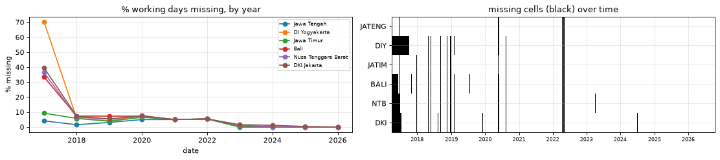
Data quality findings that drove preparation decisions
Finding | Decision
44 shared gap dates across all provinces, matched to the holiday calendar | Treat as structural (public holidays, elections), not random failure
No all province gap after 17 Aug 2022 | Recorded as a limitation. Pre and post 2022 data not fully comparable
DKI Jakarta 45 percent, DI Yogyakarta 42 percent repeated value days | stale_days added as a feature, flagged as a limitation
1 to 3 one day price reversals per province | Kept, not clipped. Documented, not silently removed
Percent working days missing by year, and missing cells over time, by province
Resulting rule, implemented in section 4: forward fill for features only, never fill targets, never interpolate.

Slide 5
METHODOLOGY
Leak safety was designed before a single feature was built
A risk register, written up front. Each row checked by an assertion in code, not just claimed in prose.

Slide 6
Every leakage risk identified up front, each with its own check
Risk | Where it could occur | How it is handled
Same day or future weather in a feature | Weather joins | Shift by min_lag before computing. check_no_leak() re derives a sampled value from raw data
Other provinces' current or future prices | Cross province features | Shift by MIN_LAG. A value assertion plus a perturbation test
Rolling windows centred on t | All weather and price windows | All windows trailing only. A global perturbation test scrambles post cutoff prices and requires nothing earlier changes
Training labels whose target lies inside the validation window | CV folds | Purge. Train only on rows with target_date less than validation start
Shuffled K fold on autocorrelated rows | CV | Chronological expanding window only. The shuffled K fold leak is quantified, not just avoided (slide 7)
Test data shaping feature or model choice | EDA, features, tuning | Test year locked before any feature informing EDA. Tuning and feature selection use CV folds only

Slide 7
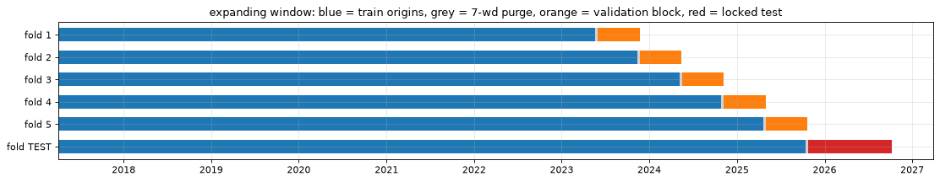
Validation design: the test year never shapes anything upstream of it
1
2
3
Lock the test
Tune on development folds
Score once
Oct 2025 to Oct 2026 (about 250 origins) fixed before any exploration that could have shaped features.
5 expanding window folds, 6 months each, with a 7 day purge gap so no training label sees into its own validation block.
Every candidate is refit on all development data and scored on the test year exactly once.
Why expanding window, not shuffled K fold: shuffled K fold puts origin t in validation while t minus 1 and t plus 1 sit in training. Given the month long persistence of spikes, those neighbours are near duplicates.
Quantified, not asserted: the same default LightGBM model, same features, scored with shuffled 5 fold K fold on the development period reports less than half the honest chronological error.

Slide 8
Eight feature groups, each with its own stated leak safety argument
Group | Information time | Leak safety argument
own: own price | up to t | PIHPS day t price publishes on day t. Forward fill uses only past values
prov: province indicator | static | Fixed category set, nothing estimated
xprov: cross province and national | up to t minus MIN_LAG | Shift first, then compute. Value assertion plus perturbation test
wx_base: rain, temperature, humidity | up to t minus 1 | Built and asserted directly in fetch_weather.py
wx_ext: data driven lagged rain windows | up to t minus MIN_LAG minus L | Calendar day rolling then shift(MIN_LAG + L). Own assertion
wx_extra: radiation and ET0 (experimental) | up to t minus 1 | Same panel construction as wx_base. Re derived and re checked
cal: calendar and holidays | deterministic | Known in advance. Not measured or reported data, so using t plus 7 properties leaks nothing
solar: Solar (BBM) price (experimental) | up to t | Administratively announced, effective same day. Leak safe as of join

Slide 9
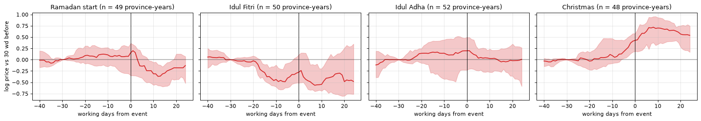
EDA findings that directly changed the feature set
Median log price path around each event, relative to 30 working days before. Shaded band is the interquartile range.
No conventional pre Lebaran surge, 2017 to 2025: prices typically lower, not higher, before Idul Fitri. The real spike is around Christmas, the rainy season onset.
Jawa Timur leads every other province: its 5 day change is the single best predictor of 5 of 6 provinces' next week move. Confirmed the cross province feature group, later the most valuable group in the ablation.
Fixed weather windows miss some signal: a programmatic scan found cells the default windows do not cover. Added data driven lagged rain windows, kept by the ablation.

Slide 10
MODELS
Five candidate families, evaluated the same way
Same folds, same rows, same metric. The comparison is like for like across classical and ML approaches.

Slide 11
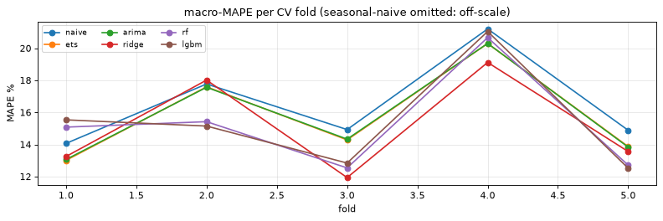
Two honest baselines, five candidate model families
Model | Family | Why it is in the lineup
Naive (persistence) | Baseline | Price in 7 working days equals today's price. CV MAPE 16.6 percent, the bar every candidate must clear.
ETS, Holt damped trend | Exponential smoothing, per province | Classical benchmark for a persistent series with a drifting level
ARIMA(1,1,1) | Box Jenkins state space, per province | Short AR/MA structure justified by the PACF. d is tuned, not assumed
Ridge regression | Linear, global, engineered features | Tests whether a linear combination of features is enough
Random Forest | Bagged trees, global, engineered features | Non linear, robust to outliers and irrelevant features
LightGBM | Gradient boosted trees, global, engineered features | Usually the strongest learner on tabular lag features
Macro MAPE per CV fold, five candidate families plus naive

Slide 12
Feature ablation: a mechanical, pre declared keep rule
Rule, fixed before results were seen: keep a group if its mean CV gain is greater than 0 and it helps 2 or more of 3 model families
Group | Mean CV effect (pp) | Families hurt by removal | Verdict
xprov, cross province | +0.74 | 3 of 3 | Kept. Most valuable engineered group
wx_ext, lagged rain windows | +0.23 | 3 of 3 | Kept
wx_base, rain, temp, humidity | +0.03 | 2 of 3 | Kept, narrowly
wx_extra, radiation and ET0 | minus 0.12 | 1 of 3 | Dropped
cal, calendar and holidays | minus 0.41 | 0 of 3 | Dropped. Top prior hypothesis, overturned by evidence
solar, Solar (BBM) price | minus 0.17 | 1 of 3 | Dropped. Constant throughout CV and test, correlated with time
Dropped groups stay built and documented in the panel. Re including any of them later is a one line change. Final feature set: 59 features.

Slide 13
Hyperparameter tuning: two models, chosen by rule, not preference
Ridge
LightGBM
2 hyperparameters tuned: alpha (9 values) and train_years (rolling window length). Full grid search.
9 hyperparameters tuned: n_estimators, learning_rate, num_leaves, min_child_samples, colsample and subsample, reg_lambda, objective. 40 iteration random search.
Selection rule, applied before any search: the two models with the lowest default settings CV MAPE are tuned. That picked Ridge and LightGBM, not Random Forest.
Tuning metric is the same CV macro MAPE used for every other selection decision in the project.
Default versus tuned, reported honestly: tuning moved Ridge from 15.17 to 13.89 percent CV MAPE, and LightGBM from 15.42 to 14.30 percent CV MAPE. A real, non trivial gain for both.
Preprocessing (imputer, scaler) is fit inside a pipeline, on the training fold only, for every model. No leakage through preprocessing.

Slide 14
Final result: the selection rule is honoured, even against test evidence
Model | CV MAPE | Test MAPE | Skill vs naive
Naive (persistence) | 16.57% | 15.20% | n/a
Tuned Ridge, selected by rule | 13.89% | 14.11% | 7.2%
Default Ridge | 14.04% | 13.68% | 10.0%
Default LightGBM | 14.75% | 13.43% | 11.6%
Random Forest (not tuned) | 14.93% | 13.55% | 10.9%
Tuned LightGBM, close second in CV | 14.30% | 13.00% | 14.5%
Tuned Ridge is the honoured pick. CV and test MAPE are close (13.89 to 14.11 percent), evidence the validation design is not optimistic for this model.
Tuned LightGBM scores 1.1 points better on test, larger than the 0.3 to 0.6 point gaps elsewhere, which overlap as noise. We do not switch. Choosing by test performance would turn the test year into a second validation set.
Flagged as a real open decision. The principled next step is a Ridge plus LightGBM average, evaluated in CV first, not chosen by peeking at test.

Slide 15
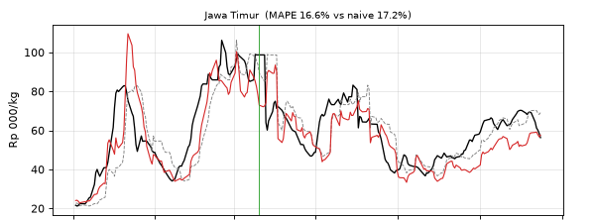
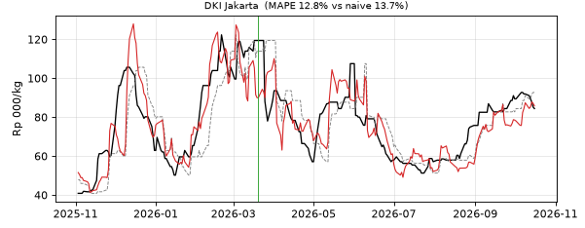
Where the model earns its keep, and where it does not
Jawa Timur: actual, naive, and model forecast
DKI Jakarta: actual, naive, and model forecast
Situation (test year) | Model MAPE | Naive MAPE | Reading
Big falls, more than 18% in 7 days | 18.3% | 34.6% | Model clearly better
Big rises, more than 22% in 7 days | 20.9% | 30.4% | Model clearly better
Quiet weeks, within 5% | 10.7% | 2.5% | Naive better. Model predicts moves that do not happen
76 percent precision, 43 percent recall at predicted rise over 15 percent, versus 37 percent for a momentum rule. Known risk: Aug to Oct 2026 drift, needs live monitoring.

Slide 16
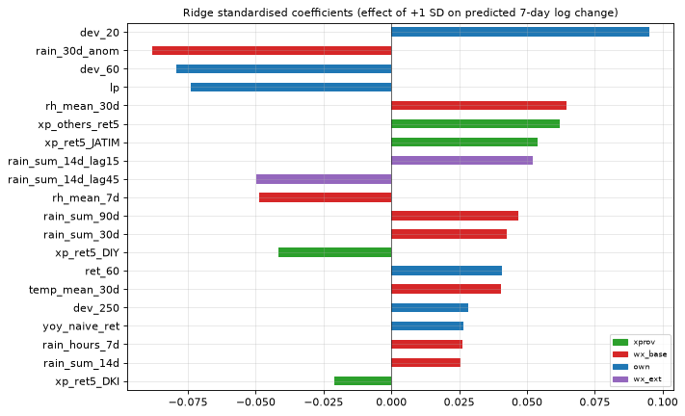
Interpretation: predictive signal, never presented as causal
Method depends on the final model: standardised coefficients for Ridge, impurity importance for Random Forest, TreeSHAP via LightGBM's native pred_contrib for LightGBM.
A model agnostic cross check: grouped permutation importance on the test year, shuffling a whole feature group together.
Framing stated explicitly throughout: importance means the model relies on this to predict, not this causes price changes. No feature here has been through causal identification.
Cross province and lagged rain features are the top permutation groups for the final model, consistent with the ablation.
Ridge standardised coefficients, final model, top 20 features by group

Slide 17
Limitations, stated plainly
# | Limitation
1 | Predictive, not causal. The named mechanisms (weather to supply, holidays to demand, arbitrage) are plausible stories, not tested effects.
2 | DKI Jakarta was added on non statistical grounds (demand anchor market) despite the lowest CV. A deliberate, documented deviation from the screening rule.
3 | Point forecasts shrink large moves toward zero. Expected behaviour of a model minimising average error, not a bug, but prediction intervals are not implemented yet.
4 | Small effective evaluation sample. One test year, about 250 autocorrelated origins times 6 provinces, only 2 Ramadan cycles in CV.
5 | The CV selected model is not the test year winner. Tuned Ridge (14.11%) versus tuned LightGBM (13.00%), a gap larger than typical noise, not yet resolved.
6 | Weather is measured at the provincial capital, not the growing region. Probably weakens the true weather signal.

Slide 18
Recommendation and next steps
Run a three month shadow pilot of the early warning score, with a fallback to persistence if it stops beating naive. Not an operational rollout.
Step | Why it matters
1. Evaluate a Ridge plus LightGBM average in CV | Cheap, and often more robust than either model alone. The principled resolution to the open model choice question
2. Add interval (quantile) forecasts | Alerts come with uncertainty. Directly addresses the shrinkage limitation
3. Agree the alert threshold with the stakeholder | Business decision. Trades false alarms against missed spikes
4. Re pull weather for major producing kabupaten | Current weather is measured at provincial capitals, not growing areas
5. Verify holiday dates against official SKB calendars | Hijri dates were computed, not government verified. Imlek dates are already independently cross checked

