Slide 1



Yin-Yang: Transparent Deep Embedding of DSLs
Vojin Jovanovic, EPFL
Twitter: @vojjov

Slide 2
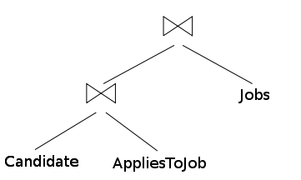
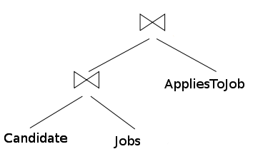
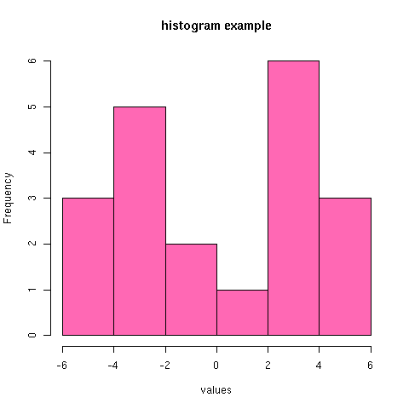
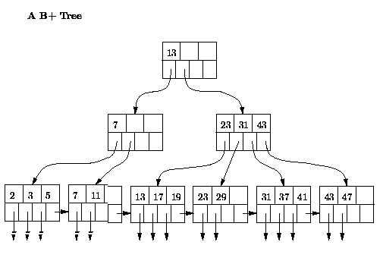
Good Performance: SQL
Compiler has domain knowledge
Compiled at run-time (access to data)
=

Slide 3
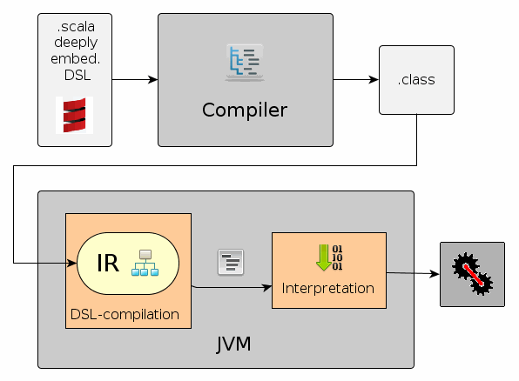
Deep Embedding

Slide 4
Deep Embedding - LMS
trait Base { trait Exp[T] type Rep[T] = Exp[T] case class Const[T](t: T) extends Exp[T] implicit def unit[T](t: T): Rep[T] = Const(t) }
trait RegexDSL extends Base { case class Matches(
t: Rep[String],
p: Rep[String]) extends Exp[Boolean] object regex { def matches(t: Rep[String], p: Rep[String) =
Matches(t, p) } def main() = regex.matches("42", "Answer to the Ultimate…") }

Slide 5
Program Text is Not All
regex.matches("42", "Answer to the Ultimate…")

Slide 6
Convoluted Interface
def infix_-(lhs: Rep[Float], rh: Rep[Int])
(implicit o: Overloaded,
ctx: SourceContext): Rep[Float]
def infix_-(lhs: Rep[Int], rh: Rep[Int])
(implicit o: Overloaded,
ctx: SourceContext): Rep[Int]

Slide 7
Type Errors
val one: Rep[Int] = 1 val void: Rep[Unit] = () one + void
No implicit view available from RepDSL.this.Rep[Unit] => Int.

Slide 8
Deep DSL Embedding
X Nice interface
X Comprehensible type errors
X Easy debugging
X Consistent Documentation
X Consistent with the host language
✓ Domain-specific analysis
✓ Fast

Slide 9
Shallow Embedding
package object regex { def regexDSL[T](b: => T) = b
def matches(text: String, pat: String): Boolean = text.matches(pat) }

Slide 10
Shallow Embedding
✓ Nice interface
✓ Comprehensible type errors
✓ Easy debugging
✓ Consistent documentation
✓ Consistent with the host language
X Domain-specific analysis
X Fast

Slide 11
During program development we do not care about performance!

Slide 12

✓Use shallow embedding for development
✓Use deep embedding in production

Slide 13
Macros
Compile-time meta-programming
Completely transparent to the users
def fix_==[T](block: => T): T =
macro fix_==Impl

Slide 14

Regular Workflow
…
foo{“Bar” == 1}
…
Type Checker
…
foo{“Bar” == 1} // typed
…

Slide 15
Macro Workflow
…
fix_=={“Bar” == 1}
…
Type Checker
fix_==Impl(Tree({“Bar” == 1}))
…
__==(“Bar”, 1) // typed
…

Slide 16
Yin-Yang Library
Uses macros to reliably translate shallow programs to deep programs!

Slide 17
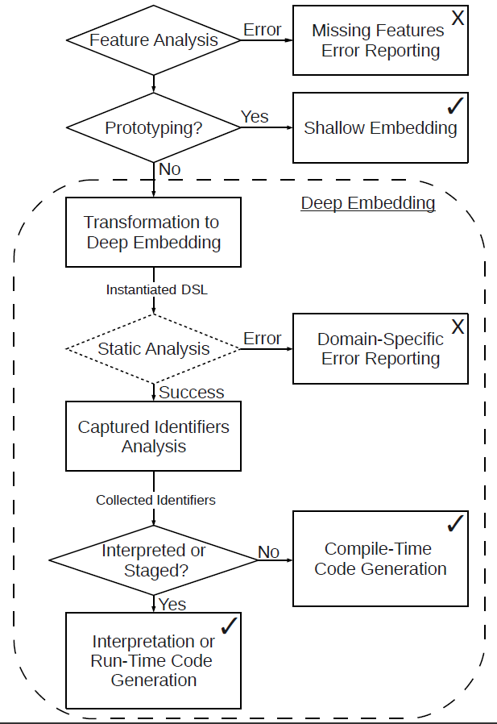

Slide 19
Shallow Program
val readHGTG = ...; val text = "42";
val pattern = "Answer to the Ultimate Q..."
regexDSL {
val res = if (readHGTG)
matches(
text,
pattern
)
else true
res
}

Slide 20
Ascription Transformation
val readHGTG = ...; val text = "42";
val pattern = "Answer to the Ultimate Q..."
regexDSL {
val res: Boolean = ((if (readHGTG)
(regex.`package`.matches(
text,
pattern
): Boolean)
else true): Boolean)
res
}

Slide 21
Lift Literals Transformation
val readHGTG = ...; val text = "42";
val pattern = "Answer to the Ultimate Q..."
regexDSL {
val res: Boolean = ((if (readHGTG)
(regex.`package`.matches(
text,
pattern
): Boolean)
else lift(true)): Boolean)
res
}

Slide 22
Virtualization Transformation
val readHGTG = ...; val text = "42";
val pattern = "Answer to the Ultimate Q..."
regexDSL {
val res: Boolean = ((__ifThenElse(readHGTG,
(regex.`package`.matches(
text,
pattern
): Boolean),
lift(true)): Boolean)
res
}

Slide 23
Scope Injection Transformation
val readHGTG = ...; val text = "42";
val pattern = "Answer to the Ultimate Q..."
regexDSL {
val res: Boolean = ((__ifThenElse(readHGTG,
(this.regex.`package`.matches(
text,
pattern
): Boolean),
lift(true)): Boolean)
res
}

Slide 24
Type Transformation
val readHGTG = ...; val text = "42";
val pattern = "Answer to the Ultimate Q..."
regexDSL {
val res: this.Rep[Boolean] = ((__ifThenElse(readHGTG,
(this.regex.`package`.matches(
text,
pattern
): this.Rep[Boolean]),
lift(true)): this.Rep[Boolean])
res
}

Slide 25
Hole Transformation
val readHGTG = ...; val text = "42";
val pattern = "Answer to the Ultimate Q..."
regexDSL {
val res: this.Rep[Boolean] = ((__ifThenElse(hole(typeTag[Boolean],1)
(this.regex.`package`.matches(
hole(typeTag[String], 2),
hole(typeTag[String], 3)
): this.Rep[Boolean]),
lift(true)): this.Rep[Boolean])
res
}

Slide 26
Cake Insertion
val readHGTG = ...; val text = "42";
val pattern = "Answer to the Ultimate Q..."
new RegexDSL { def main() {
val res: this.Rep[Boolean] = ((__ifThenElse(hole(typeTag[Boolean],1)
(this.regex.`package`.matches(
hole(typeTag[String], 2),
hole(typeTag[String], 3)
): this.Rep[Boolean]),
lift(true)): this.Rep[Boolean])
res
}}

Slide 28
Reflective Instantiation
val dsl =
c.eval(new RegexDSL {def main()={…}}

Slide 29
Domain-Specific Analysis
dsl.staticallyAnalyze(c)
Reports errors at compile time!

Slide 31
Captured Identifiers Analysis
val requiredIdents =
dsl.stagingAnalysis()

Slide 32
if (requiredIdents != Nil)
val readHGTG = ...; val text = "42";
val pattern = "Answer to the Ultimate Q..."
new RegexDSL { def main() {
val res: this.Rep[Boolean] = ((__ifThenElse(hole(typeTag[Boolean],1)
(this.regex.`package`.matches(
hole(typeTag[String], 2),
lift(pattern)
): this.Rep[Boolean]),
lift(true)): this.Rep[Boolean])
res
}}

Slide 34
Compile vs. Runtime
if (requiredIdents == Nil)
// compile at compile time
c.parse(dsl.gnerateCode())
else
// compile at run time
c.expr(Block(
guards,
dslCake,
dslInvocation
)

Slide 35
Deep DLSs: Idents vs. Constants
Deep embedding does not distinguish constants and identifiers
To check for recompilation it needs to lift the whole program on each execution

Slide 36
Guards with Deep DSLS
val s = text.map(incChar) if (matches(s, pattern)) println("OK")
How long does the lifting take?
Shallow program processes 100 KB string for the time of one lifting!

Slide 37
Guarded Recompilation
if (pattern != Cache.prevValue(<uid>))
Cache.setProgram(<uid>)(
new RegexDSL{def main()={…}}
)
Cache.program(<uid>)(cond, text)

Slide 38
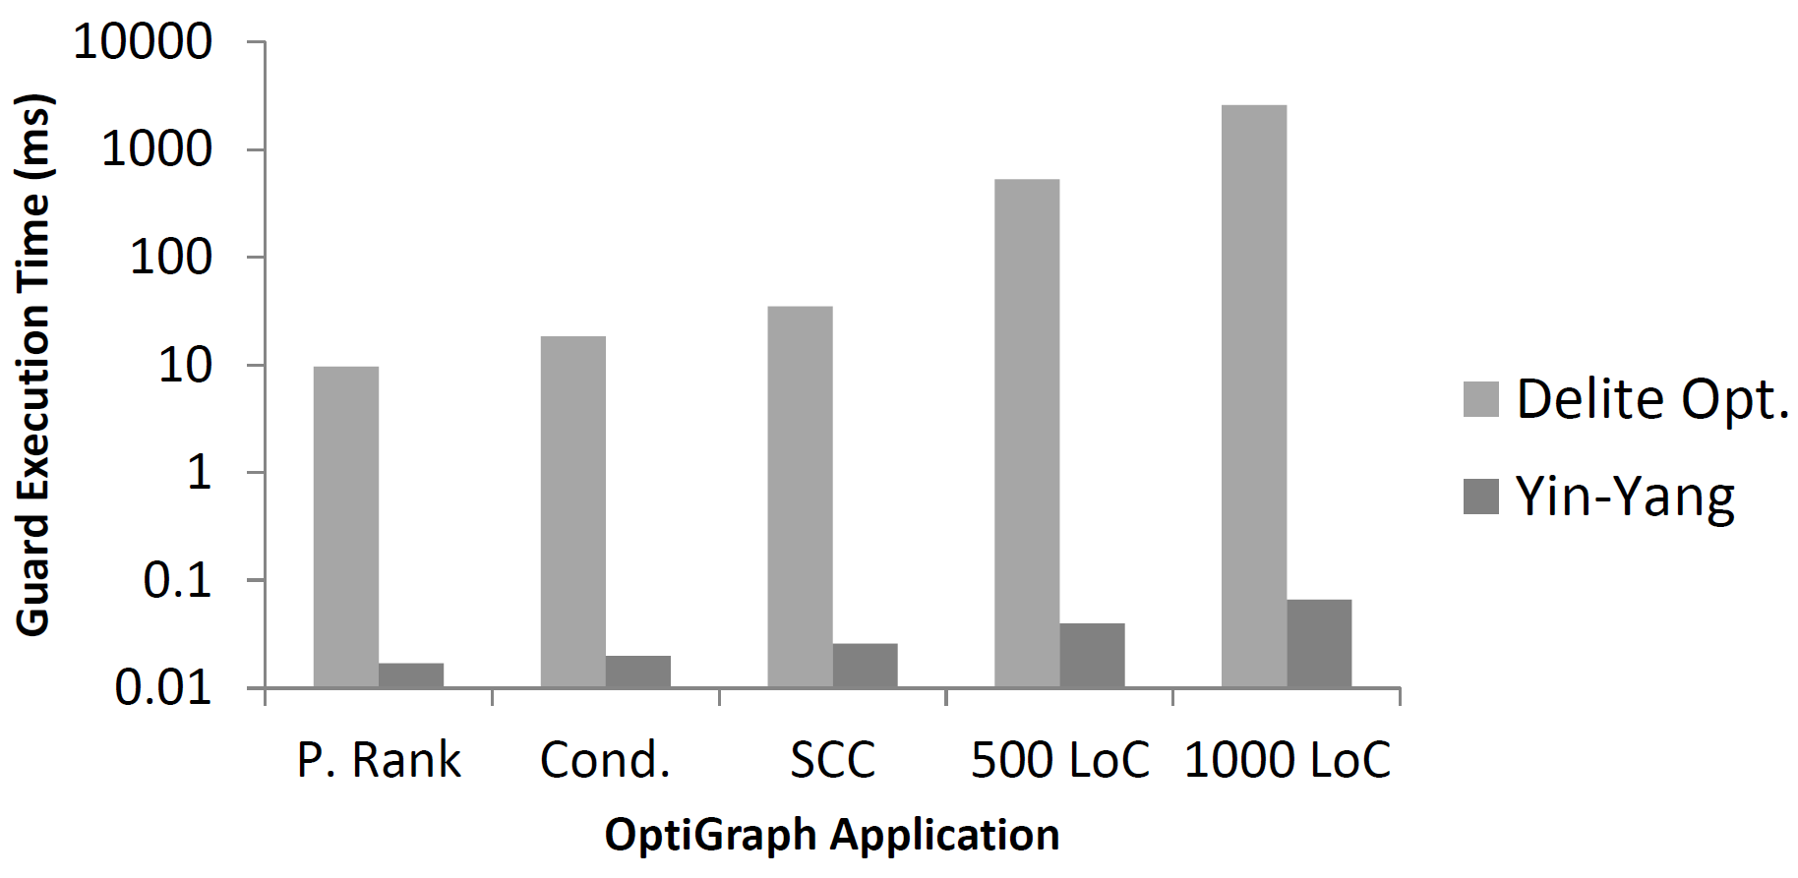
Evaluation

Slide 39
Contributions
Completely transparent deep embedding
Completely compiler agnostic
Compilation at either compile or run time
Efficient guarded recompilation

Slide 40
Slick DSL with Macors
Macro version took months to develop
Duplicate of the deep embedding
Does not work for all cases

Slide 41
Macro Version of Slick
Requires same things as Yin-Yang
Hole Transformation
Virtualization
Compile-time evaluation
These transformation are non-trivial

Slide 42
Slick with Yin-Yang
Three weeks development
Wires to the existing DSL (no duplication)
More features that the macro version

Slide 43
Future Work
Class virtualization
Cross compilation unit operation
Yin-Yang as a modular library for DSLs

Slide 44
References
Yin-Yang
http://github.com/vjovanov/mpde
http://infoscience.epfl.ch/record/185832/files/yinyang.pdf?version=2
Learn LMS
http://scala-lms.github.com
http://github.com/stanford-ppl/Delite

Slide 45
Questions?
Also at:
@vojjov
vojin.jovanovic@epfl.ch

