Slide 1

Virtusa Recruitment Processing System
UML Diagrams

Slide 2

Introduction
VRPS stands for “Virtusa Recruitment Processing System” designed by a group of Trainee’s which is a model that simulates actual recruitment process.
Team Members:
Samatha Ramidi
Sony Vallem
Jyoti sri
Janaki Ram DV
Saibharadwaj Ch

Slide 3






Diagrams
Class Diagram
Activity Diagram
Sequence Diagram
Use-Case Diagram
State Chart Diagram
Represents business entities involved in the system
Depicts the Work Flow of the system from the scratch.
Step-by-Step ordered flow of execution on System
Simulating Real Time scenario between numerous actors and use cases.
Transition of states of the system at particular instant of execution

Slide 4
Class Diagram
A class diagram in the Unified Modeling Language is a type of static structure diagram that describes the structure of a system by showing the system's classes, their attributes, operations, and the relationships among objects.

Slide 5
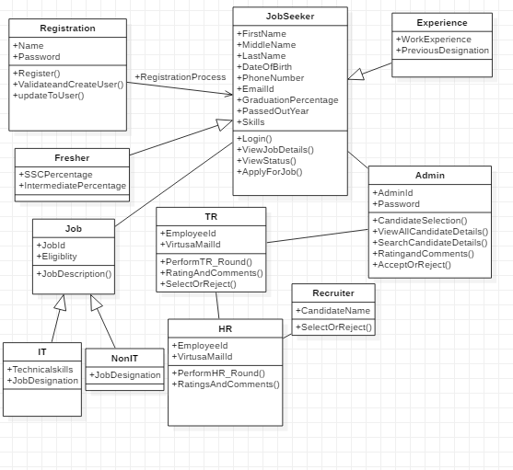

Slide 6
Activity Diagram
An activity diagram visually presents a series of actions or flow of control in a system similar to a flowchart or a data flow diagram. Activity diagrams are often used in business process modeling.

Slide 7
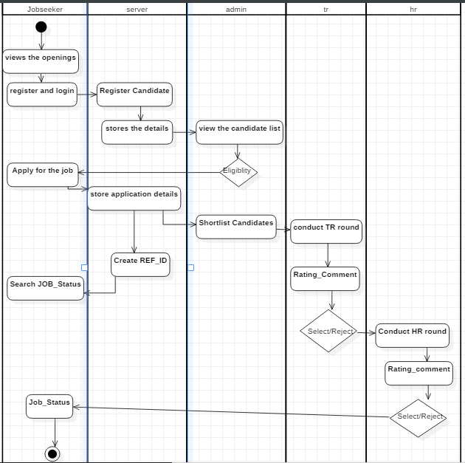

Slide 8
Sequence Diagram
A sequence diagram simply depicts interaction between objects in a sequential order i.e. the order in which these interactions take place. We can also use the terms event diagrams or event scenarios to refer to a sequence diagram . Sequence diagrams describe how and in what order the objects in a system function.

Slide 9
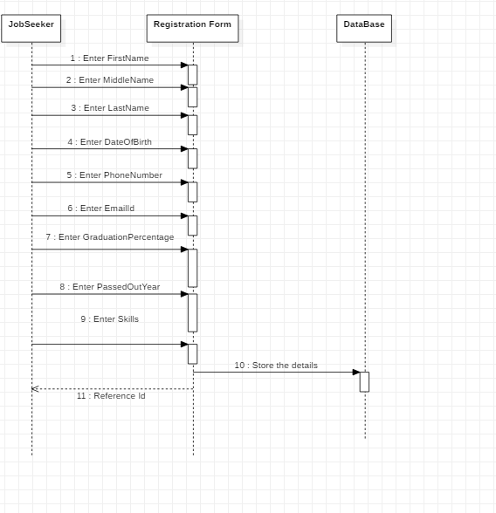
Sequence Diagram1:Job_seeker

Slide 10
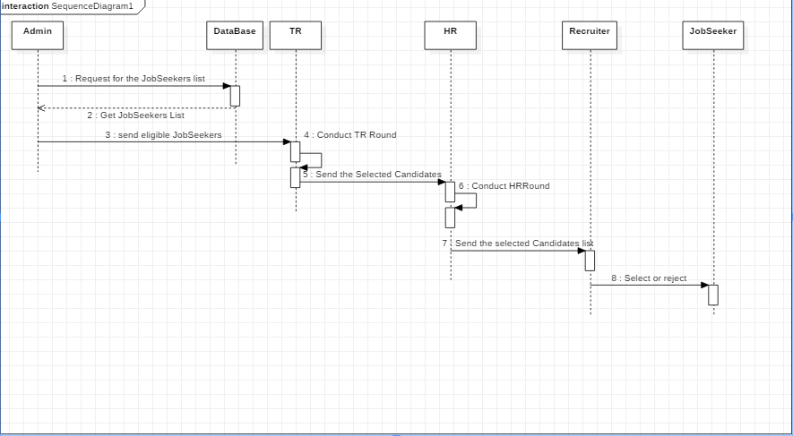
Sequence Diagram2:Overall_Interaction

Slide 11
Use Case Diagram
Use case diagrams are a way to capture the system's functionality and requirements in UML diagrams. It captures the dynamic behavior of a live system. A use case diagram consists of a use case and an actor. A use case represents a distinct functionality of a system, a component, a package, or a class.

Slide 12
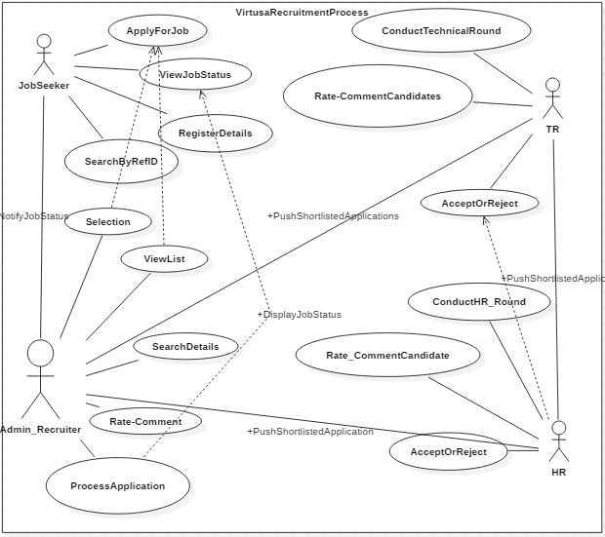

Slide 13
State Chart Diagram
A state diagram is used to represent the condition of the system or part of the system at finite instances of time. It's a behavioral diagram and it represents the behavior using finite state transitions.

Slide 14
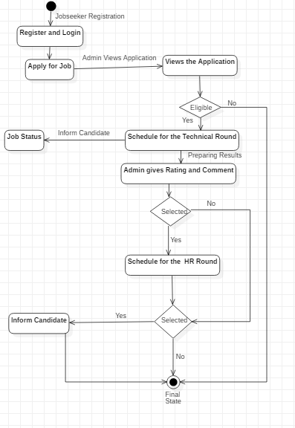

Slide 15
THANK YOU

