Slide 1
ADVANCED WEATHER
PREDICTION API
AI Project Deployment & Capstone • Week 4
Python | Scikit-learn | Flask | Joblib | Postman
Presented by: Viraj Mhatre

Slide 2
Project Overview
• Build an end-to-end machine learning application for weather estimates.
• Predict temperature, humidity, and rainfall from weather-related input features.
• Expose predictions through a REST API built with Flask.
• Test the API by sending JSON requests through Postman.
• This is an educational demonstration using simulated weather data.
WEEK 4 • AI PROJECT DEPLOYMENT | 02

Slide 3
Project Objectives
1. Prepare Data
2. Train Models
3. Deploy API
Generate and organize sample weather data.
Train regression models with Scikit-learn.
Load saved models and serve predictions with Flask.
4. Evaluate
5. Test
Measure performance on held-out test data.
Verify requests and responses using Postman.
WEEK 4 • AI PROJECT DEPLOYMENT | 03

Slide 4
Technology Stack
Python
Pandas & NumPy
Scikit-learn
Core programming language.
Create and handle tabular data.
Train Random Forest regression models.
Flask
Joblib
Postman
Provide HTTP endpoints for predictions.
Save and reload trained models.
Send JSON requests and inspect responses.
WEEK 4 • AI PROJECT DEPLOYMENT | 04

Slide 5
Dataset & Features
• Dataset: 1,500 simulated weather records generated by dataset.py.
• Input features: pressure_hpa, wind_speed_kmh, month.
• Previous observations: previous_temp_c, previous_humidity_pct, previous_rainfall_mm.
• Prediction targets: temperature_c, humidity_pct, rainfall_mm.
• The synthetic dataset is not a substitute for official meteorological records.
WEEK 4 • AI PROJECT DEPLOYMENT | 05

Slide 6
Model Training & Evaluation
Step 1 • Split
Step 2 • Train
Step 3 • Evaluate
Divide records into training and testing sets (80/20).
Train separate RandomForestRegressor models for three targets.
Calculate MAE and R² on the test set.
MAE: average absolute prediction error • R²: goodness-of-fit measure
Exact metric values are saved in model_metrics.json after training.
WEEK 4 • AI PROJECT DEPLOYMENT | 06

Slide 7
Application Architecture
1. Dataset
2. Training
3. Saved Models
4. Flask API
weather.csv
train_model.py
weather_models.joblib
app.py
5. Client Test
Postman sends JSON
POST /predict → JSON response
WEEK 4 • AI PROJECT DEPLOYMENT | 07

Slide 8
API Endpoints & Example Input
GET /
POST /predict
Checks whether the Flask API is running.
Accepts weather features in JSON and returns estimates.
Example JSON request
Response fields
{
"pressure_hpa": 1010,
"wind_speed_kmh": 12,
"month": 7,
"previous_temp_c": 28,
"previous_humidity_pct": 78,
"previous_rainfall_mm": 5
}
• predicted_temperature_c
• predicted_humidity_pct
• predicted_rainfall_mm
WEEK 4 • AI PROJECT DEPLOYMENT | 08

Slide 9
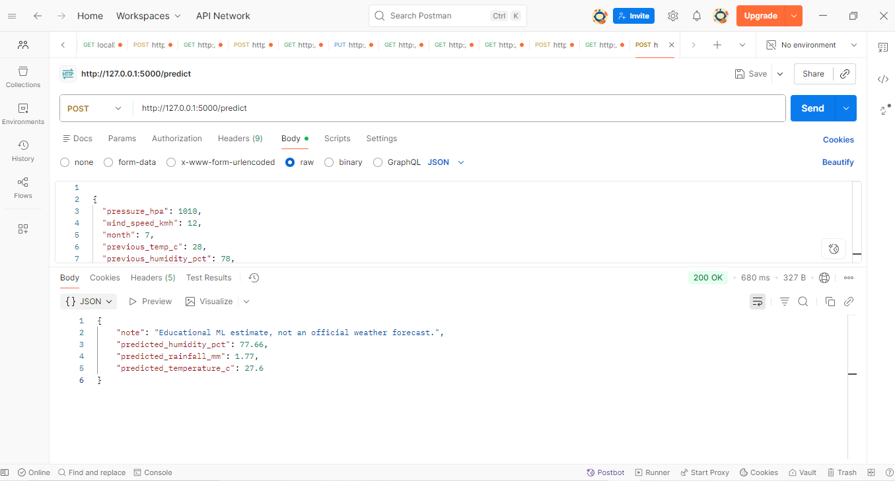
Postman Test Result
Sample successful response
Status
API returned a JSON response.
Interpretation
Values are estimates from synthetic data.
WEEK 4 • AI PROJECT DEPLOYMENT | 09

Slide 10
How to Run the Project
• Install dependencies: pip install -r requirements.txt
• Generate the dataset: python dataset.py
• Train and save models: python train_model.py
• Start the API: python app.py
• In Postman, send POST to http://127.0.0.1:5000/predict with a JSON body.
• Keep the Flask terminal running while testing the API.
WEEK 4 • AI PROJECT DEPLOYMENT | 10

Slide 11
Limitations & Future Scope
Current Limitations
Future Improvements
• Uses simulated rather than official weather data
• Predictions are for learning and demonstration
• Accuracy depends on generated data patterns
• Train with genuine historical weather records
• Add a simple web interface
• Deploy API to a cloud platform
• Add validation and monitoring
Do not use this prototype for safety-critical weather decisions.
WEEK 4 • AI PROJECT DEPLOYMENT | 11

Slide 12
Conclusion
The project demonstrates a complete ML workflow—from dataset preparation and model evaluation to model serialization, Flask API deployment, and Postman testing.
• Training and evaluating regression models
• Saving models with Joblib
• Building and testing a REST API
Thank you .

