Slide 1
EEE 306: Project Investigating The Effect of HVDC Connection and Large Industrial Loads in IEEE 39-Bus Network
Presented by :
Group-11
Taufiqur Rahman SIDDIQUI (1706144)
Sabbir Hossain Ujjal (1706146)
Samiha Tahsin (1706147)
Sadia Alam (1706151)

Slide 2
Overview of the Network System
39 Buses (B01-B39)
34 Lines (L01-L34)
Voltage Ratings 345kV and 16.5kV
12 Transformers (T01-T12)
10+1 Generators (Two G05)
G02 Slack Generator
19 Loads (LD01-LD09)
Nominal Frequency 50Hz
Software used: PSAF
Solution method: Newton Raphson with 100 iterations

Slide 3
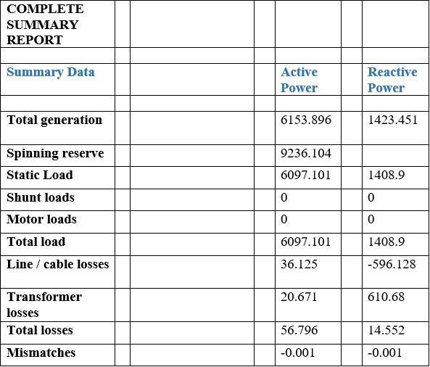
Base Case Summary

Slide 4
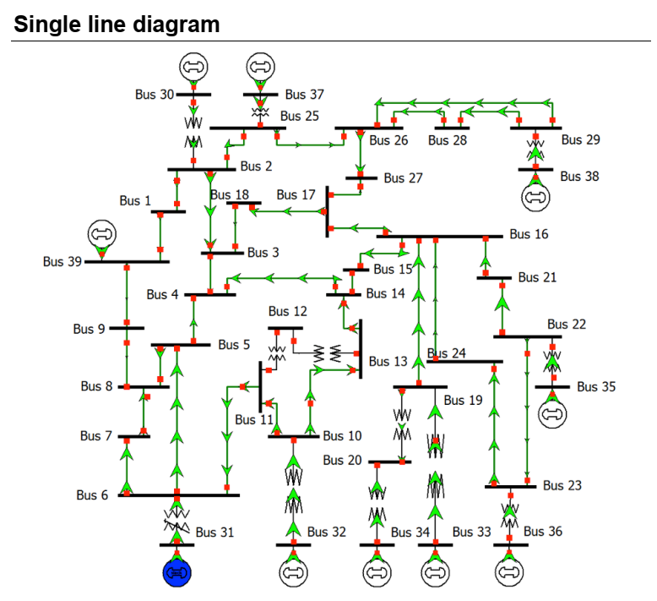
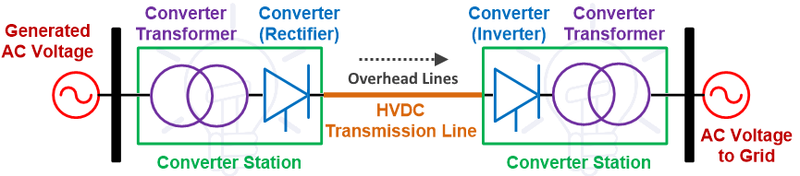
HVDC line between bus 9 and 39
10 motors at bus 23
Components of HVDC line

Slide 5
Abnormal report after addition of HVDC line
Some bus voltages are outside ±10% limit
BUSES OUTSIDE VOLTAGE LIMITS ( 100 %)
Bus ID | V sol - [pu]
B11 | 0.898
B12 | 0.88
B04 | 0.885
B05 | 0.872
B06 | 0.879
B07 | 0.847
B08 | 0.836
B09 | 0.745
B9_INV | 0.733

Slide 6
Abnormalities after addition of induction motor
Some bus voltages are outside ±10% voltage
One transformer crosses its emergency MVA limit
3 generators are outside reactive limit
BUSES OUTSIDE VOLTAGE LIMITS ( 100 %)
Bus ID | V sol - [pu]
B10 | 0.861
B11 | 0.843
B12 | 0.825
B13 | 0.854
B14 | 0.849
B04 | 0.826
B15 | 0.891
B05 | 0.801
B06 | 0.81
B07 | 0.767
B08 | 0.751
B09 | 0.607
B9_INV | 0.592
OVERLOADED TRANSFORMERS (WITHIN 100 %)
ID | Bus From | Bus To | Power Flow - [MVA] | Loading Limit - [MVA] | Emergency Loading Limit - [MVA]
T03 | B06 | B31 | 1267.882 | 800 | 850
GENERATORS AT REACTIVE LIMITS (WITHIN 0 %)
ID | Q Gen - [MVAR] | Q Min - [MVAR] | Q Max - [MVAR]
G03 | 630.48 | -192 | 448
G06 | 541.39 | -192 | 448
G07 | 473.84 | -168 | 392

Slide 7
Solution for transformer overloading
Reasoning:
T-3 connected to swing generator which is supplying excessive power
Solution:
Redistribute the swing generation
Total load | 6737.101
Total losses | 145.062

Slide 8
Solution for transformer overloading
Generator | MVA rating | P_{gen} | P calculated [MW]
G-02 | 700 |  | 573.15
G-03 | 800 |  | 655.03
G-04 | 800 | 640 | 655.03
G-06 | 800 | 640 | 655.03
G-07 | 700 | 560 | 573.15
G-08 | 700 | 560 | 573.15
G-09 | 1000 | 800 | 818.79
G-10 | 1000 | 800 | 818.79
 | Total=6500
Total Load+ Total loss= 6737.101+93.008 = 6830.109
Generation of G-01 + G-05 = 1000+508 = 1508
Remaining total power to be generated
= 6830.109-1508 = 5322.109 MW

Slide 9
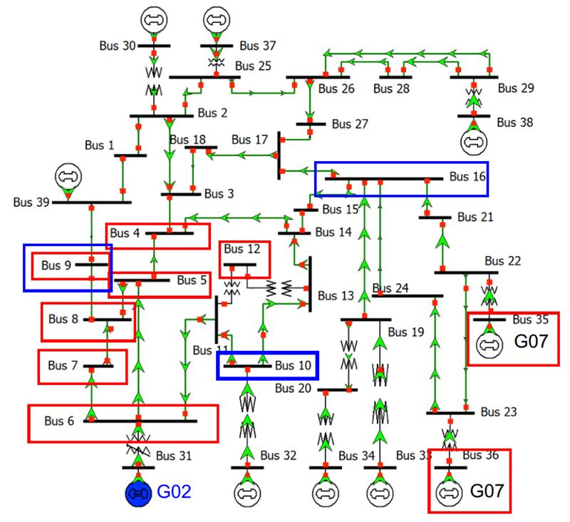
Solution for overloaded generator and bus voltage
Adding SVC
Adding Shunt Capacitor
ID | Bus No | Duplic | Rated Voltage (kV) | Q_{max} | Q_{min}
SVC01 | 09 | 1 | 345 | 300 | -100
SVC02 | 10 | 2 | 345 | 260 | -100
SVC03 | 16 | 1 | 345 | 300 | -100
ID | Bus No | Duplic | MVAR rating (MVAR) | Rated voltage (kV) | Losses(MW)
SC01 | 09 | 1 | 300 | 345 | 0.3
SC02 | 10 | 2 | 260 | 345 | 0.26
SC03 | 16 | 1 | 300 | 345 | 03

Slide 10
Comparison between two alternatives:
 |  | SVC | Shunt capacitor
Total generation | Active power (MW) | 6815.485 | 6819.541
 | Reactive power (MVAR) | 2716.888 | 1522.502
Total Load | Active power (MW) | 6737.101 | 6738.271
 | Reactive power (MVAR) | 1888.9 | 719.001
Total Loss | Active power (MW) | 78.38 | 77.64
 | Reactive power (MVAR) | 827.704 | 803.216

Slide 11
Contribution of each member:
Data calculation, Data entry and base case solve (1706144 & 1706151)
Addition of HVDC and induction motor; Solution of transformer overloading by distributed swing generation (1706147)
Addition of corrective devices; Solution of the abnormal bus voltage and generators outside limit (1706146)

Slide 12
THANK YOU !

