Slide 1
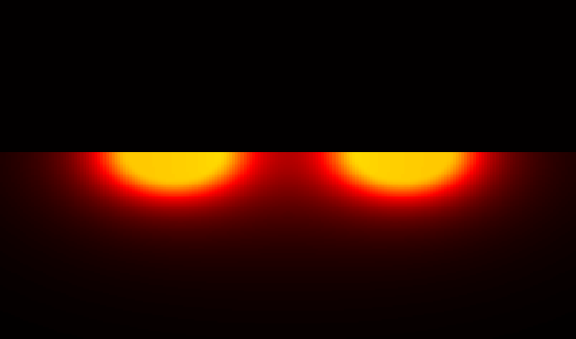

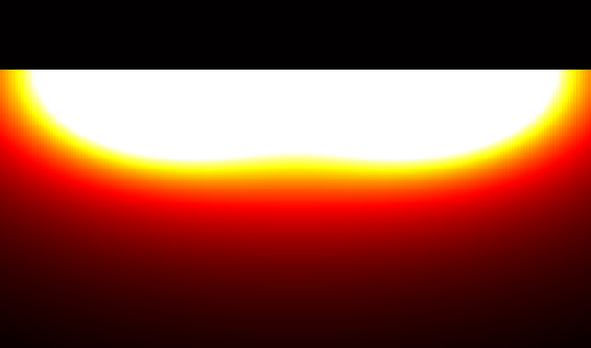

A. 225 μm diameter electrodes, separated by 575 μm, 150 μm above the retinal surface
depth plane
retinal plane
retinal plane
B. 225 μm diameter electrodes, separated by 575 μm, 450 μm above the retinal surface
Vitreous
retinal plane
Retinal surface
depth plane
retinal plane

