Slide 1
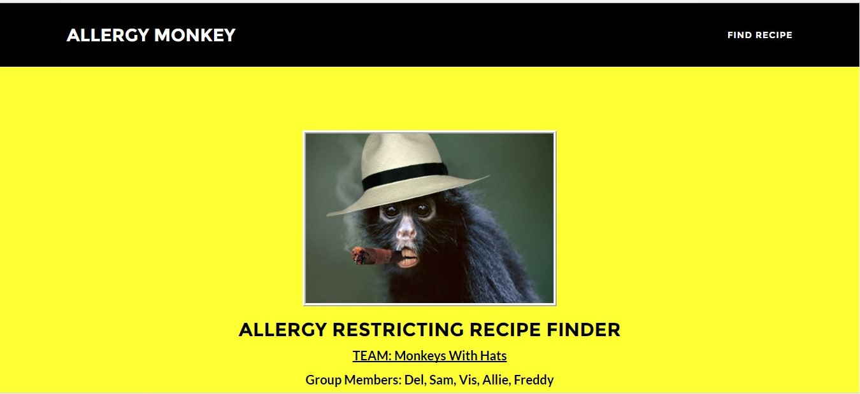

Slide 2

Got food allergies?
Our app is a recipe finder
selecting recipes eliminating
multiple food allergies,
ingredients, or for
diet restrictions

Slide 3
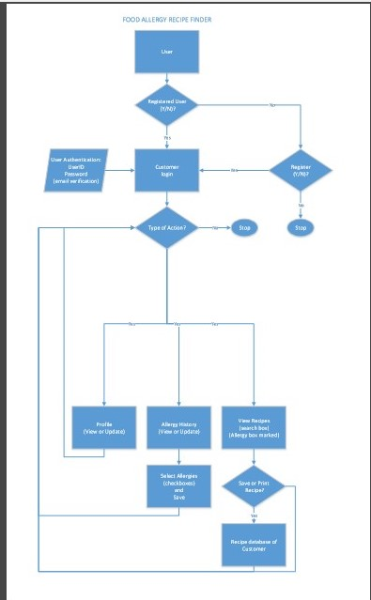
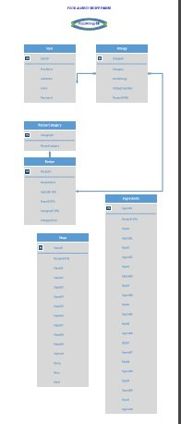
Data Flow Diagram and Entity Relationship Diagram (ERD)

Slide 4
SEO/Accessibility Freddy Rivera
For SEO
Adwords from google - Helps find keywords-look for high volume with low competition and price
Robots.txt – Tells search engines what parts of the website they can crawl through / are relevant
.HTAccess – Security block from crawlers keeping them from obtaining certain information of the website, its password protected
For Accessibility
Chrome Accessibility Dev tools extension – Audits the page telling you what is failing accessibility and where in the page
Chrome Lens extension – Allows user to mimic visual disabilities
Tenon.io Runs your code, also gives recommendations
Tota11y – Checks for accessibility on the page, can be dropped down any page from bookmarks, also available in GitHub to apply on any application

Slide 5
FRONT END: Vis Vasanth &Allie James

Slide 6

BACK END: Sam Noorani & Del Randall

Slide 7
TECHNOLOGIES USED
Node and Express Web Server
MySQL Database with a Sequelize ORM
Get routes
Nightmare
SEO Strategies
Testing Framework (nightmare)
Heroku
New Technology: Casper attempted
Polished Frontend / UI
Folder Structure (MVC Paradigm)
Handlebars

Slide 8
FUTURE DEVELOPMENT
user table with password authentication and with retention of user's allergies and recipes (user profile)
add recipe category to allow user to select Breakfast, Lunch, Dinner, Snack for recipes
add ingredient table with only ingredients; add quantity table with only quantities
pull from multiple APIs for recipes
users can add recipes
add 'Diet' and 'Calories' to the selection along with the existing selection of 'Allergies‘
ADD Pet allergies

Slide 9


Slide 10

That’s All

