Slide 1
SECURE DATA HIDING IN IMAGES USING STEGANOGRAPHY
CAPSTONE PROJECT
Presented By: VISHAL P
Student Name : VISHAL P
College Name & Department : Adhiyamaan College of Engineering(Autonomous), Department of Information Technology

Slide 2
OUTLINE
Problem Statement
Technology used
Wow factor
End users
Result
Conclusion
Git-hub Link
Future scope

Slide 3
Problem Statement
Growing Security Needs
With the increasing demand for secure data transfer, traditional encryption techniques are becoming more vulnerable to interception and unauthorized decryption.
Limitations of Conventional Methods
Existing data protection techniques often attract attention, making them susceptible to attacks and compromising security.
The Need for an Advanced Approach
A more discreet and robust method is required to integrate sensitive information into digital media while maintaining perceptual quality and ensuring security.
Key Focus Areas
This solution will emphasize:
Enhancing embedding efficiency for optimal data concealment
Improving resistance to attacks to prevent unauthorized extraction
Preserving the visual quality of the carrier image to avoid suspicion
Project Objective
The objective of this project is to develop a Steganography-based Secure Data Hiding in Images system that ensures:
Private data is securely embedded within images
The hidden information remains undetectable to the human eye
The system is highly resilient to steganalysis techniques

Slide 4
Technology used
Libraries Used in the Program
OpenCV (cv2) – Handles image processing tasks such as reading, modifying, and saving images.
OS Module – Executes system commands (e.g., opening the encrypted image).
String Module – Provides character manipulation utilities (though not explicitly required in this program).
Platform Compatibility
Primarily designed for Windows (uses os.system("start encryptedImage.jpg") to open the image).
Can be adapted for Linux/macOS with minor modifications.
Requires Python 3.x with OpenCV installed (pip install opencv-python).

Slide 5
Wow factors
Unique Factors:
Advanced Encryption with Secure Data Hiding in Images
Real-Time Image Steganography with Passkey Protection
Innovative Approach: Custom Encryption and Passkey-Based Decryption

Slide 6
End users
End Users of the Project:
Cybersecurity Experts – Utilize the system for secure communication and data protection.
Businesses & Enterprises – Safeguard confidential corporate information.
Privacy-Focused Individuals – Protect personal data from unauthorized access.🚀

Slide 7

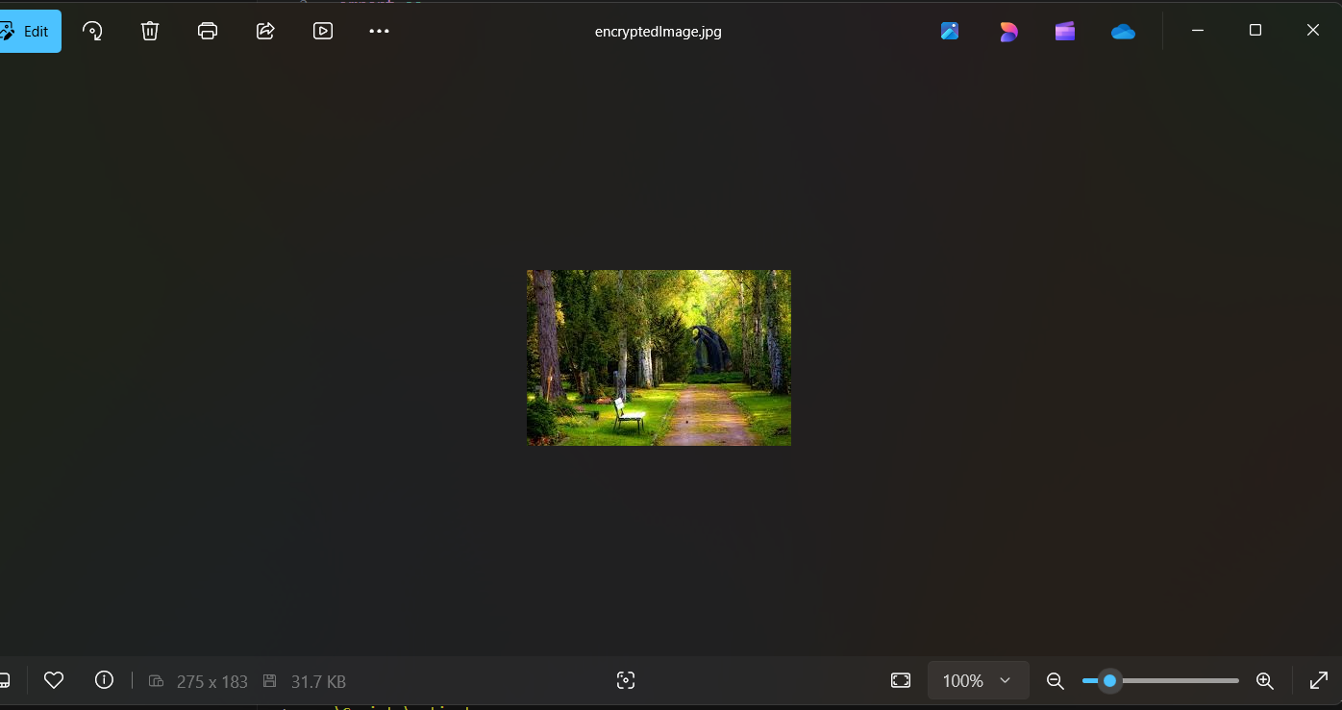
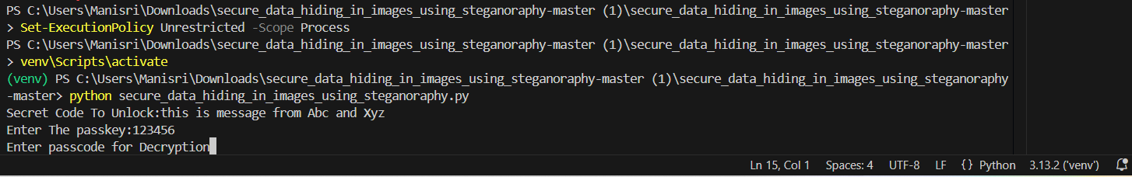
Results

Slide 8
Conclusion
Here’s the revised version with some changes for clarity and flow:
Safeguarding Information Concealed in Images
The challenge of securely transmitting confidential data is effectively addressed by this Steganography-based solution, which embeds sensitive information within digital images while preserving their visual integrity.
Unlike traditional encryption methods that may draw attention and risk interception, this approach ensures covert communication by making the hidden data imperceptible to unauthorized individuals.
Enhanced Security Features
Passkey-Protected Decryption – Ensures only authorized users can access the hidden information.
Direct Pixel Manipulation – Embeds data at the pixel level for enhanced stealth and security.
Lightweight Yet Robust Approach – Minimizes image distortion while maintaining strong data protection.
Ideal for Various Sectors
This steganographic system provides a secure communication channel suitable for:
Cybersecurity – Protecting sensitive digital assets.
Law Enforcement – Concealing critical intelligence data.
Corporate Data Protection – Securing confidential business communications.

Slide 9
GitHub Link
The GitHub link : https://github.com/VisaalP/secure_data_hiding_in_images_using_steganoraphy-master.git

Slide 10
Future scope(optional)
Future Scope in Cybersecurity
As cyber threats continue to evolve, enhancing cybersecurity knowledge is crucial for personal protection and identity security. The future scope in this field includes:
Learning Advanced Cybersecurity Measures – Understanding ethical hacking, penetration testing, and secure communication techniques.
Identity Protection Strategies – Implementing strong authentication, encryption, and secure browsing practices to prevent identity theft.
Threat Detection & Prevention – Gaining expertise in malware analysis, phishing detection, and cybersecurity frameworks to stay ahead of attackers.
Privacy & Data Security – Exploring encryption, steganography, and secure networking to safeguard personal and professional data.

Slide 11
THANK YOU

