Slide 1

Career Aspiration And Preparedness
Group 3B​
s16348 - Rathnasiri K. P. M.
s16350 - Rathnayake R. M. I. L.
s16353 - Saheer Khan M. J. M.
s16365 - Silva A. V. A.

Slide 2

1.Introduction
Background
Career planning is a crucial step for university students as they prepare for life after graduation. Many students face challenges in identifying their career goals and assessing their readiness for the professional world .
This study focuses on third-year undergraduates from the Faculty of Science, University of Colombo. It explores their aspirations, level of preparedness, and the challenges they anticipate.

Slide 3
Objectives 1.To analyze the distribution of GPA among students. 2.To analyze how gender influences career aspirations. 3. To identify the most common challenges faced by students from different hometown areas. 4.To analyze how GPA influences students' career preparedness levels. 5. To explore the relationship between degree type and students' career goals.

Slide 4
Significance of the Study 1.Helps universities improve career guidance based on feedback from students. 2.Highlights the skills students think are important for their future careers. 3.Helps universities design better programs to prepare students for the workforce. 4.Identifies the challenges students face, helping universities and employers address them.

Slide 5
2.Dataset
This dataset focuses on the career aspirations and preparedness of students from the University of Colombo, Faculty of Science. It captures insights into their educational background, career goals, challenges, and the factors influencing their career decisions.
The dataset contains 152 observations and 17 variables, which include both categorical and numerical data.
Categorical Variables:
Gender , Hometown_Area , Degree_Type , Career_Goal , Sector_Preference , Career_Influences , Additional_Knowledge , Knowledge_Sources , Knowledge_Frequency , Skill_Relevance , Career_Preparedness, Career_Experiences , Guidance_Usage , Guidance_Satisfaction , Career_Challenges .
Numerical Variables:
GPA , GPA_Credits

Slide 6
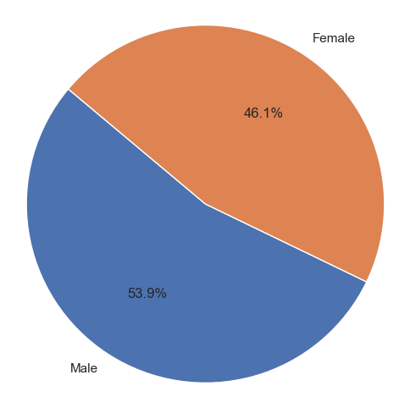
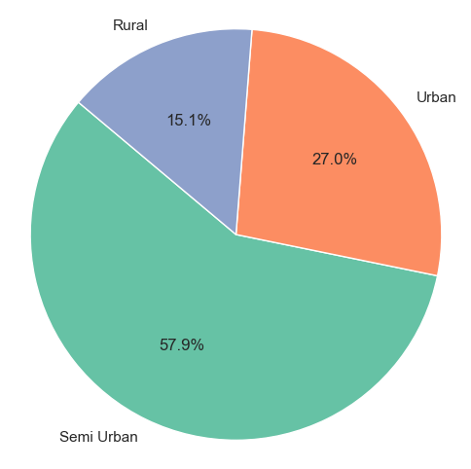
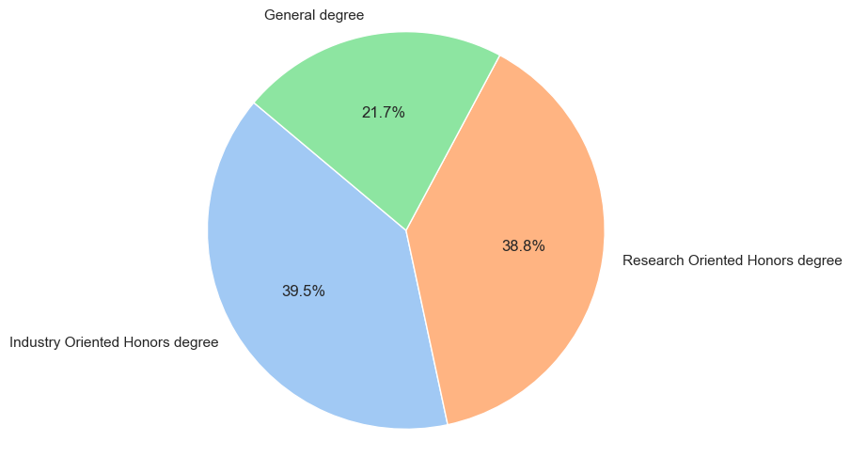
3.Descriptive Analysis
Gender distribution
Hometown Area distribution
Degree Type distribution

Slide 7
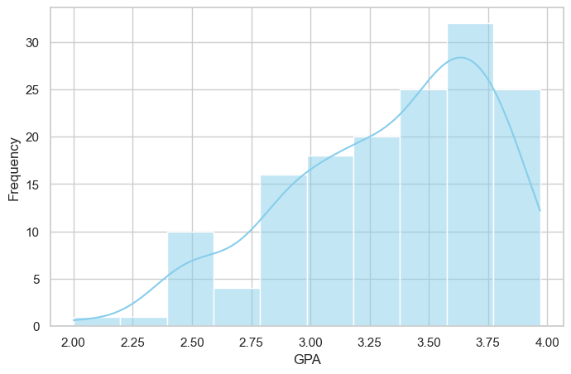
Distribution of GPA
The histogram illustrates the distribution of GPAs among students.
The peak of the distribution is around a GPA of 3.5.
Fewer students have very low or very high GPAs.
The graph indicates that students generally maintain GPAs in the upper middle range.

Slide 8
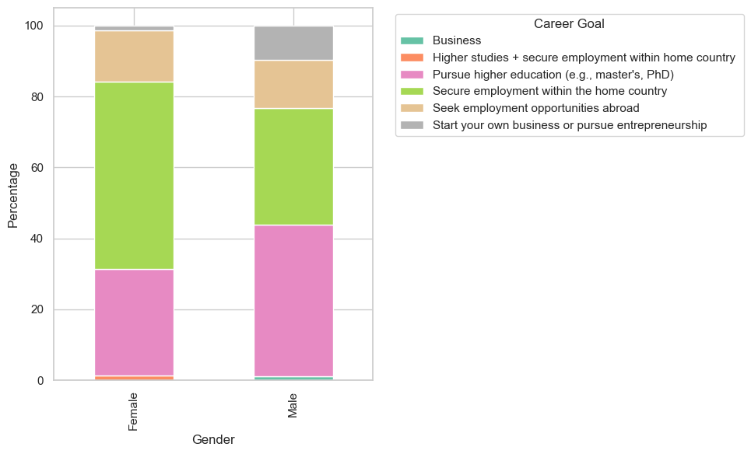
2. Gender vs. Career Goal
The stacked bar chart compares career goals between genders.
For males, the most common career goal is pursuing higher education.
Females have a higher proportion aiming to secure employment within the home country.
Few from both genders target entrepreneurship.

Slide 9
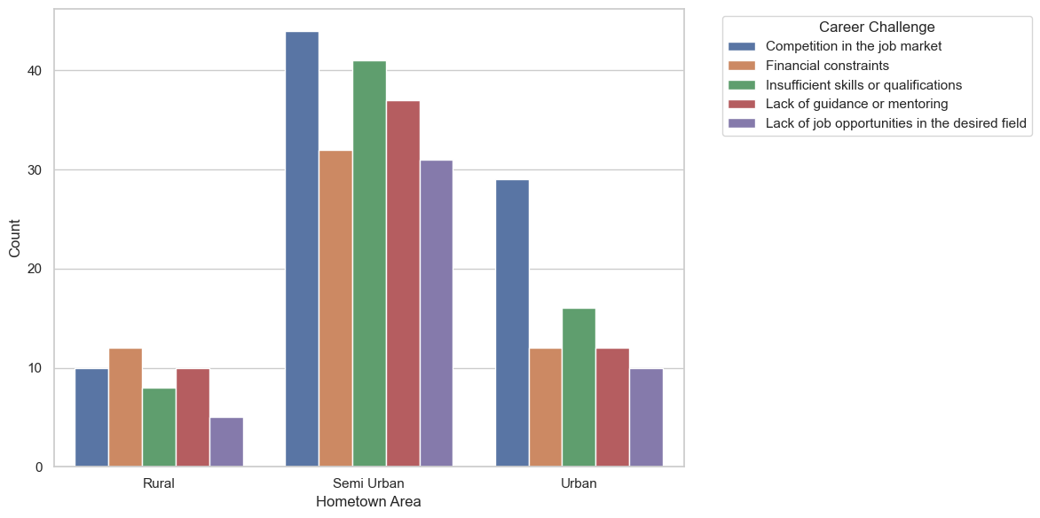
3.Hometown Area vs. Career Challenges
The chart shows career challenges by hometown area type.
Rural areas: Biggest challenge is Financial constraints.
Semi Urban areas: Main challenge is Competition in the job market.
Urban areas: Main challenge is also Competition in the job market.
Insufficient skills or qualifications is a common challenge across all areas.

Slide 10
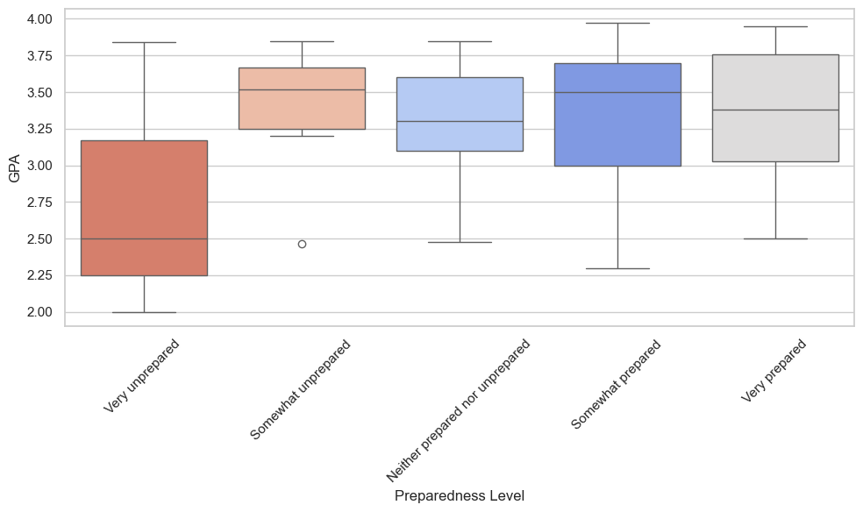
4.GPA vs. Career Preparedness Level
The box plot shows the relationship between students' GPA and career preparedness level.
'Very prepared' students usually have higher GPAs .
'Very unprepared' students generally have lower GPAs.
Other groups have GPA distributions between these extremes.
'Somewhat prepared' students show a wider range of GPAs.

Slide 11
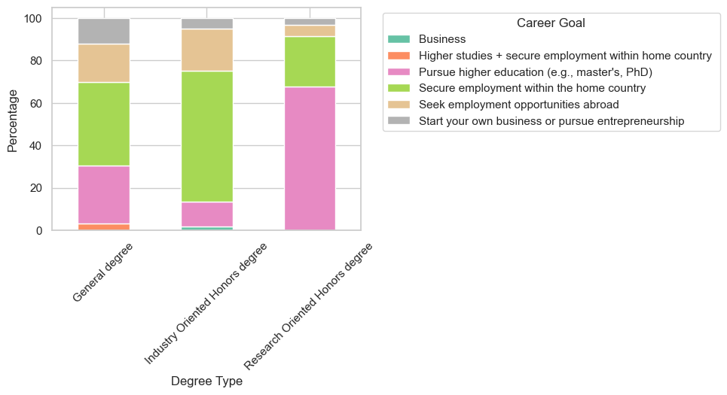
5.Degree Type vs. Career Goals
The chart shows the relationship between the type of degree and students' career goals.
General degree students mostly aim to secure a job in their home country.
Industry Oriented degree students also mostly aim to secure a job in their home country.
Research Oriented degree students mostly aim to pursue higher education.
Few students across all degrees want to start their own business.

Slide 12
4.Conclusion and Future work
Conclusion
Most students have GPAs around 3.5, indicating a generally high academic performance among the majority of the students.
Most students want to either continue their education or get a job in their home country.
Rural students face financial problems, while urban students deal with job competition.
Higher GPA students feel more prepared for their careers.
Women prefer local jobs, and men are more interested in higher education.
Research Oriented degree students aim for further studies, while industry oriented degree students focus on getting jobs.

Slide 13
Future Work
Study how internships help with career readiness.
Create programs to develop the skills students need for the job market.
Provide personalized career advice based on student needs.
Work with companies to make sure students learn the skills employers want.
Explore how different learning resources impact students' career preparation.

Slide 14

Thank you

