Slide 1

IPL Data Analysis
Visalakshi Shamugasundaram

Slide 2
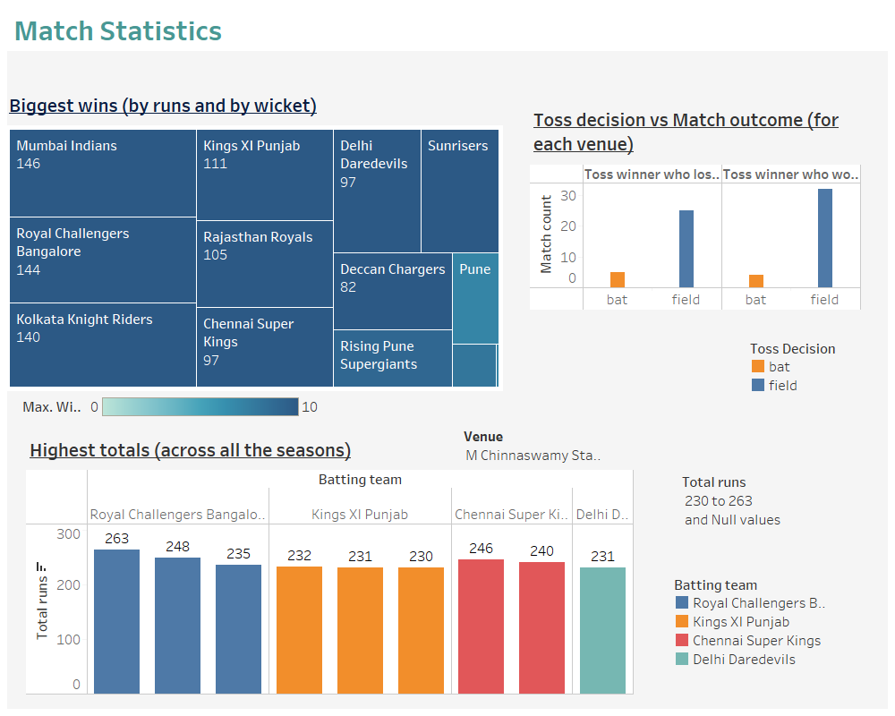

Slide 3
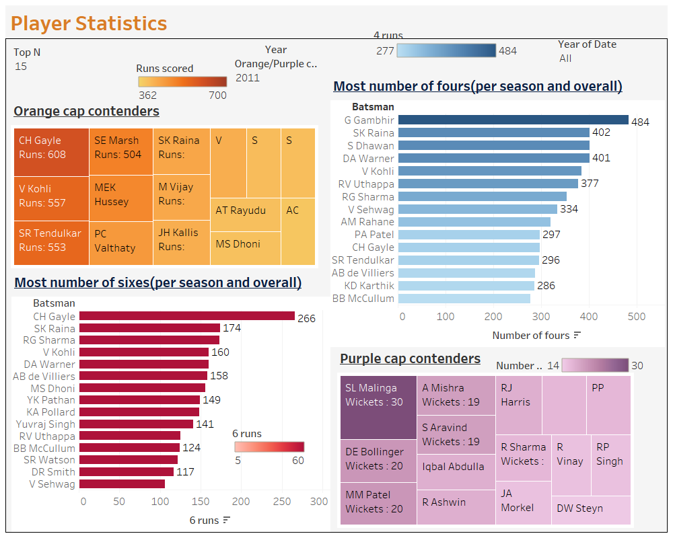

Slide 4
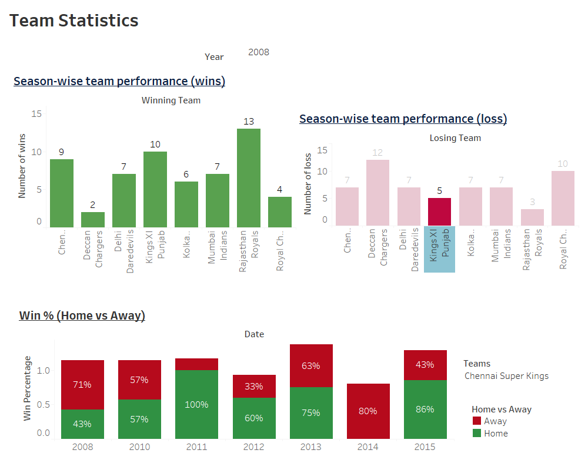

Slide 5
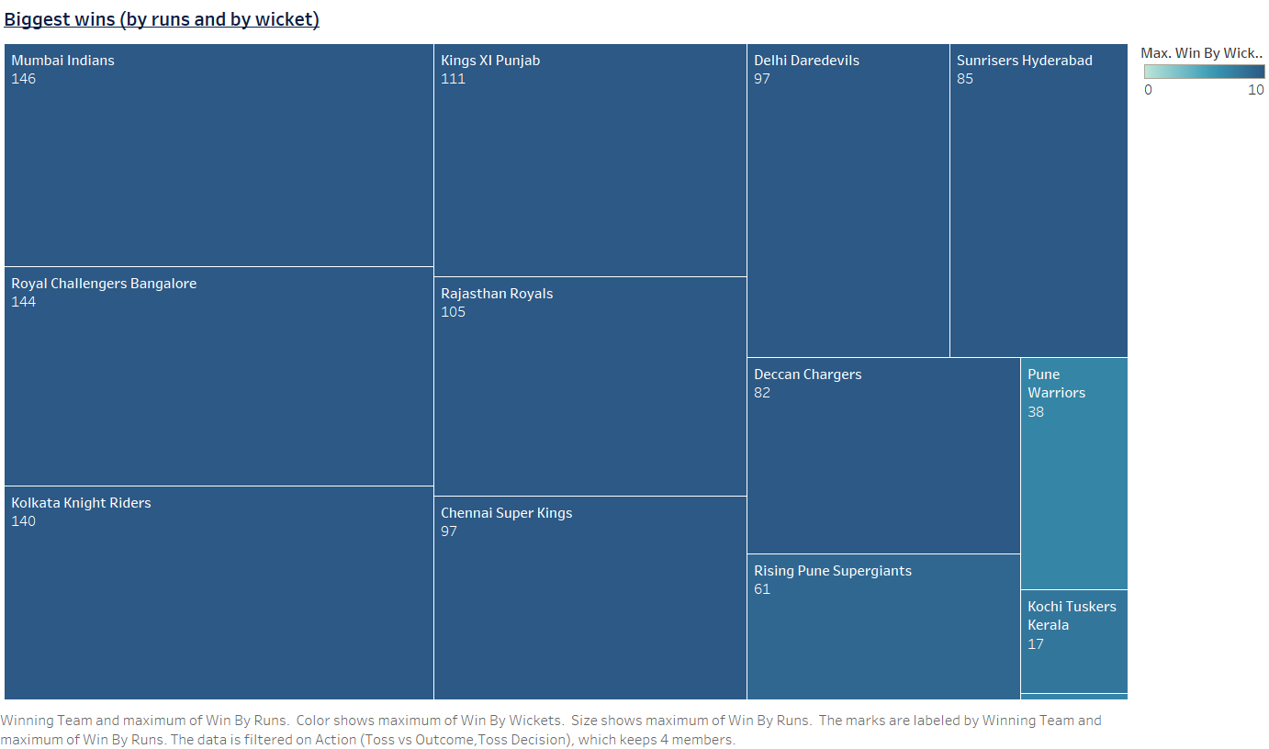
Mumbai Indians were the ones with a biggest win of 146 runs and 10 wickets

Slide 6
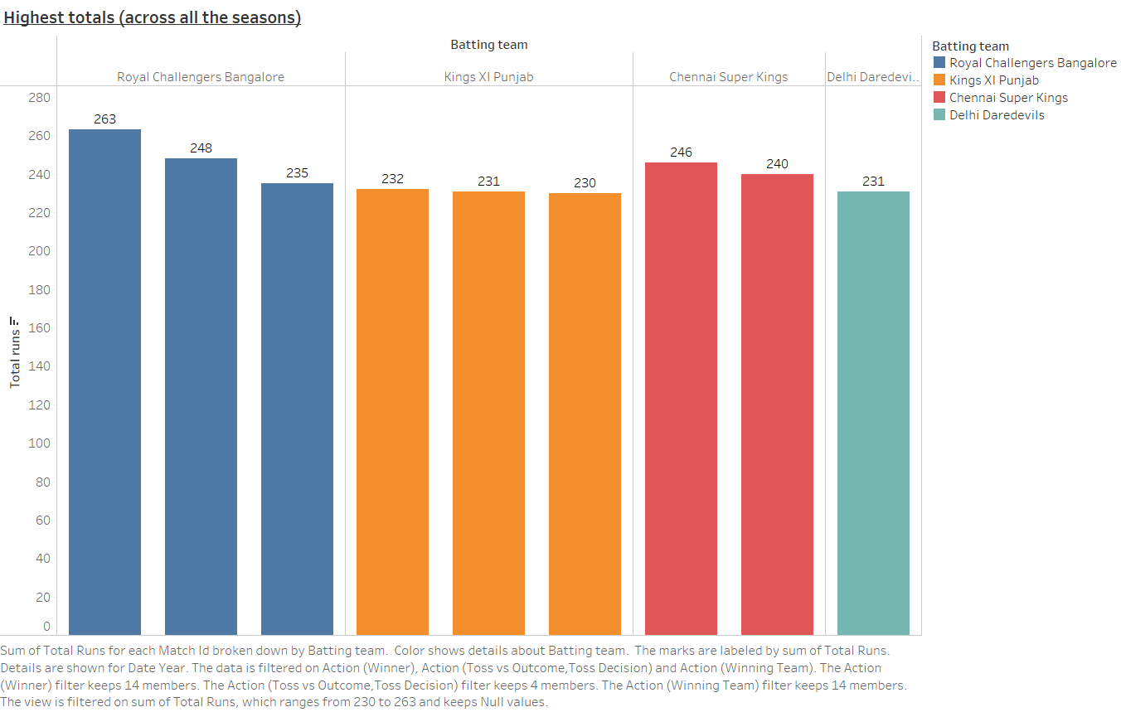
Ροψαλ Χηαλλενγερσ Βανγαλορε holds the highest score in the IPL history of 263 and 248 in the year 2013 and 2016.

Slide 7
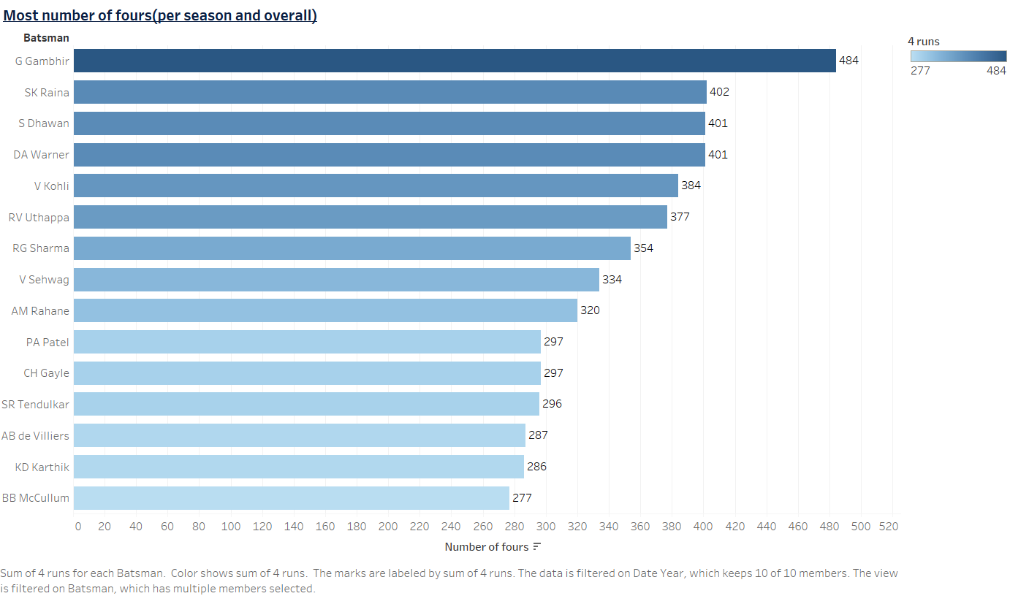
Gautam Gambhir has hit maximum number of fours across all IPL seasons.

Slide 8
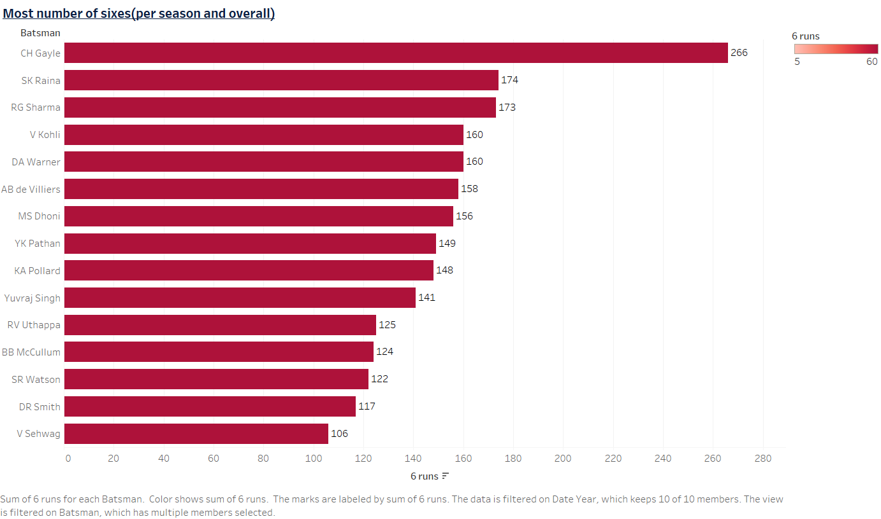
Chris Gayle has hit most no of sixes across all IPL seasons.

Slide 9
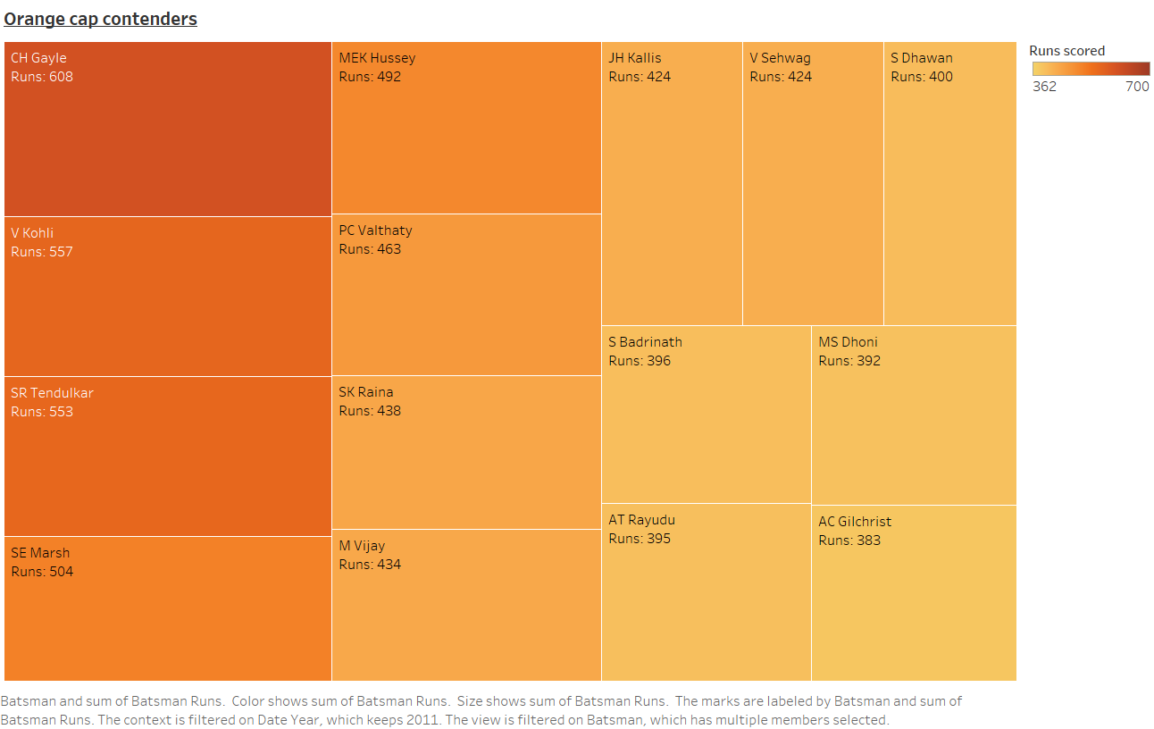
Chris Gayle scored the maximum number of runs in a particular season)

Slide 10
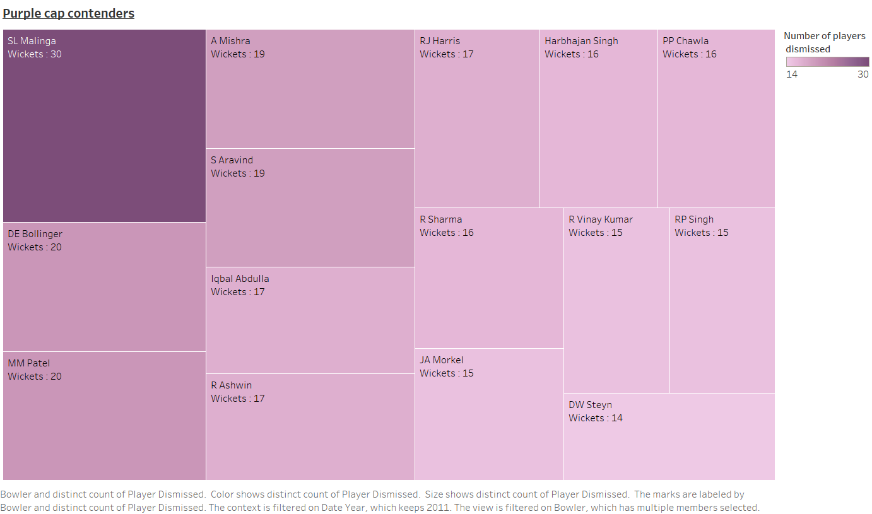
SL Malinga holds the record for taking highest number of wickets.

Slide 11
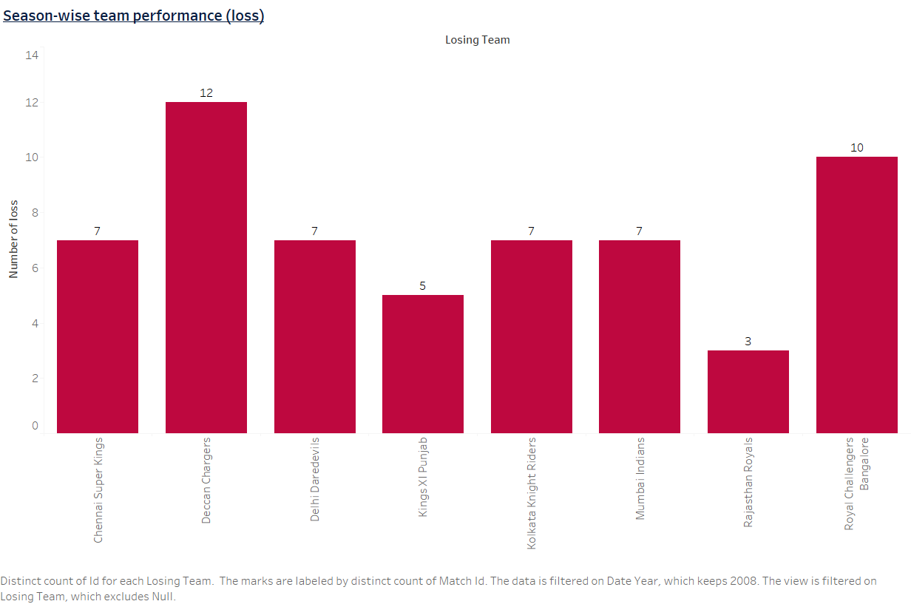
The highest number of matches lost in a season is 12 and Deccan Chargers performed the worst.

Slide 12
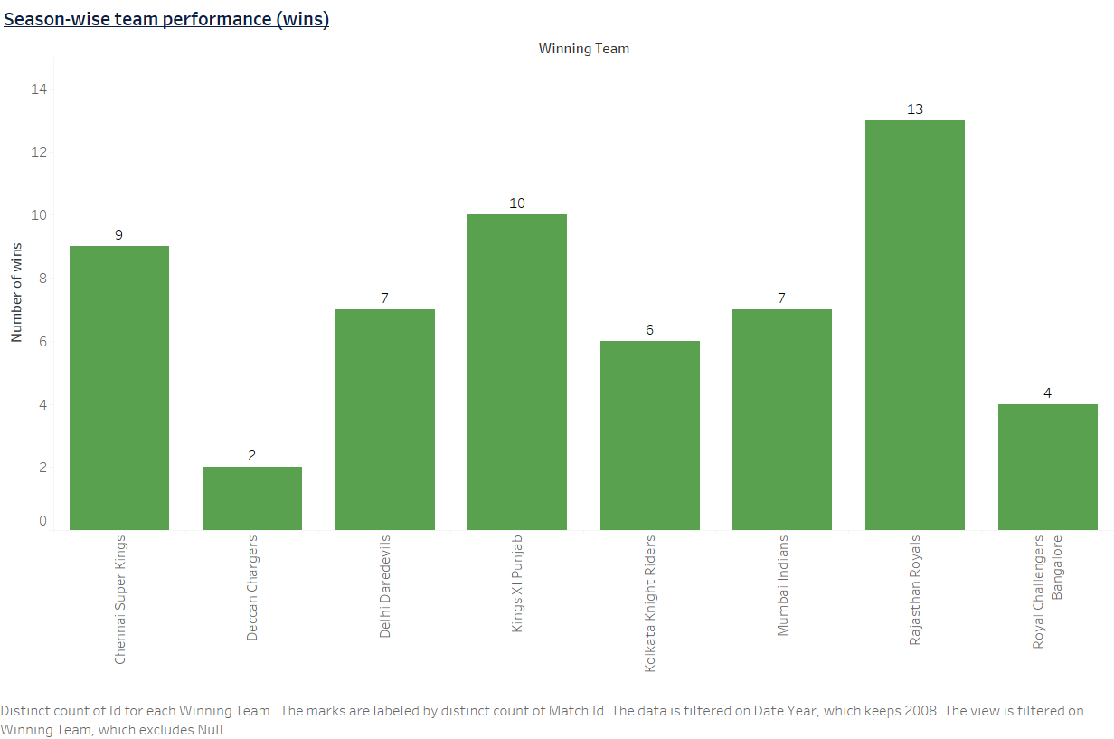
The highest number of matches won in a season is 13 and this was achieved by Rajasthan Royals.

Slide 13
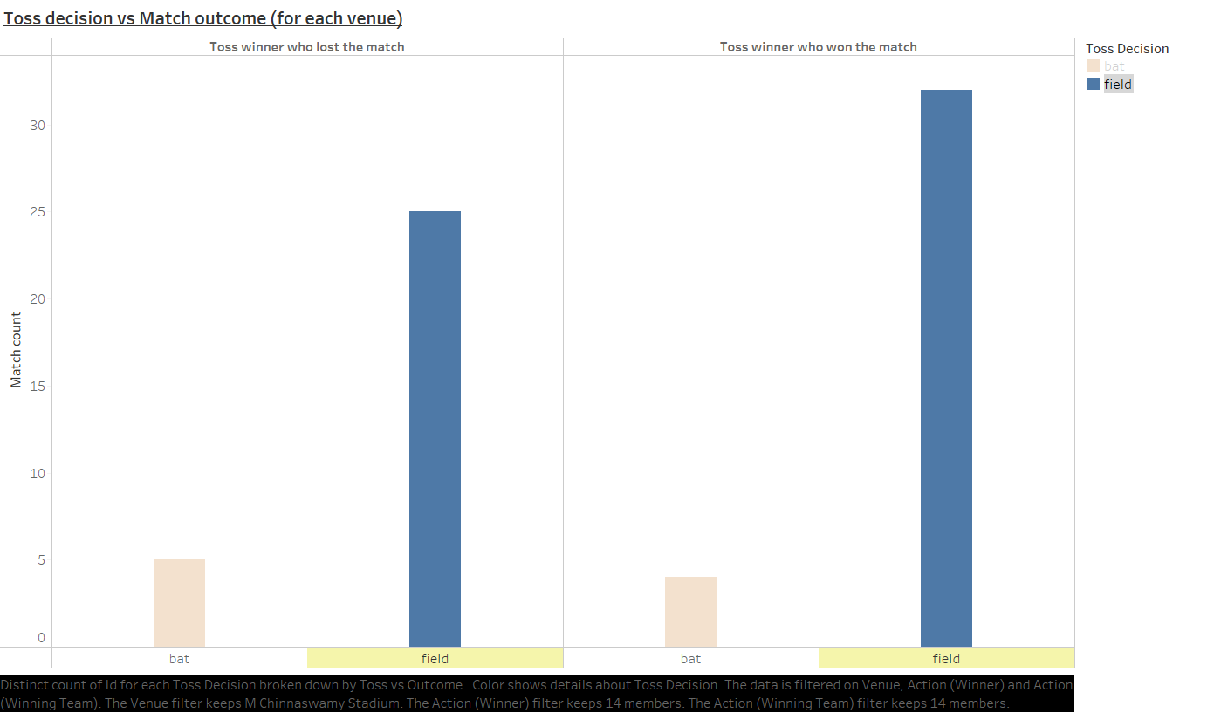

Slide 14
