Slide 1

IILM UNIVERSITY, GREATER NOIDA
INTERNSHIP REPORT PRESENTATION
Social Media Marketing Internship
InAmigos Foundation
Vishesh Kumar Bachchas Roll No. 25SCS1003005456 B.Tech – CSE (AI & ML)
Semester – 3rd
Session – 2025-29 05 June 2026 – 19 June 2026
01

Slide 2
ABOUT THE STUDENT
Candidate Profile
ID
Roll Number
S
Internship Role
25SCS1003005456
Social Media Marketing Intern
U
Institute
I
Organization
IILM University, Greater Noida, U.P.
InAmigos Foundation
A
Programme
C
Duration
B.Tech – Computer Science & Engineering (AI & ML)
05 June – 19 June 2026
The internship placed a technical student in a communication-led environment, connecting digital execution with social impact.
InAmigos Foundation • Social Media Marketing Internship
02

Slide 3
ABOUT THE ORGANIZATION
InAmigos Foundation
A social-impact organization using community action, volunteerism and digital communication to support causes across India.
S
Project Seva
E
Project BachpanShala
J
Project Jeev
Food and clothing support for people in need.
Education support for underprivileged children.
Animal welfare, rescue, protection and feeding.
U
Project Udaan
P
Project Prakriti
V
Project Vikas
Women empowerment through skills and independence.
Environmental conservation and sustainability.
Skill development and employability support.
Official website: inamigosfoundation.org.in
InAmigos Foundation • Social Media Marketing Internship
03

Slide 4
INTERNSHIP FOCUS
From Social Posts to Social Impact
The practical challenge
Internship response
Social-impact communication needs more than posting. It must attract attention, encourage interaction, explain a cause clearly, and move people toward participation or support.
UNDERSTAND
Read the objective and audience.
↓
ENGAGE
Add context-aware interaction.
↓
CREATE
Build useful educational material.
↓
AMPLIFY
Extend cause visibility.
↓
DOCUMENT
Capture proof and submit clearly.
InAmigos Foundation • Social Media Marketing Internship
04

Slide 5
PROJECT OBJECTIVES
What the Internship Set Out to Achieve
•
Organic Engagement
•
Cause Communication
•
Educational Content
Practice meaningful interaction and audience-response techniques.
Support environmental and social-impact messaging.
Create a learner-focused resource for children.
•
Fundraising Outreach
•
Digital Documentation
•
Professional Execution
Communicate donation opportunities to a personal network.
Organize evidence, screenshots and submissions.
Follow briefs, deadlines and communication workflows.
The emphasis was practical execution rather than theoretical observation.
InAmigos Foundation • Social Media Marketing Internship
05

Slide 6
WORKSTREAM 01
Organic Engagement & Reach Practice
Assessment 1 converted simple platform interaction into hands-on practice with organic engagement.
• Reviewed assigned cause-related content
• Wrote context-aware comments
• Supported the original message through interaction
• Captured and compiled evidence for submission
InAmigos Foundation • Social Media Marketing Internship
06

Slide 7
WORKSTREAM 02
Green Mission – Environmental Awareness
Plant → Document → Amplify
The assignment connected a real-world environmental action with digital storytelling and campaign participation.
1
Plantation
2
Interaction
3
Amplification
Carry out and document the green action.
Share a clear plant photo during the discussion.
Publicly share the message with campaign hashtags.
#InAmigos #GreenMission #TreeOfLife #PlantHopeGrowFuture
Evidence note: plantation video was not supplied for this report; the slide documents the assigned workflow without inventing reach metrics.
InAmigos Foundation • Social Media Marketing Internship
07

Slide 8
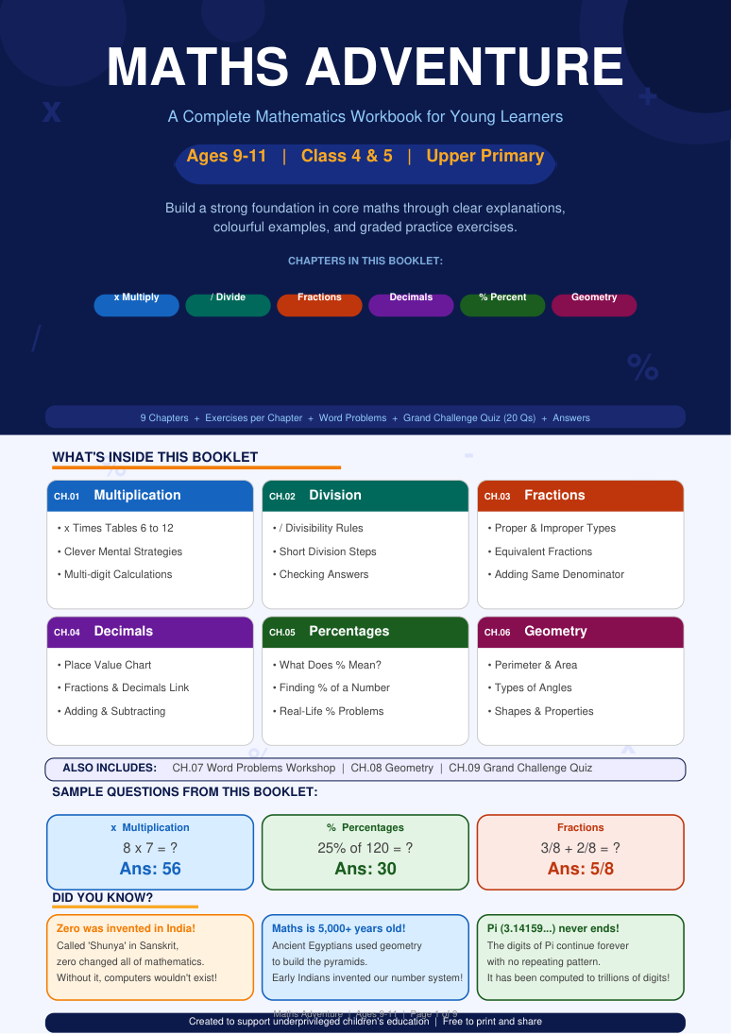
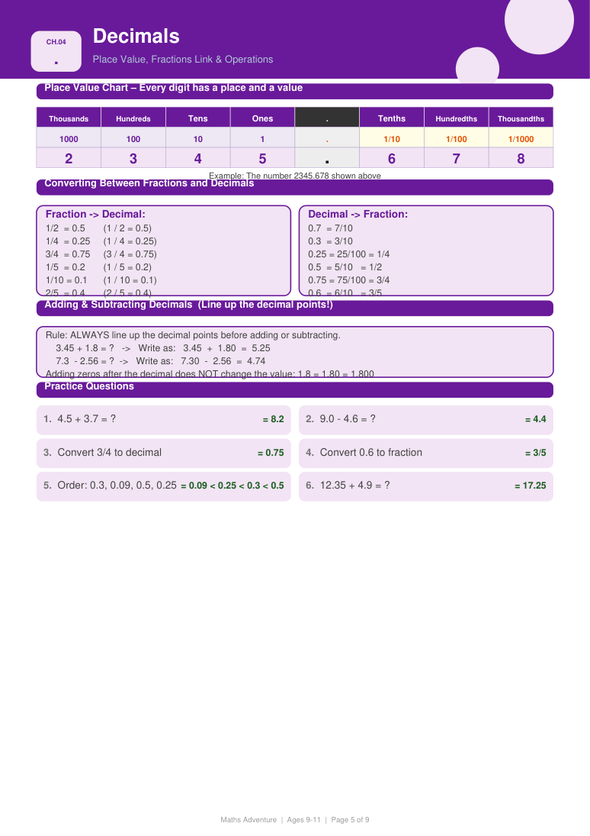
WORKSTREAM 03
Maths Adventure – Educational Content
A reusable learning resource
Designed for upper-primary learners with simple explanations, worked examples, graded practice, real-life problems, self-checking answers and an engaging challenge section.
M
Core Topics
G
Core Topics
Multiplication • Division • Fractions
Decimals • Percentages • Geometry
Interpretation: audience definition + instructional design + content creation.
InAmigos Foundation • Social Media Marketing Internship
08

Slide 9
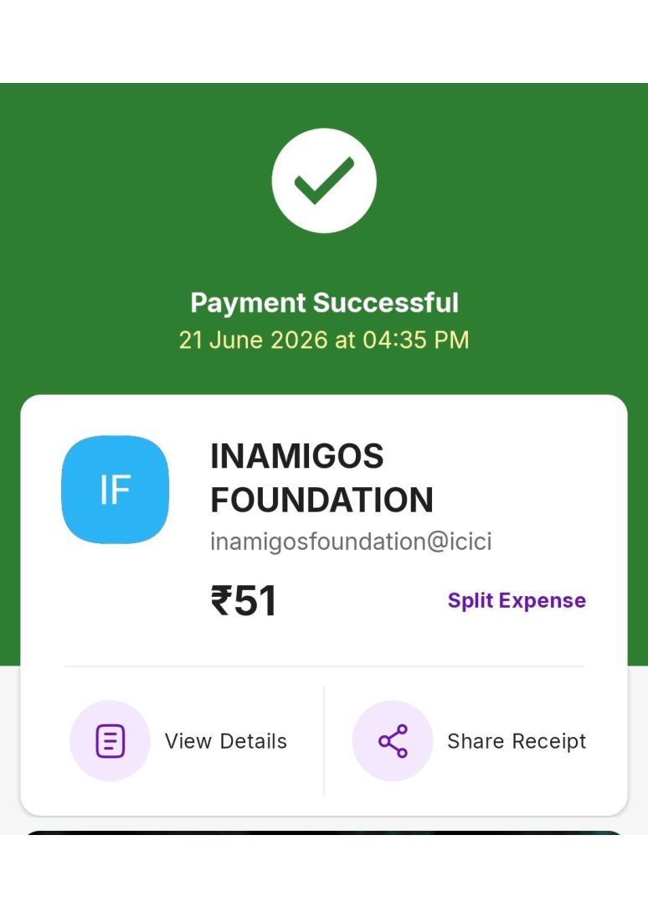
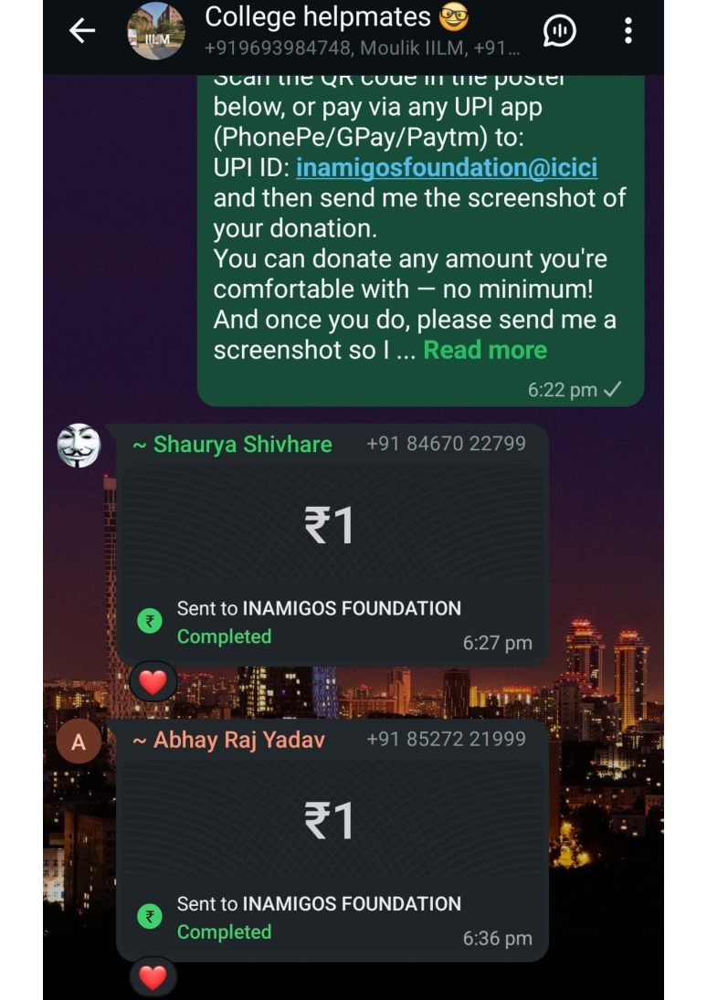
WORKSTREAM 04
Fundraising & Donor Outreach
Turning personal networks into support
The fundraising task introduced a direct-response communication workflow:
1. Identify reachable supporters
2. Communicate the purpose of the request
3. Encourage voluntary participation
4. Collect confirmation evidence
The focus was on respectful outreach, clarity of purpose and evidence-based documentation.
InAmigos Foundation • Social Media Marketing Internship
09

Slide 10
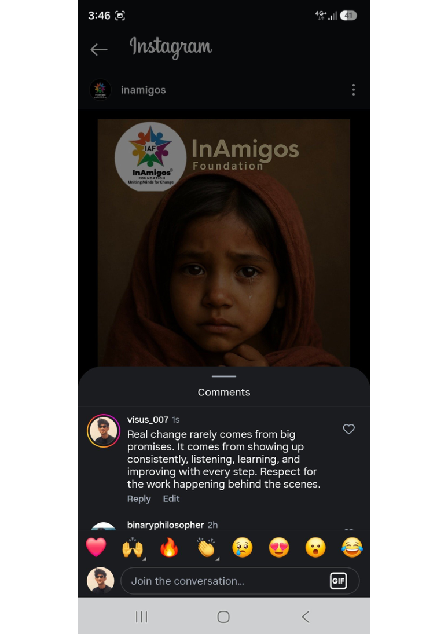
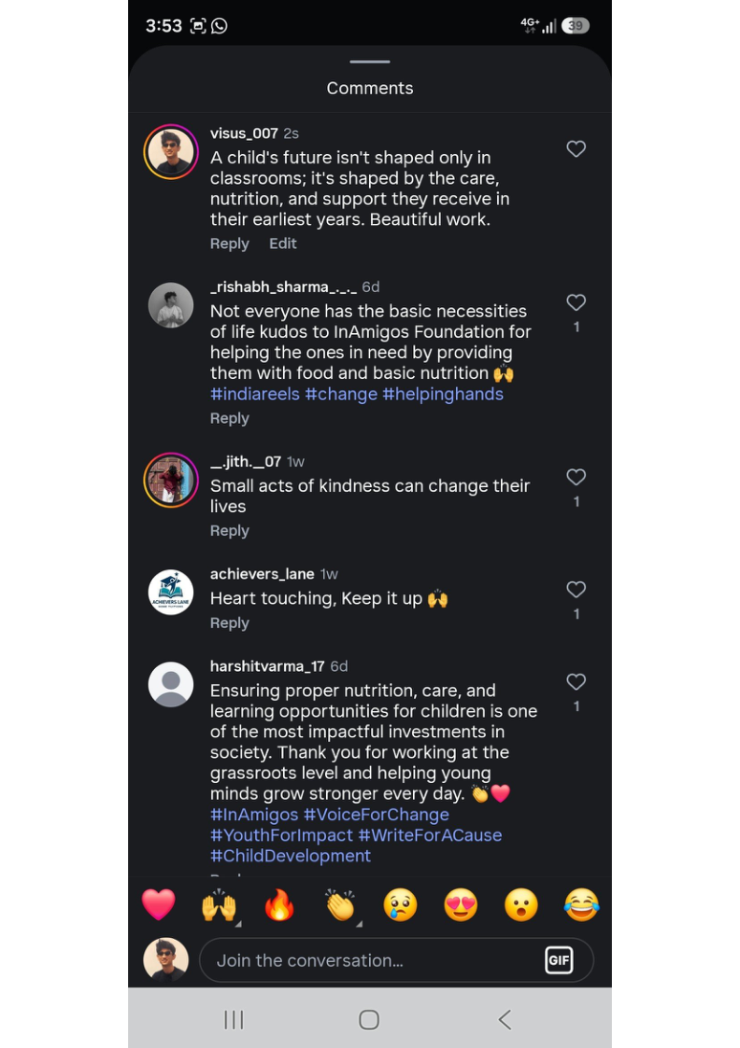
WORKSTREAM 05
Community Engagement Round
Cause-based conversation
A second engagement round covered themes such as:
• environmental responsibility
• compassion and dignity
• education and opportunity
• nutrition and childhood care
• volunteerism and community service
Comments were written to reinforce the central message of each post rather than simply praise it.
InAmigos Foundation • Social Media Marketing Internship
10

Slide 11
OUTCOMES
Skills & Capabilities Developed
✓
Organic Engagement
✓
Audience Awareness
✓
Content Design
Context-aware interaction and concise public communication.
Tone and message adapted to content and cause.
Structured educational resource development.
✓
Campaign Thinking
✓
Outreach
✓
Documentation
Linking action, awareness, interaction and support.
Cause-based direct-response communication.
Evidence capture, organization and submission discipline.
Overall learning: social media marketing can function as an engine for awareness, participation and social impact.
InAmigos Foundation • Social Media Marketing Internship
11

Slide 12
CONCLUSION
From engagement to impact.
The internship provided practical exposure to organic engagement, cause communication, educational content, fundraising outreach and digital documentation — turning social media activity into structured social-impact work.
Thank You
Vishesh Kumar Bachchas Roll No. 25SCS1003005456 IILM University, Greater Noida
12

