Slide 1

Web-based Volume Rendering and 3D/4D Visualization of Model Forecast
Organization: Indian Space Research Organization (ISRO)
Problem Statement: The numerical weather models are used for generating forecast, these model forecast contains 4D information (i.e., Latitude, Longitude, Height/pressure and Time). These model forecasts are gridded at a defined
sampling interval, and are very useful for planning and decision supports. WebGL is a JavaScript API for rendering high-performance interactive 3D and 2D graphics. The participants must develop a web-based tool for 3D/4D visualization of model forecast.
Team Name: Heisenbugs Problem Statement Code: NM389 Team Leader Name: Vishnu Kumar College Code : 1-3511920870
4-D information
Latitude
Longitude
Pressure
Time
Numerical
Weather Model
Problem
Model Forecast
Types
Air Quality modelling
Climate Modelling
Wind Modelling
Wildfire Modelling
Ocean surface Modelling
Temperature Modelling
Humidity Modelling
Pressure Modelling
Model
Forecast
Web-based
Model
For Model
Forecast
Visualization using WebGL

Slide 2
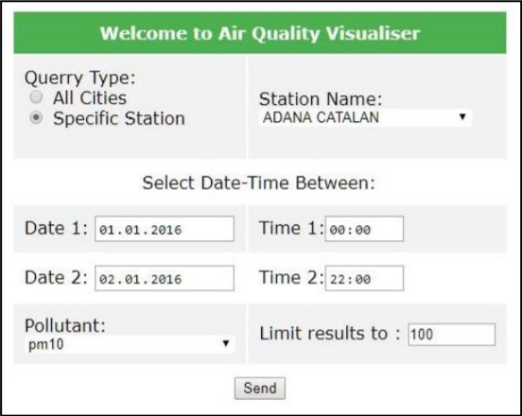
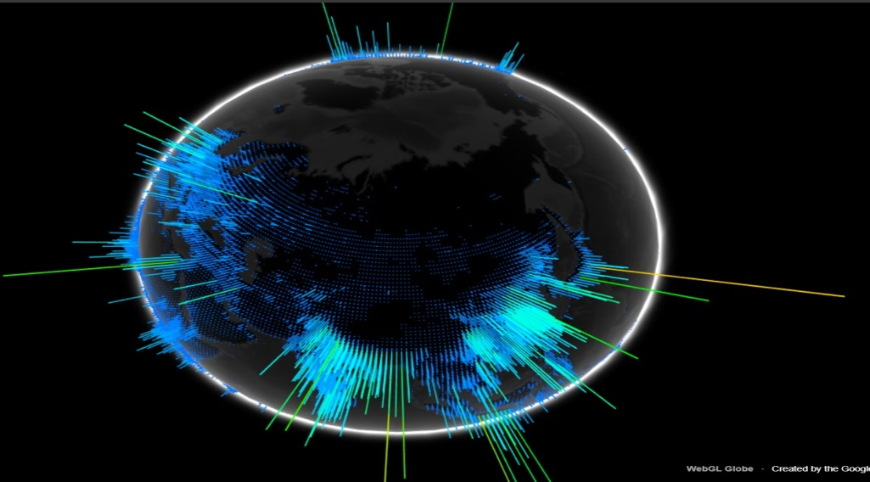
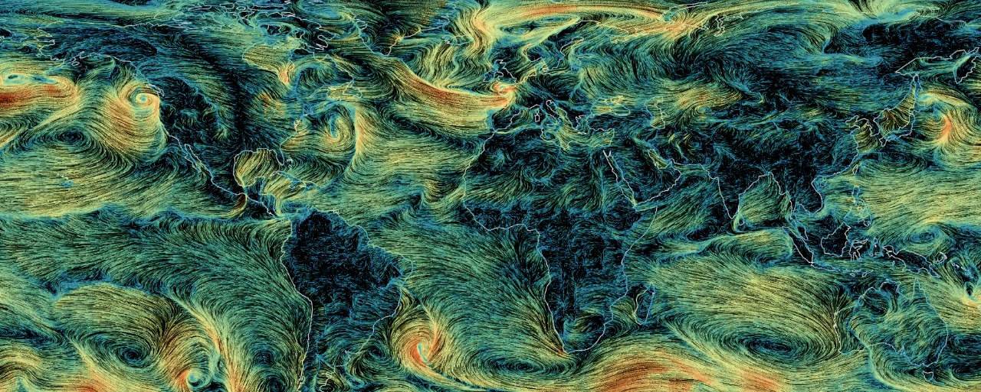
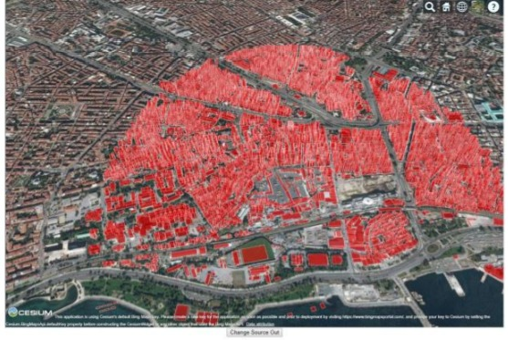
Implementation Idea
Abhigyataa is a web based tool for 3D/4D visualization of model forecast implemented through web application which performs volume rendering i.e. gives 2D visualization of the data on the map, 3D like visualization on the globe both in space and space/time.
Model forecasts are graded at a defined sampling interval.
Useful for planning and decision support due to visual tools given.
Abhigyataa provides a multi model visualization tool and provide real-time visual data using WebGL and OpenGL.
Forecast model ranges from
Air quality visualizer
Wind map
Wild fire visualization
Ocean Surface modeling
Uses web globe model representation to depict 4D data.
Portal helps government agencies in making environment policies.
Features
Spatial Searching Algorithm is used for visualization using WebGL.
Efficient Algorithm like K-Nearest Neighbour Algorithm.
Range queries in trees and KNN queries.
Compatible with browser.
No need of running heavy prediction models (cloud based model running)
Provides Multi-touch environment
Provide browser extension for parallel-processing.
Multi-colour plotting of data for clear understanding.
Web-scraping in future can be inculcated on the model integrated with the website at business level to solve queries submitted by various organizations and speed can be enhanced through multi-threading.

Slide 3
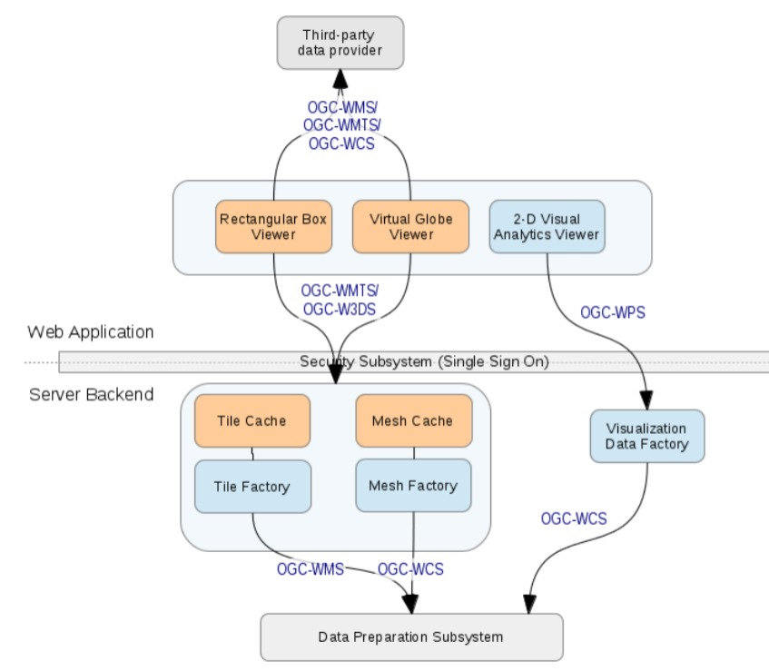
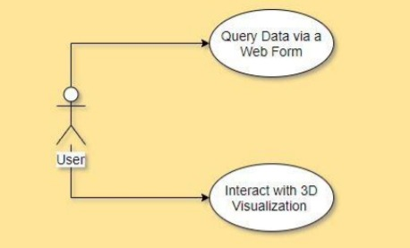
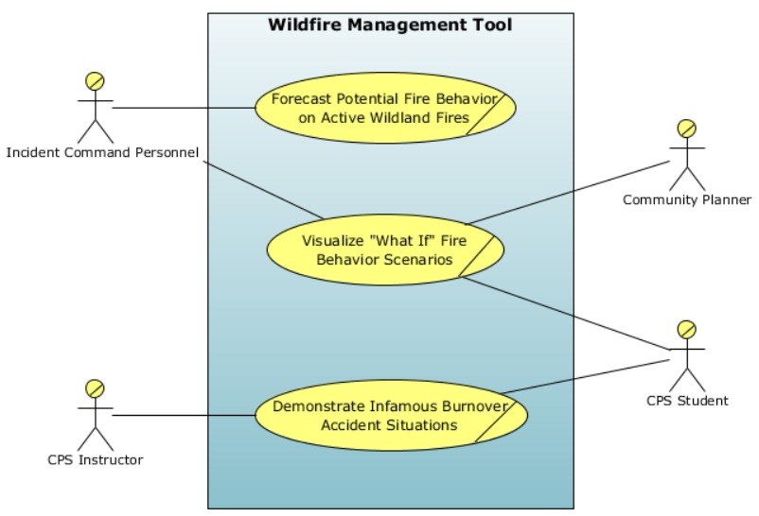
SYSTEM ARCHITECTURE
USE CASE DIAGRAMS
WIND MAP COLOURING MODULE
Preprocessing using NumPy and Pandas
Preprocessed Data
Data
Encoded using label encoder
Shader( )
JSON file
Manipulate data on GPU side
Binary Format Data
WILDFIRE MANAGEMENT MODULE USE CASE
P
Load on GPU
DATA FLOW DIAGRAM OF WORKING
Spatial Searching Algorithm
Query data
Web Form
Calculate
New Position based on Wind Velocity
Numerical Weather Model
Predicts the features
Interacts with visualization
Our Tool
Website and Other API
Till all points are plotted
Virtual Globe Viewer
RGBA
Visualization
3D Visualization On Map

Slide 4
Technology Stack
Distributed Model
WebGL( JavaScript API), OpenGL and AJAX.
Python Environment : time, os, url, re, math, bs4, requests, threading, pathlib, Json
Extension + Web Application Frontend: HTML,CSS,JavaScript, Bootstrap.
Extension + Web Application Backend: Django Framework ,REST API.
Cesium JS and Spatial Algorithm.
Machine Learning, Data Visualization: TensorFlow, Scikit Learn, Pandas, Numpy, Matplotlib.
Technologies: WebGL JavaScript API, Web Development, Multi-Threading, Machine Learning.
Air Quality Modelling: Help the government to implement new environment policies. Can also aid in the analysis of the city pollution.
Wildfire Visualization: Improves safety of firefighter, promotes the principles of tenets of Campbell Production System (CPS) predicting nature of wildfire.
Wind Map: Help in analysing the cycle of monsoon, thus can aid in agricultural planning, visual model for efficient analysis.
Ocean Surface Modelling: Can be used in Military Navy operations and in trades carried out by Merchant Navy in navigation to check if depth is appropriate to venture out or not.
Climate Modelling: Can predict wider conditions thus can aid in making economical choices relating to crops, storage and inventory, household expenditure pertaining to clothing and lodging etc. It can also visualize overall effect on the environment.
REST API: Query Response Model for platform independence, portability and scalability. It also offers a customizable and flexible development, and can be used as a service oriented product.
Browser Extension to provide parallel processing.
Web Application Approach: No need of installing/updating software on their local machine.
Performance of the system: Speed of data access and data manipulation.
Time Slider: Allow easy interpretation of where and when data is available.
Several illustration facilities
2D view on the map
Virtual Globe
3D views both in space and space/time.
Analytic tools to display time-series at selected points.
Can facilitate the dissemination of spatial high volume data through efficient visualization.
Visualization of temporal/spatial of available data-sources in one application
Multiplier and distributed system can enhance system efficiency.
UI of the system will be enhanced by providing web-map based information seeking tool where the user can select an area from the map and send a query to the system using coordinates of the bounding box.
Made the Application by extending on the research papers studied.
Conclusion
Use Cases and Utilities

