Slide 1
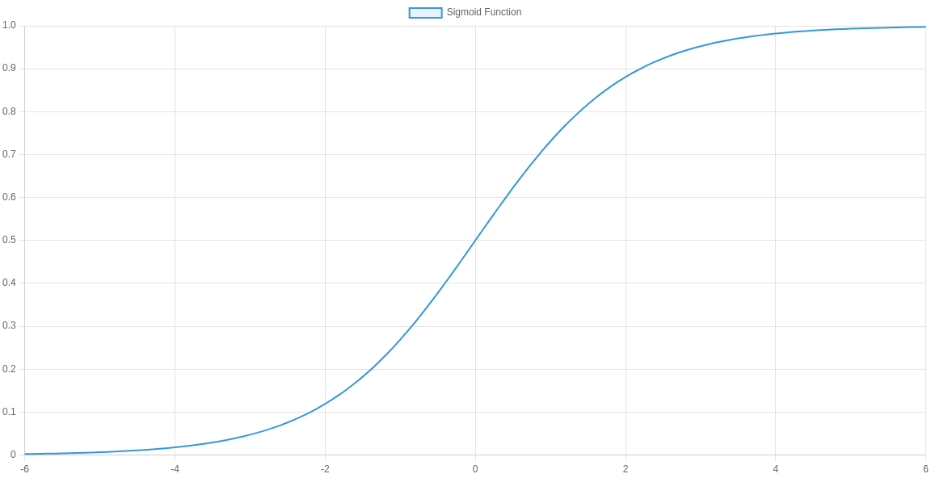
Logistic Regression: From Fundamentals to Deployment
ARYAN Balani
Date: 22 July 2025
A comprehensive overview from fundamentals to implementation, evaluation, and real-world applications
Mad with Genspark

Slide 2

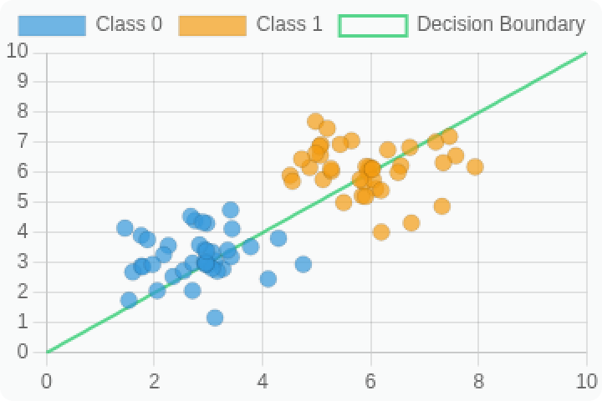

Introduction to Logistic Regression
What is logistic regression? A statistical method for binary classification that estimates the probability of an event occurring based on given independent variables.
Types of problems it solves: Binary classification problems (yes/no, true/false, 0/1), and can be extended to multi-class classification.
Why is it important? Foundation of many complex ML algorithms, easily interpretable, computationally efficient, and provides probability scores.
Despite its name, logistic regression is used for classification, not regression problems.

Slide 3

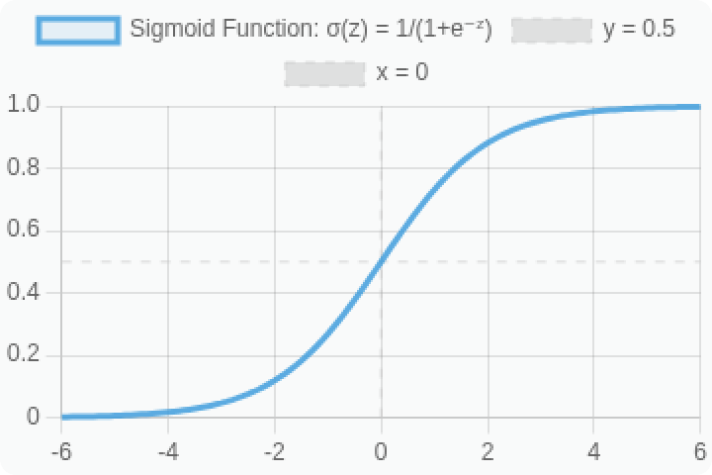

Mathematical Foundation & Sigmoid Function
Mathematical form: Logistic regression models the probability that Y=1 given features X.
P(Y=1|X) = σ(β₀ + β₁X₁ + β₂X₂ + ... + βₙXₙ)
Log-odds (logit): The natural logarithm of the odds that Y=1.
logit(p) = ln(p/(1-p)) = β₀ + β₁X₁ + ... + βₙXₙ
This transformation creates a linear relationship with the features.
Sigmoid function: Transforms any real-valued number into a probability between 0 and 1.
σ(z) = 1/(1+e⁻ᶻ)
Where z = C + m₁X₁ + m₂X₂ + ... + mₙXₙ

Slide 4

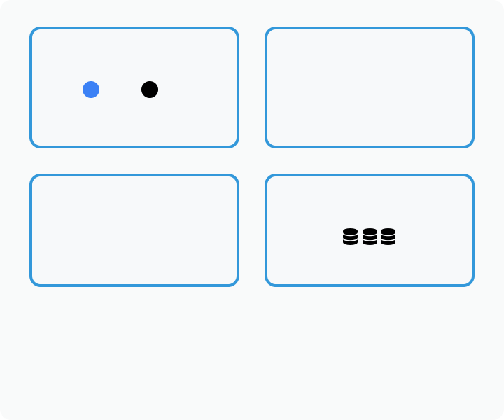

Assumptions of Logistic Regression
Binary/Categorical Dependent Variable: The outcome variable must be discrete, typically binary (0/1). For multi-class problems, extensions like multinomial logistic regression are used.
Binary Outcome
= 0 = 1
No Multicollinearity
X₁ ⊥ X₂ ⊥ X₃
No Multicollinearity: Independent variables should not be highly correlated with each other. High correlation can lead to unstable estimates and large standard errors.
Linear Log-Odds
log(p/(1-p)) = β₀ + β₁X₁
+ ... + βₙXₙ
Large Sample
Linearity of Independent Variables and Log Odds: The log-odds (logit) of the outcome should have a linear relationship with the independent variables.
Large Sample Size: Requires a sufficiently large dataset, especially if the number of predictors is high, to ensure reliable estimates and adequate statistical power.
Unlike linear regression, logistic regression doesn't require homoscedasticity, normality of errors, or linearity between dependent and independent variables.

Slide 5
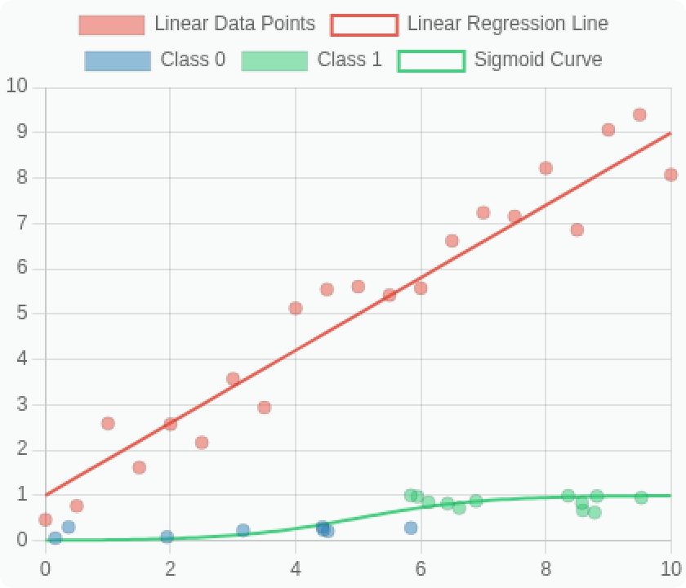
Linear vs. Logistic Regression
Aspect | Linear Regression | Logistic Regression
Purpose | Predict continuous values | Classify binary outcomes
Continuous values (any range)
Output
Probability values (0 to 1)
Function
y = m x + c
p = 1/(1+e^{-(y)})
Decision
No boundary (regression line)
Classification threshold (typically 0.5)
Boundary
Cost Function
Mean Squared Error (MSE)
Log Loss (Cross-Entropy)
Predicting house prices, sales forecasting, continuous variable estimation
Spam detection, disease diagnosis, customer churn prediction
Use Case

Slide 6
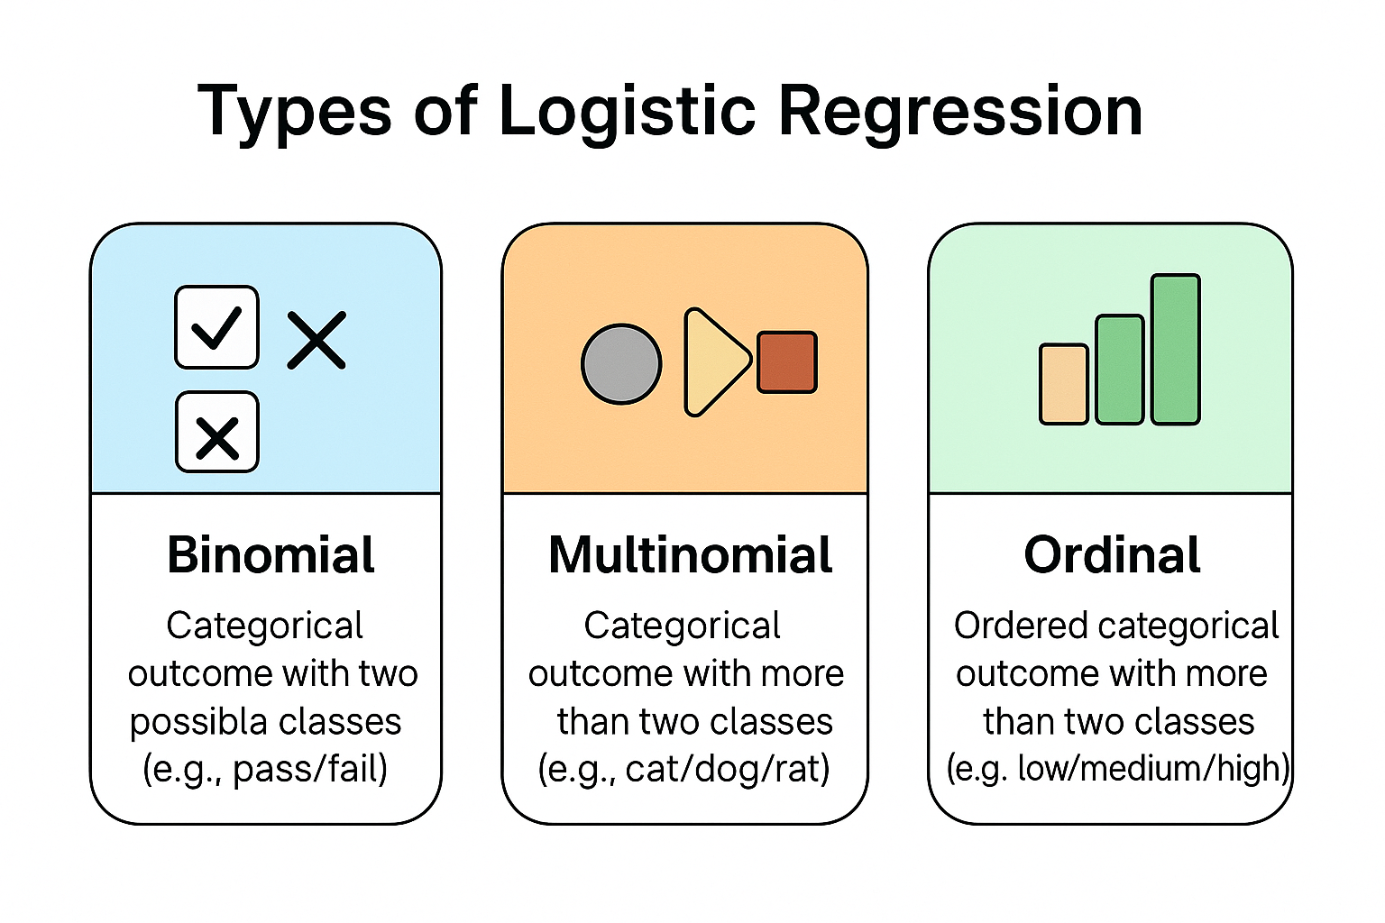
Types of Logistic Regression
Binomial Logistic Regression:
Used when the dependent variable has two classes (e.g., 0/1, yes/no).
Common in binary classification tasks like spam detection or loan approval.
Multinomial Logistic Regression:
Used when the dependent variable has more than two unordered categories.
Example: Predicting mode of transport (car, bus, train).
Ordinal Logistic Regression:
Used when the dependent variable has more than two ordered categories.
Example: Customer satisfaction (low, medium, high).
Preserves the rank/order among categories.

Slide 7



Model Training & Implementation
Data Preparation: Cleaning data (handling missing values, outliers), feature scaling (standardization or normalization), categorical encoding (one-hot, label encoding), feature selection.
Logistic Regression
Implementation Flow
Data Collection & Exploration
Train/Test Split: Typically 70-80% training data, 20-30% test data. Stratified sampling ensures class balance. Consider cross-validation for more robust evaluation.
Data Preprocessing & Feature Engineering
Train/Test Split
Training Process: Initialize model parameters, feed training data, optimize weights using gradient descent or variants (SGD, Adam), adjust regularization parameters (L1/L2) to prevent overfitting.
Model Training & Parameter Tuning
Model Evaluation
Prediction Output: Model outputs probability scores (0-1), classification threshold (default 0.5) determines final class. Threshold can be tuned based on precision/recall requirements.
Made with Genspark
7

Slide 8
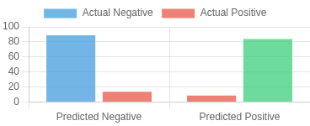
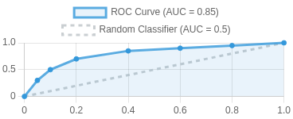

Evaluation Metrics
Accuracy: Proportion of correct predictions (TP+TN)/(TP+TN+FP+FN). Misleading for imbalanced datasets.
Confusion Matrix
Precision: Proportion of positive identifications that were actually correct. TP/(TP+FP). Focuses on false positives.
Recall (Sensitivity): Proportion of actual positives correctly identified. TP/(TP+FN). Focuses on false negatives.
ROC Curve
F1-Score: Harmonic mean of precision and recall. 2* (Precision*Recall)/(Precision+Recall). Balances both metrics.
ROC Curve & AUC: Plots True Positive Rate vs False Positive Rate at various thresholds. AUC measures the entire area under the curve (0.5=random, 1.0=perfect).
Choosing metrics depends on your problem context: precision for minimizing false positives, recall for minimizing false negatives.

Slide 9
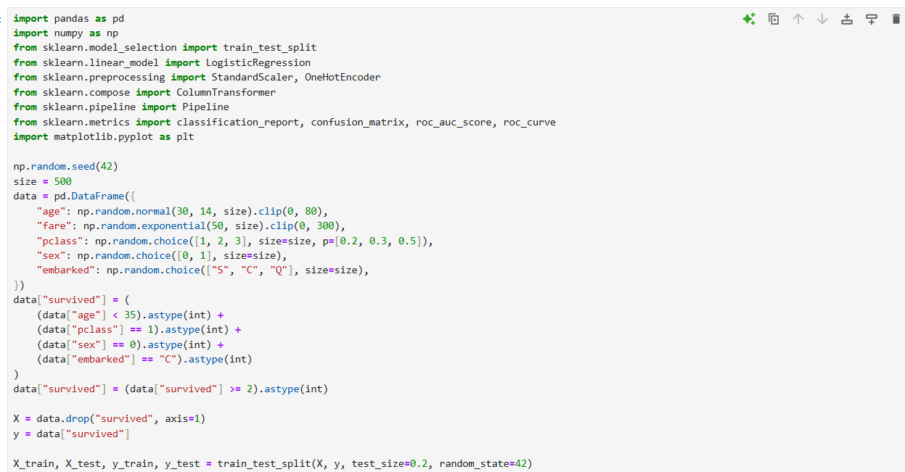
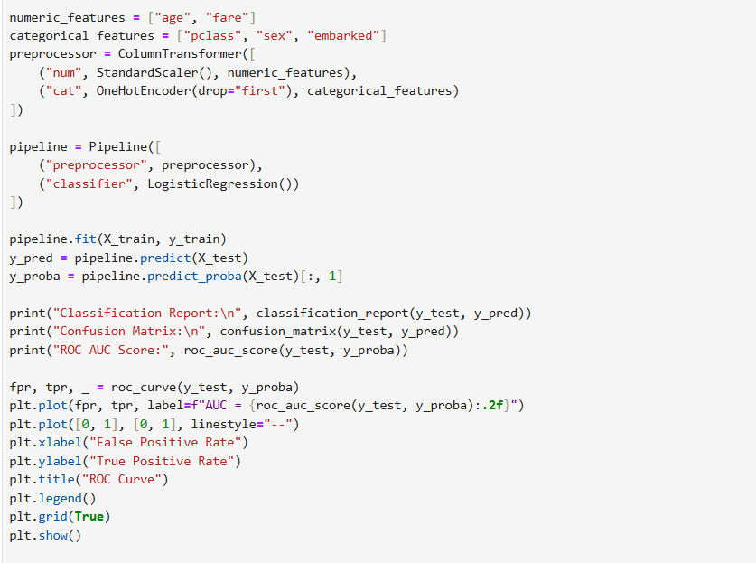
Code Snippets

Slide 10
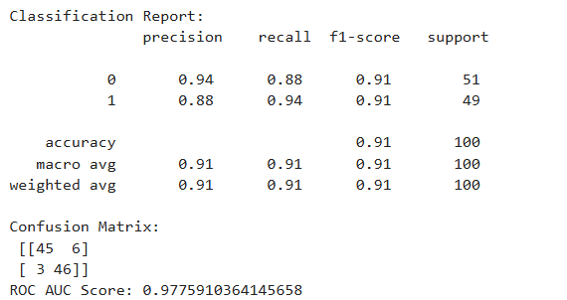
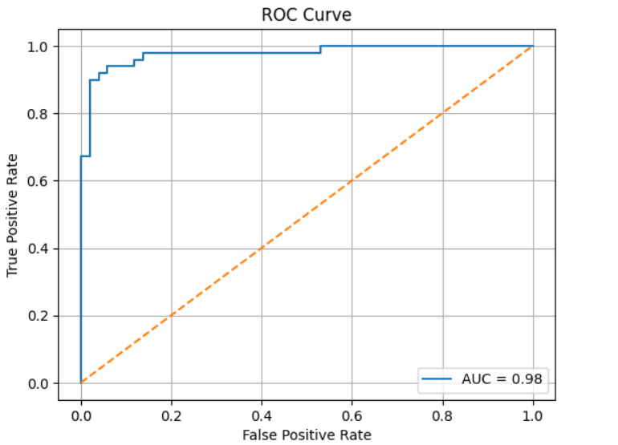
Code Snippets

Slide 11

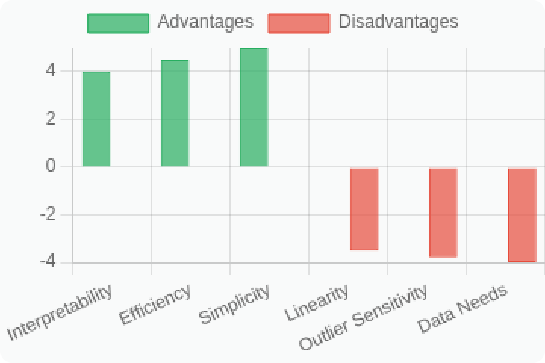




Advantages and Disadvantages
Advantages
Simplicity: Easy to implement, understand, and interpret the results
Efficiency: Computationally less intensive than many other algorithms, trains quickly
Interpretability: Coefficients represent feature importance and direction of influence
Disadvantages
Linear Decision Boundaries: Cannot handle complex non-linear relationships without transformations
Sensitive to Outliers: Extreme values can significantly impact model performance
Large Dataset Requirement: Needs sufficient data for reliable probability estimates
Made with Genspark
11

Slide 12




Real-World Applications
Medical Diagnosis: Predicting disease occurrence, patient outcomes, or risk classification based on medical indicators (e.g., diabetes prediction, cancer detection)
Credit Scoring: Determining loan approval likelihood by classifying customers into "good" or "bad" credit risks based on financial history
Marketing: Customer churn prediction, identifying potential customers for targeted campaigns, purchase likelihood modeling
Spam Detection: Classifying emails as spam or legitimate based on content features and metadata
Other Applications: Fraud detection, sentiment analysis, election outcome prediction, quality control in manufacturing

Slide 13

Summary & Key Takeaways
Logistic regression is foundational for binary classification problems despite its name containing "regression"
Uses sigmoid function to transform linear predictions into probability values between 0 and 1
Always check assumptions: binary outcome, independence, linearity of log-odds, sufficient sample size
Evaluate with appropriate metrics: accuracy, precision, recall, F1-score, and ROC AUC
Excellent interpretability with coefficients representing feature importance and direction

