Slide 1
Advance Business Analytics
DATA SCIENCE PROJECT IN PYTHON
Team Members Prina Shah 23 Harsha Bharuka 38 Aditi Deshpande 54 Vishal Talreja 59

Slide 2
Aim
To be able to implement data science and scientific libraries in python on a real world dataset
Analyse data using python libraries like pandas and numpy
Learn and create data visualizations using matplotlib and the seaborn modules with python
This data can be used for a lot of purposes such as price prediction to exemplify the use of linear regression in machine learning

Slide 3
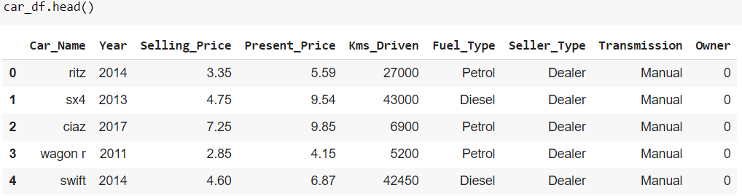
Dataset - Vehicle Price Prediction Reason For Choosing The Dataset
Https://www.Kaggle.Com/nehalbirla/vehicle-dataset-from-cardekho
Covid decreased the income earning capabilities of the families due to which they resorted to second hand cars instead of brand new cars
The relevance of this dataset in current times encouraged us to conduct this study
This dataset contains information about used cars listed on www.Cardekho.Com
This data can be used for a lot of purposes such as price prediction to exemplify the use of linear regression in machine learning

Slide 4
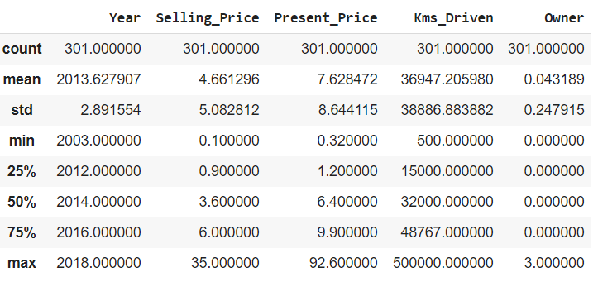
Descriptive Analytics On Data
The describe () function computes a summary of statistics pertaining to the data frame columns
This function gives the mean, standard deviation and IQR values
It excludes the character columns and given summary about numeric columns

Slide 5
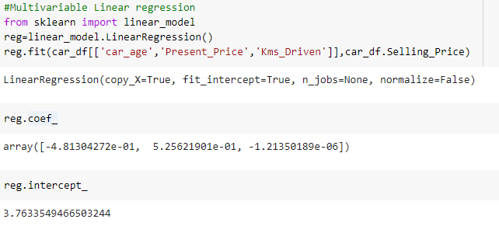

Building a ML Model Using Linear Regression
Linear regression is a method for discovering the relationship between variables in the dataset
Dependent variable - selling price
Independent variables- age of the car, current market price and kilometres driven

Slide 6

Conclusion
Our python linear regression model shows R² value of 85% of the selling price prediction of cars on cardekho.com
This will help us determine our profit component pre sales. Due to which we can work on cost optimisation and minimization

Slide 7
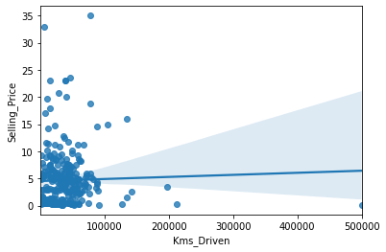
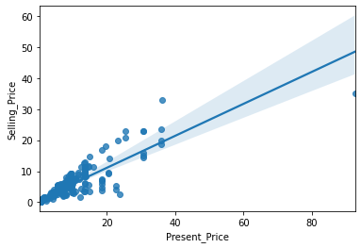
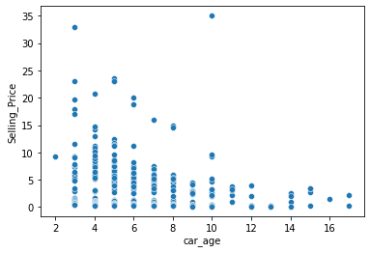
Insights From Analysis
A buyer will pay a higher price for a comparatively lesser driven car. Hence the lower the kms driven the higher the selling price.
Present price of a car plays an important role in predicting Selling Price, One increases the other gradually increases.
Here the graph shows that newer the car, higher is the selling price. Car age is affecting negatively as old car decreases the selling price.

Slide 8
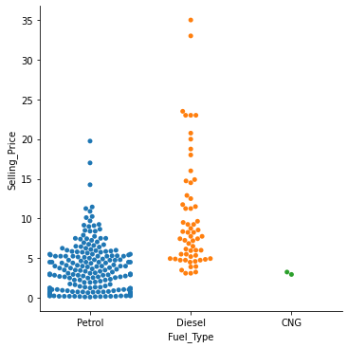
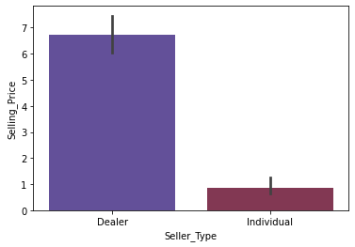
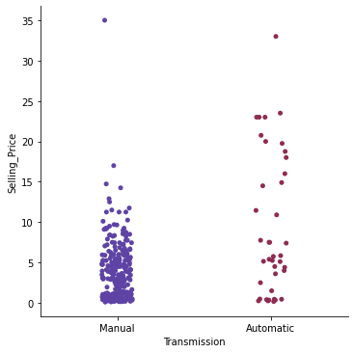
Insights From Analysis
Selling Price of cars with Fuel Type of Diesel is higher than Petrol and CNG
Cars sold by Individual tend to get less Selling Price when sold by Dealers
Car of Manual type is of less priced whereas of Automatic type is high

Slide 9
Future Scope
The science of predictive analytics can generate future insights with a significant degree of precision
With the help of sophisticated predictive analytics tools and models in python, any company can now use past and current data to reliably forecast trends and behaviors in milliseconds, days, or years into the future

Slide 10

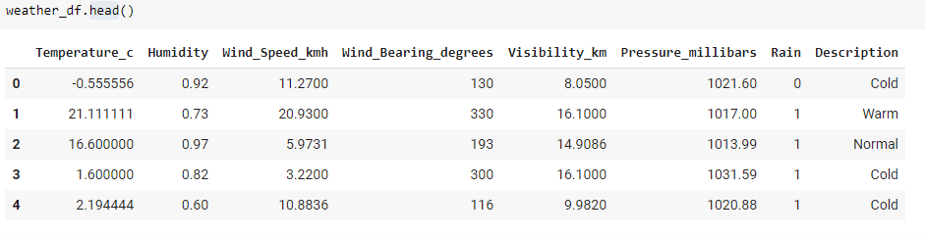
Dataset - Weather Prediction Reason For Choosing The Dataset
Https://www.Kaggle.Com/zakriarehman/weather-data-for-linear-regression
The data set consists of 4999 row and 8 columns
The head function used gives us the data of the first N rows and all columns
Reliability of the weather prediction not only extends to income earning in India but also affects government revenue
It helps in avoiding natural calamities like cyclones and typhoons to save life and property

Slide 11
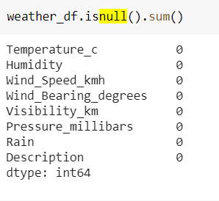
Missing Values
There are no missing values in the dataset used

Slide 12
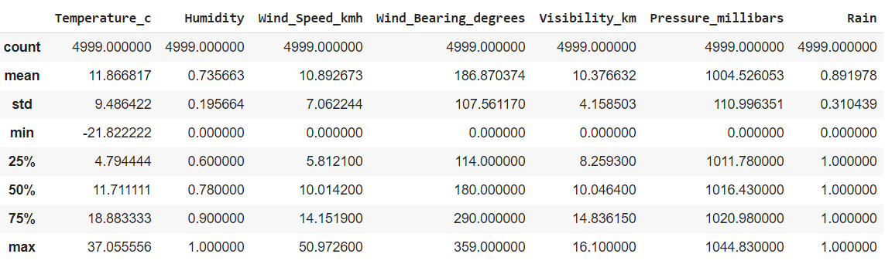
Descriptive Analytics On Data
The describe() function computes a summary of statistics pertaining to the Data Frame column
A low standard deviation of humidity i.e. 0.19 here implies that most of the values in the dataset for humidity are close to the average of humidity which is 0.73
While a high standard deviation of wind bearing degrees i.e. 107.56 implies that the values in the data set are more spread out

Slide 13
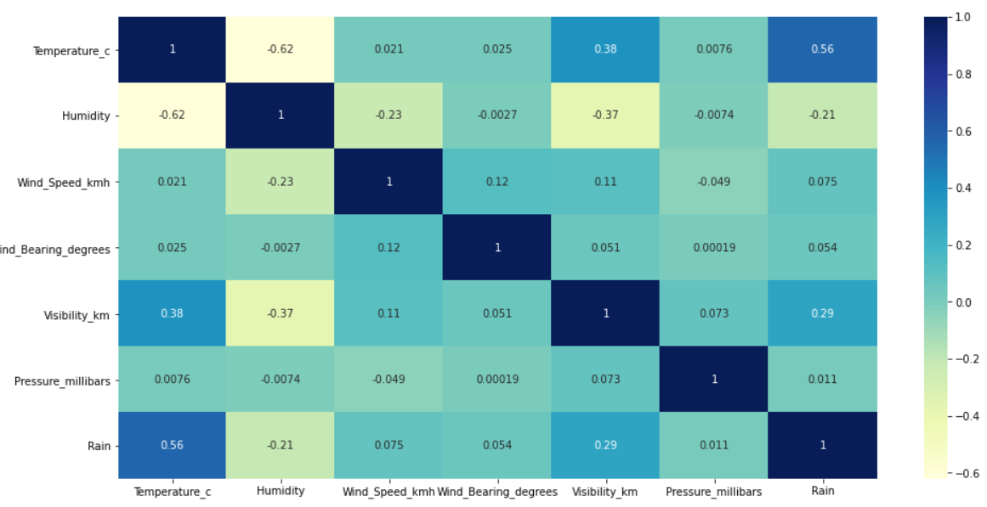
Correlation Matrix
From the matrix, we get highest correlation of temperature with humidity
We can also consider visibility km and rain for multivariable linear regression

Slide 14
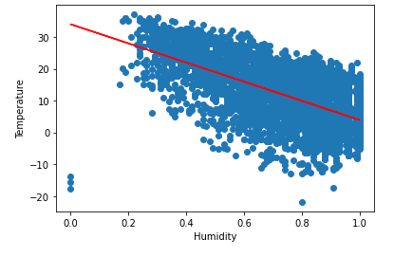
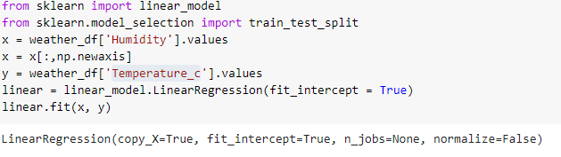
Building A ML Model Using Linear Regression
Single Linear Regression
Dependent Variable - Temperature
Independent Variable - Humidity

Slide 15
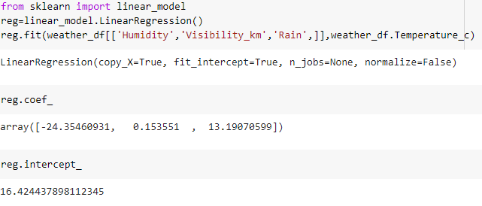
Building A ML Model Using Linear Regression
Multivariable Linear Regression
Dependent Variable - Temperature
Independent Variable – Humidity, Visibility_Km and Rain

Slide 16

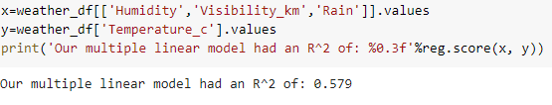
Conclusion
Our single linear regression model shows R² value of 38.5% for weather prediction
Our multiple linear regression model shows R² value of 58% for weather prediction

Slide 17
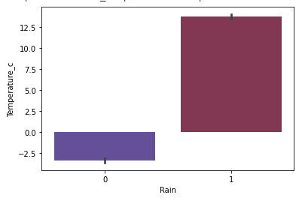
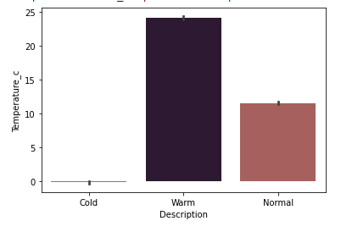
Insights From Analysis
Higher the density of rain lower the temperature
Warm - High Temperature
Normal - Average Temperature
Cold - Zero Or Negative Temperature

Slide 18
Future Scope
Weather forecasting is the application of science and technology to predict the conditions of the atmosphere for a given location and time
In a country like India, 50 % of the population is directly or indirectly dependant on weather forecasting for an efficient yield and daily income
The commodities, futures and forwards market worth USD 37,029 million derives its speculative prediction based on the weather forecasting
It also helps prevent unforeseen damage by act of nature to save life and property

Slide 19
THANK YOU

