Slide 1
Movie app
Vishal Reddy Bandari

Slide 2


Movie app
User Stories
Functional Requirements
Microservices Decomposition
Architecture Diagram
Data Model Diagram
Data Flow Diagram
Tools & Technologies

Slide 3
USER STORIES
User should be able to register with the application so that user can login and use the functionalities of the application.
User should be able to login with username and password in order to access the functionalities of the application.
User Should be able to view movies using Third Party API.
User Should be able to save movies to a Wishlist so that user can access them later.
User should be able to access movies save them to Wishlist and Delete movies saved to Wishlist

Slide 4
Functional Requirements
Aws Cloud
Angular
API Gateway
Hosts the Entire Application Infrastructure
User interface for movie application
Manages and routes API requests between the frontend and microservices

Slide 5
FUNCTIONAL REQUIREMENTS
Eureka server
Config server
Microservices
Service Registry for Microservices. Helps microservices find and communicate with each other.
Manages configuration properties for Microservices
User Profile Service
Authentication Service
Movie Service
Wishlist Service

Slide 6
FUNCTIONAL REQUIREMENTS
databases
Kafka Message Bus
MySQL used by User Profile Service, Authentication Service, and MongoDB for Wishlist Service.
Facilitates communication between microservices, enabling asynchronous processing.

Slide 7
Decomposition
Microservices | Database
User Login Service | MySQL
Authentication Service | MySQL
Movie Service | External Movie API
Wish List | MongoDB
API Gateway | Manages & Routes API requests

Slide 8
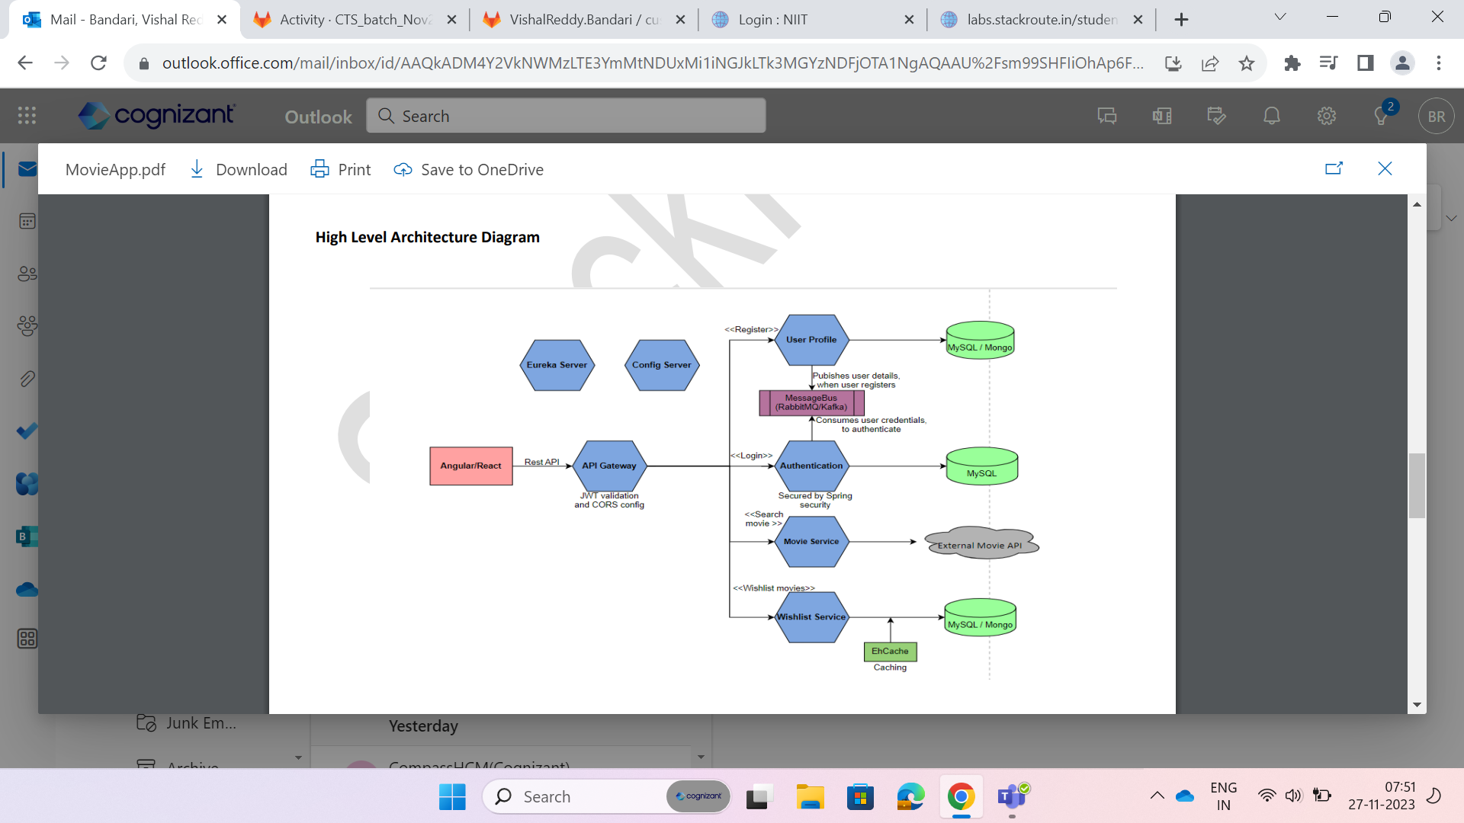
AWS
AWS
AWS
AWS

Slide 9
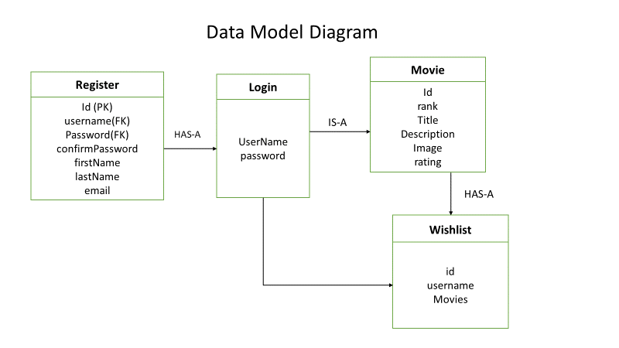

Slide 10
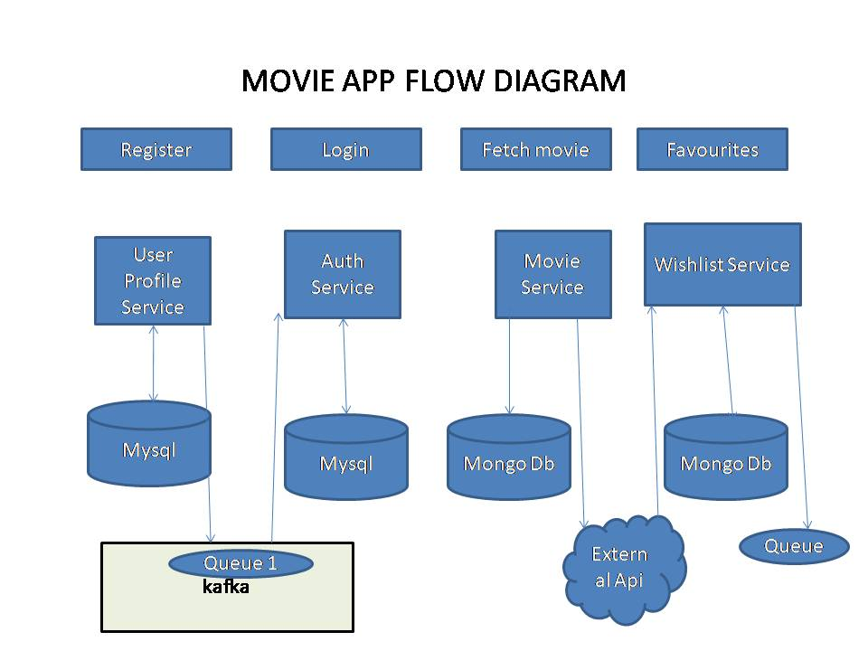

Slide 11
Tools & Technologies
Source Code Management | Gitlab
Middleware | Spring Boot
Frontend | Angular
Data Store | MySQL, MongoDB
Testing | JUnit, Jasmine
API Documentation | Swagger
Message Bus | Kafka
Cloud | AWS

Slide 12

THANK YOU
VISHAL REDDY BANDARI
Vishalreddy.bandari@cognizant.com

