Slide 1

Understand Codon Bias and Gene clustering in Mycobacterium Species
Name – Vishwesh Viraj Deshpande
Roll No – MT -1904

Slide 2
Mycobacterium Species
Mycobacterium Tuberculosis
Mycobacterium Tuberculosis is pathogenic rod shaped bacteria which causes Tuberculosis (TB), airborne disease which infects the lungs, where it can survive within immune cells by evading destruction.
The data used is CDS( coding sequence region) FASTA file
Mycobacterium tuberculosis H37Rv - https://www.ncbi.nlm.nih.gov/assembly/GCF_000195955.2
Mycobacterium Smegmatis
Mycobacterium smegmatis is non-pathogenic, rod shaped bacteria found in soil and water.
Mycobacterium Smegmatis mc²155 –
https://www.ncbi.nlm.nih.gov/assembly/GCF_000015005.1
Both this species are similar in genetic term only differ in pathogenic and no-pathogenic. Studying this can give us opportunity to understand how genetic code shape pathogenicity.

Slide 3
Workflow
Clustering genes.
PCA (Principal Component Analysis)
5
CDS( codon sequencing region FASTA File
Codon understanding and RSCU value
GC content analysis.
GC3 vs GC12
Neutrality Plot
1
2
3
4

Slide 4
Objectives
  Compare and study codon usage bias between pathogenic and non-pathogenic species
  Investigate the role of selection vs mutation in shaping codon usage done by neutrality plot.
  Identify functional patterns in genes based on clustering.
Decoding the story of how codon bias shaped survival, adaptability and pathogenicity

Slide 5
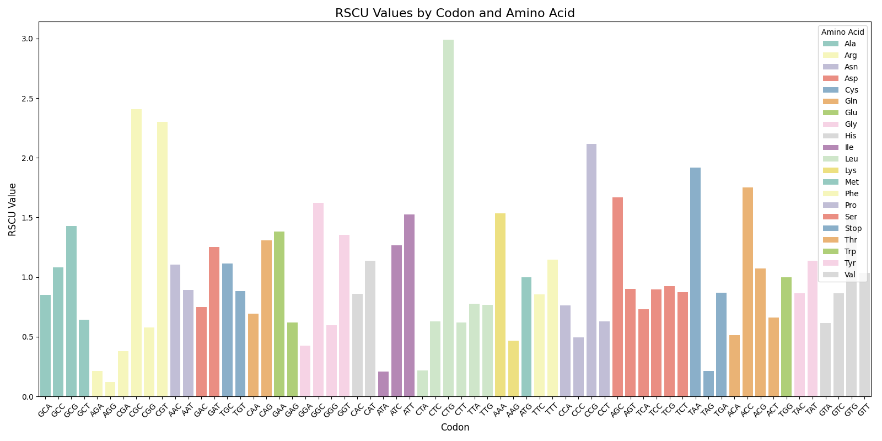
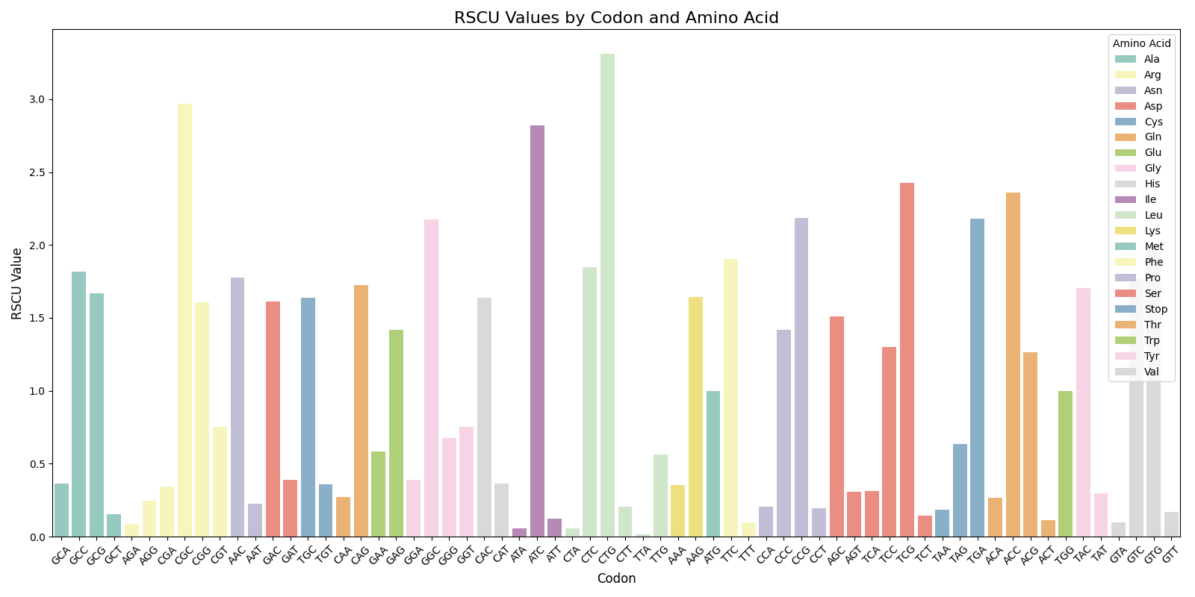
Results
1. Codon Bias and RSCU Value bar chart
Mycobacterium Smegmatis
( Non-Pathogenic )
Mycobacterium Tuberculosis ( Pathogenic )

Slide 6
Pathogenic M. tuberculosis shows higher RSCU values for GC-rich codons, it also has high G-C rich genome
Non-pathogenic M. smegmatis has more balanced codon usage, suggesting greater adaptability across environments.
Preferred codons in M. tuberculosis may enhance expression of virulence-associated proteins, contributing to its pathogenicity.
Variations in codon bias of M. smegmatis likely influence translational speed and accuracy, particularly under host-imposed stress conditions.
Codon bias shows evolutionary pressures works,
In M. tuberculosis codons that promotes pathogenic protein synthesis are priotized
In M. smegmatis codon diversity is maintained as it is required for environmental flexibility.

Slide 7
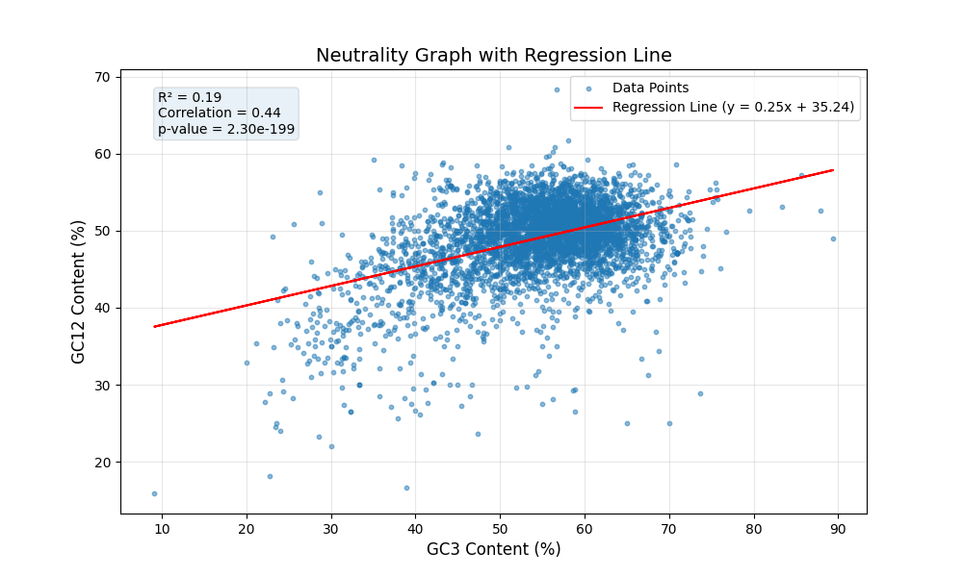
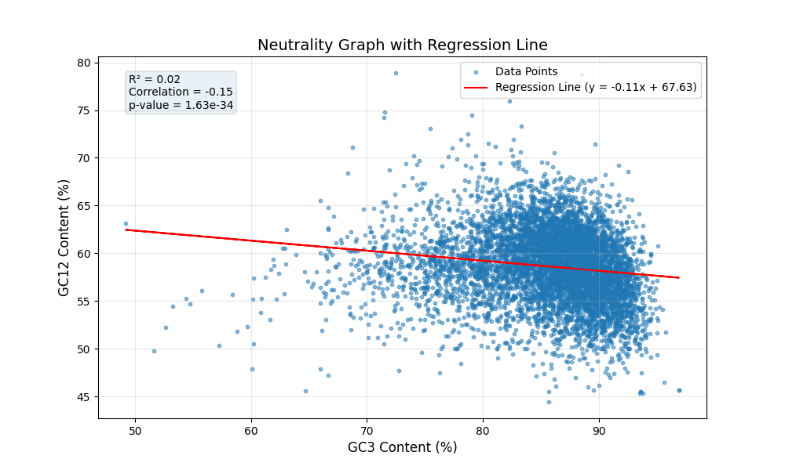
2. Neutrality Plots
Mycobacterium Smegmatis
( Non-Pathogenic )
Mycobacterium Tuberculosis ( Pathogenic )

Slide 8
M. tuberculosis (pathogenic) shows a positive correlation (R = 0.44, R² = 0.19), which shows there is balance in mutation and adaptive constraints.
M. smegmatis (non-pathogenic) has a weak negative correlation (R = -0.15, R² = 0.02), suggesting lower selective pressure and higher codon usage neutrality which is it favors natural selection and codon choices are less optimized.
Regression slope of M. tuberculosis which is 0.25 shows stronger GC3 influence, driven by adaptive translational needs, codons are more optimized for specific task.
M. smegmatis (-0.11 slope) shows relaxed constraints, fitting its non-pathogenic, flexible nature.
The codon usage patterns highlight how evolution has shaped these species differently. M. tuberculosis has adapted its codon usage to thrive in the specific conditions of its host environment, while M. smegmatis shows greater flexibility in its genome, allowing it to adapt to a variety of environments.

Slide 9
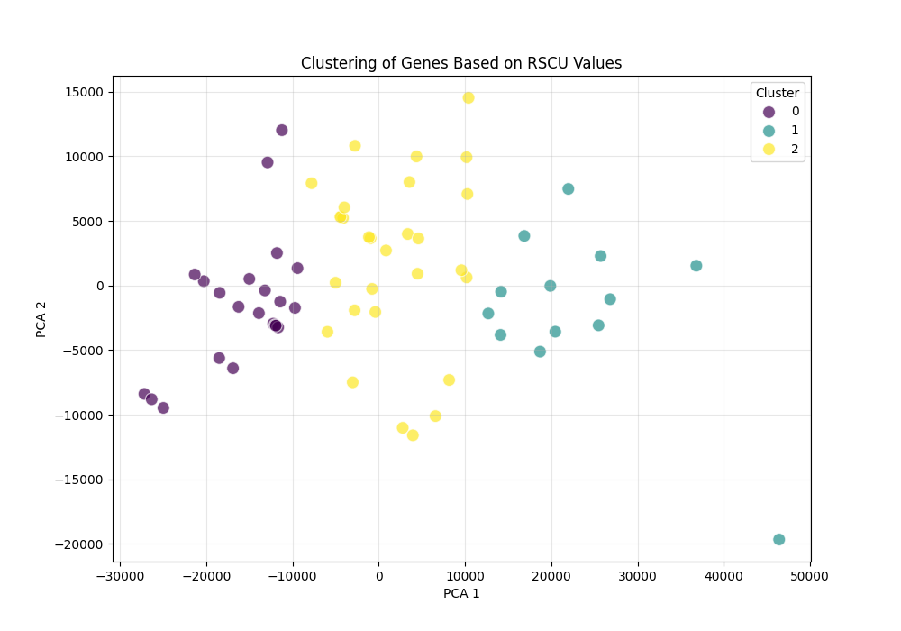
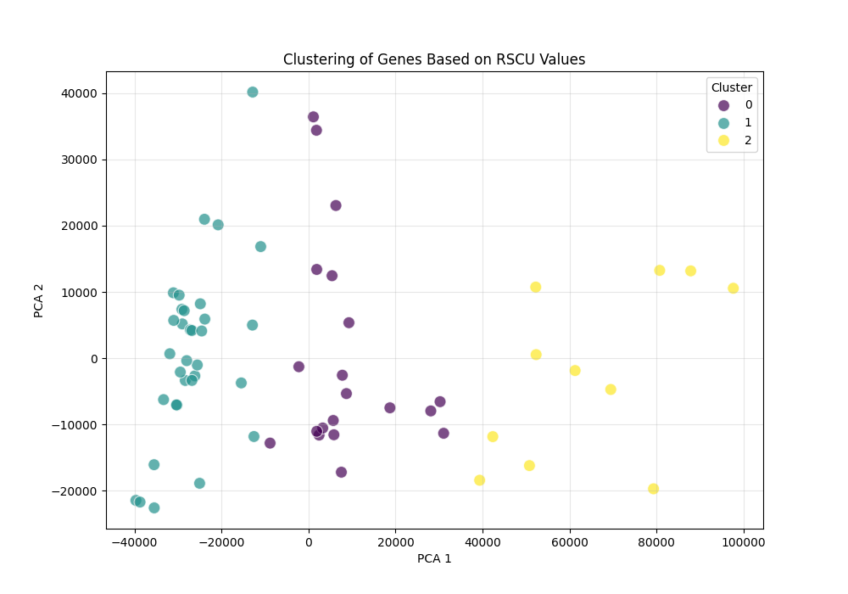
3. Clustering Gene Map
Mycobacterium Tuberculosis ( Pathogenic )
Mycobacterium Smegmatis
( Non-Pathogenic )

Slide 10
M. tuberculosis (Pathogenic)
Tightly clustered codon usage pattern, it is because it has optimized codon for specific protein synthesis and virulence gene for pathogenicity
M. Smegmatis ( Non – Pathogenic)
Diverse gene clustering pattern is seen which proves that it has flexible codon usage not specific.
Clustering revealed the genetic personalities of these species: one tailored for invasion, the other for versatility so that It can adapt.

Slide 11
Final Conclusion
The analysis demonstrates how codon usage shapes the distinct lifestyles of M. tuberculosis and M. smegmatis. In M. tuberculosis, strong selective pressure has shaped codon preferences, ensuring that critical proteins, it can produce critical proteins—especially the ones it needs to infect and survive in the host. On the other hand, M. smegmatis shows a more relaxed pattern, reflecting its ability to adapt to all sorts of environments.
The clustering analysis gives more insight into these differences. In M. tuberculosis, you see gene clusters with strong codon biases, especially in genes tied to virulence. This fits with the idea that the bacterium optimizes these genes for infection. But M. smegmatis has more diverse gene clusters, which makes sense since it’s more about flexibility and doesn’t rely as much on specific codon preferences.

Slide 12
Refrences
Plotkin, J., Kudla, G. Synonymous but not the same: the causes and consequences of codon bias. Nat Rev Genet 12, 32–42 (2011). https://doi.org/10.1038/nrg2899
https://doi.org/10.1099/00221287-142-4-915

Slide 13

Thank you

